Slide 1
The German Traffic Sign Benchmark – Week2
Daniel Minguez Camacho
Javier de la Rúa Martínez

Slide 2
Problem
Single-image detection of traffic signs in natural (outdoor) images for real-world driving.
Despite of human accuracy recognizing traffic signs, drivers attention is regularly drawn to different tasks and situations.
Image classification can help in future applications in driving.
900 images (600 for training and 300 for test)
43 categories of traffic signs.

Slide 3
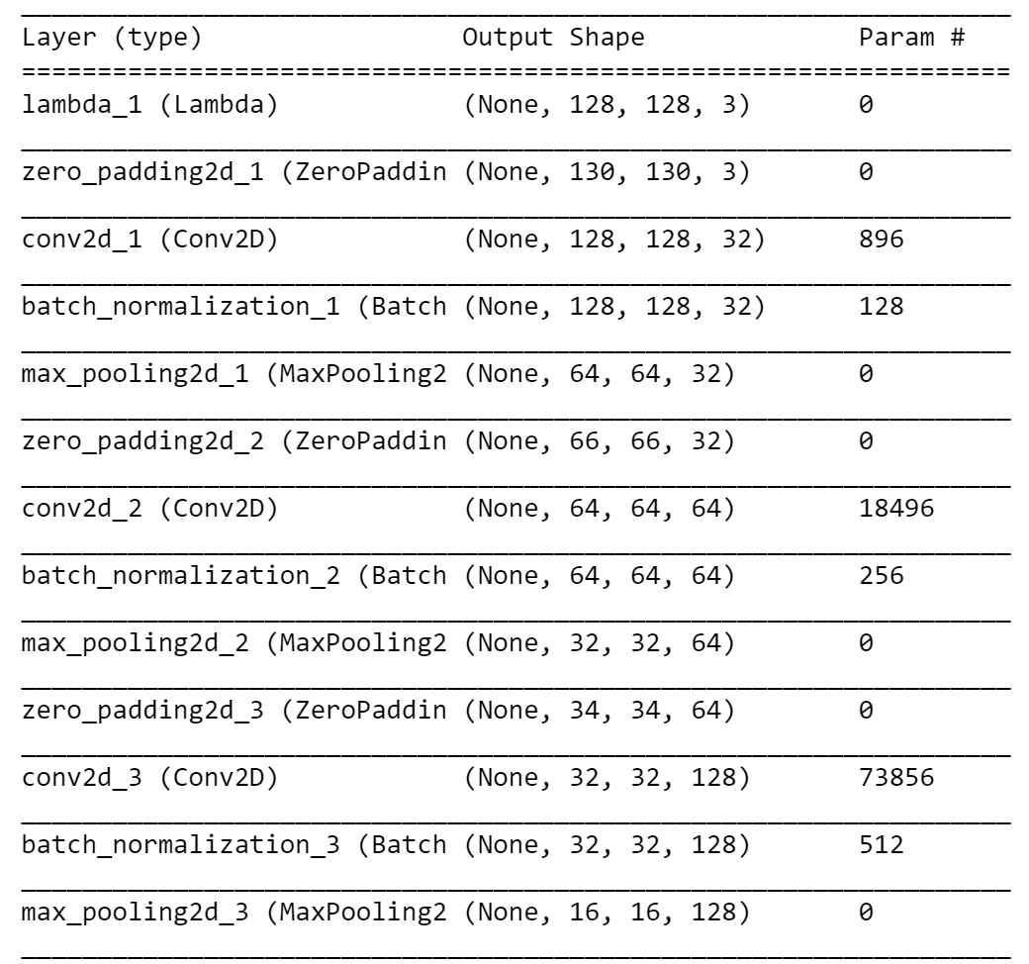
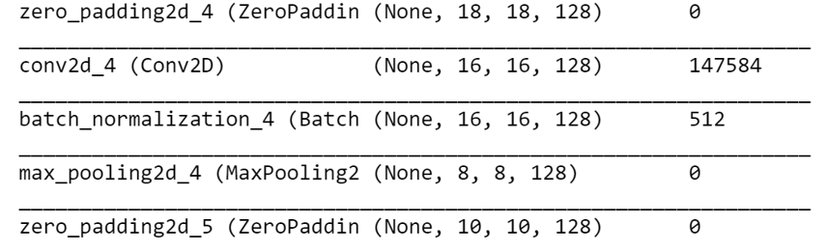
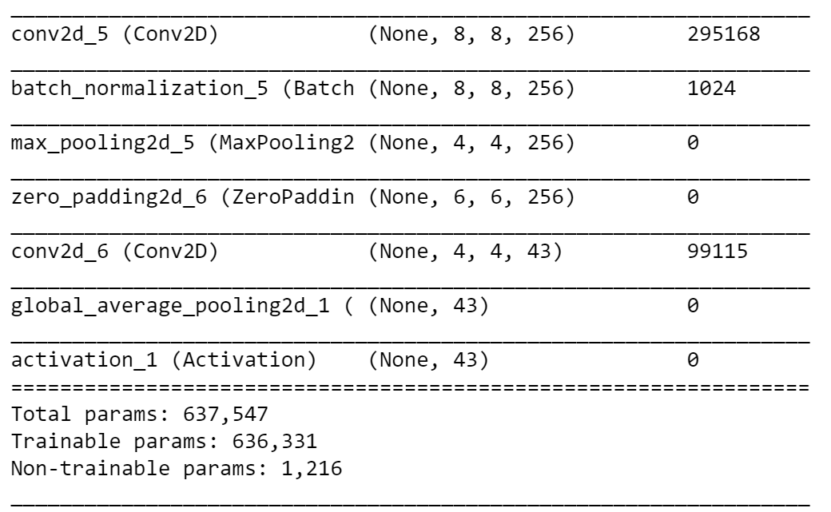
Network architecture

Slide 4

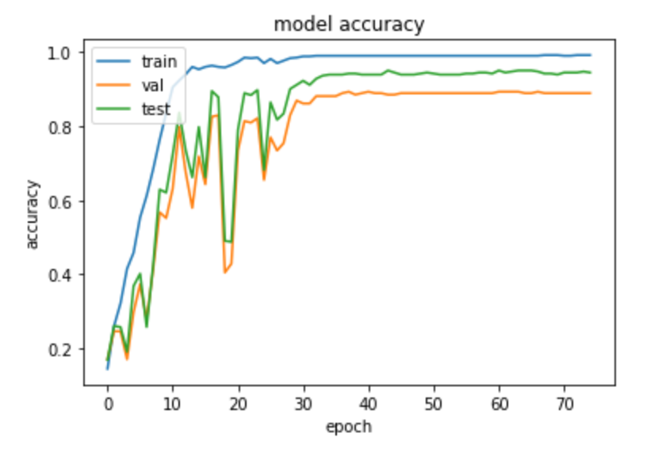
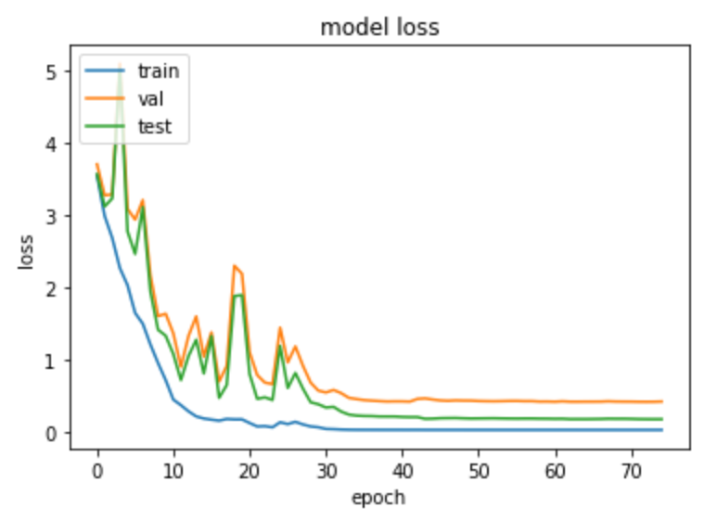
Performance (Without data Aug.)

Slide 5
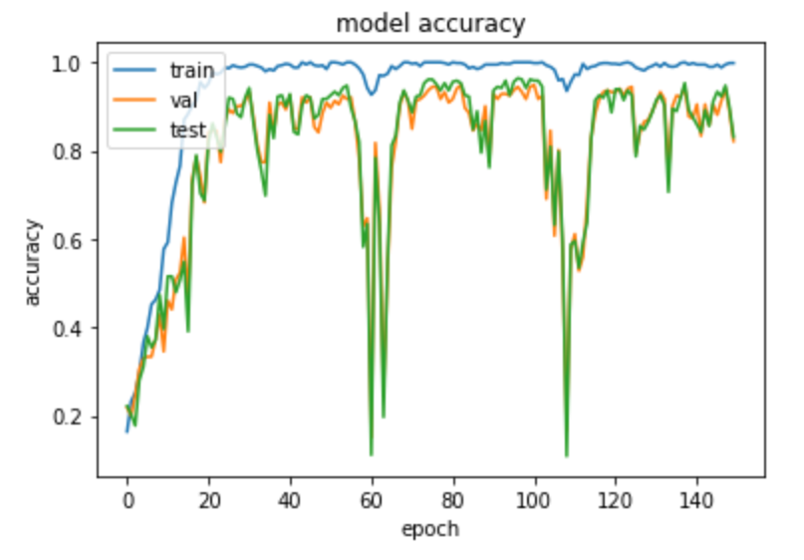
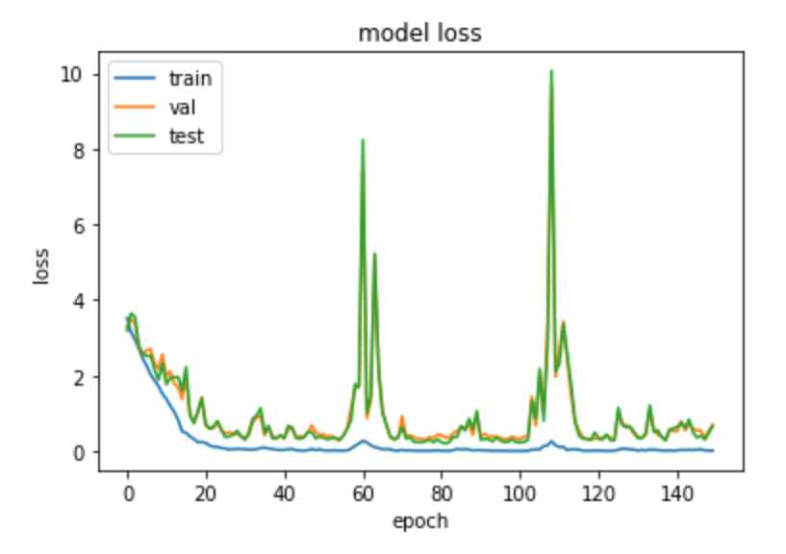
Performance (With data Aug.)

Slide 6

Process followed
Network construction:
Experimentation with different layouts.
Finally we decided to go for a fully convolutional network.
Relu and softmax as activation functions.
Batch normalization.
Image size experimentation:
We tried different sizes for the original images, at the end we decided to go with Height = 500 and size = (128,128).

Slide 7
Process followed
Data augmentation
We were playing with ImageDataGenerator function, with parameters like featurewise, shift, zoom or zca. Finally we used only shift and zoom because the others changed the images too much.
Callback definition for testing data
We build a callback function for retrieving test evaluation for each epoch (in order to be able to plot it as the description stablish).

