Slide 1
The German Traffic Sign Benchmark – Week 3
Daniel Minguez Camacho
Javier de la Rúa Martínez

Slide 2
Problem
Single-image detection of traffic signs in natural (outdoor) images for real-world driving.
Despite of human accuracy recognizing traffic signs, drivers attention is regularly drawn to different tasks and situations.
Image classification can help in future applications in driving.
900 images (600 for training and 300 for test)
43 categories of traffic signs.

Slide 3
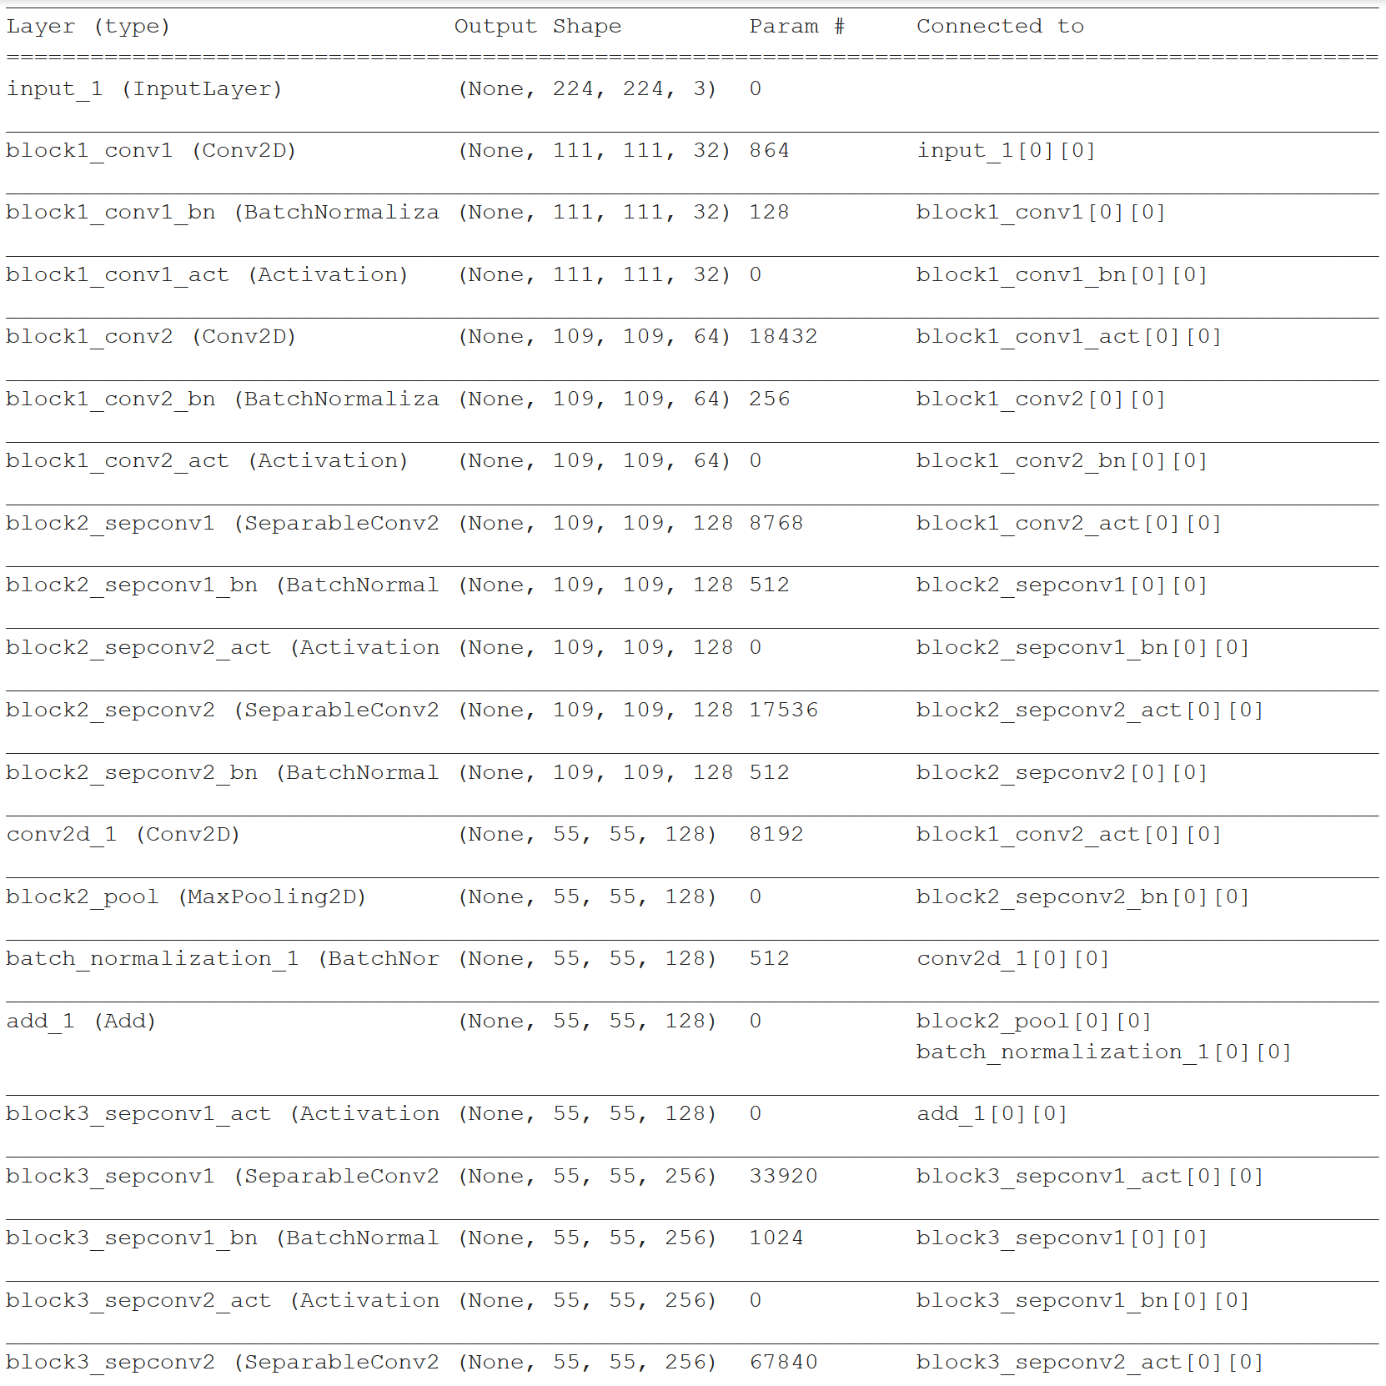
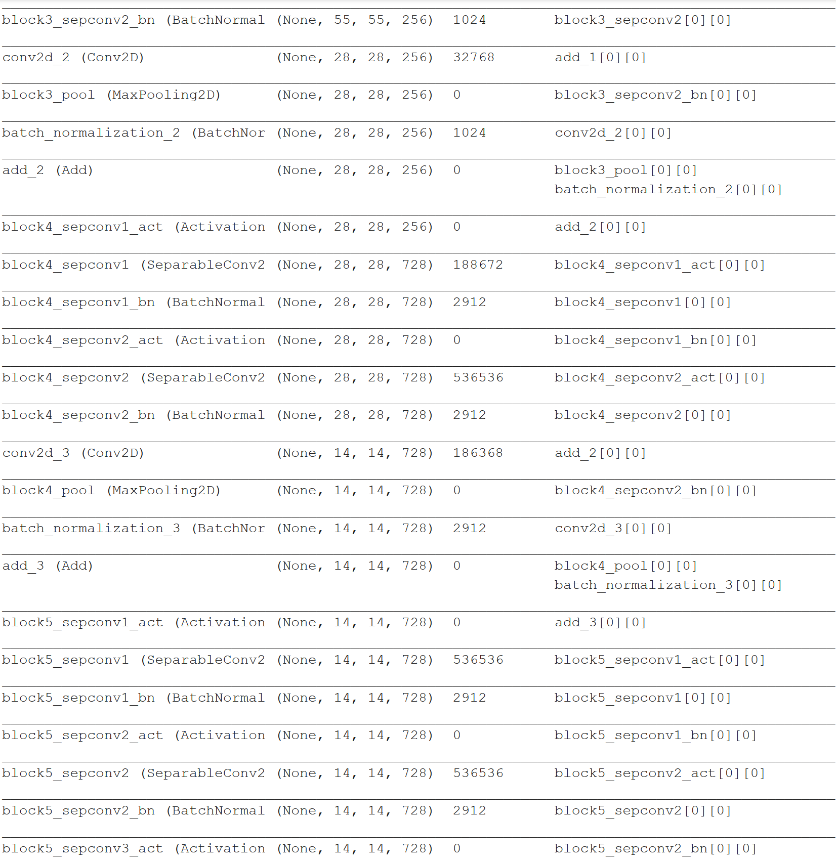
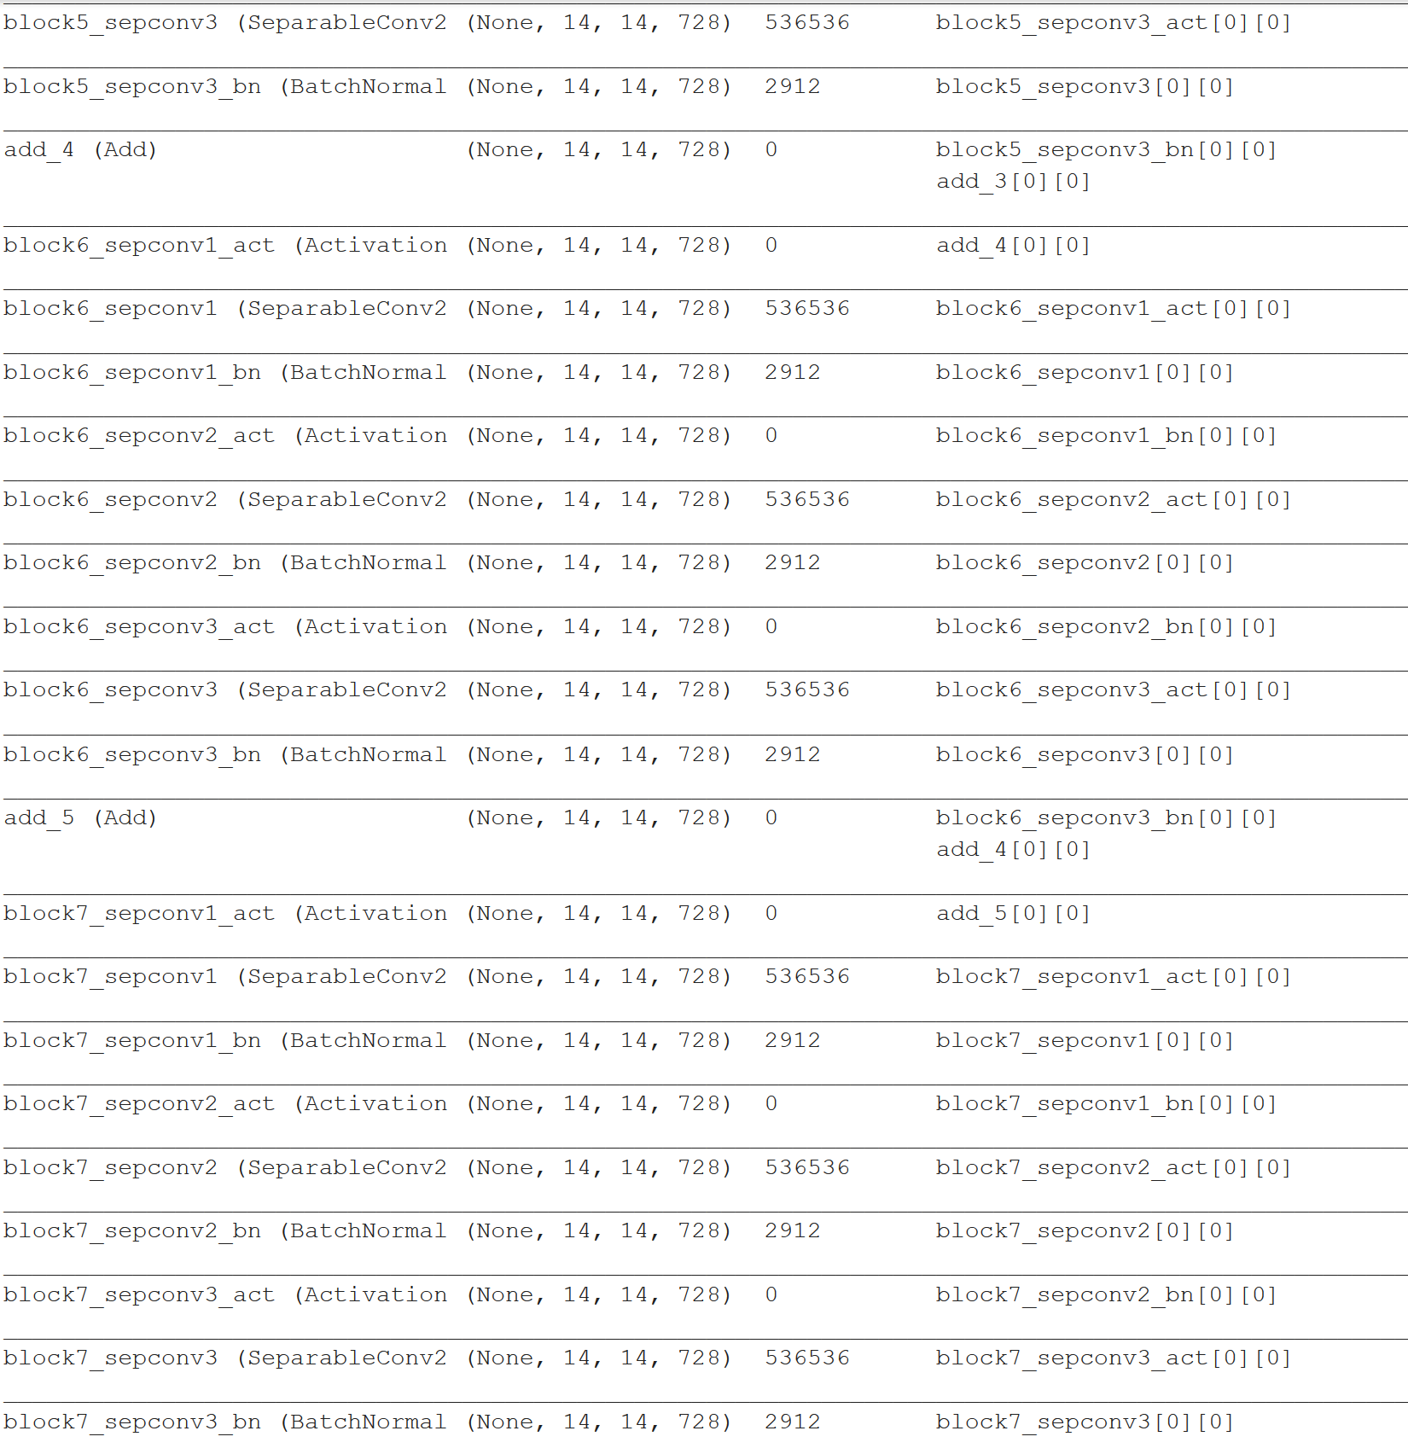
Network architecture (1)

Slide 4
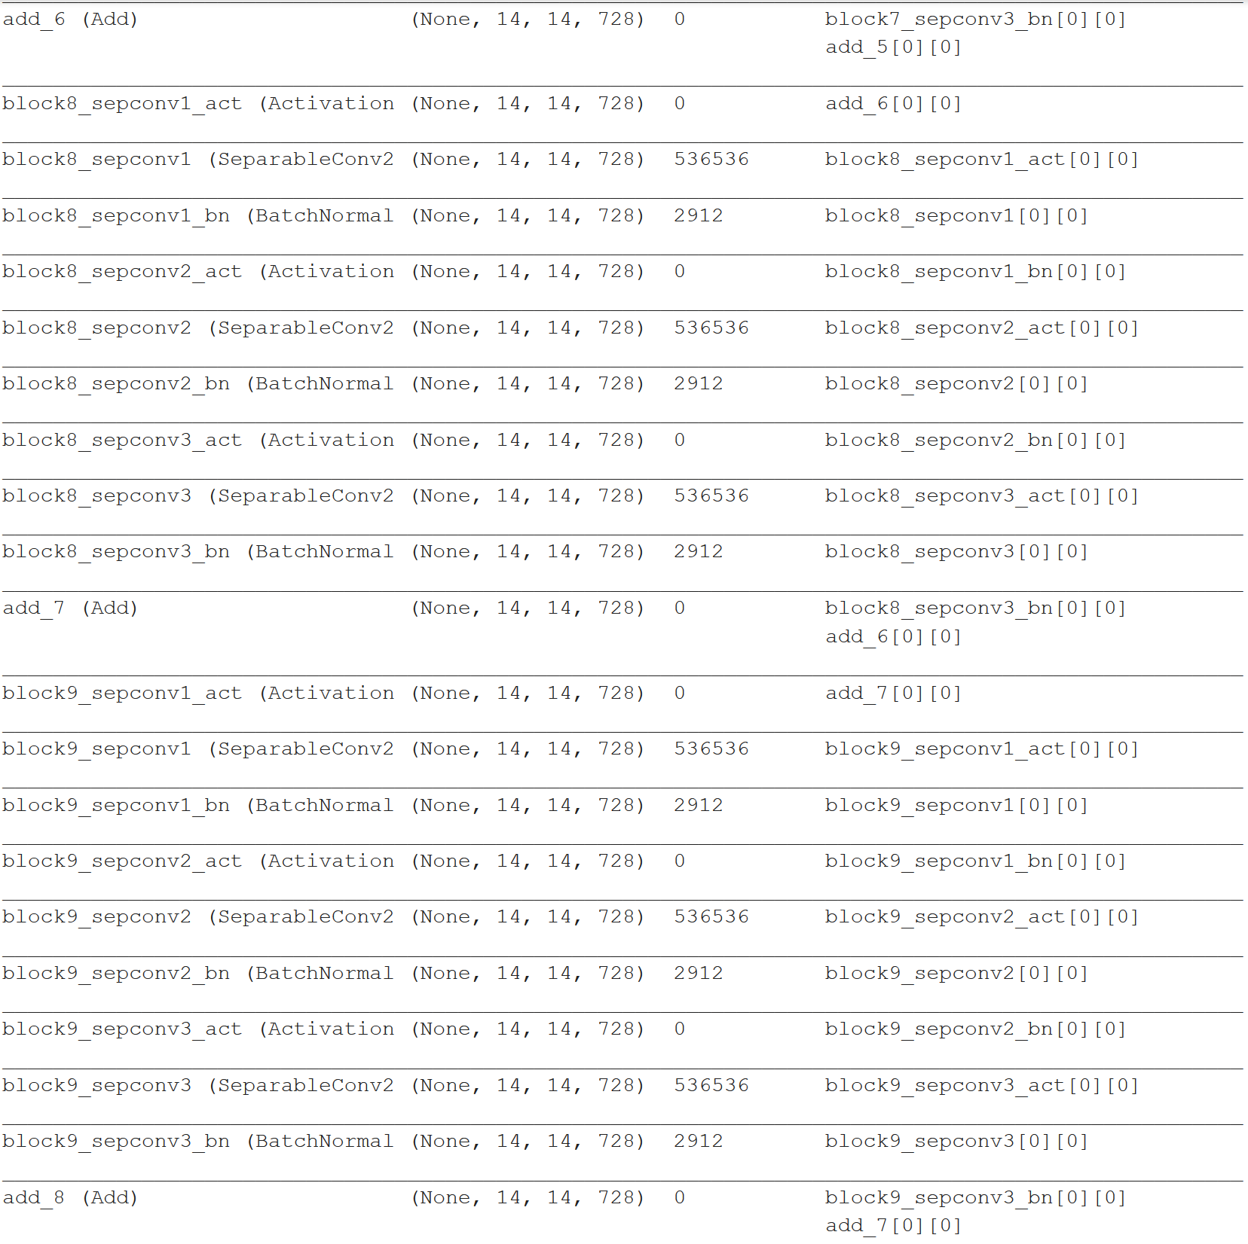
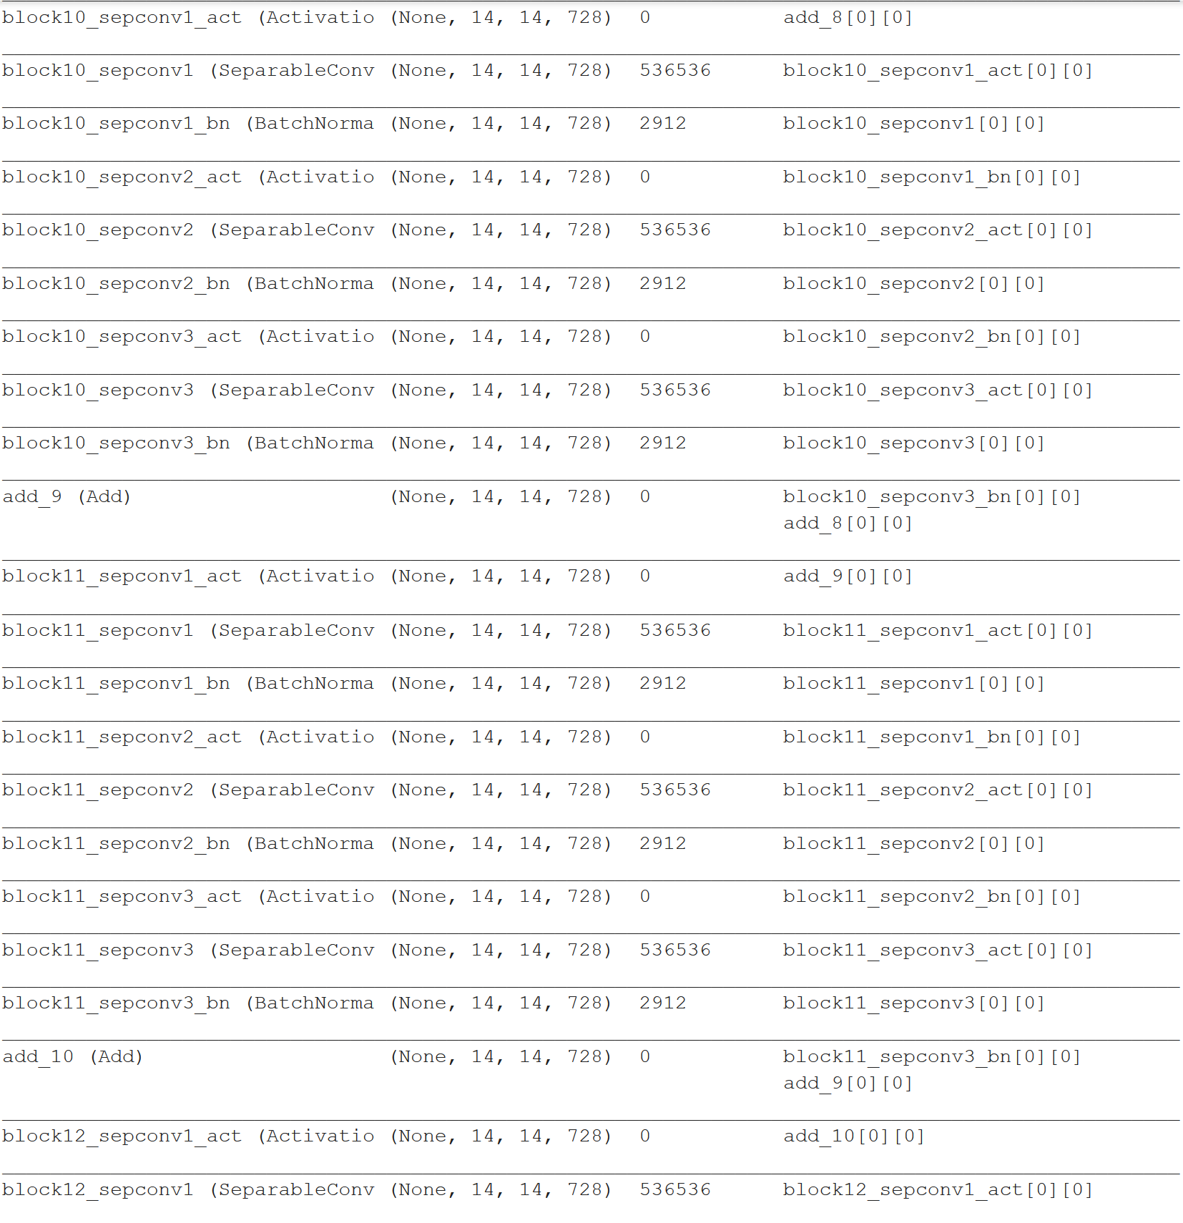
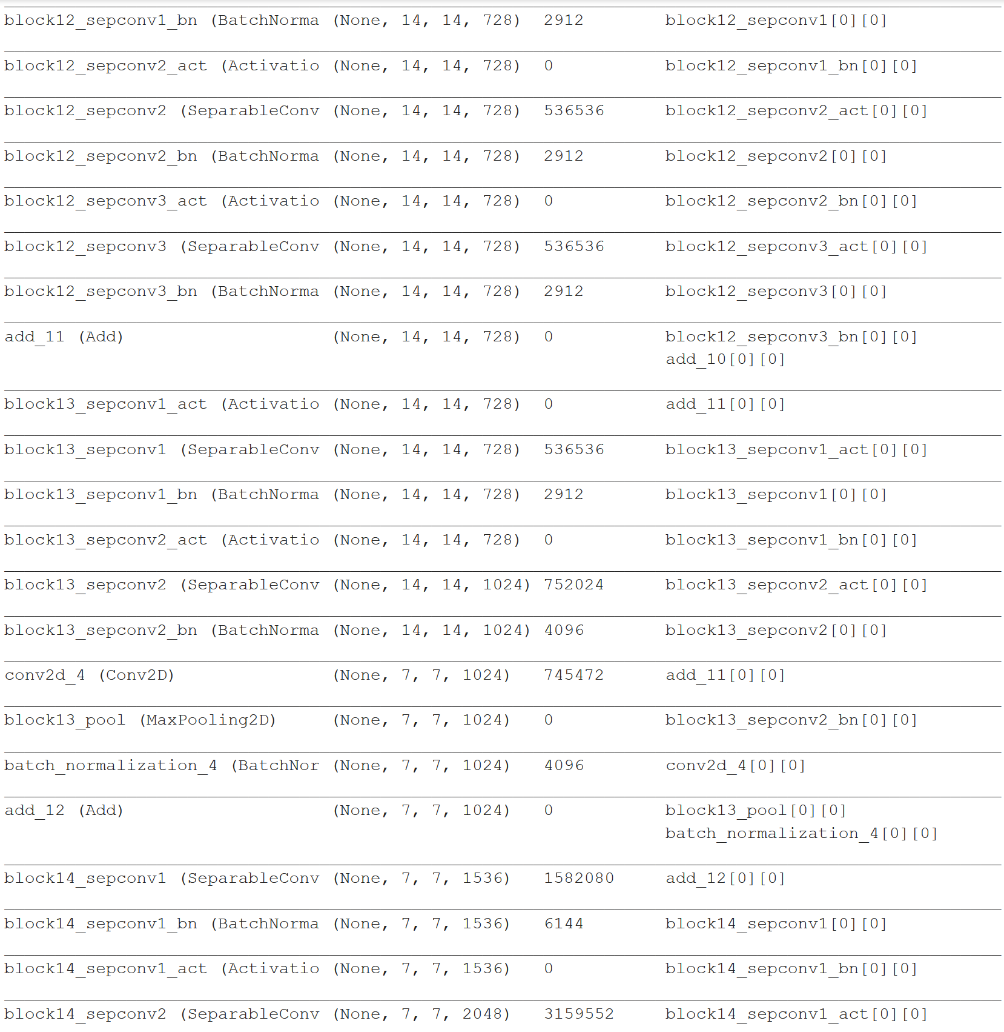
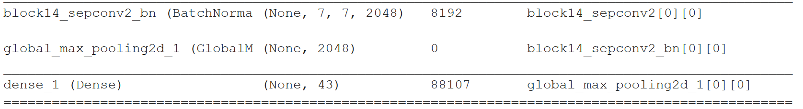
Network architecture (1)

Slide 5
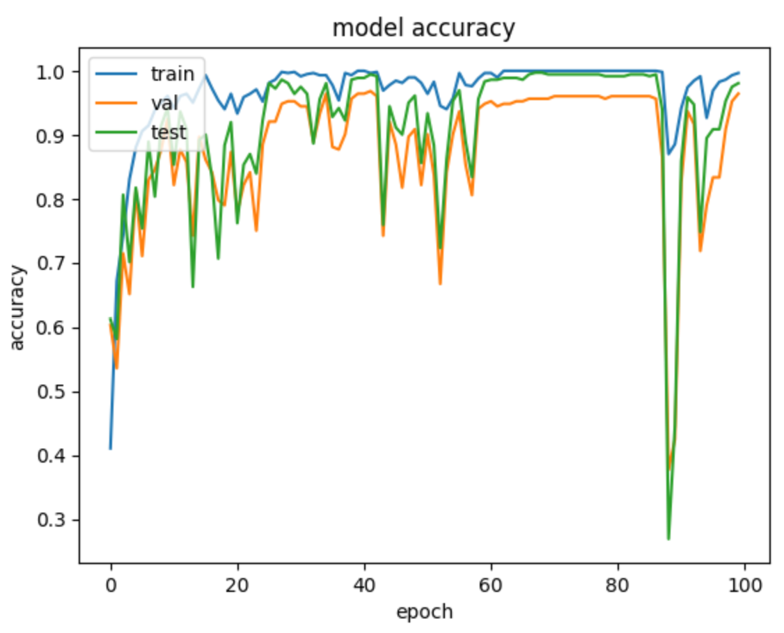
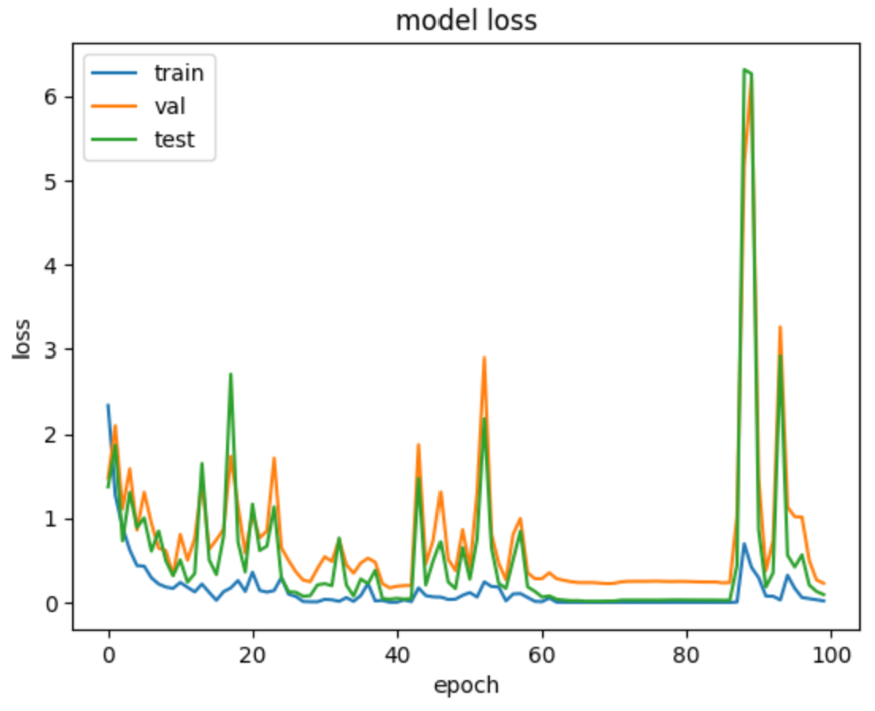
Performance (with Data Augmentation)

Slide 6
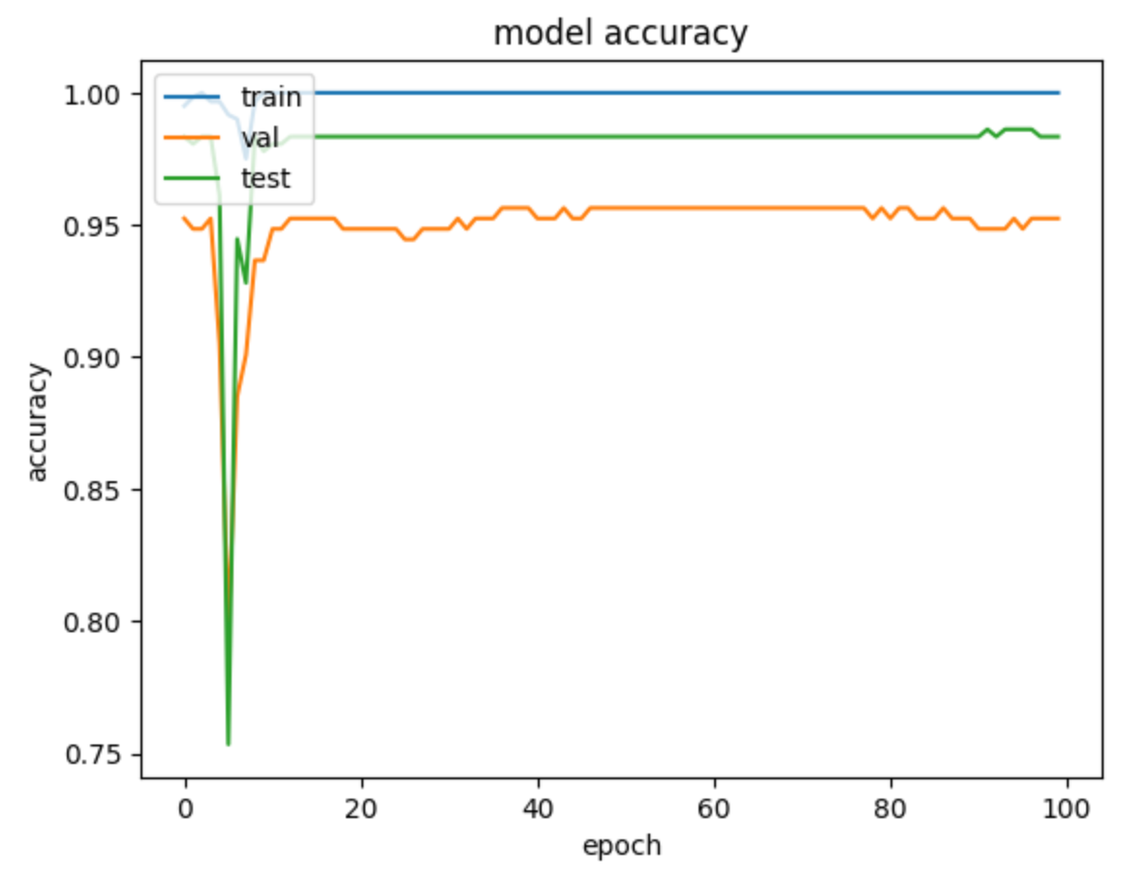
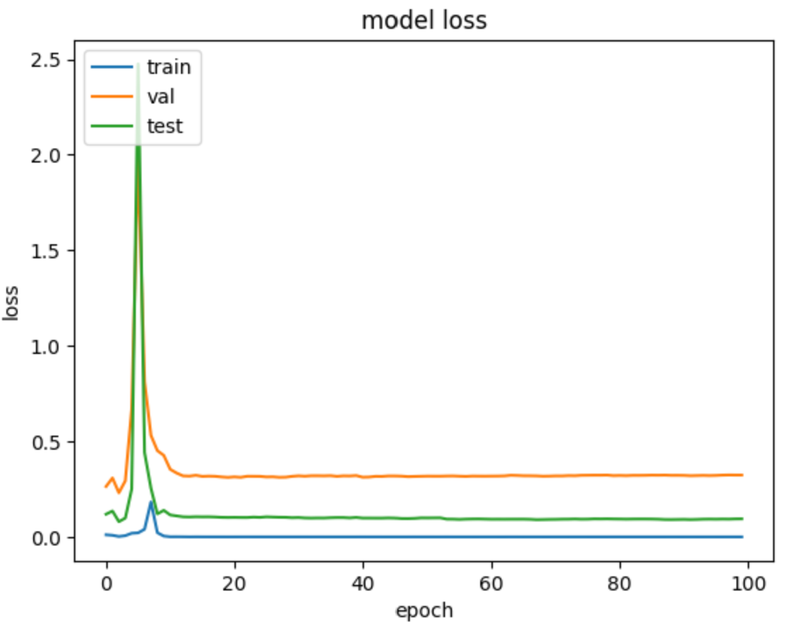
Performance (without Data Augmentation)

Slide 7
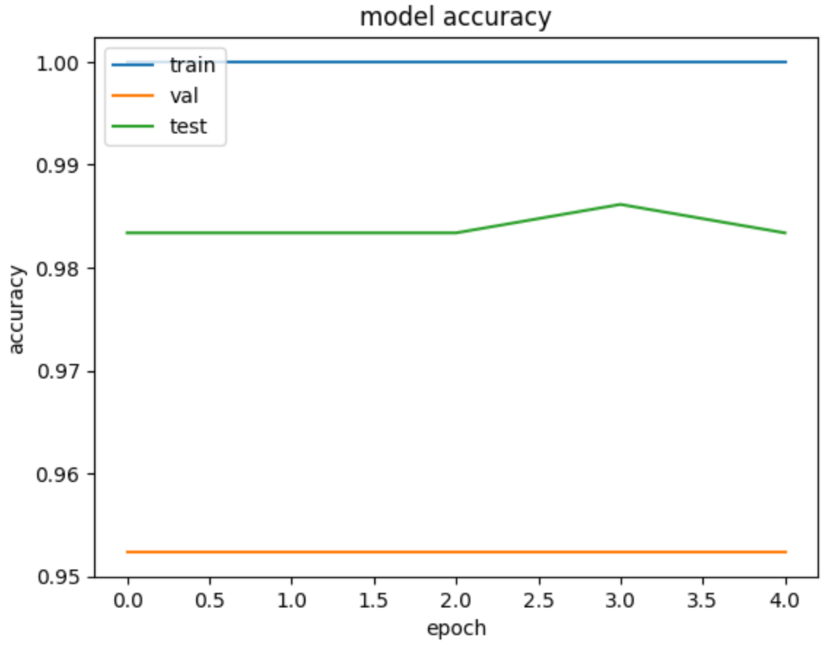
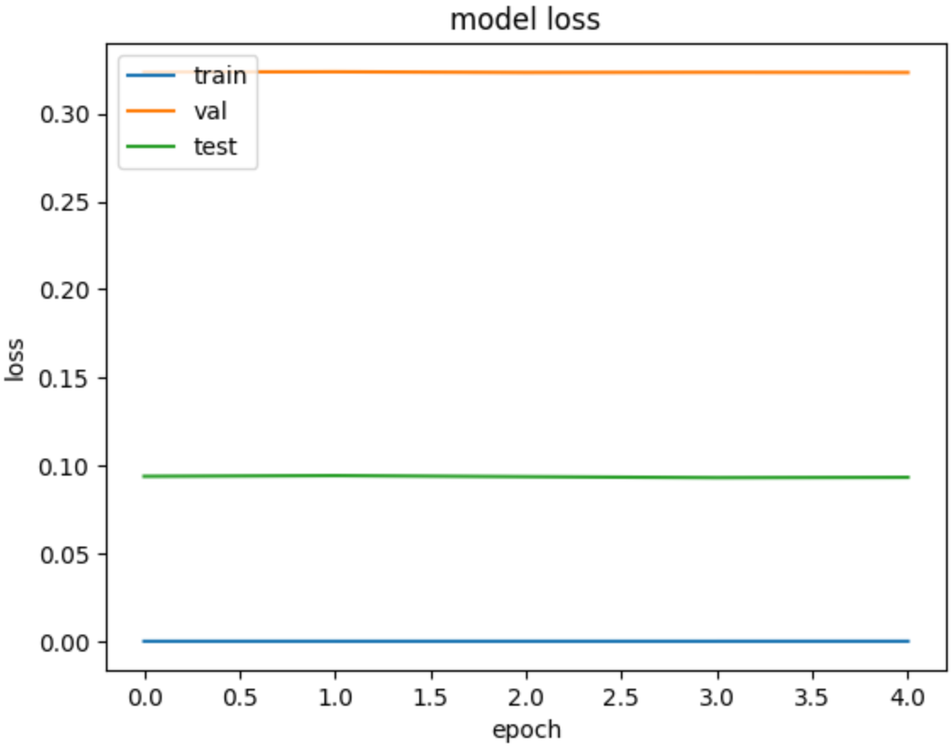
Performance (without DA with EarlyStopping)

Slide 8

Process followed
Backbones:
Attempts with ResNet50, ResNeXt50 and Xception.
Finally, we chose Xception with weights pre-trained on ImageNet and excluding the GlobalAveragePolling and Fully-Connected net at the end.
Transfer learning approach:
Reuse of the ‘feature-extraction’ part of Xception
+ GlobalMaxPooling2D
+ Dense layer with softmax activation function.

Slide 9
Process followed
Performance improvement
Data augmentation: Attempts with different parameters. Finally, not included.
Early stopping: monitoring ‘val_acc’ with patience 4
Callback definition for testing data
We built a callback function for retrieving test evaluation for each epoch (to be able to plot it as the description mentions)

Slide 10
Xception
Model evaluation: ImageNet database
 | Size | Top-1 Acc | Top-5 Acc | Parameters | Depth
Xception | 88 MB | 0.790 | 0.945 | 22,910,480 | 126
ResNeXt101 | 170 MB | 0.787 | 0.943 | 44,315,560 | -
ResNeXt50 | 96 MB | 0.777 | 0.938 | 25,097,128 | -
InceptionV3 | 92 MB | 0.779 | 0.937 | 23,851,784 | 159
ResNet101 | 171 MB | 0.764 | 0.928 | 44,707,176 | -
DenseNet121 | 33 MB | 0.750 | 0.923 | 8,062,504 | 121
ResNet50 | 98 MB | 0.749 | 0.921 | 25,636,712 | -
Source: https://keras.io/applications

Slide 11
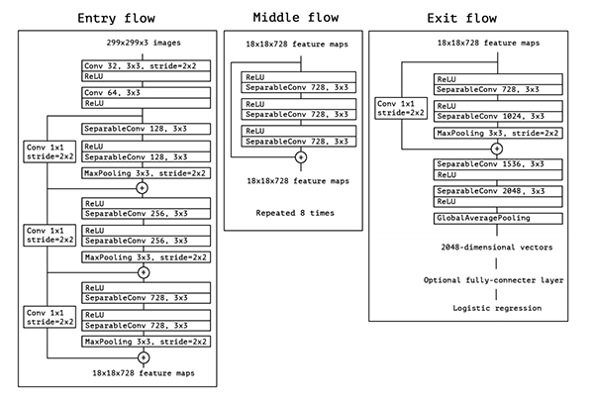
Xception overview

