Slide 1
The German Traffic Sign Benchmark
Daniel Minguez Camacho
Javier de la Rúa Martínez

Slide 2
Problem
Single-image detection of traffic signs in natural (outdoor) images for real-world driving.
Despite of human accuracy recognizing traffic signs, drivers attention is regularly drawn to different tasks and situations.
Image classification can help in future applications in driving.
900 images (600 for training and 300 for test)
43 categories of traffic signs.

Slide 3
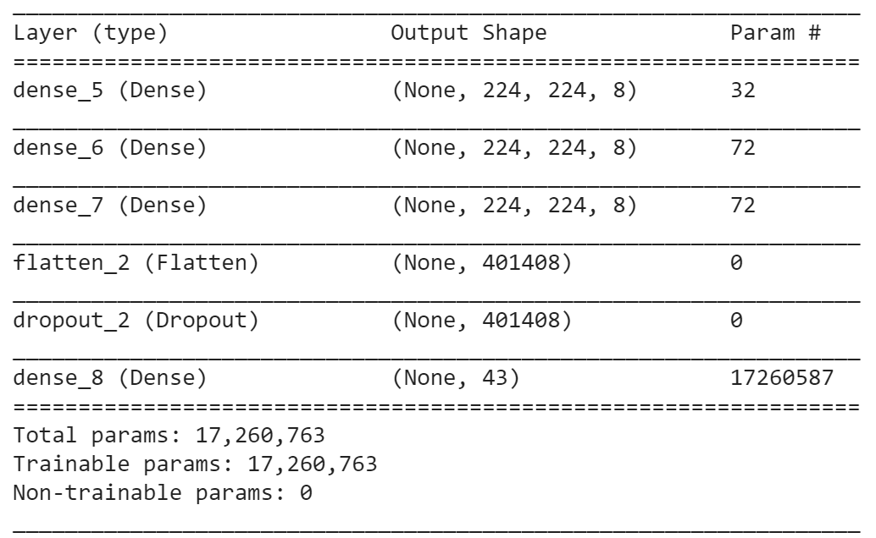
Network architecture

Slide 4
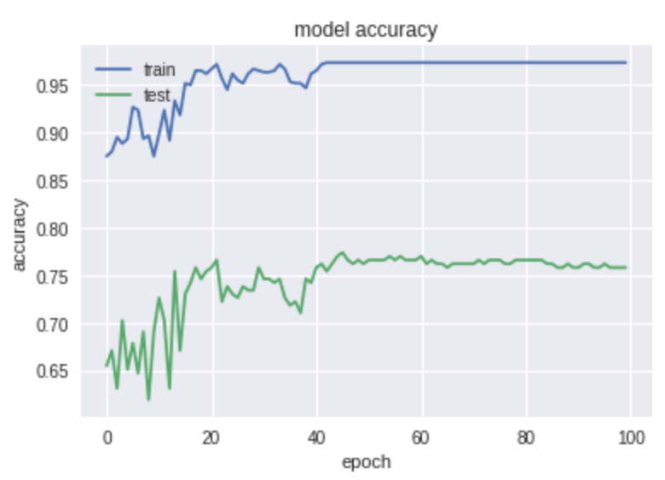
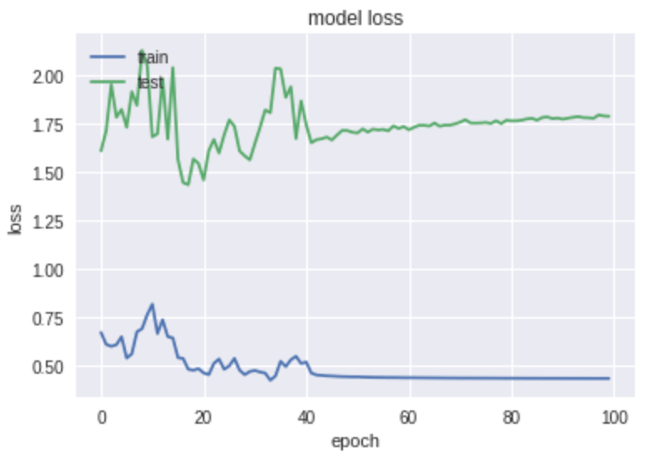
Performance

Slide 5

Previous attempts
Procedure based on trial and error of different architectures.
Fit:
Batch size: 8 -16 - 32, Epochs: 100
Batch size: 64, Epochs: 20
Batch size: 8, Epochs: 1000 …
Layers:
Dense (8) – Dropout() – Dense(8) – Dropout() – Flatten() – Dropout()
Dense(8-16) – Dropout() – Dense(8-16) – Dense(8-16) – Flatten() - Dropout()
Dense(8) – Dense(8) – Dense(8) – Dropout() – Flatten ...
Activation:
Relu for input and hidden layers.
Softmax for output layer.
Optimization:
Stochastic gradient descent optimizer.

