Slide 1


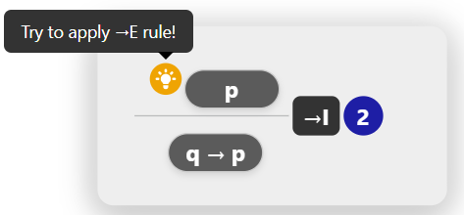
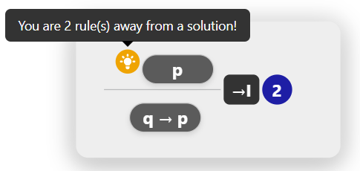
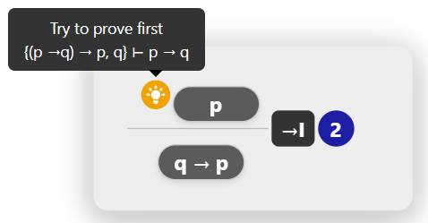
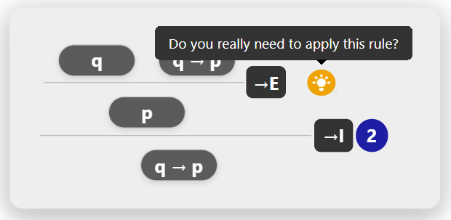
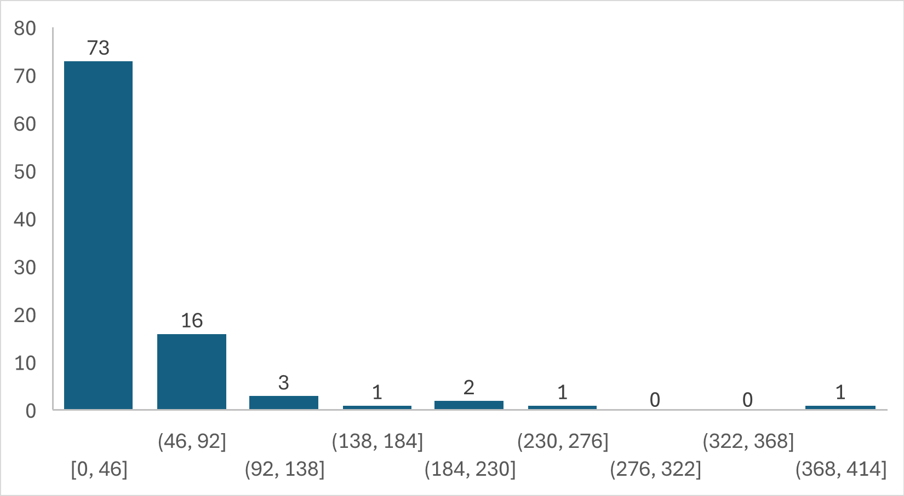
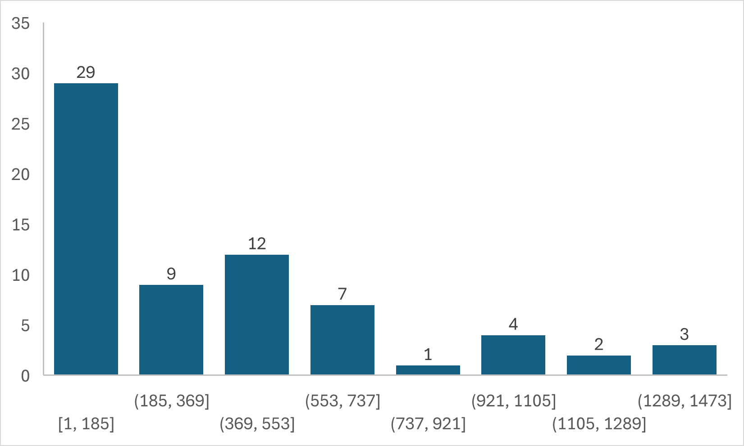




Natural Deduction Proofs for Educational Feedback
Daniel Macau d.macau@campus.fct.unl.pt
Ricardo Gonçalves and João Costa Seco
NOVA LINCS Research Group
Software Systems/Intelligent Systems
Motivation
Proof Graph (“explores multiple possible games”)
Natural deduction proofs are essential but challenging for students to master.
Few learning resources exist, and most lack meaningful feedback.
Existing platforms provide only very basic or generic guidance.
Stores multiple proofs for the initial problem, using the transition graph.
Stopping conditions (timeouts, node limits) are applied to prevent overly large
graphs and keep feedback fast.
I don’t know how
to progress…
This is much clearer now
{(p →q) → p, q} ⊢ q → p
{(p →q) → p, q, p} ⊢ q
Is this correct?
That feedback makes sense I see my mistake
{(p →q) → p, q} ⊢ q
→_{I}
I have no idea how to
solve this
→_{I}
{(p →q) → p, q} ⊢ p →q
Yes! My proof is
correct.
→_{E}
→_{E}
{(p →q) → p, q} ⊢(p →q) → p
Without Feedback
With Feedback
{(p →q) → p, q} ⊢ p
Feedback Objectives
→_{I}
{(p →q) → p} ⊢ q → p
Our feedback system was designed with four key goals to support students in learning natural deduction proofs.
Trimmed Graph (“selects winning games only”)
Using well-known graph algorithms, it removes the nodes and edges that do not lead to a solution.
Rude Guidance
Progress Tracking
{(p →q) → p, q} ⊢ q → p
{(p →q) → p, q, p} ⊢ q
{(p →q) → p, q} ⊢ q
→_{I}
→_{I}
{(p →q) → p, q} ⊢ p →q
→_{E}
→_{E}
{(p →q) → p, q} ⊢(p →q) → p
Improvement Hints
{(p →q) → p, q} ⊢ p
Simplify the main problem
→_{I}
{(p →q) → p} ⊢ q → p
Solutions Extraction
From the last graph we can then extract solutions to generate feedback
{(p →q) → p, q} ⊢ q → p
{(p →q) → p, q, p} ⊢ q
Proposed Solution
→_{I}
We developed an algorithm that automatically generates natural deduction
proofs for propositional and first-order logic.
Our algorithm has three steps, each using hypergraphs to represent proofs.
The final graph can be queried to generate a solution and provide feedback.
{(p →q) → p, q} ⊢ q
→_{I}
{(p →q) → p, q} ⊢ p →q
→_{E}
{(p →q) → p, q} ⊢(p →q) → p
{(p →q) → p, q} ⊢ p
Transition Graph
Proof Graph
Trimmed Graph
→_{I}
Problem
Solution/s
Feedback
{(p →q) → p} ⊢ q → p
Finally, these solutions can be queried multiple times to generate feedback.
Transition Graph (“rules of the game”)
Results
Stores information about the formulas and rules that can be applied in the proofs
No. of problems
Propositional Logic
No. of problems
First-Order Logic
→_{I}
p
(p →q) → p
p →q
ε
q
q → p
~75% of the problems were solved under 50 ms
~75% of the problems were solved under 600 ms
p →q
q
Problem
{(p → q) → p} ⊢ q → p
ε
ε
ε
ε
ε
→_{I}
→_{E}
Time (ms)
→_{E}
→_{I}
p
→_{E}
Time (ms)
Conclusion
Try out our app
Main Contributions
Algorithm generates human-readable natural deduction proofs.
Feedback aligns with student reasoning for more effective learning.
Stores multiple solutions per problem, improving response time.
Future Work
Generate exercises with adjustable difficulty.
Improve scalability and efficiency of real-time feedback.

