Slide 1


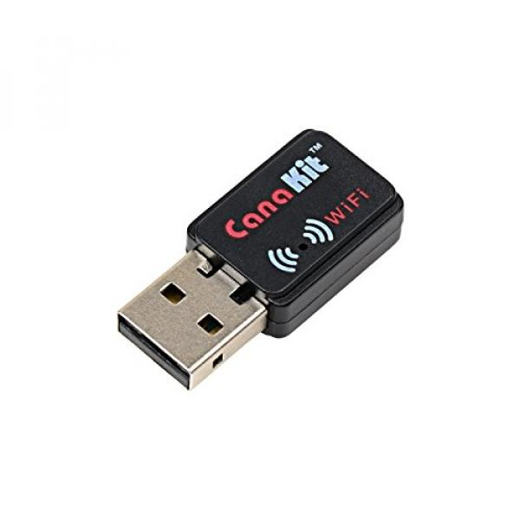


WiFi Connection notes:
Private IP Address (10.0…)
LED on the WiFi dongle shows network connection
Can be configured to automatically connect to a network
Can connect via telnet (requires installation) or ssh
Bluetooth Connection Notes:
169… IP Address
Max Bluetooth Connections:
5 to Mac
1 to PC

Slide 2
Install Telnet
Telnet is insecure, but the EV3s have private IP addresses
Install on EV3
Updates the package list
sudo apt-get update
Install Telnet package
sudo apt-get install telnetd
Install & Connect on Mac
Use Homebrew to install telnet
brew install telnet
Connect with Telnet
telnet -l robot <ip address>
Password: maker
Using Telnet in Python

Slide 3
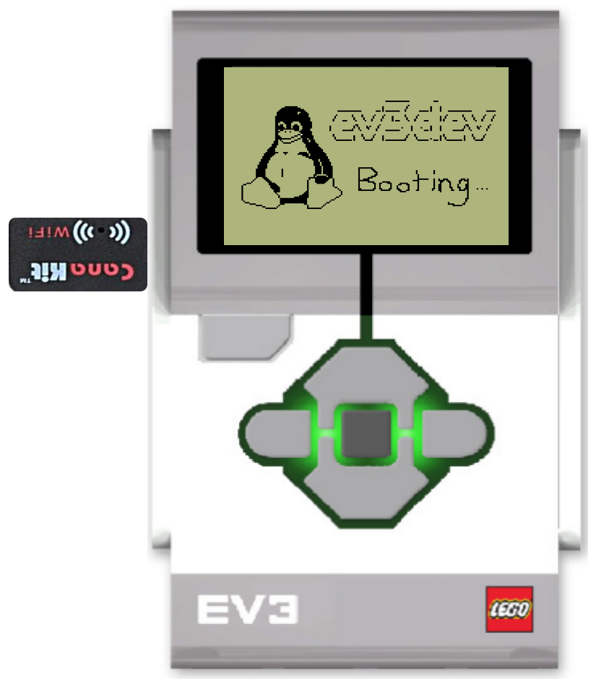

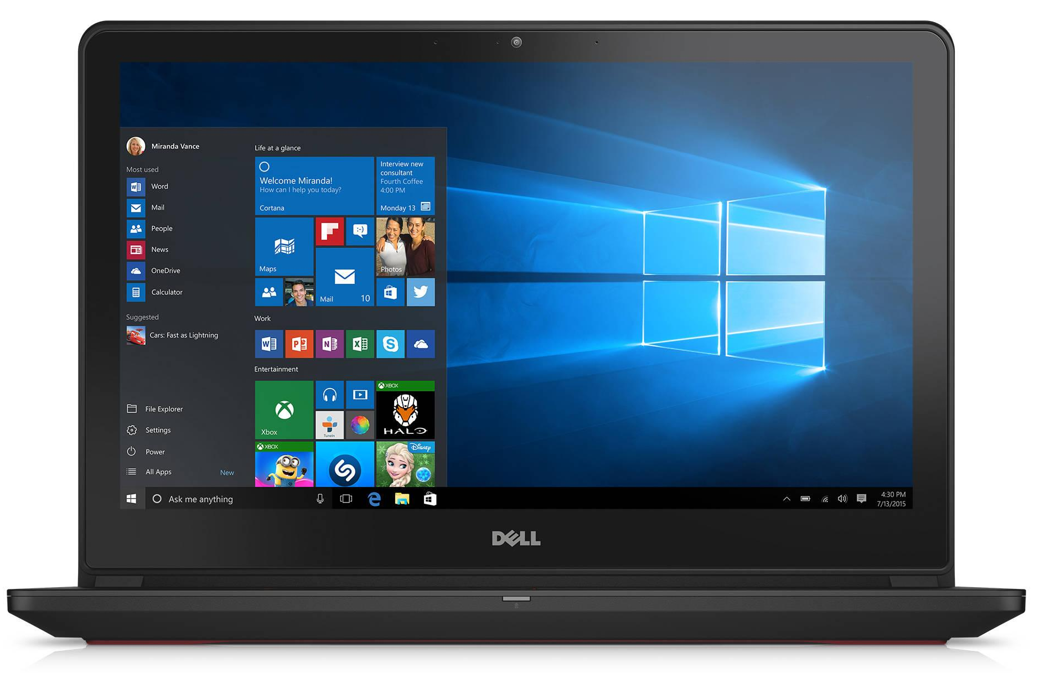
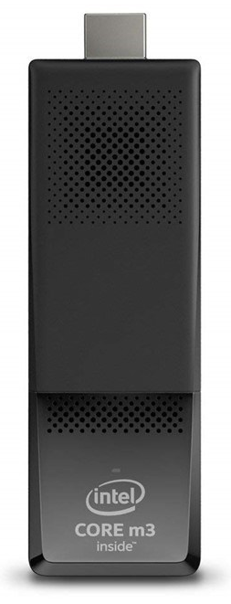
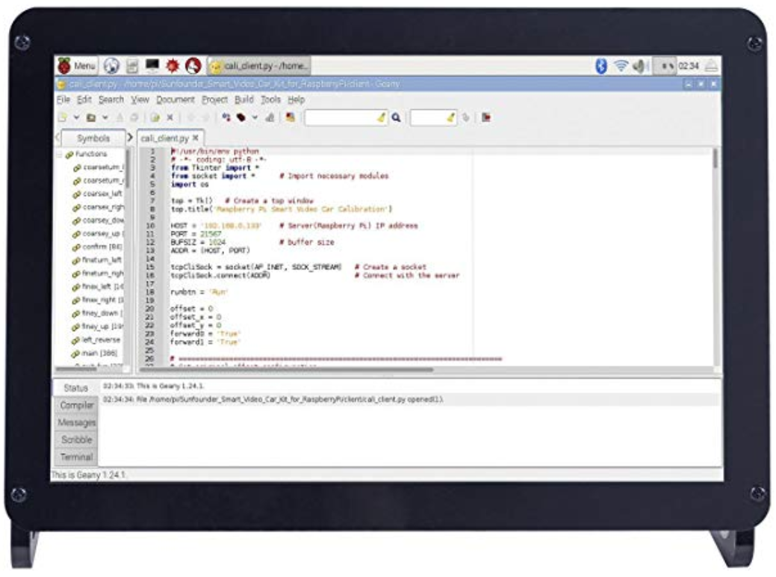
Possibility of installing telnet on EV3
Tufts Wireless
Serve Webpage to control EVs
Read EV3 IP Addresses
EV3s Running EV3Dev with CanaKit WiFi Dongles
Intel Stick &
10.1" IPS Display Panel
Student Computers
Hardware
Wireless Network
Programming Task

Slide 4
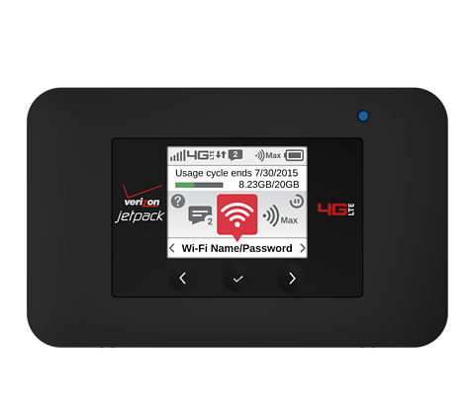
Possibility of installing telnet on EV3
Local Area Network
Internet
Serve Webpage to control EVs
Read EV3 IP Addresses
Broadcast LAN
Verizon 4G Jetpack
EV3s Running EV3Dev with CanaKit WiFi Dongles
Intel Stick &
10.1" IPS Display Panel
Student Computers
Hardware
Wireless Network
Programming Task

Slide 5
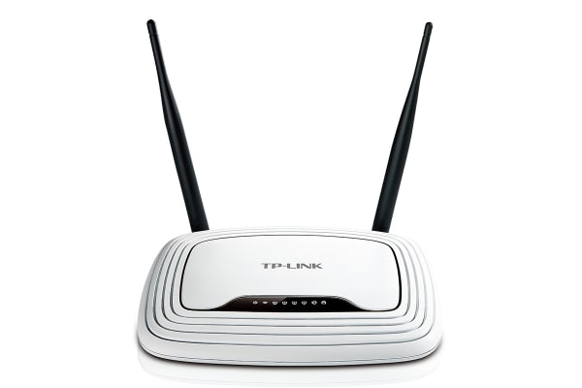
Possibility of installing telnet on EV3
Local Area Network
Internet
Serve Webpage to control EVs
Read EV3 IP Addresses
Broadcast LAN
Verizon 4G Jetpack
*
EV3s Running EV3Dev with CanaKit WiFi Dongles
Intel Stick &
10.1" IPS Display Panel
Student Computers
Hardware
Wireless Network
Programming Task
*Router may be needed for LAN

Slide 6

Possibility of installing telnet on EV3
Local Area Network
Internet
Serve Webpage to control EVs
Read EV3 IP Addresses
Broadcast LAN
Verizon 4G Jetpack
*
EV3s Running EV3Dev with CanaKit WiFi Dongles
Intel Stick &
10.1" IPS Display Panel
Student Computers
Hardware
Wireless Network
Programming Task
*Router may be needed for LAN

