Slide 1


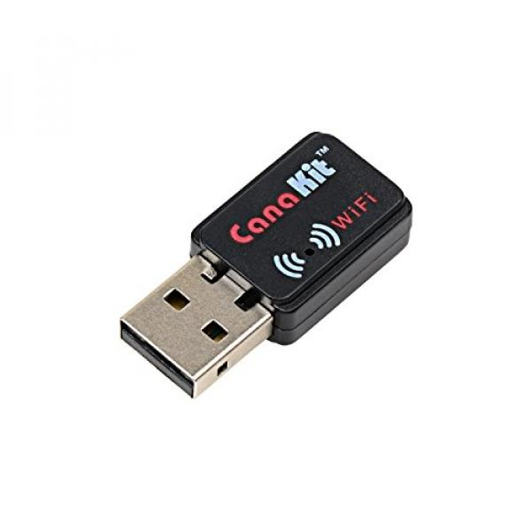


WiFi Connection notes:
Private IP Address (10.0…)
LED on the WiFi dongle shows network connection
Can be configured to automatically connect to a network
Can connect via telnet (requires installation) or ssh
Bluetooth Connection Notes:
169… IP Address
Max Bluetooth Connections:
5 to Mac
1 to PC

Slide 2
Install Telnet
Telnet is insecure, but the EV3s have private IP addresses
Install on EV3
Updates the package list
sudo apt-get update
Install Telnet package
sudo apt-get install telnetd
Install & Connect on Mac
Use Homebrew to install telnet
brew install telnet
Connect with Telnet
telnet -l robot <ip address>
Password: maker
Using Telnet in Python

Slide 3
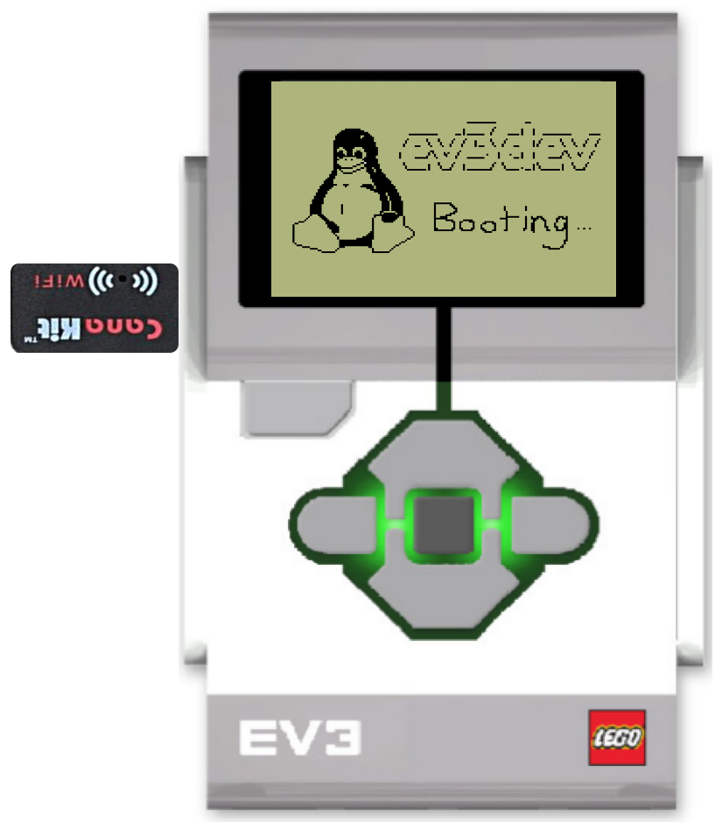

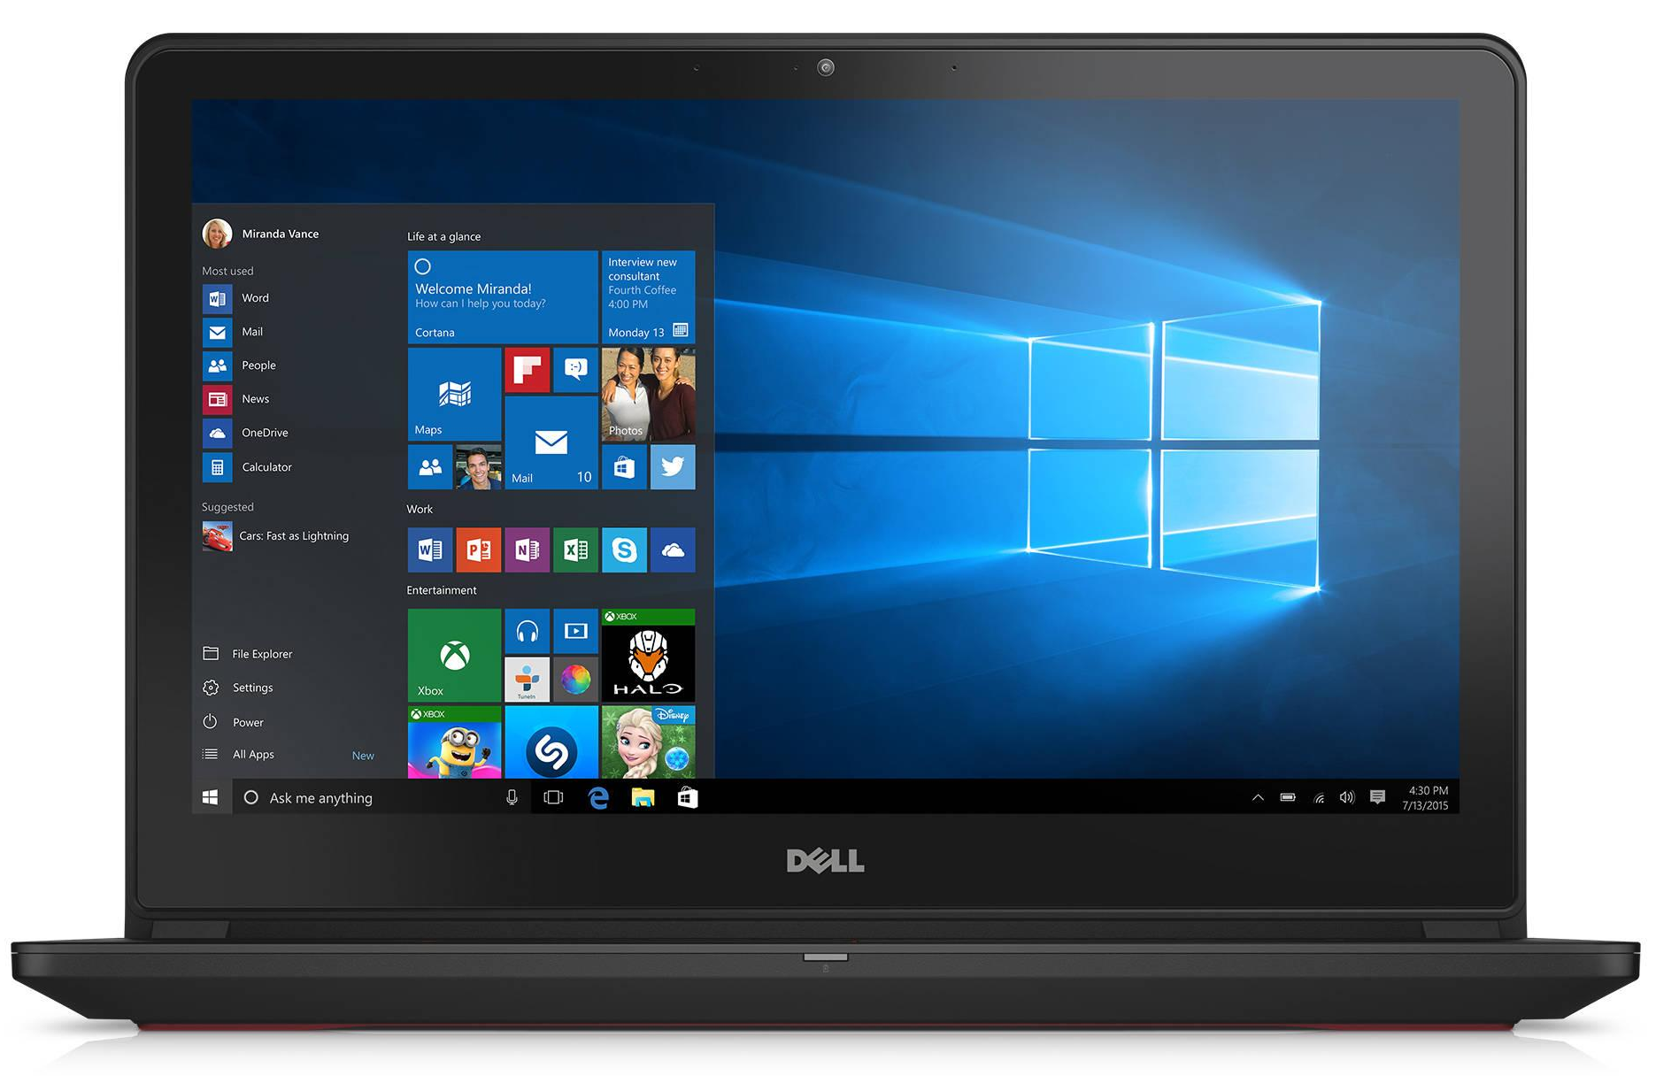
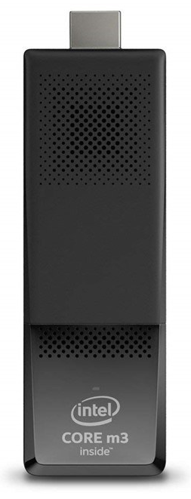
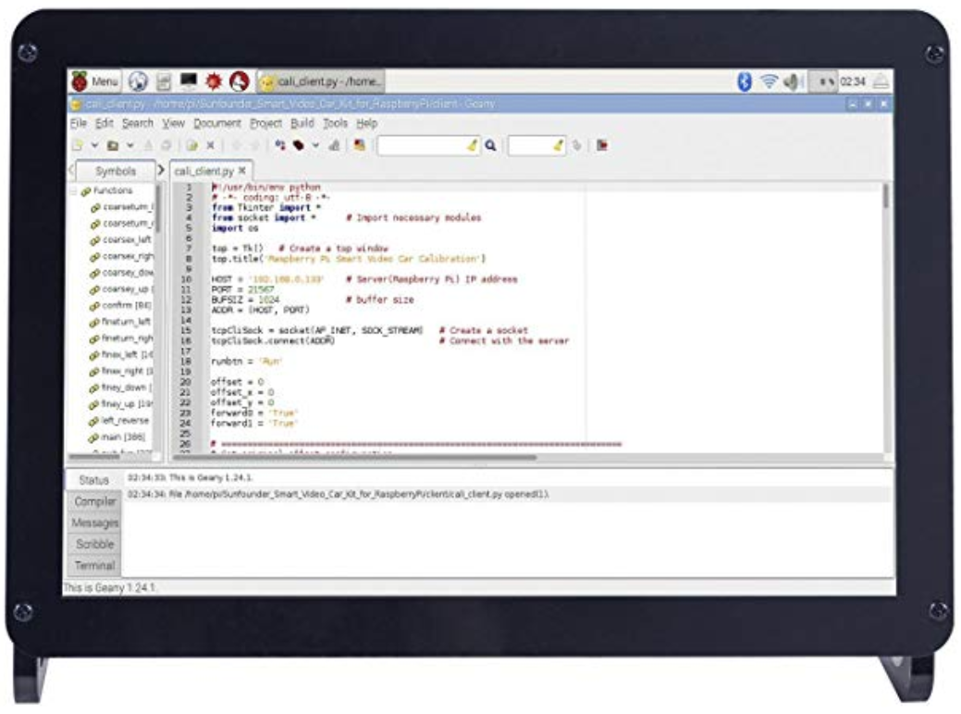
Telnet
Tufts Wireless
Serve Webpage to control EVs
Read EV3 IP Addresses
EV3s Running EV3Dev with CanaKit WiFi Dongles
Intel Stick &
10.1" IPS Display Panel
Student Computers
Hardware
Wireless Network
Programming Task

Slide 4
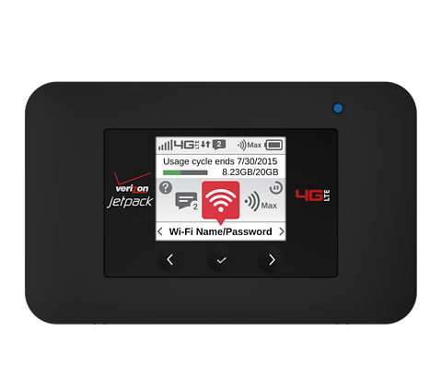
Telnet
Local Area Network
Internet
Serve Webpage to control EVs
Read EV3 IP Addresses
Broadcast LAN
Verizon 4G Jetpack
EV3s Running EV3Dev with CanaKit WiFi Dongles
Intel Stick &
10.1" IPS Display Panel
Student Computers
Hardware
Wireless Network
Programming Task

Slide 5
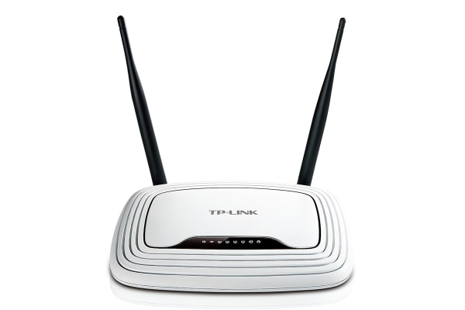
Telnet
Local Area Network
Internet
Serve Webpage to control EVs
Read EV3 IP Addresses
Broadcast LAN
Verizon 4G Jetpack
*
EV3s Running EV3Dev with CanaKit WiFi Dongles
Intel Stick &
10.1" IPS Display Panel
Student Computers
Hardware
Wireless Network
Programming Task
*Router may be needed for LAN

Slide 6

Telnet
Local Area Network
Internet
Serve Webpage to control EVs
Read EV3 IP Addresses
Broadcast LAN
Verizon 4G Jetpack
*
EV3s Running EV3Dev with CanaKit WiFi Dongles
Intel Stick &
10.1" IPS Display Panel
Student Computers
Hardware
Wireless Network
Programming Task
*Router may be needed for LAN

