Slide 1
Simple Quiz Application
Members
Mesa,Daniel Karl

Slide 2
Introduction
The Simple Quiz Application is a basic Java program using Swing (JOptionPane) to interact with users. It aims to provide a fun and educational way to test knowledge about the Philippines.

Slide 3
Objective
To develop a GUI-based quiz application using Java that evaluates user input and displays the score. It enhances understanding of Java OOP and GUI concepts.

Slide 4
Scope and Limitation
The project covers a five-question quiz with basic answer validation and scoring. It does not include advanced features like user accounts, data storage, or question randomization.

Slide 5
Algorithm
1. Start
2. Display welcome message
3. Ask name and questions
4. Check answers and count score
5. Show results and end.

Slide 6
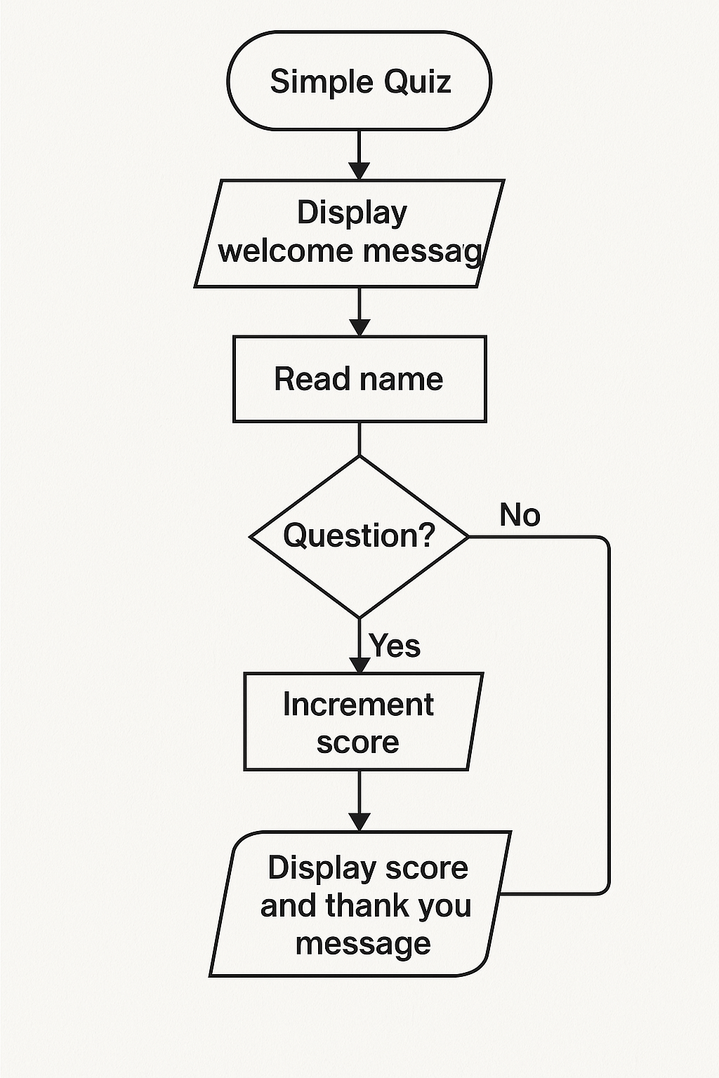
Flowchart

Slide 7
Program (Java Code)
The program uses JOptionPane for GUI input and output. It checks each answer, tracks the score, and displays the final result.

