Slide 1
Life After Spinal Cord Injury
Daniel Morales

Slide 2
Spinal Cord Injury Affects
A spinal cord injury (SCI) can greatly affect a person’s life and future. In addition to physical limitations, further medical needs and pain and suffering, their education, career, family prospects and overall mental health can be affected as well.
Growing up in the SCI community, I wanted to better understand quality of life after a SCI.
I decided to narrow my research to the following variables:
Average Age at Injury
Lifespan Post-Injury
Raising a Family
Pursuit of Education
Occupation

Slide 3
Research Data
This research was conducted through analyzing the National Spinal Cord Injury Model Systems (SCIMS) Database.
The SCIMS Database was established in 1973 as a repository of data collected through the collaborative efforts of federally funded SCI Model System Centers.
The SCIMS Database and project research consists of years from 1972 through 2021.
-Follow-up interviews were conducted at the first anniversary if injury, then every following 5 year anniversary.
The SCIMS Database captures data on 6% of new SCI cases that occur each year in the United States.

Slide 4
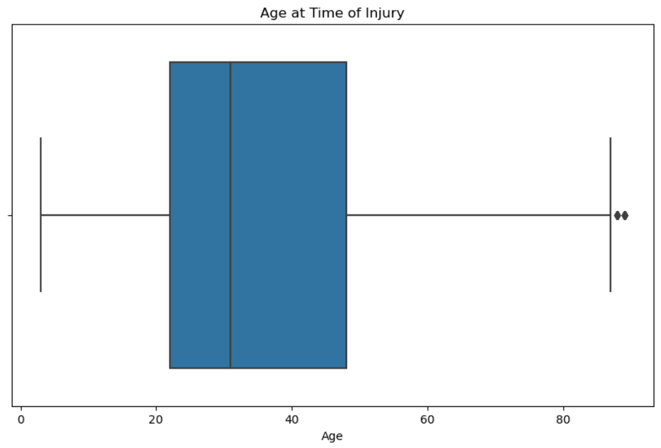
Age at SCI
The average age at spinal cord injury was 35.93 years.
A majority of injuries happened between the ages 22 – 48.
Ages 22-48 are a very formidable time for most people. These are the years where you are finding who you are, completing your education, building a career and/or starting a family.

Slide 5
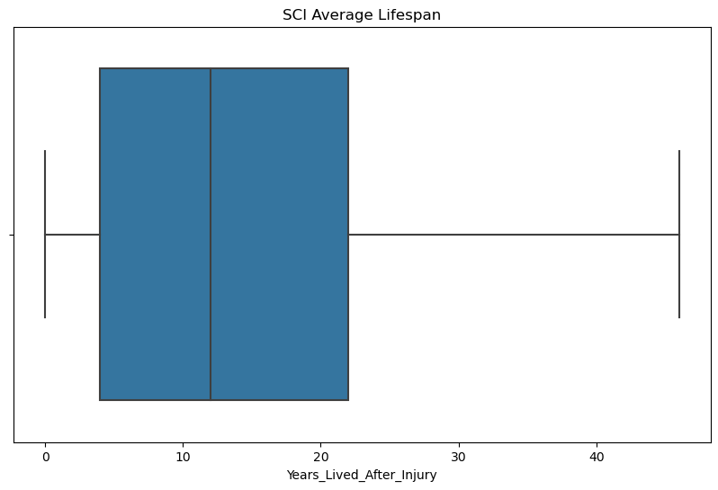
Average Lifespan post SCI
The average lifespan after injury is 13.90 years.
A majority of lifespans range from ages 4 – 22 though some survivors have lived 45+ years post injury.

Slide 6
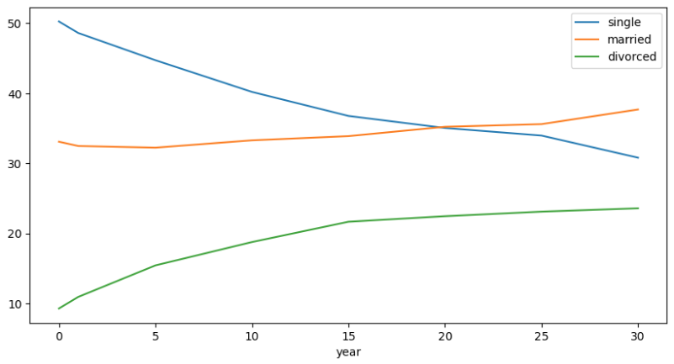
Marriage Rates
The percentage of single survivors decreased from time of injury through 30 years.
Both the marriage rate and divorce rate increased over this time period.

Slide 7
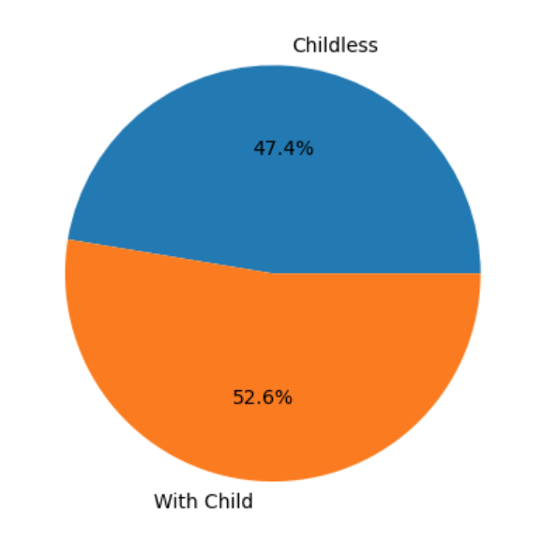
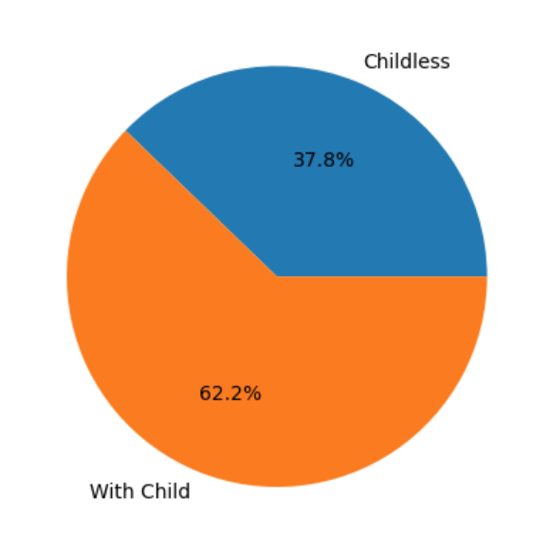
Child Birth
At Injury
Post Injury
The number of survivors with children increased 9.6% after injury, suggesting that survivors did not allow their limitations to prevent them from having a family.

Slide 8
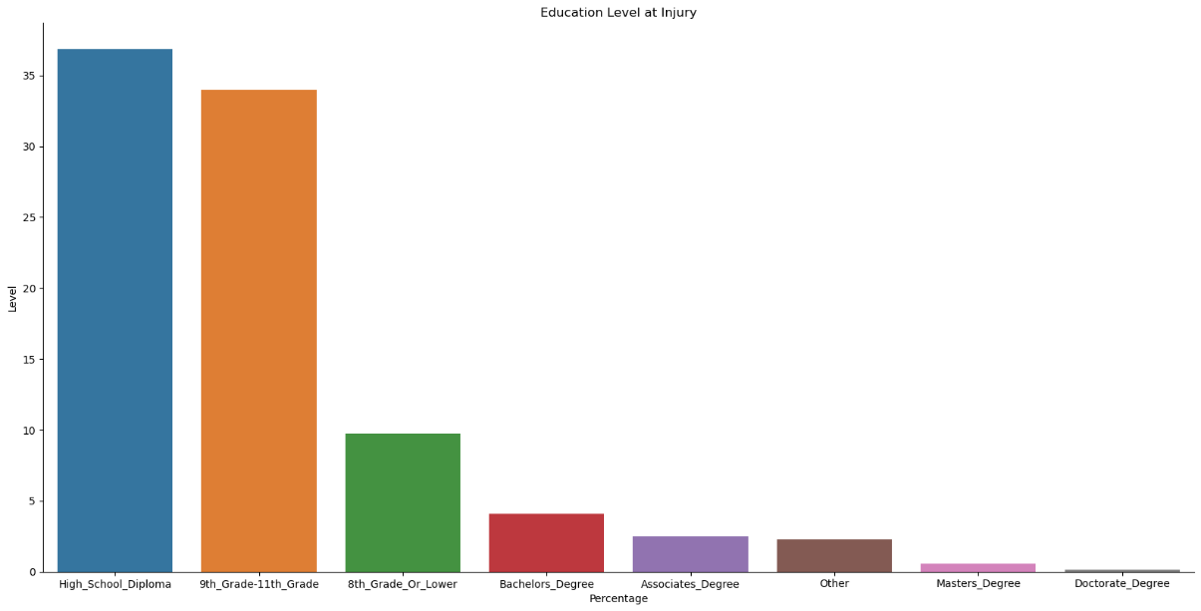
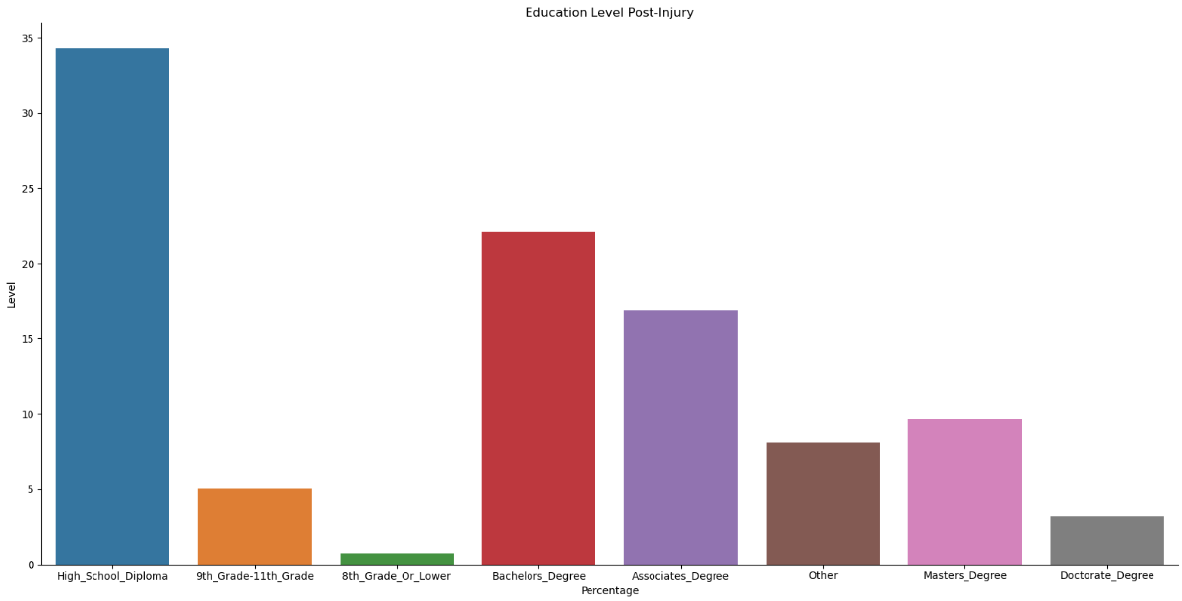
Highest Education Level Completed

Slide 9
Highest Education Level Completed
The amount of survivors continuing to pursue higher levels of education saw a dramatic increase post-injury
Bachelor’s Degrees saw an 18.02% increase
Associate’s Degrees saw an 14.45% increase
Master’s Degrees saw an 9.11% increase
Doctorate Degrees saw an 3.02% increase
High School Diplomas or lower education saw a 40.51% drop

Slide 10

Power of communication

Slide 11

Overcoming nervousness
Confidence-building strategies

Slide 12
Selecting visual aids
Enhancing your presentation

Slide 13
Navigating Q&A sessions
Know your material in advance
Anticipate common questions
Rehearse your responses
Maintaining composure during the Q&A session is essential for projecting confidence and authority. Consider the following tips for staying composed:
Stay calm
Actively listen
Pause and reflect
Maintain eye contact

Slide 14

Speaking impact
Your ability to communicate effectively will leave a lasting impact on your audience
Effectively communicating involves not only delivering a message but also resonating with the experiences, values, and emotions of those listening

Slide 15
Dynamic delivery
Learn to infuse energy into your delivery to leave a lasting impression.
One of the goals of effective communication is to motivate your audience.
Metric | Measurement | Target | Actual
Audience attendance | # of attendees | 150 | 120
Engagement duration | Minutes | 60 | 75
Q&A interaction | # of questions | 10 | 15
Positive feedback | Percentage (%) | 90 | 95
Rate of information retention | Percentage (%) | 80 | 85

Slide 16
Final tips & takeaways
Consistent rehearsal
Strengthen your familiarity
Refine delivery style
Pacing, tone, and emphasis
Timing and transitions
Aim for seamless, professional delivery
Practice audience
Enlist colleagues to listen & provide feedback
Seek feedback
Reflect on performance
Explore new techniques
Set personal goals
Iterate and adapt

Slide 17
Speaking engagement metrics
Impact factor | Measurement | Target | Achieved
Audience interaction | Percentage (%) | 85 | 88
Knowledge retention | Percentage (%) | 75 | 80
Post-presentation surveys | Average rating | 4.2 | 4.5
Referral rate | Percentage (%) | 10 | 12
Collaboration opportunities | # of opportunities | 8 | 10

Slide 18
Thank you
Brita Tamm
502-555-0152
brita@firstupconsultants.com
www.firstupconsultants.com

