Slide 1
Life After Spinal Cord Injury
Daniel Morales

Slide 2
Spinal Cord Injury Affects
A spinal cord injury (SCI) can greatly affect a person’s life and outlook on the future. In addition to the daily challenges of physical limitations, medical needs, as well as pain and suffering, a SCI survivor’s ability to achieve life milestones that their able-bodied peers may take for granted can also be impacted.
Growing up with a quadriplegic mother and understanding the everyday challenges her injury created,
During my mother’s initial hospitalization post SCI, her doctor told her that she would never drive, never get married and never have a family. Not only did she accomplish all three of these milestones, but she also went on to obtain a bachelor’s degree from Rice University as well as work to help other SCI survivors achieve independent living.
I wanted to better understand how other survivors’ life milestones compare at injury versus post injury.

Slide 3
Data Questions
How does a SCI survivor’s life milestones compare at injury vs post injury? Do they let their injury stop them from continuing to live a full life? Or do they continue to strive for their goals, even with the everyday obstacles their SCI injury places in front of them?
I will find this answer by analyzing the following:
What is the average age a spinal cord injury occurs?
What is the average number of years a SCI survivor lives post-injury vs at large?
What percentage of survivors give birth at injury vs post injury?
What percentage of survivors pursue higher education at injury vs post injury?
What percentage of survivors have a career at injury vs post injury?

Slide 4
Research Data
This research was conducted through analyzing the National Spinal Cord Injury Model Systems (SCIMS) Database.
The SCIMS Database was established in 1973 as a repository of data collected through the collaborative efforts of federally funded SCI Model System Centers.
The SCIMS Database and project research consists of years from 1972 through 2021.
-Follow-up interviews were conducted at the first anniversary if injury, then every following 5 year anniversary.
The SCIMS Database captures data on 6% of new SCI cases that occur each year in the United States.

Slide 5
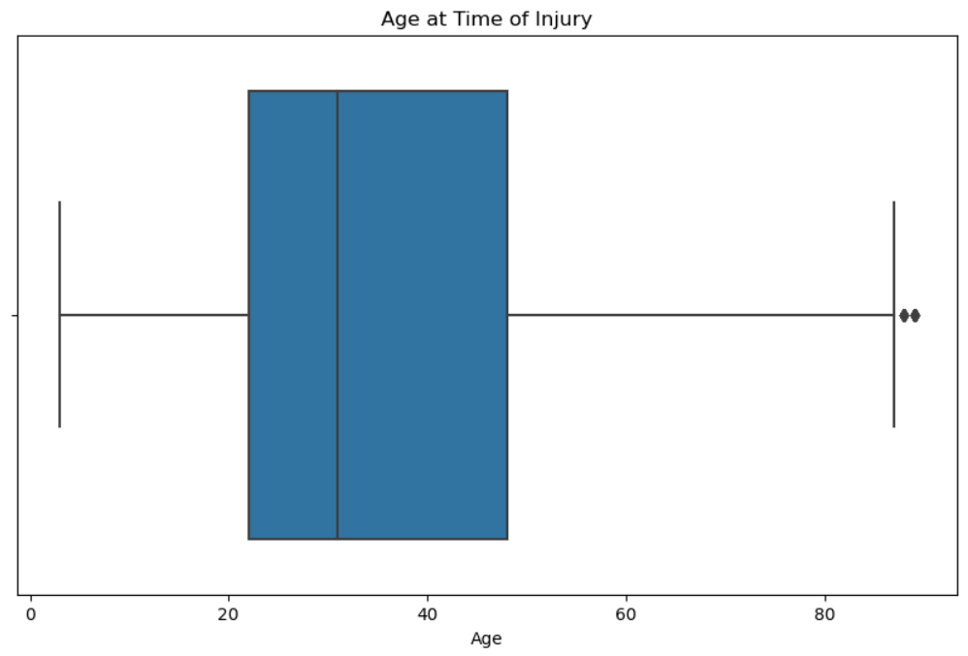
What is the average age a spinal cord injury occurs?
The average age at spinal cord injury was 35.93 years.
A majority of injuries happened between the ages 22 – 48.
Ages 22-48 are a very formidable time for most people. These are the years where you are finding who you are, completing your education, building a career and/or starting a family.

Slide 6
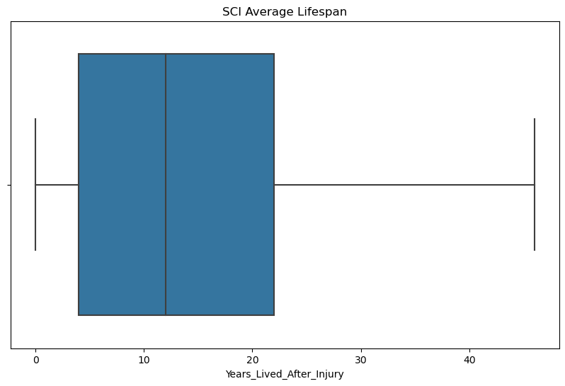
What is the average number of years a SCI survivor lives post-injury vs at large?
The average lifespan of a SCI survivor is 55.56.
ADD COMPARISON BY GENDER?

Slide 7
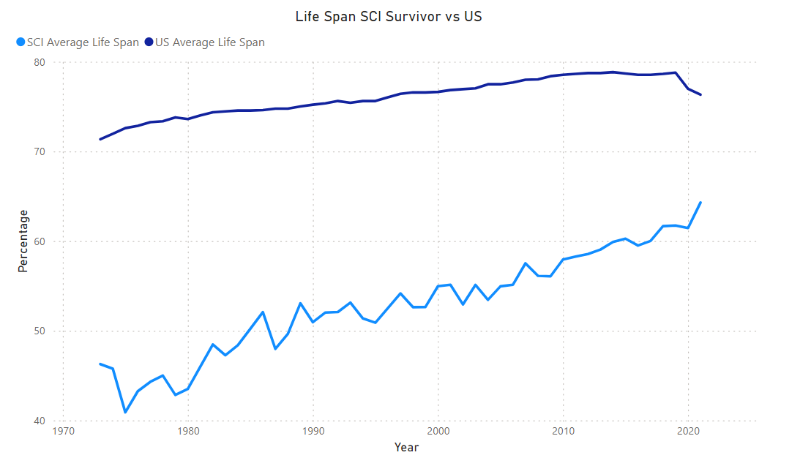
What is the average number of years a SCI survivor lives post-injury vs at large?
The average lifespan of a SCI survivor is 55.56.

Slide 8
What is the average number of years a SCI survivor lives post-injury vs at large?
The average lifespan after injury is 13.90 years.
A majority of lifespans range from ages 4 – 22 though some survivors have lived 45+ years post injury.
ADD COMPARISON BY GENDER?

Slide 9
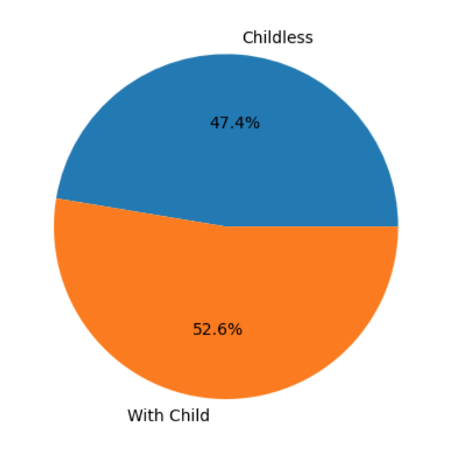
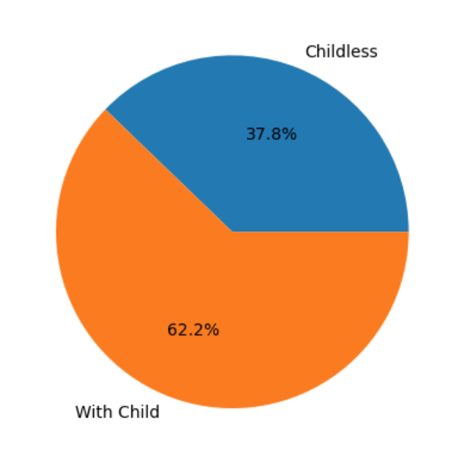
What percentage of survivors give birth at injury vs post injury?
At Injury
Post Injury
The number of survivors with children increased 9.6% after injury, suggesting that survivors did not allow their limitations to prevent them from having a family.

Slide 10
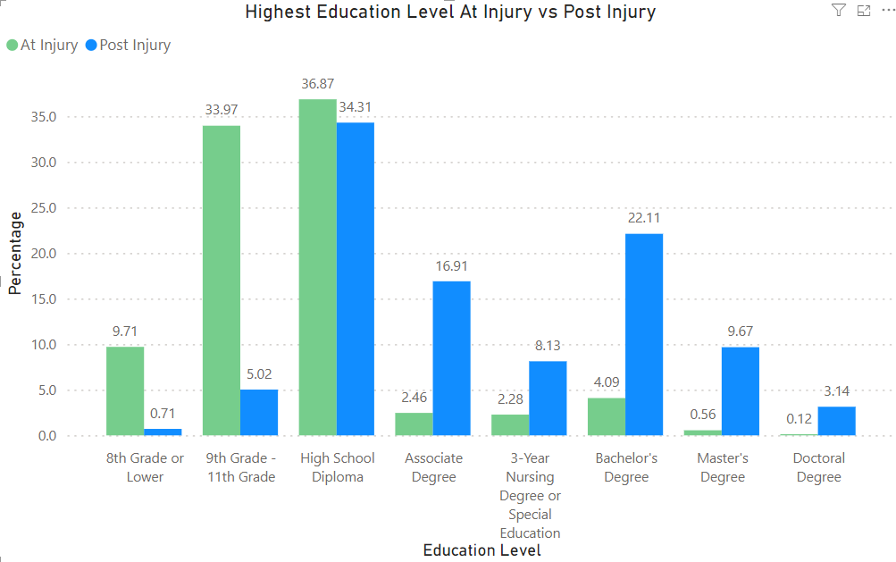
Highest Education Level Completed

Slide 11
What percentage of survivors pursue higher education at injury vs post injury?
The number of survivors continuing to pursue higher levels of education saw a dramatic increase post-injury
Bachelor’s Degrees saw an 18.02% increase
Associate’s Degrees saw an 14.45% increase
Master’s Degrees saw an 9.11% increase
Doctorate Degrees saw an 3.02% increase
High School Diplomas or lower education saw a 40.51% drop

Slide 12
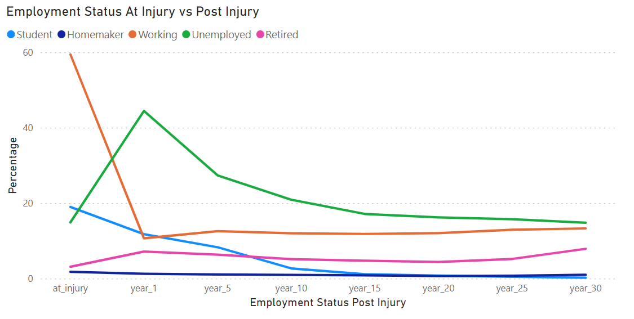
What percentage of survivors have a career at injury vs post injury?
At Injury
Post Injury

Slide 13
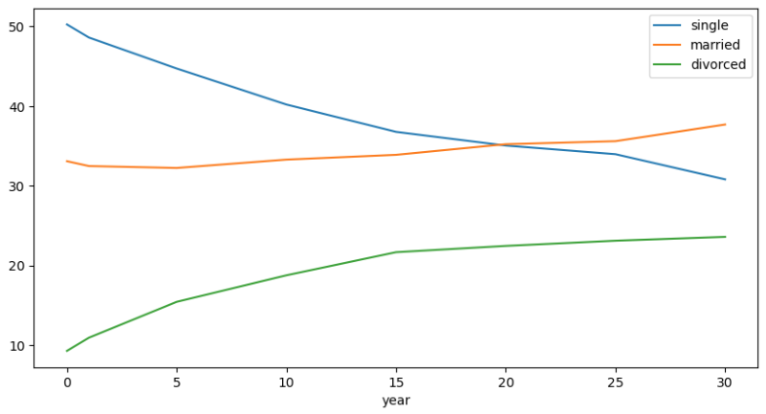
Marriage Rates
The percentage of single survivors decreased from time of injury through 30 years.
Both the marriage rate and divorce rate increased over this time period.

Slide 14

Power of communication

Slide 15

Overcoming nervousness
Confidence-building strategies

Slide 16
Selecting visual aids
Enhancing your presentation

Slide 17
Navigating Q&A sessions
Know your material in advance
Anticipate common questions
Rehearse your responses
Maintaining composure during the Q&A session is essential for projecting confidence and authority. Consider the following tips for staying composed:
Stay calm
Actively listen
Pause and reflect
Maintain eye contact

Slide 18

Speaking impact
Your ability to communicate effectively will leave a lasting impact on your audience
Effectively communicating involves not only delivering a message but also resonating with the experiences, values, and emotions of those listening

Slide 19
Dynamic delivery
Learn to infuse energy into your delivery to leave a lasting impression.
One of the goals of effective communication is to motivate your audience.
Metric | Measurement | Target | Actual
Audience attendance | # of attendees | 150 | 120
Engagement duration | Minutes | 60 | 75
Q&A interaction | # of questions | 10 | 15
Positive feedback | Percentage (%) | 90 | 95
Rate of information retention | Percentage (%) | 80 | 85

Slide 20
Final tips & takeaways
Consistent rehearsal
Strengthen your familiarity
Refine delivery style
Pacing, tone, and emphasis
Timing and transitions
Aim for seamless, professional delivery
Practice audience
Enlist colleagues to listen & provide feedback
Seek feedback
Reflect on performance
Explore new techniques
Set personal goals
Iterate and adapt

Slide 21
Speaking engagement metrics
Impact factor | Measurement | Target | Achieved
Audience interaction | Percentage (%) | 85 | 88
Knowledge retention | Percentage (%) | 75 | 80
Post-presentation surveys | Average rating | 4.2 | 4.5
Referral rate | Percentage (%) | 10 | 12
Collaboration opportunities | # of opportunities | 8 | 10

Slide 22
Thank you
Brita Tamm
502-555-0152
brita@firstupconsultants.com
www.firstupconsultants.com

