Slide 1
Convolutions (Filters)

Slide 2
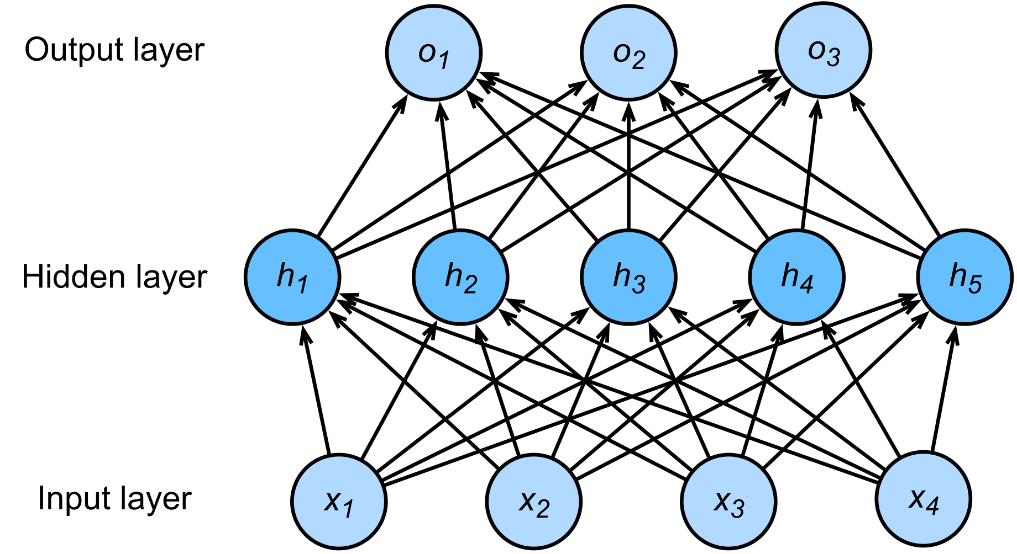
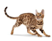
Problem of MLP
To many parameters to train…
# hidden units: 100
# parameters: 100x120,000 =12 million
……
……
# inputs: 200x200x3 =120,000
Flatten
Image Size: 200x200x3

Slide 3
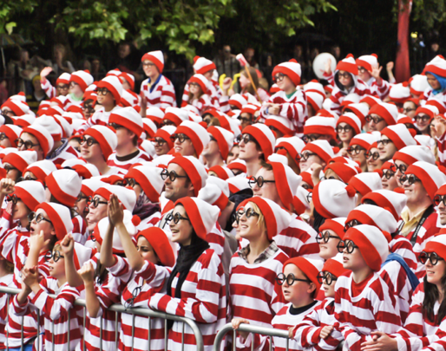

Can we reduce parameters?
Where is Waldo?

Slide 4
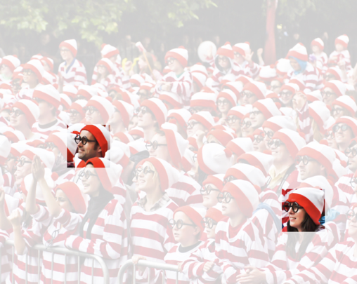
Our vision system…
1. Translation Invariance:
Similar respond to the same object, regardless of its location

Slide 5
Our vision system…
2. Locality:
Focusing on somewhat local regions, rather than a larger scale

Slide 6
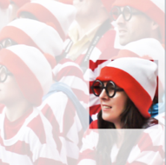

Filters
Each pixel on the image can be realized as $x_{i,j}$
Each “weight” on the filter (or convolution, or kernel) window can be defined by $w_{a,b}$

Slide 7
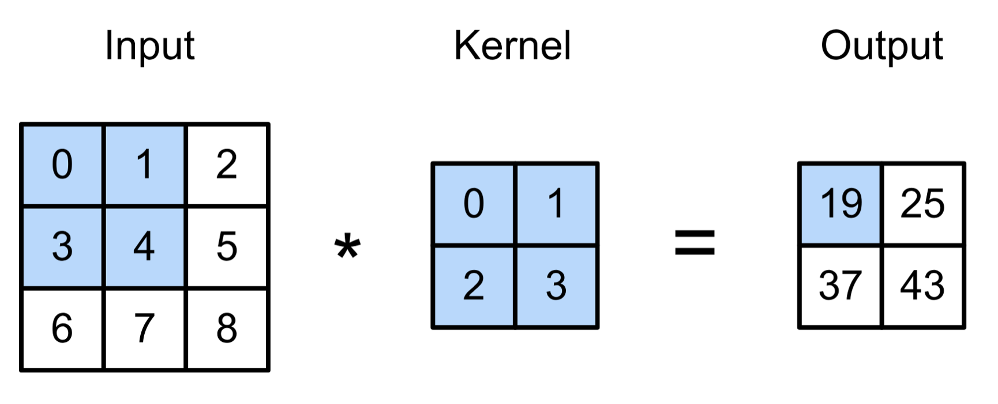
2D Convolution Example
(vdumoulin@ Github)

Slide 8
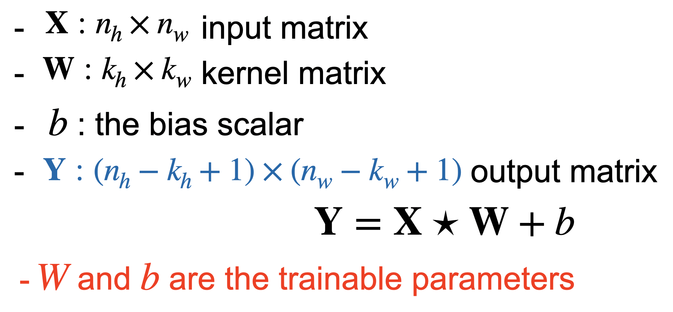
2D Convolution Example
(vdumoulin@ Github)

Slide 9
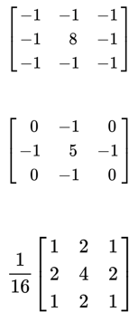
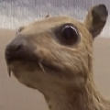
Filters
What will happen after the filters?
(wikipedia)

Slide 10
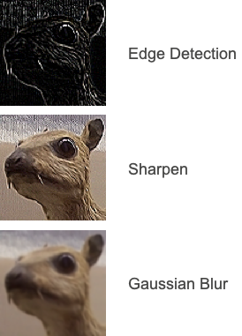
Filters
(wikipedia)

