Slide 1
Padding & Stride

Slide 2
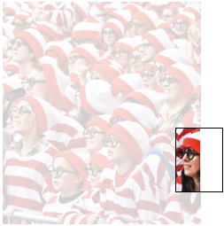
What do we do near the boundary?
The original convolution window may
ignore this Waldo at the boundary …

Slide 3
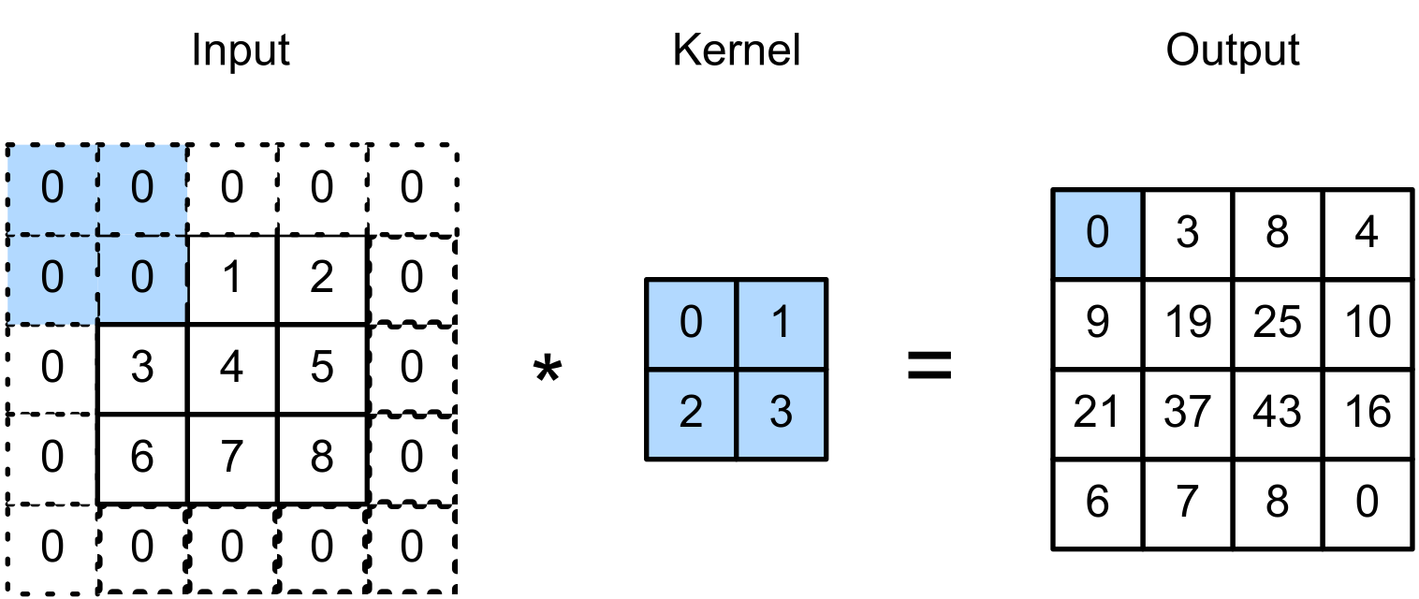
Padding
Padding adds rows/columns around the input.
(vdumoulin@ Github)

Slide 4
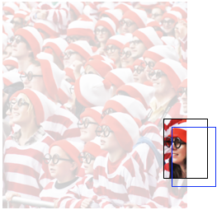
How about two nearly identical windows?
Too computationally expensive to slide one pixel at a time…

Slide 5
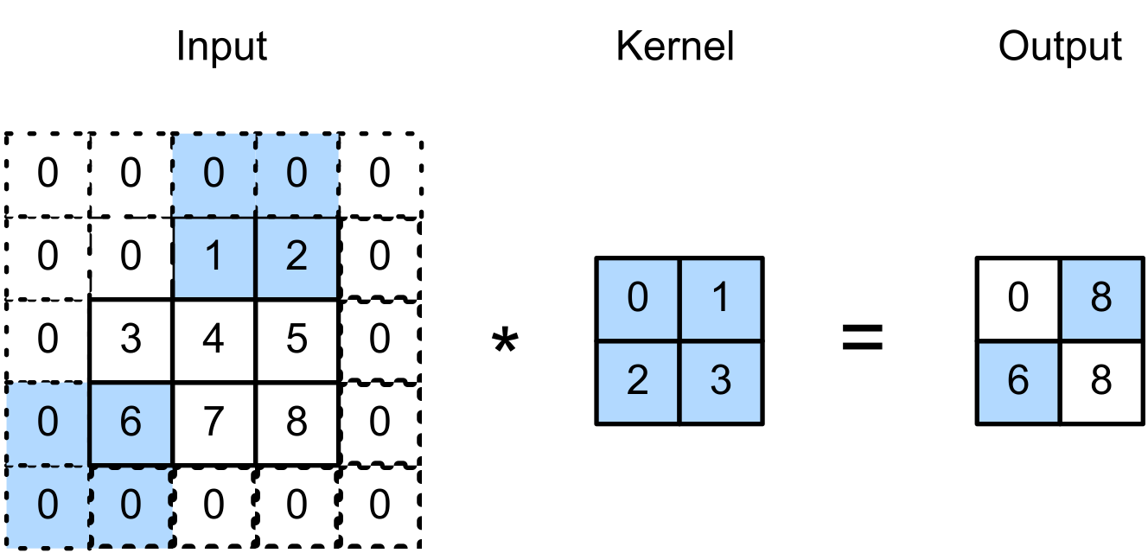
Stride
Stride is the number of “unit” the kernel shifted per slide over rows/columns.
E.g., Strides of 3 for height and 2 for width
(vdumoulin@ Github)

Slide 6
Pooling

Slide 7
Pooling
Pooling is used to reduce size (h & w) of the feature map.
can operate with padding and stride
no weights to train
Max Pooling: Returns the maximal value in the pooling window
Average Pooling: Returns the average in the window

Slide 8
CNN Layers
(Output)
A simple Convolutional Neural Network (CNN) is usually made of the following layers:
Convolution
Pooling
Dense
(Input)

Slide 9
CNN – Hands on
In this exercise, we train a CNN as follows :
Reading a sample dataset
Implementing a CNN
Making predictions with the trained network
Follow through this notebook: MLA-CV-DAY1-CNN.ipynb
Run the notebook from your SageMaker instance.

