Slide 1
ML Applications

Slide 2
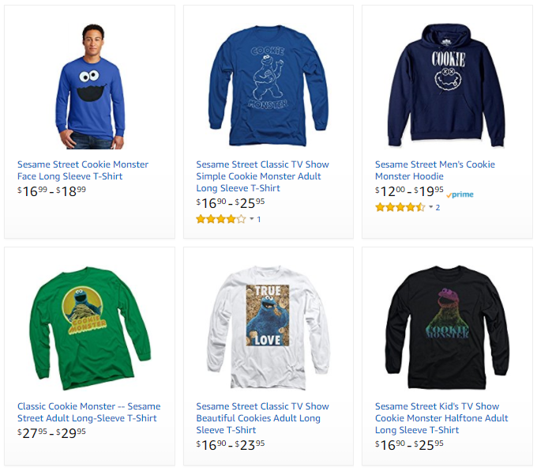
ML Applications
Problem type
Description
Example
Ranking
Helping users find the most relevant items
Ranking algorithm within Amazon Search
Recommendation
Giving users the items they may be most interested in
Classification
Figuring out what category does an item belongs to
Regression
Predicting a numerical value of an item
Clustering
Putting similar items together
Anomaly Detection
Finding uncommon items

Slide 3
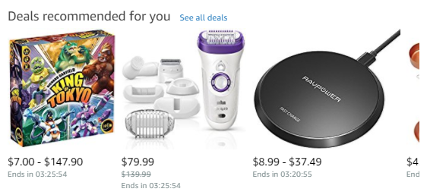
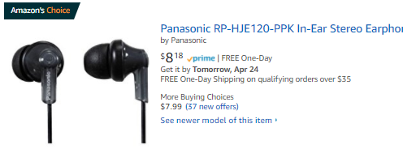
ML Applications
Problem type
Description
Example
Ranking
Helping users find the most relevant items
Recommendations across the website
Amazon’s Choice
Recommendation
Giving users the items they may be most interested in
Classification
Figuring out what category does an item belongs to
Regression
Predicting a numerical value of an item
Clustering
Putting similar items together
Anomaly Detection
Finding uncommon items

Slide 4
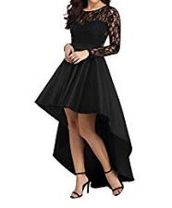
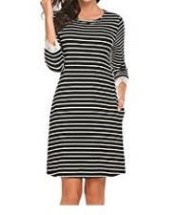
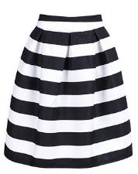
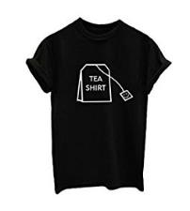
ML Applications
Problem type
Description
Example
Ranking
Helping users find the most relevant items
Product classification for our catalog
Recommendation
Giving users the items they may be most interested in
Classification
Figuring out what category does an item belongs to
High-Low Dress
Straight Dress
Regression
Predicting a numerical value of an item
Clustering
Putting similar items together
Anomaly Detection
Finding uncommon items
Striped Skirt
Graphic Shirt

Slide 5
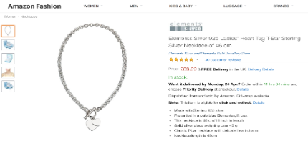
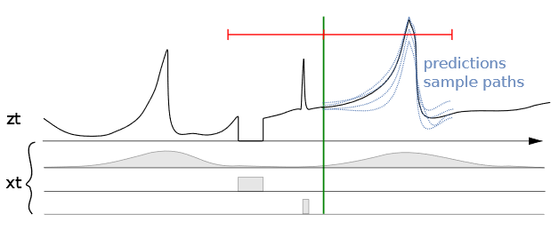
ML Applications
Problem type
Description
Example
Ranking
Helping users find the most relevant items
Predicting sales for specific ASINs
Recommendation
Giving users the items they may be most interested in
Classification
Figuring out what category does an item belongs to
Regression
Predicting a numerical value of a item
Clustering
Putting similar items together
Anomaly Detection
Finding uncommon items
Seasonality | Out of stock | Promotions

Slide 6
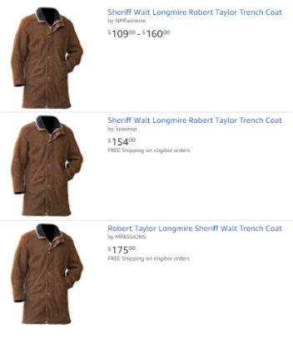
ML Applications
Problem type
Description
Example
Ranking
Helping users find the most relevant items
Close-matching for near-duplicates
Recommendation
Giving users the items they may be most interested in
Classification
Figuring out what category does an item belongs to
Regression
Predicting a numerical value of an item
Clustering
Putting similar items together
Anomaly Detection
Finding uncommon items

Slide 7


ML Applications
Problem type
Description
Example
Ranking
Helping users find the most relevant items
Fruit freshness
Recommendation
Giving users the items they may be most interested in
Before
After
Classification
Figuring out what category does an item belongs to
Regression
Predicting a numerical value of an item
Clustering
Putting similar items together
Good
Damage
Serious Damage
Decay
Anomaly Detection
Finding uncommon items

