Slide 1
Supervised Learning & Unsupervised Learning

Slide 2
Supervised vs. Unsupervised Learning
Problem type
Description
Ranking
Helping users find the most relevant items
Data is provided with the correct labels
Supervised Learning
Recommendation
Giving users the items they may be most interested in
Classification
Figuring out what category does an item belongs to
Regression
Predicting a numerical value of an item
Data is provided without labels
Unsupervised Learning
Clustering
Putting similar items together
Anomaly Detection
Anomaly Detection
Anomaly Detection
Finding uncommon items

Slide 3
Supervised vs. Unsupervised Learning
Problem type
Description
Ranking
Helping users find the most relevant items
Data is provided with the correct labels
Supervised Learning
Recommendation
Giving users the items they may be most interested in
Classification
Figuring out what category does an item belongs to
Regression
Predicting a numerical value of an item
Data is provided without labels
Unsupervised Learning
Clustering
Putting similar items together
Anomaly Detection
Anomaly Detection
Anomaly Detection
Finding uncommon items

Slide 4
Supervised Learning - Regression
Data is provided with the correct labels
Supervised Learning
Regression (Quantity)
Classification (Category)
Target
Features
Price | Bedrooms | SqFootage | Age
280.000 | 3 | 3292 | 14
210.030 | 2 | 2465 | 6

Slide 5
Supervised Learning - Classification
Data is provided with the correct labels
Supervised Learning
Regression (Quantity)
Classification (Category)
Target
Features
Star | Points | Edges | Size
1 | 5 | 10< | 150
0 | 0 | >9 | 750

Slide 6
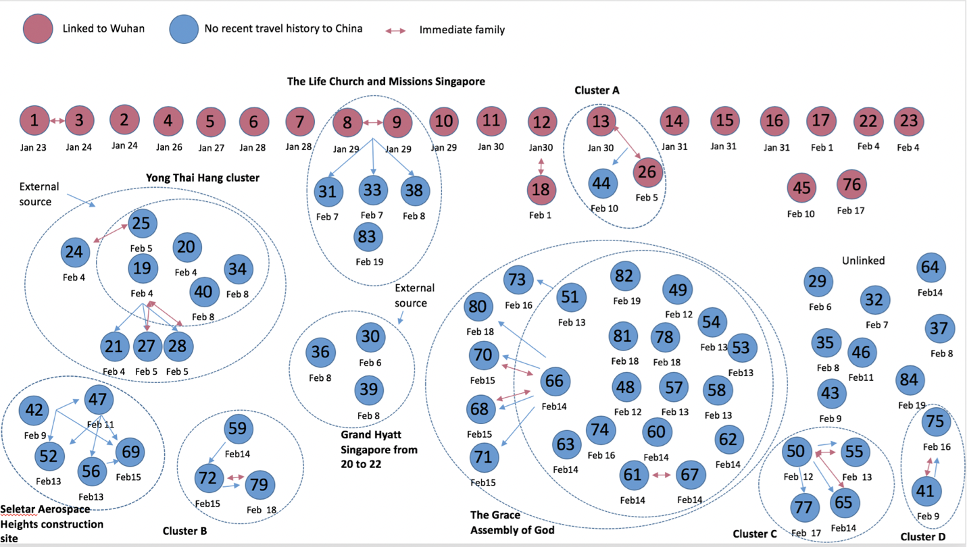
Unsupervised Learning - Clustering
Cluster network of the cases in Singapore for the COVID-19 global epidemic as of February 19, 2020 .
The pink circles represent the imported cases where as the blue circles represent cases with no travel history to China.
https://www.researchgate.net/publication/339503056

Slide 7
Supervised Learning & Unsupervised Learning

