Slide 1
Underfitting and Overfitting

Slide 2
Underfitting
The model performs poorly on both training and test datasets.
Class 1
Too simple
Cannot adequately capture the underlying structure of training data
Corresponding to high bias
y
Class 2
Class 1
Class 2
x

Slide 3
Model Evaluation - Overfitting
The model performs well on training data, but it doesn’t generalize well on test data.
y
Class 1
Too complex
May memorize or imitate the noise instead of the underlying relationship of training data
Corresponding to high variance
Class 2
Class 1
Class 2
x

Slide 4
Model Evaluation - Optimum
The model performs well on both training and test datasets.
Neither too simple nor too complex
Able to capture the underlying structure
Corresponding to low bias and low variance:
y
Class 1
Class 2
Class 1
Class 2
x

Slide 5
Model Evaluation
3 scenarios of a model:
Underfitting
Overfitting
Optimum
Error ~ Bias + Variance
Bias-variance trade-off

Slide 6
Model Evaluation Metrics

Slide 7
Evaluation Metrics
Mean Square Error (MSE)
Rooted Mean Square Error (RMSE)
Mean Absolute Error (MAE)
R Squared (R²)
…
Confusion Matrix
Accuracy
Precision & Recall
F1 Score
…
Regression
Classification

Slide 8
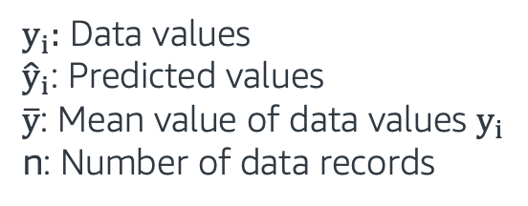
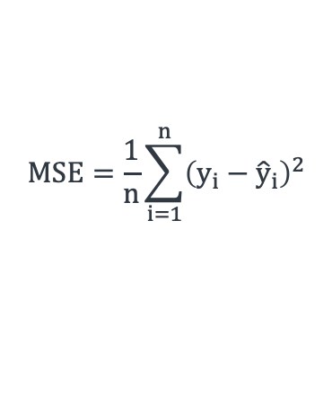
Regression - MSE
Metrics | Equations
Mean Squared Error (MSE)
$y_{i}:$ Data values
${\hat{y}}_{i}$: Predicted values
$\overline{y}$: Mean value of data values $y_{i}$
n: Number of data records
$$MSE=\frac{1}{n}\sum_{i=1}^{n}{{\left(y_{i}−{\hat{y}}_{i}\right)}^{2}}$$

Slide 9

Regression - RMSE
Metrics | Equations
Mean Squared Error (MSE)
Root Mean Squared Error (RMSE)
$y_{i}:$ Data values
${\hat{y}}_{i}$: Predicted values
$\overline{y}$: Mean value of data values $y_{i}$
n: Number of data records
$$MSE=\frac{1}{n}\sum_{i=1}^{n}{{\left(y_{i}−{\hat{y}}_{i}\right)}^{2}}$$
$$RMSE= \sqrt{MSE}$$

Slide 10
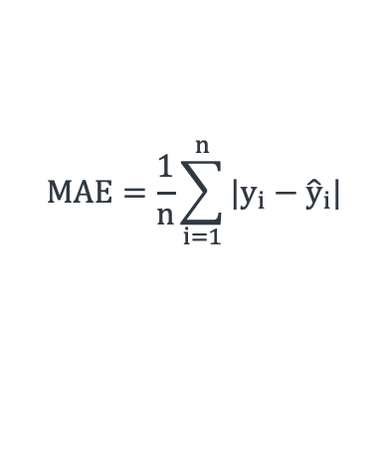
Regression - MAE
Metrics | Equations
Mean Squared Error (MSE)
Root Mean Squared Error (RMSE)
Mean Absolute Error (MAE)
$y_{i}:$ Data values
${\hat{y}}_{i}$: Predicted values
$\overline{y}$: Mean value of data values $y_{i}$
n: Number of data records
$$MSE=\frac{1}{n}\sum_{i=1}^{n}{{\left(y_{i}−{\hat{y}}_{i}\right)}^{2}}$$
$$RMSE= \sqrt{MSE}$$
$$MAE=\frac{1}{n}\sum_{i=1}^{n}{{|y}_{i}−{\hat{y}}_{i}|}$$

Slide 11
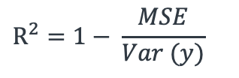
Regression - R²
Metrics | Equations
Mean Squared Error (MSE)
Root Mean Squared Error (RMSE)
Mean Absolute Error (MAE)
R Squared (R²)
$y_{i}:$ Data values
${\hat{y}}_{i}$: Predicted values
$\overline{y}$: Mean value of data values $y_{i}$
n: Number of data records
$$MSE=\frac{1}{n}\sum_{i=1}^{n}{{\left(y_{i}−{\hat{y}}_{i}\right)}^{2}}$$
$$RMSE= \sqrt{MSE}$$
$$MAE=\frac{1}{n}\sum_{i=1}^{n}{{|y}_{i}−{\hat{y}}_{i}|}$$
$$R^{2}=1− \frac{MSE}{Var (y)}$$

Slide 12
Evaluation Metrics
Mean Square Error (MSE)
Rooted Mean Square Error (RMSE)
Mean Absolute Error (MAE)
R Squared (R²)
…
Confusion Matrix
Accuracy
Precision & Recall
F1 Score
…
Regression
Classification

Slide 13
Classification - Confusion Matrix
Prediction
Positive
Negative
Positive
(TP)
True Positive
(FN)
False Negative
Negative
Positive
19
2
True State
(FP)
False Positive
(TN)
True Negative
Negative
1
3

Slide 14

Classification - Accuracy
Prediction
Positive
Negative
Accuracy*: The percent (ratio) of cases classified correctly:
$$Accuracy= \frac{TP+TN}{TP+FP+FN+TN }$$
$Accuracy= \frac{19+3}{19+1+2+3}$ = 0.88
*$0 (\text{bad}\text{)}≤Accuracy≤1\text{ (}\text{good}\text{)}$
(TP)
True Positive
(FN)
False Negative
Positive
19
2
True State
(FP)
False Positive
(TN)
True Negative
Negative
1
3

Slide 15

Classification - Accuracy
Prediction
Positive
Negative
High Accuracy Paradox:
Accuracy is misleading when dealing with imbalanced datasets
$Accuracy= \frac{2+88}{2+2+8+88}$ = 0.90
(TP)
True Positive
(FN)
False Negative
Positive
2
8
True State
(FP)
False Positive
(TN)
True Negative
Negative
2
88

Slide 16

Classification - Precision
Prediction
Positive
Negative
Precision*: Accuracy of a predicted positive outcome:
$$Precision= \frac{TP}{TP+FP}$$
$Precision= \frac{2}{2+2}$ = 0.50
*$0 (\text{bad}\text{)}≤Precision≤1\text{ (}\text{good}\text{)}$
True Positive
False Negative
Positive
2
8
True State
False Positive
True Negative
Negative
2
88

Slide 17

Classification - Recall
Prediction
Positive
Negative
Recall*: Measures model’s ability to predict a positive outcome:
$$Recall= \frac{TP}{TP+FN}$$
$Recall= \frac{2}{2+8}$ = 0.20
*$0 (\text{bad}\text{)}≤Recall≤1\text{ (}\text{good}\text{)}$
True Positive
False Negative
Positive
2
8
True State
False Positive
True Negative
Negative
2
88

Slide 18

Classification - F1 Score
F1 Score*: It is a combined metric, the harmonic mean of precision and recall.
$$\text{F}\text{1_}\text{score}\text{ = }\frac{2 ∗(precision ∗recall)}{(precision+recall)}$$
$$\text{∗}0 (\text{bad}\text{)}≤\text{F}\text{1_}\text{score}≤1\text{ (}\text{good}\text{)}$$
Recall
F1 score
Precision

Slide 19

Classification - F1 Score
F1 Score*: It is a combined metric, the harmonic mean of precision and recall.
$$\text{F}\text{1_}\text{score}\text{ = }\frac{2 ∗(precision ∗recall)}{(precision+recall)}$$
$$\text{∗}0 (\text{bad}\text{)}≤\text{F}\text{1_}\text{score}≤1\text{ (}\text{good}\text{)}$$
Recall
F1 score
Low when one or both of the precision and recall are low
Precision

Slide 20

Classification - F1 Score
F1 Score*: It is a combined metric, the harmonic mean of precision and recall.
$$\text{F}\text{1_}\text{score}\text{ = }\frac{2 ∗(precision ∗recall)}{(precision+recall)}$$
$$\text{∗}0 (\text{bad}\text{)}≤\text{F}\text{1_}\text{score}≤1\text{ (}\text{good}\text{)}$$
Recall
F1 score
High when both precision and recall are high
Precision

Slide 21
Evaluation Metrics
Mean Square Error (MSE)
Rooted Mean Square Error (RMSE)
Mean Absolute Error (MAE)
R Squared (R²)
…
Confusion Matrix
Accuracy
Precision & Recall
F1 Score
…
Regression
Classification

