Slide 1
Image Representation

Slide 2
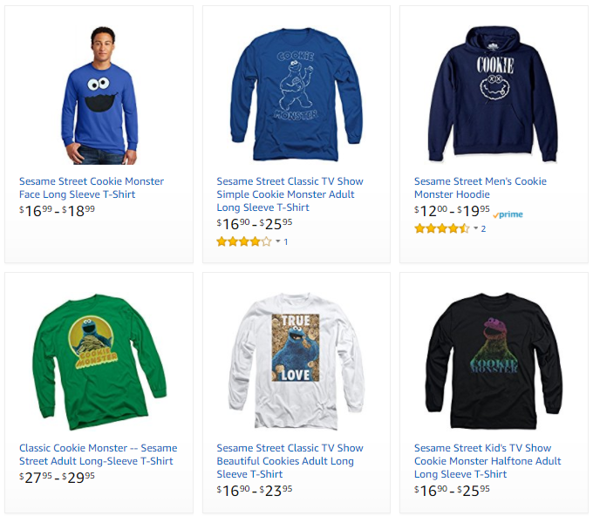
Motivation
How does the algorithm recognize:
?!
“long sleeve shirt men cookie monster”

Slide 3


Image Representation
Images are made of pixels, pixels values between 0 and 255.
Two common types:
“RED”
“GREEN”
Grayscale Image:
Single channel
Pixels values between 0-255
0: Darkest intensity
255: Brightest intensity
Color Image:
3 channels
Red, Green and Blue
RGB is a common representation
Pixels values between 0-255
”BLUE”

Slide 4
Image Representation
On a N x M grayscale image, Im (M: # of rows, N: # of columns)
Columns
Im [m, n] => m pixels down, n pixels right
112 | 103 | 121 | 99 | 76 | 45 | 44 | 61
98 | 123 | 131 | 132 | 74 | 49 | 45 | 66
157 | 158 | 165 | 134 | 78 | 51 | 52 | 59
145 | 143 | 134 | 131 | 124 | 121 | 125 | 123
141 | 141 | 143 | 92 | 91 | 80 | 83 | 88
142 | 145 | 151 | 93 | 88 | 86 | 85 | 79
223 | 221 | 225 | 226 | 221 | 235 | 222 | 231
209 | 201 | 214 | 216 | 226 | 237 | 231 | 230
Rows
Im [0, 0]
Im [M-1, N-1]

Slide 5
Color Images
On a N x M x 3 color image, Im
N: # of rows,
M: # of columns,
3 channels
112 | 103 | 121 | 99 | 76 | 45 | 44 | 61
98 | 123 | 131 | 132 | 74 | 49 | 45 | 66
157 | 158 | 165 | 134 | 78 | 51 | 52 | 59
145 | 143 | 134 | 131 | 124 | 121 | 125 | 23
141 | 141 | 143 | 92 | 91 | 80 | 83 | 88
142 | 145 | 151 | 93 | 88 | 86 | 85 | 79
223 | 221 | 225 | 226 | 221 | 235 | 222 | 231
209 | 201 | 214 | 216 | 226 | 237 | 231 | 230
98 | 91 | 76 | 75 | 65 | 65 | 54 | 71
98 | 123 | 131 | 132 | 74 | 49 | 45 | 76
157 | 158 | 165 | 134 | 78 | 51 | 52 | 72
145 | 143 | 134 | 131 | 124 | 121 | 125 | 22
141 | 141 | 143 | 92 | 91 | 80 | 83 | 21
142 | 145 | 151 | 93 | 88 | 86 | 85 | 27
223 | 221 | 225 | 226 | 221 | 235 | 222 | 67
209 | 201 | 214 | 216 | 226 | 237 | 231 | 66
112 | 103 | 121 | 99 | 76 | 45 | 44 | 61
98 | 123 | 131 | 132 | 74 | 49 | 45 | 66
157 | 158 | 165 | 134 | 78 | 51 | 52 | 59
145 | 143 | 134 | 131 | 124 | 121 | 125 | 123
141 | 141 | 143 | 92 | 91 | 80 | 83 | 88
142 | 145 | 151 | 93 | 88 | 86 | 85 | 79
223 | 221 | 225 | 226 | 221 | 235 | 222 | 231
209 | 201 | 214 | 216 | 226 | 237 | 231 | 230
Im [m, n, c] :
m pixels down,
n pixels right,
c : 0,1, or 2 (“R”, “G”, or “B”)
B
G
B
R
G
R

Slide 6
Color Images
On a N x M x 3 color image, Im
N: # of rows,
M: # of columns,
3 channels
112 | 103 | 121 | 99 | 76 | 45 | 44 | 61
98 | 123 | 131 | 132 | 74 | 49 | 45 | 66
157 | 158 | 165 | 134 | 78 | 51 | 52 | 59
145 | 143 | 134 | 131 | 124 | 121 | 125 | 23
141 | 141 | 143 | 92 | 91 | 80 | 83 | 88
142 | 145 | 151 | 93 | 88 | 86 | 85 | 79
223 | 221 | 225 | 226 | 221 | 235 | 222 | 31
209 | 201 | 214 | 216 | 226 | 237 | 231 | 30
98 | 91 | 76 | 75 | 65 | 65 | 54 | 71
98 | 123 | 131 | 132 | 74 | 49 | 45 | 76
157 | 158 | 165 | 134 | 78 | 51 | 52 | 72
145 | 143 | 134 | 131 | 124 | 121 | 125 | 22
141 | 141 | 143 | 92 | 91 | 80 | 83 | 21
142 | 145 | 151 | 93 | 88 | 86 | 85 | 27
223 | 221 | 225 | 226 | 221 | 235 | 222 | 67
209 | 201 | 214 | 216 | 226 | 237 | 231 | 66
43 | 103 | 121 | 129 | 176 | 145 | 144 | 162
8 | 123 | 131 | 132 | 74 | 49 | 45 | 166
157 | 158 | 165 | 134 | 78 | 51 | 52 | 159
145 | 143 | 134 | 131 | 124 | 121 | 125 | 123
141 | 141 | 143 | 92 | 91 | 80 | 83 | 255
142 | 145 | 151 | 93 | 88 | 86 | 85 | 77
223 | 221 | 225 | 226 | 221 | 235 | 222 | 221
209 | 201 | 214 | 216 | 226 | 237 | 231 | 230
Im [0, 0, 0] => 43
B
G
B
R
G
R

Slide 7
Color Images
On a N x M x 3 color image, Im
N: # of rows,
M: # of columns,
3 channels
112 | 103 | 121 | 99 | 76 | 45 | 44 | 61
98 | 123 | 131 | 132 | 74 | 49 | 45 | 66
157 | 158 | 165 | 134 | 78 | 51 | 52 | 59
145 | 143 | 134 | 131 | 124 | 121 | 125 | 23
141 | 141 | 143 | 92 | 91 | 80 | 83 | 88
142 | 145 | 151 | 93 | 88 | 86 | 85 | 79
223 | 221 | 225 | 226 | 221 | 235 | 222 | 31
209 | 201 | 214 | 216 | 226 | 237 | 231 | 30
98 | 91 | 76 | 75 | 65 | 65 | 54 | 71
98 | 123 | 131 | 132 | 74 | 49 | 45 | 76
157 | 158 | 165 | 134 | 78 | 51 | 52 | 72
145 | 143 | 134 | 131 | 124 | 121 | 125 | 22
141 | 141 | 143 | 92 | 91 | 80 | 83 | 21
142 | 145 | 151 | 93 | 88 | 86 | 85 | 27
223 | 221 | 225 | 226 | 221 | 235 | 222 | 67
209 | 201 | 214 | 216 | 226 | 237 | 231 | 66
43 | 103 | 121 | 129 | 176 | 145 | 144 | 162
8 | 123 | 131 | 132 | 74 | 49 | 45 | 166
157 | 158 | 165 | 134 | 78 | 51 | 52 | 159
145 | 143 | 134 | 131 | 124 | 121 | 125 | 123
141 | 141 | 143 | 92 | 91 | 80 | 83 | 255
142 | 145 | 151 | 93 | 88 | 86 | 85 | 77
223 | 221 | 225 | 226 | 221 | 235 | 222 | 221
209 | 201 | 214 | 216 | 226 | 237 | 231 | 230
Im [0, 0, 0] => 43
Im [0, 0, 1] => 98
B
G
B
R
G
R

Slide 8
Color Images
On a N x M x 3 color image, Im
N: # of rows,
M: # of columns,
3 channels
112 | 103 | 121 | 99 | 76 | 45 | 44 | 61
98 | 123 | 131 | 132 | 74 | 49 | 45 | 66
157 | 158 | 165 | 134 | 78 | 51 | 52 | 59
145 | 143 | 134 | 131 | 124 | 121 | 125 | 23
141 | 141 | 143 | 92 | 91 | 80 | 83 | 88
142 | 145 | 151 | 93 | 88 | 86 | 85 | 79
223 | 221 | 225 | 226 | 221 | 235 | 222 | 31
209 | 201 | 214 | 216 | 226 | 237 | 231 | 30
98 | 91 | 76 | 75 | 65 | 65 | 54 | 71
98 | 123 | 131 | 132 | 74 | 49 | 45 | 76
157 | 158 | 165 | 134 | 78 | 51 | 52 | 72
145 | 143 | 134 | 131 | 124 | 121 | 125 | 22
141 | 141 | 143 | 92 | 91 | 80 | 83 | 21
142 | 145 | 151 | 93 | 88 | 86 | 85 | 27
223 | 221 | 225 | 226 | 221 | 235 | 222 | 67
209 | 201 | 214 | 216 | 226 | 237 | 231 | 66
43 | 103 | 121 | 129 | 176 | 145 | 144 | 162
8 | 123 | 131 | 132 | 74 | 49 | 45 | 166
157 | 158 | 165 | 134 | 78 | 51 | 52 | 159
145 | 143 | 134 | 131 | 124 | 121 | 125 | 123
141 | 141 | 143 | 92 | 91 | 80 | 83 | 255
142 | 145 | 151 | 93 | 88 | 86 | 85 | 77
223 | 221 | 225 | 226 | 221 | 235 | 222 | 221
209 | 201 | 214 | 216 | 226 | 237 | 231 | 230
Im [0, 0, 0] => 43
Im [0, 0, 1] => 98
Im [N-1, M-1, 2] => 30
B
G
B
R
G
R

Slide 9
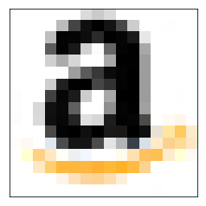
Color Images
E.g., on a 16x16 RGB image, Im :
Red
Blue
16 cells
Im [11, 5] = [120, 42, 151]
Green
16 cells

