Slide 1
Neuron & Activation Functions

Slide 2
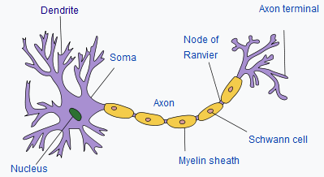
Artificial Neuron
Inspired by human brain with billions of connected neurons
Active?

Slide 3

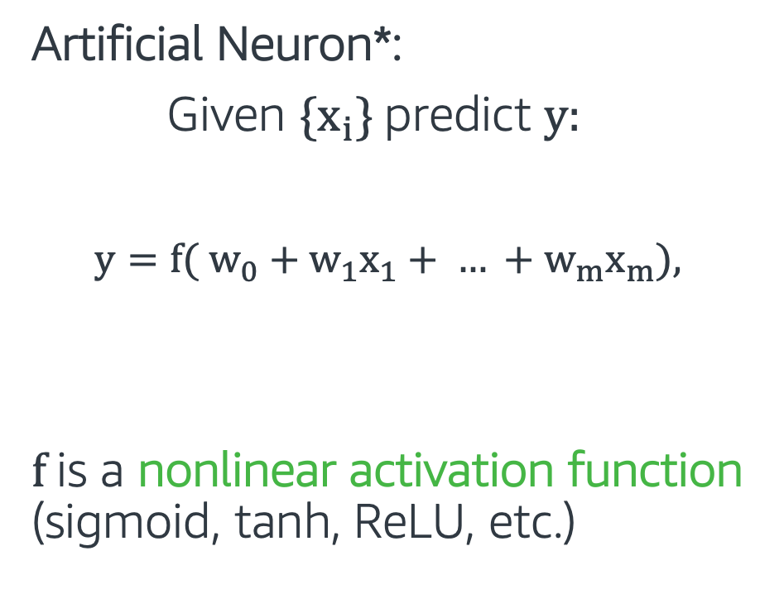
Artificial Neuron
Weights
Artificial Neuron*:
Given {$x_{i}$} predict $y$:
$y={f( w}_{0}+w_{1}x_{1}+ … +w_{m}x_{m}$),
f is a nonlinear activation function (sigmoid, tanh, ReLU, etc.)
w₀
w₁ x₁
x₁
x₂
w₂ x₂
Weighted
Sum
f
$$y$$
Weighted Sum
w₃ x₃
Output
x₃
Inputs
Activation
function

Slide 4
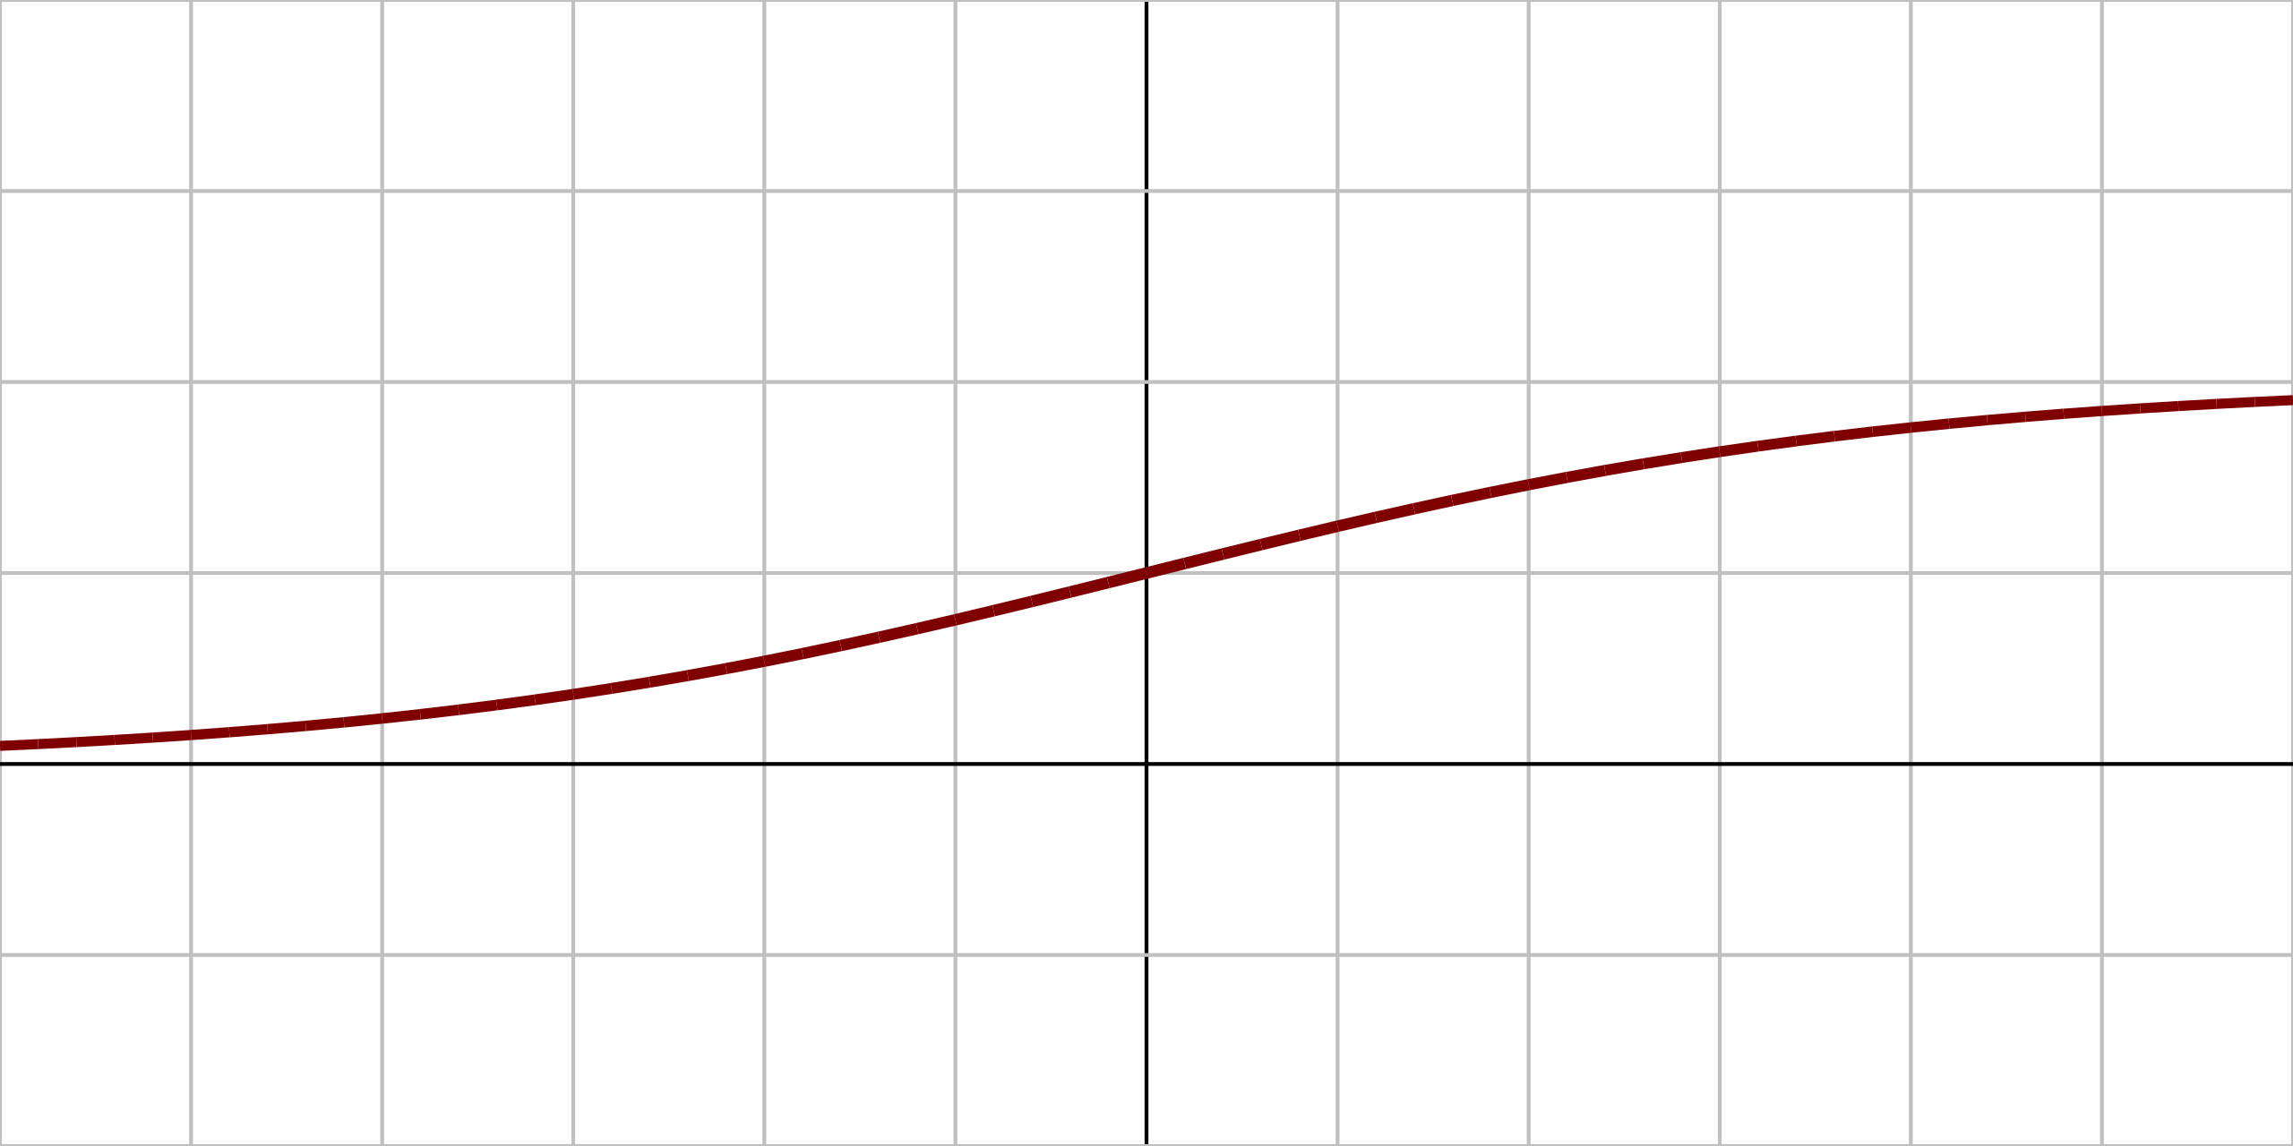
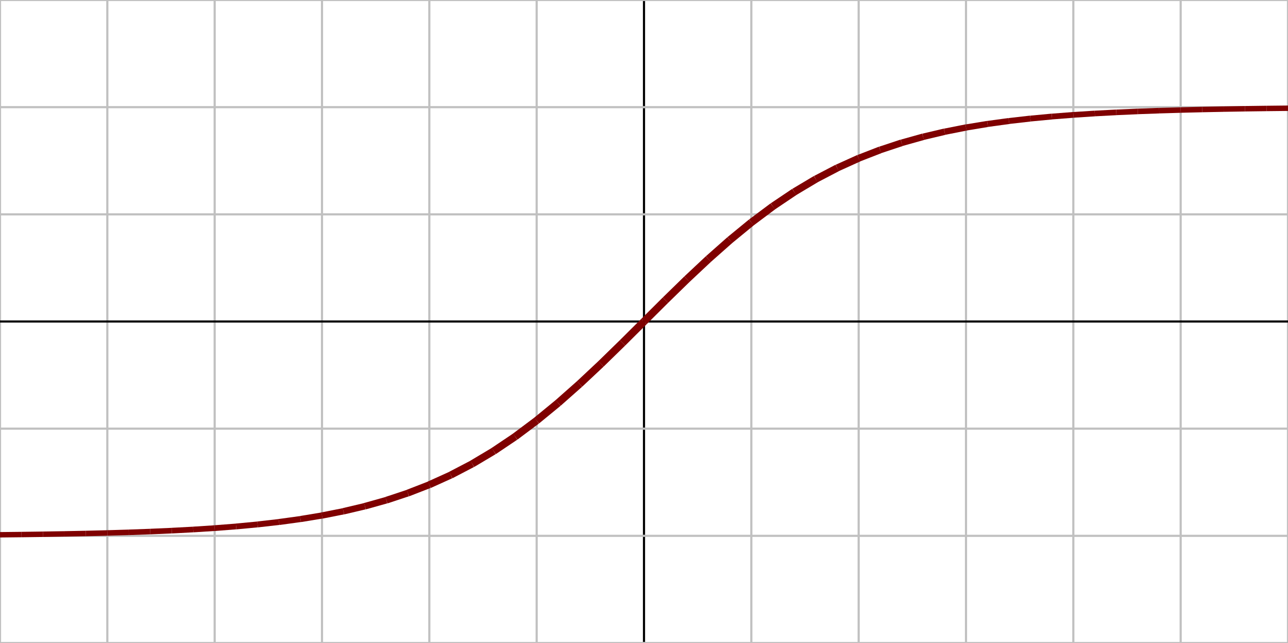
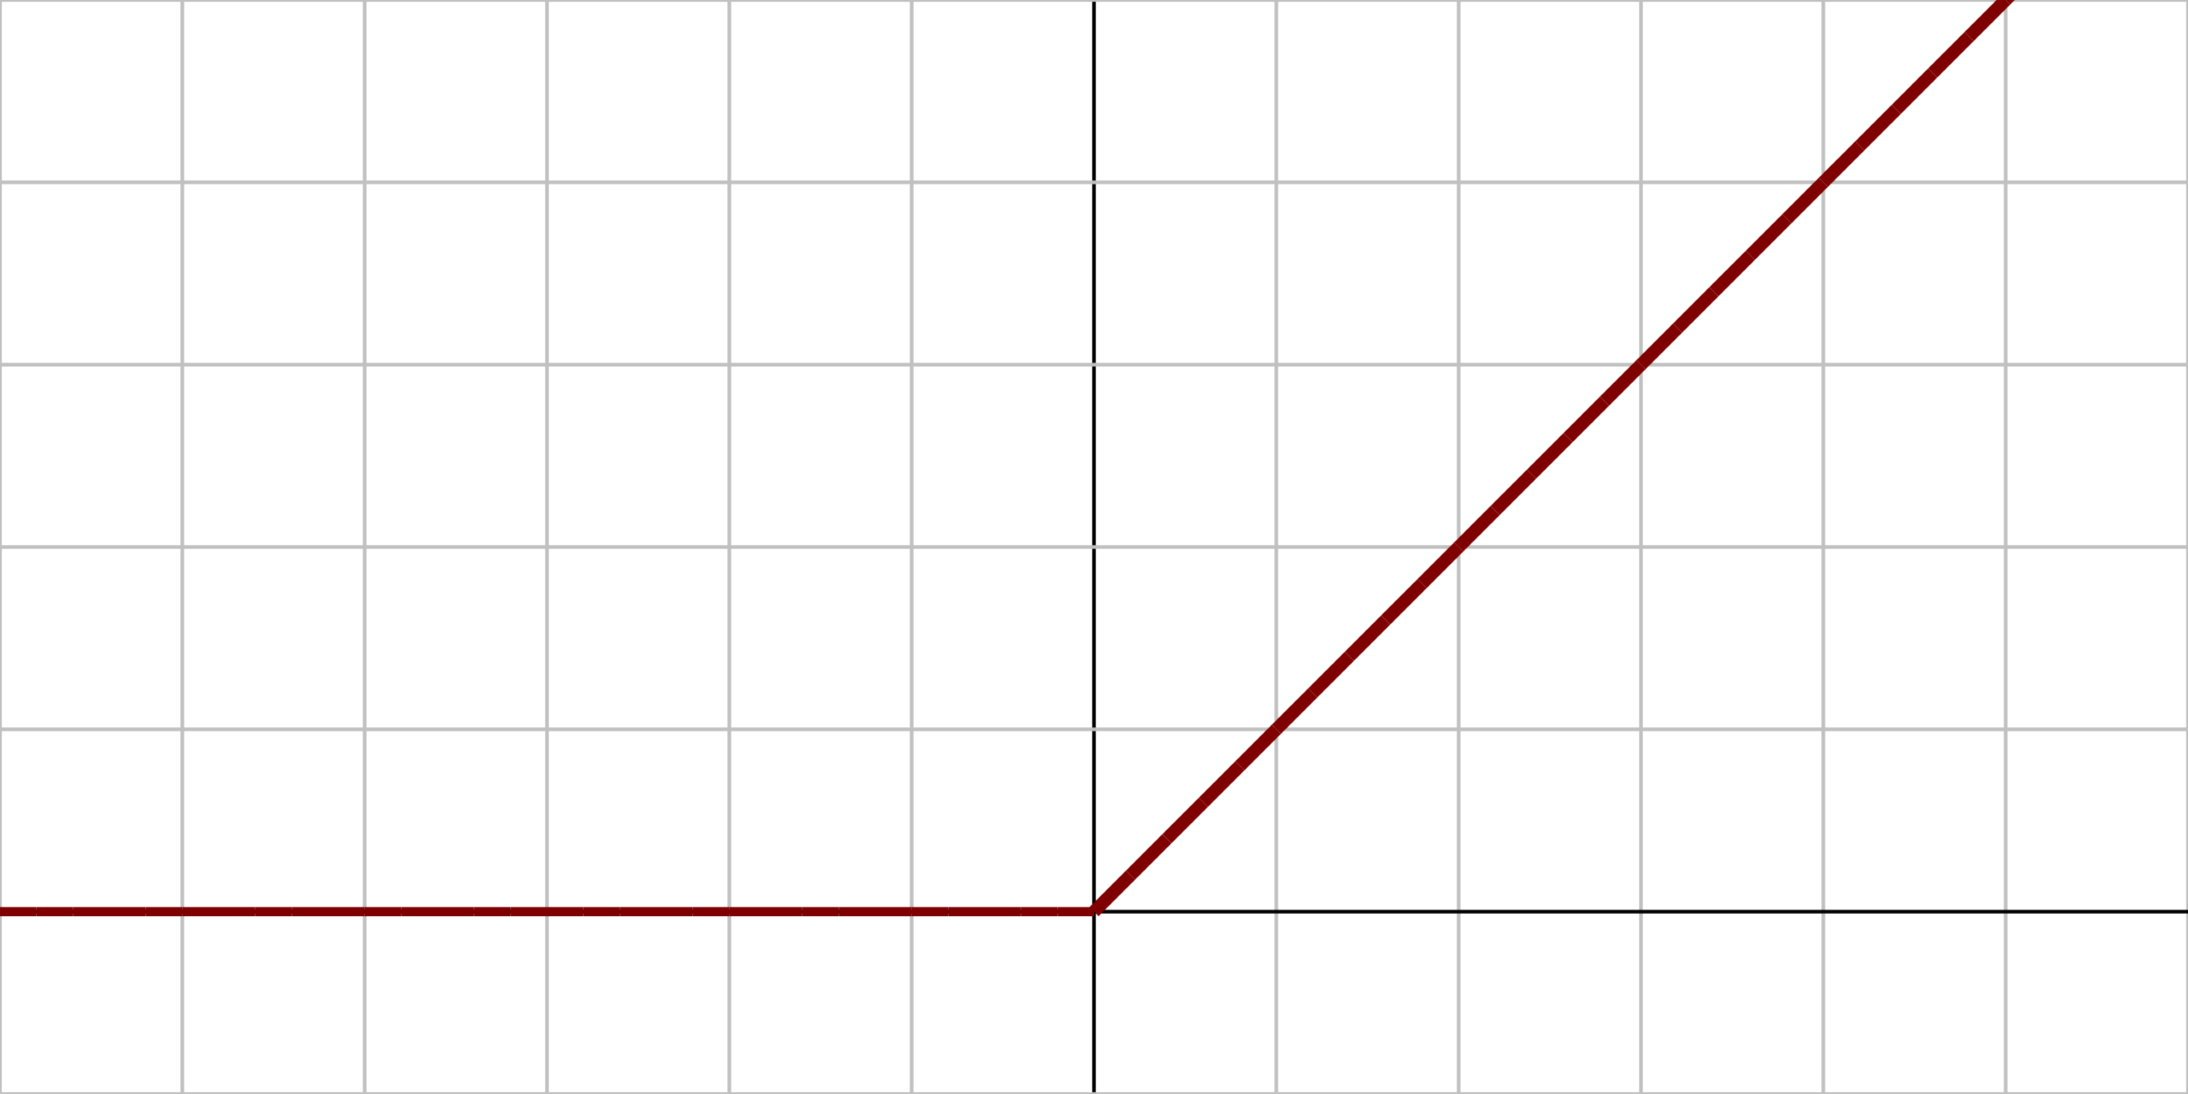
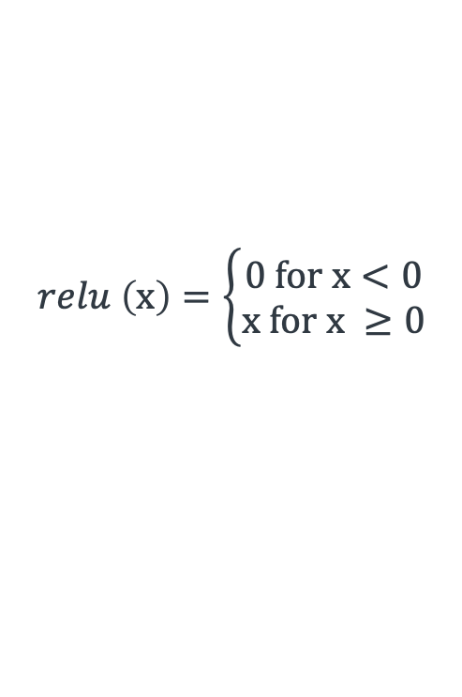
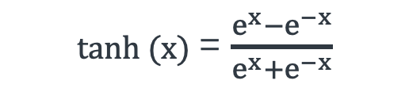

Activation Function
A differentiable operator at each neuron that transforms input signals to outputs, with adding non-linearity, e.g.,
Derivatives of these functions are also important for optimization.
Sigmoid
Hyperbolic tangent (tanh)
Rectified Linear Unit (ReLU)
1
sigmoid (x) = $\frac{1}{1+e^{−x}}$
0
x
1
tanh (x) = $\frac{e^{x}−e^{−x}}{e^{x}+e^{−x}}$
x
-1
$$relu \left(x\right)=\left\{\begin{aligned}0 for x<0 \\ x for x ≥0\end{aligned}\right.$$
0
x

Slide 5
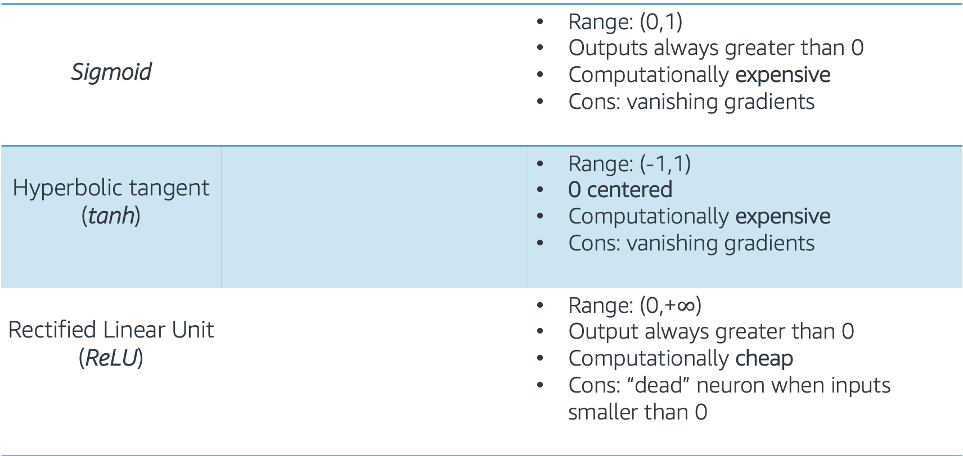
Activation Function
Sigmoid |  | Range: (0,1) Outputs always greater than 0 Computationally expensive Cons: vanishing gradients
Hyperbolic tangent (tanh) |  | Range: (-1,1) 0 centered Computationally expensive Cons: vanishing gradients
Rectified Linear Unit (ReLU) |  | Range: (0,+$∞$) Output always greater than 0 Computationally cheap Cons: “dead” neuron when inputs smaller than 0
1
0
x
1
x
-1
0
x

