Slide 1
Computer Vision Datasets

Slide 2
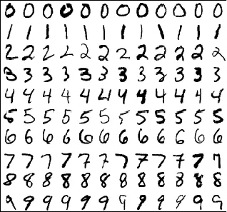
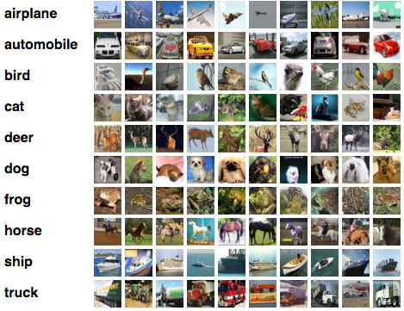
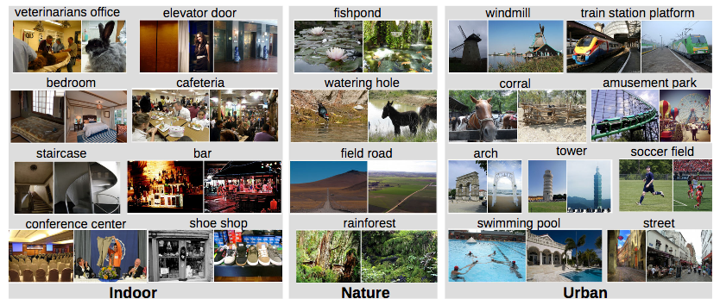
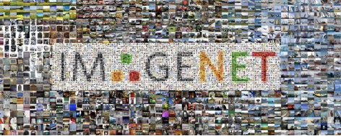
Computer Vision Dataset
A lot of publicly available CV datasets
In academia : for benchmarking
In industry: using as “source” dataset for transfer learning

Slide 3
MNIST*
A dataset of handwritten digits (0,1..,9) images
28 x 28 grayscale
Centered and scaled
50,000 training data
10,000 test data
* LeCun et al. (1999): The MNIST Dataset Of Handwritten Digits

Slide 4
Fashion–MNIST*
A drop-in replacement of MNIST
There are 10 classes; 28 x 28 grayscale; Centered and scaled
60,000 training data and10,000 test data
More details
* Xiao et al. (2017): Fashion-MNIST

Slide 5
CIFAR-10*
A tiny image dataset
32x32 color images
10 classes: 6,000 images per class
50000 training and 10000 test images
Not centered and scaled
More details
* Alex Krizhevsky, Vinod Nair, and Geoffrey Hinton

Slide 6
ImageNet Dataset*
One of the most popular image classification datasets
The largest CV dataset (at the time orders of magnitude)
22,000 distinct categories over 14M images
* J. Deng, et al. (2009) ImageNet: A Large-Scale Hierarchical Image Database

Slide 7
ImageNet Competition - ILSVRC*
ImageNet Large Scale Visual Recognition Challenge (ILSVRC):
A Image classification competition
ML models are trained to classify 1000 image categories
Training size: ~1.2 Million, Validation size: 50,000 and Test size: 150,000
Started since 2010; Dominated by deep neural networks since 2012
Alexnet, VGGNet and ResNet models that were trained on this dataset (Coming soon!)
* Olga Russakovsky, Jia Deng et al. (2015): ImageNet Large Scale Visual Recognition Challenge

Slide 8
Places Dataset*
More than 10M images with 400+ unique scene categories
5000 - 30,000 training images per class
Consistent with real-world frequencies of occurrence
* B. Zhou, et al. (2017): Places: A 10 Million Image Database for Scene Recognition

Slide 9
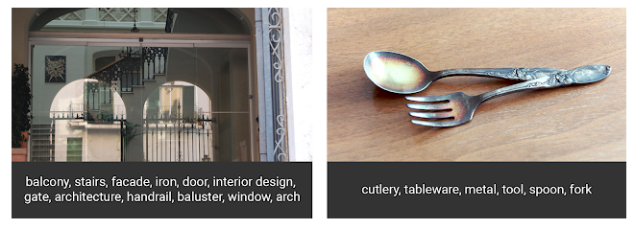
Open Images Dataset*
The largest existing dataset with object location annotations
About 9M images with over 6000 categories
16M bounding boxes for 600 object classes on 1.9M images
* https://github.com/openimages/dataset

Slide 10
A list of computer vision datasets
MNIST: http://yann.lecun.com/exdb/mnist/
Fashion – MNIST: https://github.com/zalandoresearch/fashion-mnist
CIFAR 10: https://www.cs.toronto.edu/~kriz/cifar.html
Open Images: https://github.com/openimages/dataset
Places: http://places2.csail.mit.edu/index.html
ImageNet: http://www.image-net.org/
Caltech 101: http://www.vision.caltech.edu/Image_Datasets/Caltech101/
Caltech 256: http://www.vision.caltech.edu/Image_Datasets/Caltech256/
Vehicle make and model rec. dataset: http://vmmrdb.cecsresearch.org/

