Slide 1
LeNet

Slide 2
Why CNN in 1990s?
Image Source: Wikipedia

Slide 3
LeNet*
A CNN trained to classify digits (MNIST Dataset)
* LeCun et al., (1998). Gradient-based learning applied to document recognition.

Slide 4
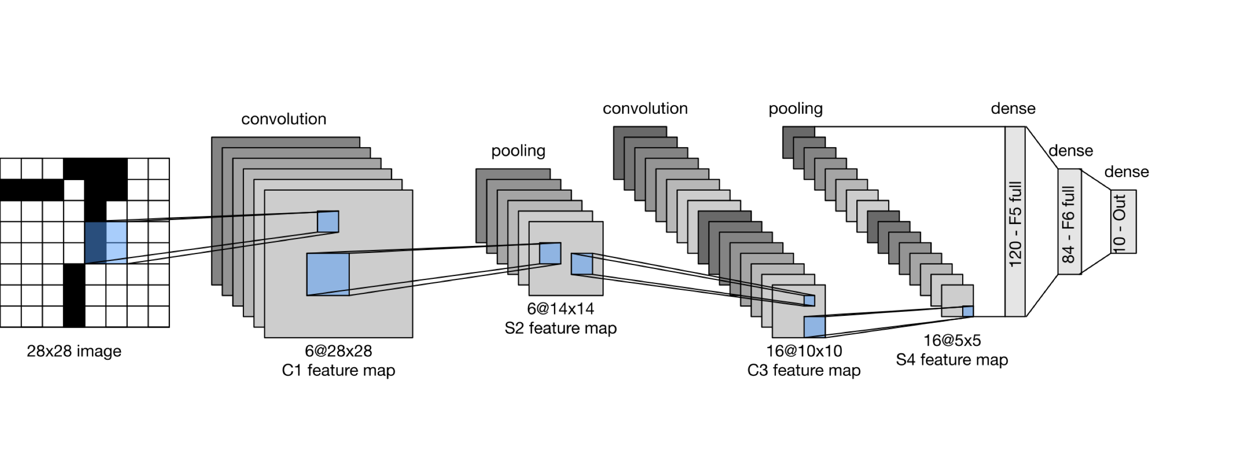
LeNet
LeNet is a five layer convolutional neural network.

Slide 5
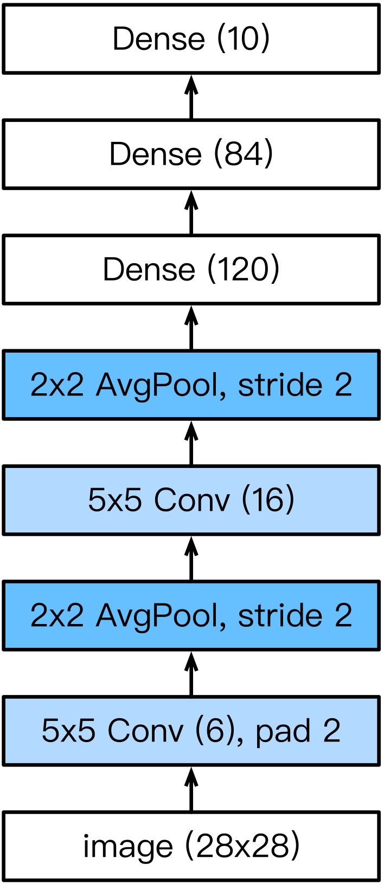
LeNet
LeNet consists of two parts:
Part I. Convolution Block
Convolution layer
to recognize the spatial patterns
5×5 kernel with sigmoid activation function
Average pooling layer
to reduce the dimensionality
Part II. Fully-connected layers Block
3 fully-connected (or Dense) layers

Slide 6
LeNet

