Slide 1
AlexNet

Slide 2
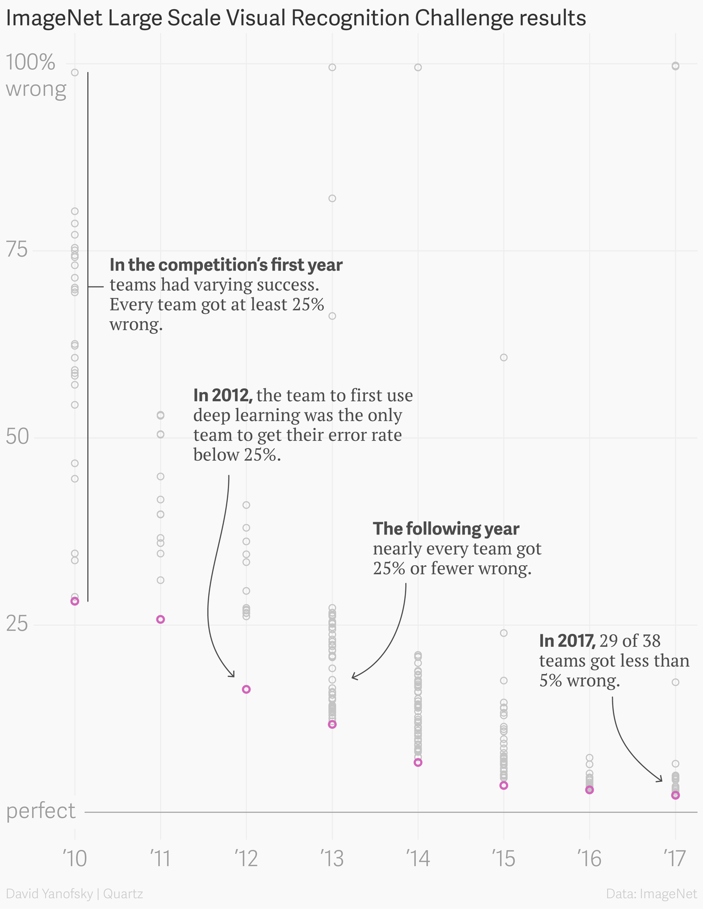

AlexNet*
Won ImageNet competition in 2012
One of the most influential papers in CV (cited 60,000+ times)
* Krizhevsky et al., (2012). Imagenet classification with deep convolutional neural networks.
Figure from here.

Slide 3
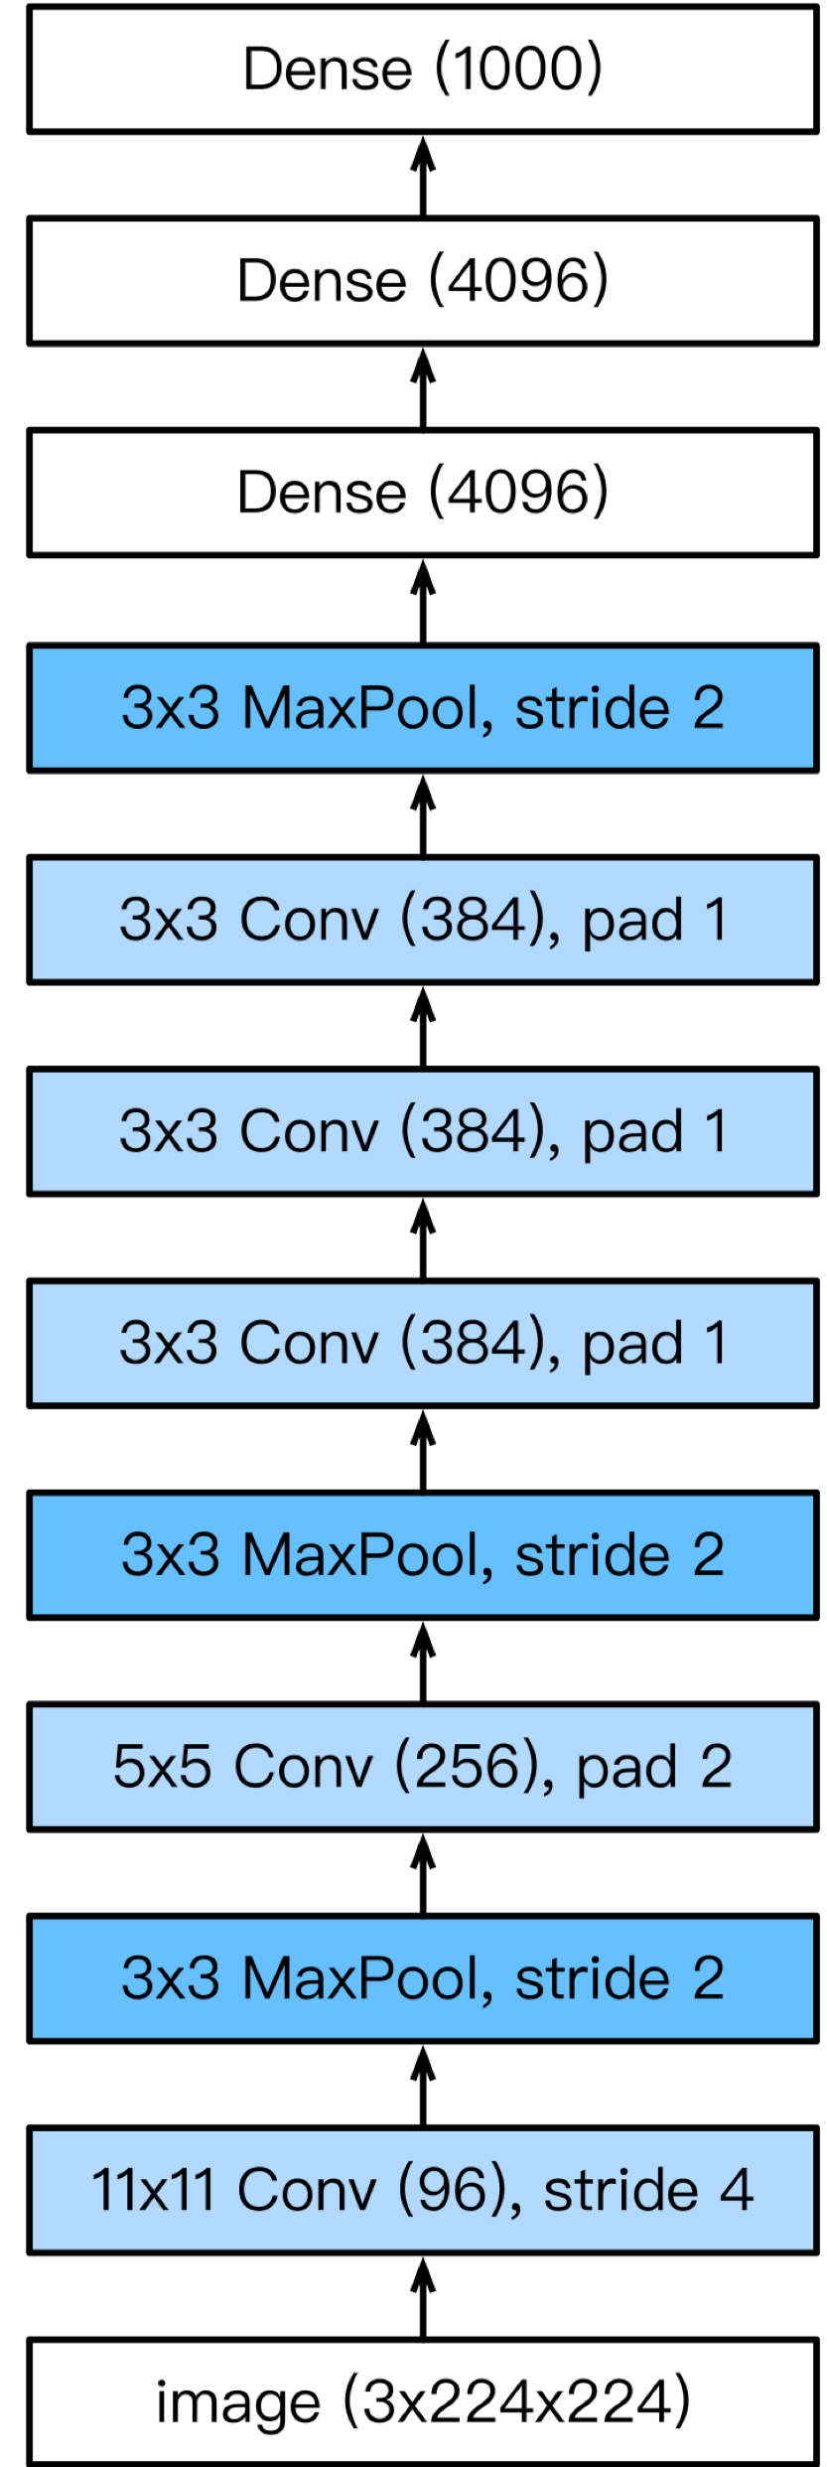
AlexNet*
Won ImageNet competition in 2012
One of the most influential papers in CV (cited 60,000+ times)
More complicated architecture than LeNet with more layers
* Krizhevsky et al., (2012). Imagenet classification with deep convolutional neural networks.
Figure from here.

Slide 4

AlexNet
Larger pooling size
Larger kernel size and stride
More output channels
Max pooling
LeNet
AlexNet

Slide 5
AlexNet
1000 classes output
Increased hidden size from 120 to 4096, with Dropout
LeNet
AlexNet

Slide 6
Dropout
A regularization technique to prevent overfitting
Randomly removes some nodes with a fixed probability during the training
More details.

Slide 7
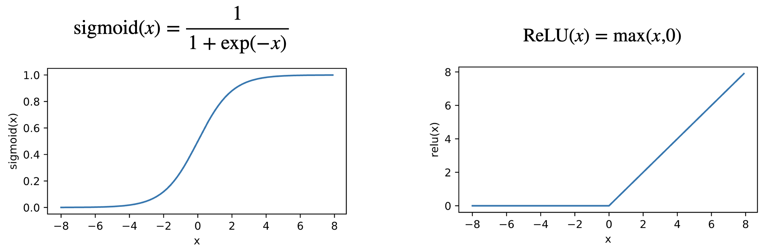
AlexNet - Tricks
Change activation function from sigmoid to ReLU

Slide 8
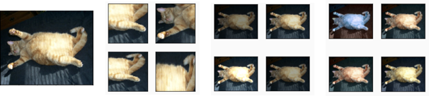
AlexNet - Tricks
2. Data augmentation
Random crop
Change brightness
Change hue

Slide 9
AlexNet Summary
A larger and deeper “LeNet”
Dropout, ReLU and preprocessing were the other key steps in achieving excellent performance
~62 Million parameters

