Slide 1
Transfer Learning

Slide 2
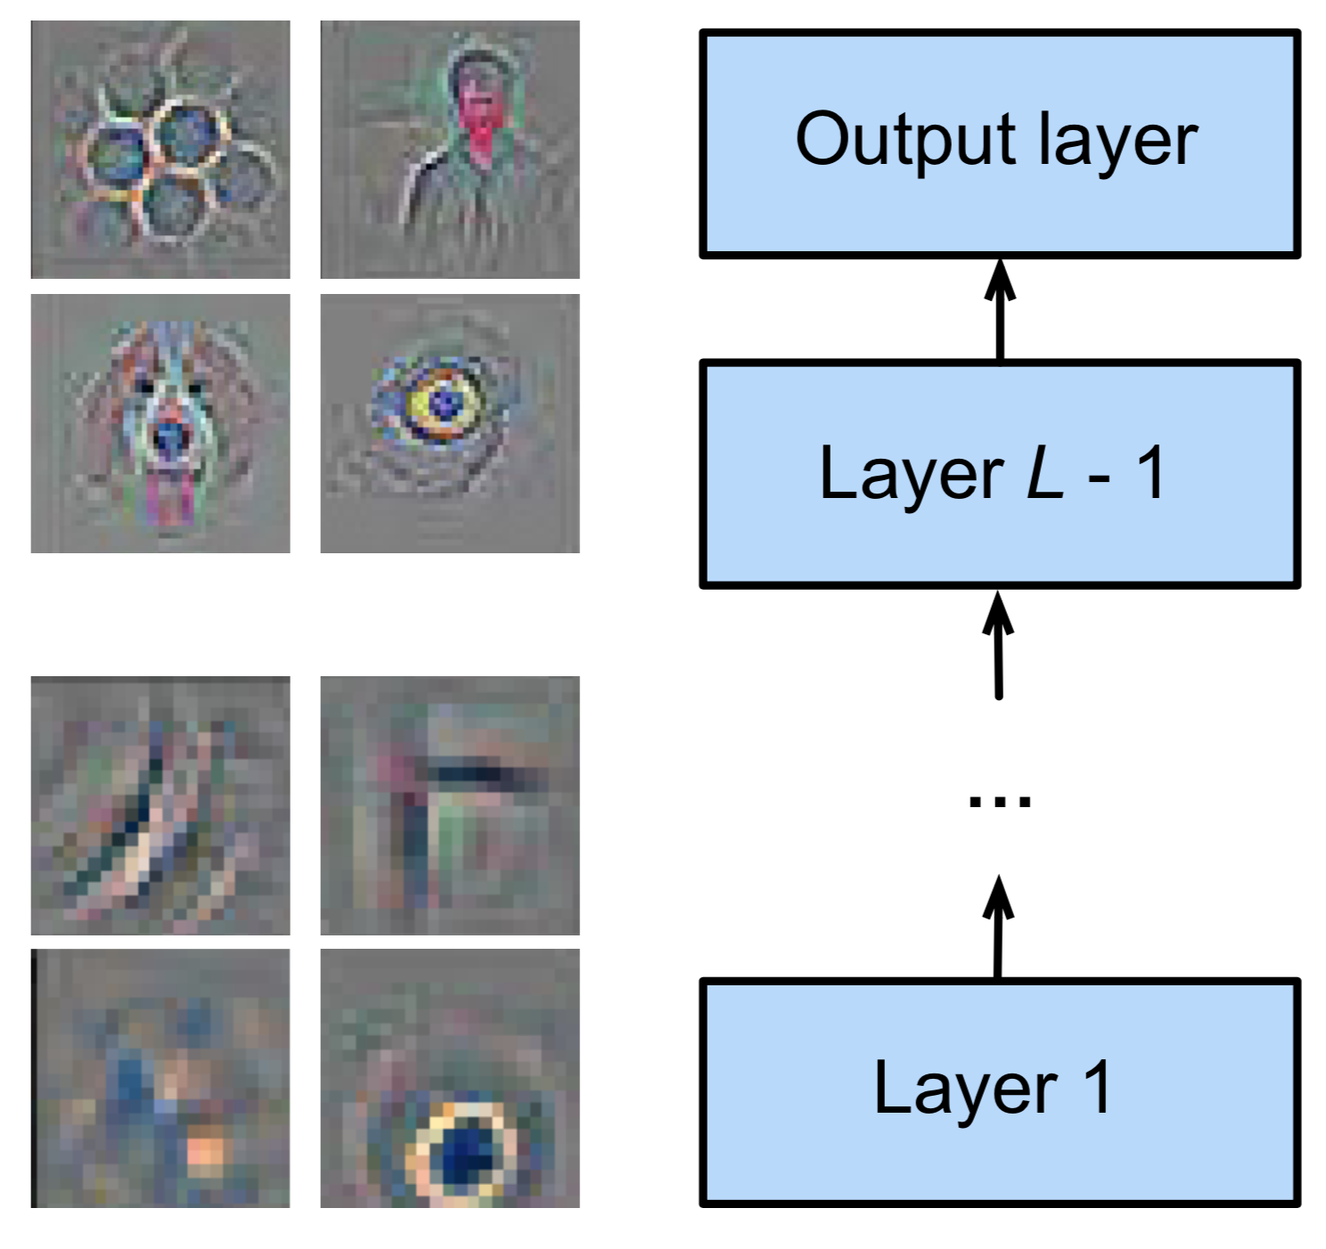
Motivation
Transfer Learning (or Fine-tuning)
Using a pre-trained network and adjust one or more layer(s)
Hierarchical feature representations
Low-level features are universal
High-level features are more related to objects in the dataset

Slide 3
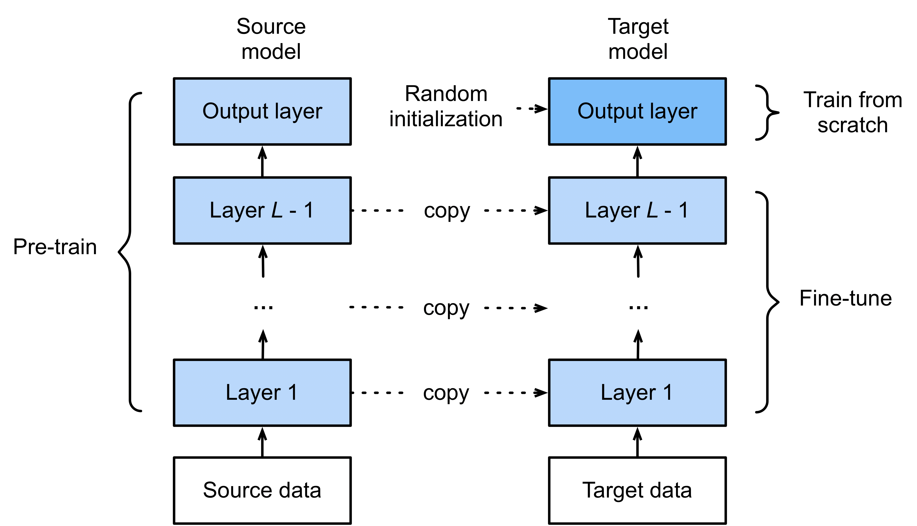
Transfer Learning
Four steps:
Pretrain a base network on the source data set.

Slide 4
Transfer Learning
Four steps:
2. Create a target neural network architecture and copy the trained parameters.

Slide 5
Transfer Learning
Four steps:
3. Create and random initialize the output layer.

Slide 6
Transfer Learning
Four steps:
4. Train from scratch and finetune.

Slide 7
Transfer Learning Tricks
Training (and/or finetuning) with strong regularization:
Smaller learning rate
Fewer epochs
Using more diverse source dataset
Knowing what pretrained models to use

Slide 8

GluonCV Model Zoo
Pretraining is expensive:
The Gluon CV Model Zoo contains 200+ pretrained CNNs
Image Classification
Object Detection
Semantic Segmentation
…

Slide 9
Utilizing Pre-trained Models
There are multiple ways to use a pre-trained model:
Using as a fixed pre-trained model (no training)
Training only the last layer (i.e., freezing the other pre-trained feature layers)
Fine-tuning the layers end-to-end
Training from scratch using the target dataset
INCREASING COST

Slide 10
Transfer Learning - Hands on
The exercise covers the following topics we learned today:
Using pre-trained AlexNet architecture in Gluon
Training it on the example dataset
Follow through this notebook:
MLA-CV-DAY2-Transfer-Learning.ipynb
Run the notebook from your SageMaker instance.

