Slide 1
U-Net

Slide 2
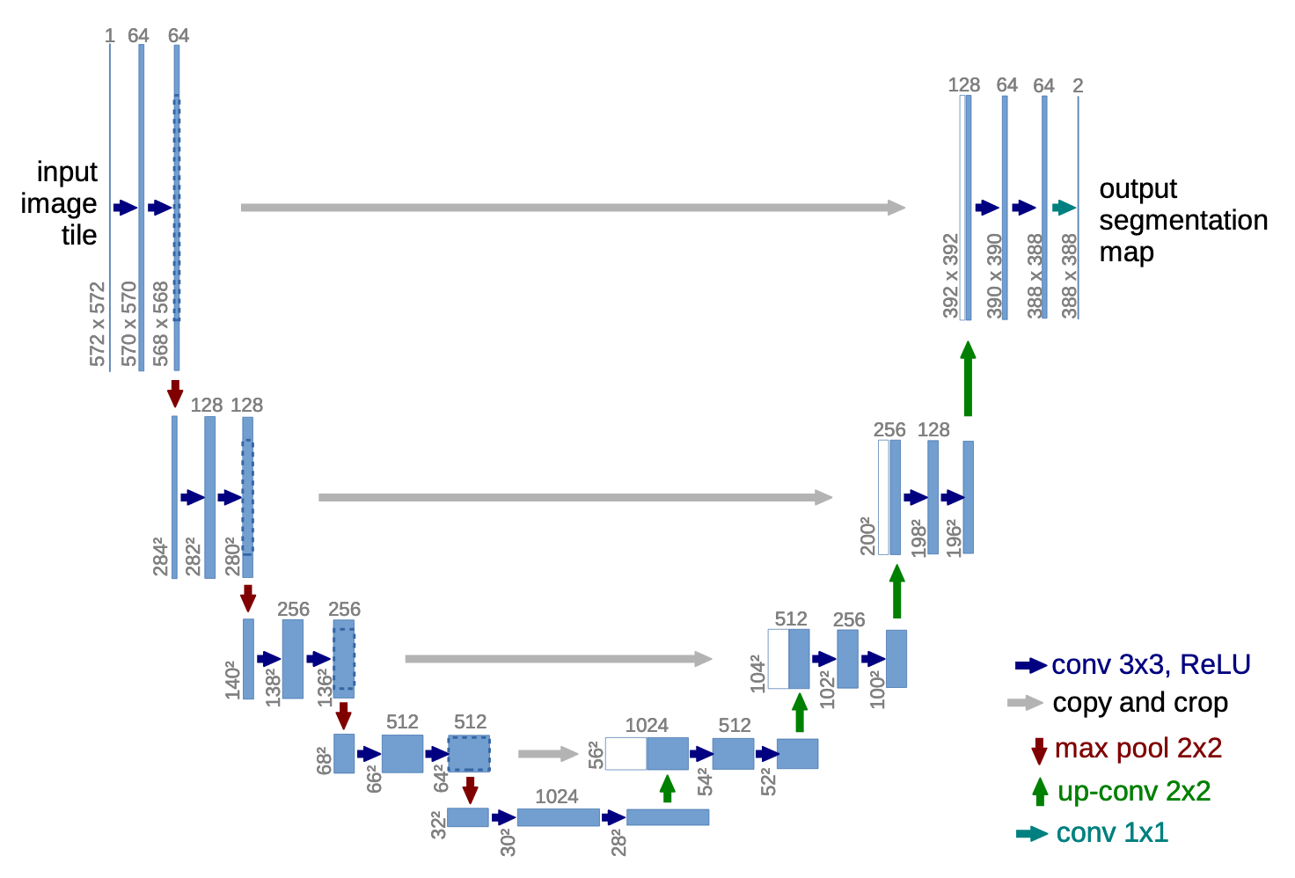
U-Net*
CNN for biomedical image segmentation.
Symmetric U shape:
Convolutions + Poolings
Using “up-convolutions” on upsampled layers
* Ronneberger, O., Fischer, P., Brox, T. (2015)

Slide 3
U-Net
CNN for biomedical image segmentation.
Using one-to-one skip-connections
Creating a (almost) symmetric architecture
Can learn more precise pixel predictions

Slide 4
U-Net VS FCN
FCN | U-NET
Only one upsampling layer, with skip architecture (FCN-16s, FCN-8s, etc) | Multiple upsampling layers, with skip connections
Bilinear interpolation for upsampling | Learnable weight filters instead of fixed interpolation technique

Slide 5
MLA CV Thank you!

