Slide 1
ResNet

Slide 2
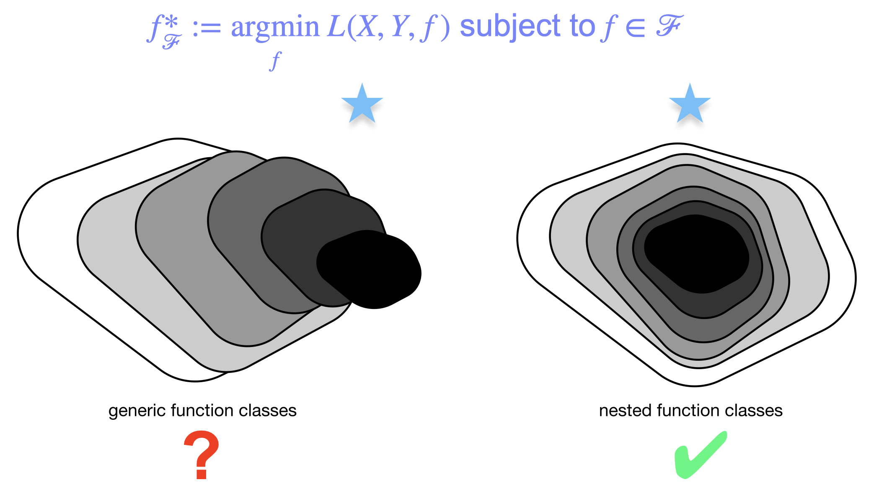
Motivation
Does adding layers improve model performance?
Theoretically, …
Loss
# Layers

Slide 3
Motivation
Does adding layers improve model performance?
Degradation: with the network depth increasing, loss rebounds
Loss
# Layers

Slide 4
Motivation
How to address degradation?
A deep residual learning framework – ResNet*
* He et al., 2015

Slide 5
Residual Blocks Idea
Regular Block
Residual Block
Adding a “short cut”
Also called a “skip connection”

Slide 6
Residual Blocks Idea
Regular Block
Residual Block
Skip connections
“Taylor expansion” style parametrization
Work as a ”refinement step"

Slide 7
ResNet Blocks
Regular ResNet Block

Slide 8
ResNet Blocks
Regular ResNet Block
ResNet Block with
1x1 convolution

Slide 9
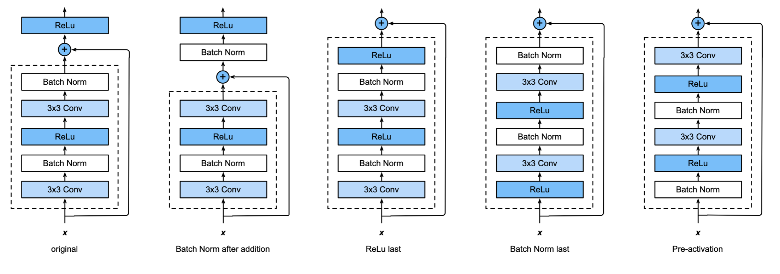
ResNet Blocks
Try different permutations within ResNet blocks.

Slide 10
ResNet
ResNet18 : 18 convolution layers

Slide 11
ResNet
ResNet has varied length by repeating number of Residual blocks
e.g., ResNet 18, ResNet 34, ResNet 50, ResNet 101, ResNet 152
The deeper the model, the higher accuracy it can achieve
More Details.

Slide 12
Parameter Size & Layers
 | # of Parameters | # of Convolutional Layers | # of Dense Layers
LeNet | 60 k | 2 | 3
AlexNet | 62 M | 5 | 3
VGG16 | 138 M | 13 | 3
VGG19 | 144 M | 16 | 3
ResNet50 | 25.6 M | 49 | 1
ResNet101 | 44.5 M | 100* | 1
ResNet152 | 60.3 M | 151* | 1
* Not include ”1x1 conv skip connection”

Slide 13
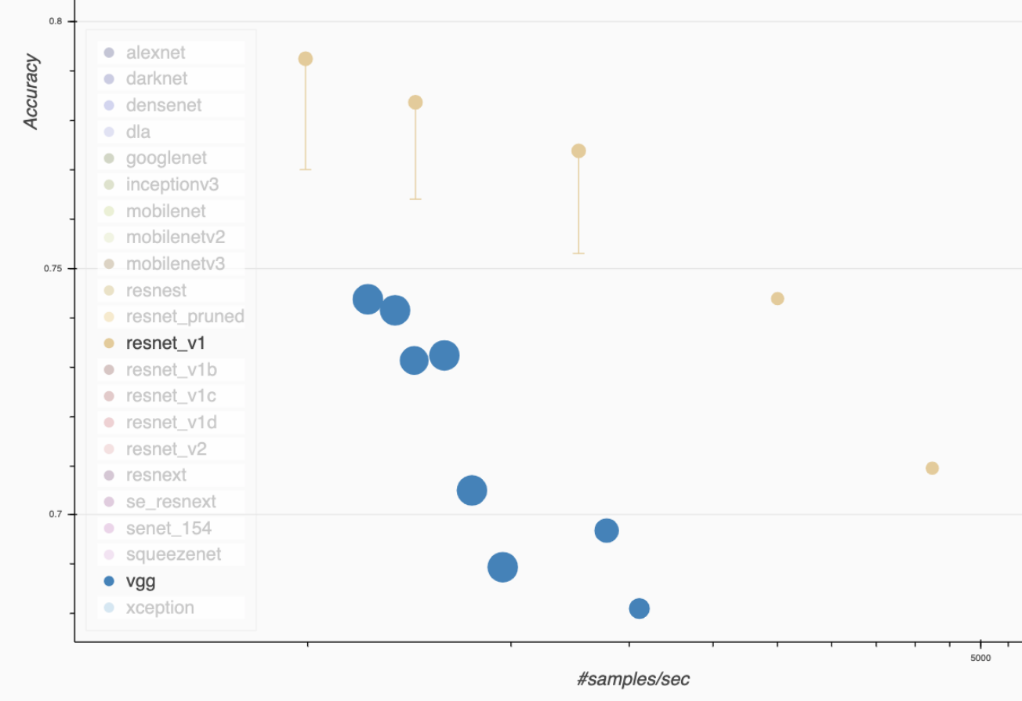
ResNet v.s. VGG
Inference Throughputs vs. Validation Accuracy of ImageNet pre-trained models
Note: The size of dot is proportional to the device memory requirement
ResNets
VGGs
https://gluon-cv.mxnet.io/model_zoo/classification.html

Slide 14
ResNet - Hands on
In this exercise, we use pre-trained ResNet model in Gluon for image classification.
Follow through this notebook: MLA-CV-DAY3-ResNet.ipynb
Run the notebook from your SageMaker instance.

