Slide 1
YOLO

Slide 2
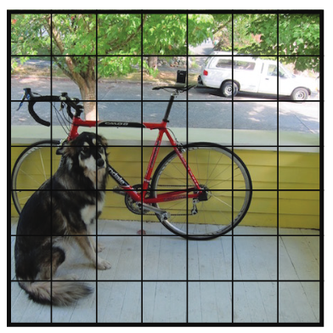
YOLO (You Only Look Once)
YOLO* processes a image all at once.
We will divide the image into “S x S” grid cells.
Assume, dividing into 7x7 cells
S
S
* Redmon, J. et al., You only look once: Unified, real-time object detection. In: CVPR. (2016)

Slide 3
YOLO (You Only Look Once)
Each cell applies a fixed number of bounding boxes.
If 2 boxes here, then total number of boxes per image: 7x7x2 = 98
7
7

Slide 4
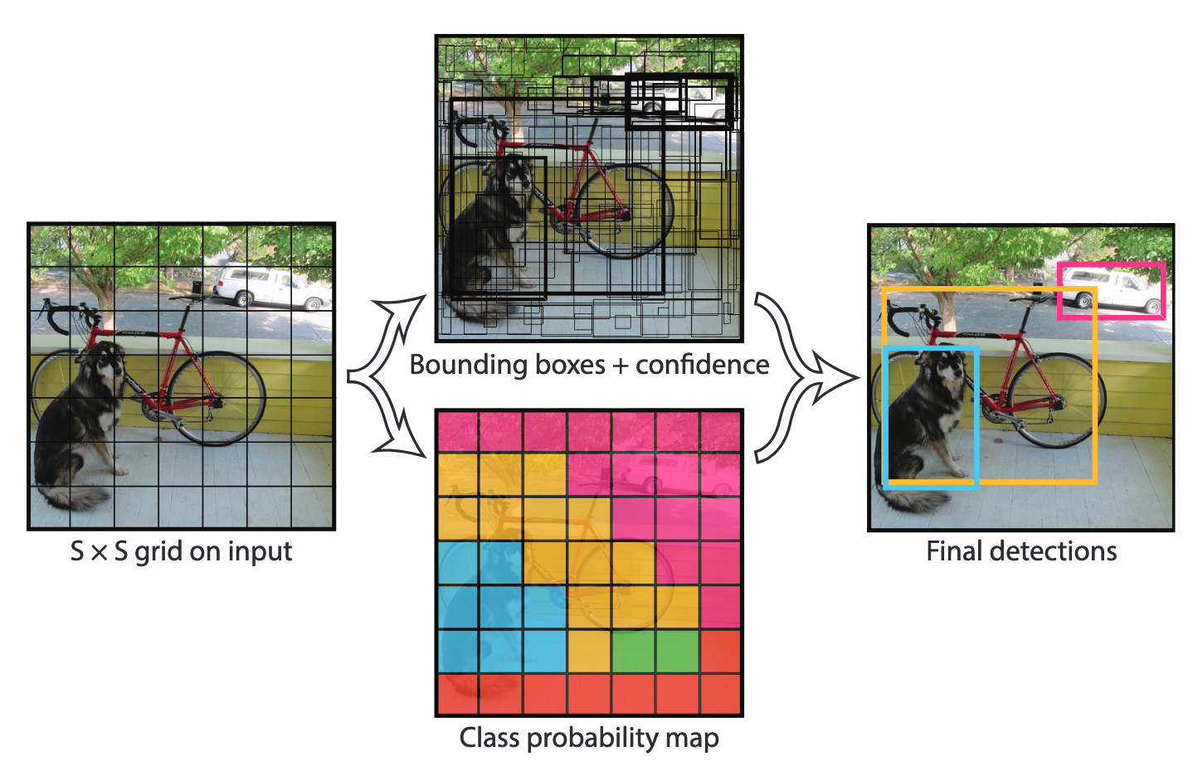
YOLO (You Only Look Once)
Two folds:
1. Each bounding box outputs 5 components:
(b_{x} , b_{y}): Box center coordinates
b_{h ,} b_{w} : Box height and width
P_{C} : The probability of the bounding box enclosing any object
[b_{x} , b_{y} , b_{h} , b_{w} , P_{C}]

Slide 5
YOLO (You Only Look Once)
Two folds:
2. Each grid cell outputs probabilities of belonging to each class
e.g., 3 classes:
[dog, bike, car]
c₁: P {dog}
c₂: P {bike}
c₃: P {car}

Slide 6
YOLO (You Only Look Once)
Output shape of YOLO:
7 X 7 x ( 2 x 5 + 20) = 7x7x30
2 boxes per cell
20 object classes:
[c₁ , c₂ , …, c₂₀]
Bounding box values:
[P_{C} , b_{x} , b_{y} , b_{h} , b_{w} ]

Slide 7
YOLO (You Only Look Once)
Drop bounding boxes with low confidence (of being an object).
For each class, apply Non-max suppression to output final results.
[P_{C} , b_{x} , b_{y} , b_{h} , b_{w} ]

Slide 8
YOLO (You Only Look Once)
Pros:
Simple and fast detection method
Can run on real-time, good for videos
Cons:
Strong spatial constraints on bounding boxes
Small objects may be missed, e.g. flock of birds
Difficult to generalize to other aspect ratios

Slide 9

YOLO - Hands on
In this exercise, we use pre-trained YOLO detector in Gluon for object detection.
Follow through this notebook: MLA-CV-DAY3-YOLO.ipynb
Run the notebook from your SageMaker instance.

