Slide 1
Semantic Segmentation

Slide 2
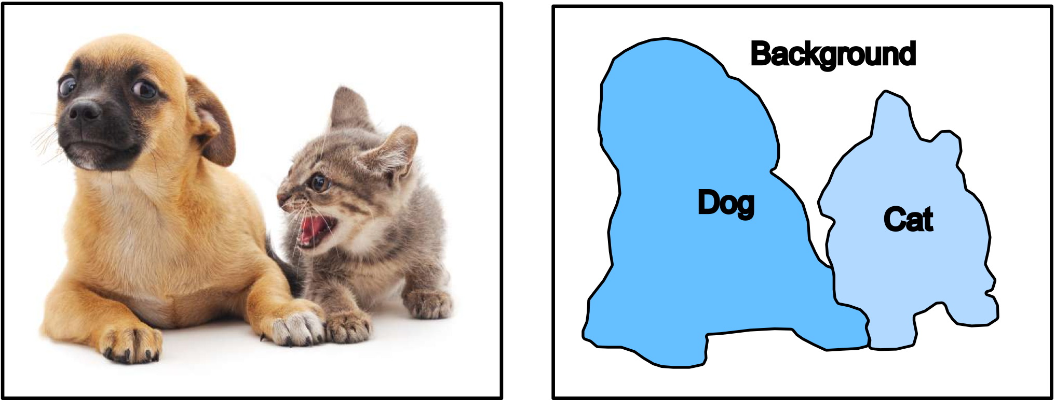
Semantic Segmentation
Semantic Segmentation divides the image into different semantic regions by transforming image pixels to pixel categories.

Slide 3
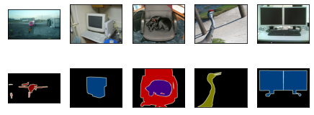
Pascal Visual Object Classes (VOC)
Pascal VOC is a benchmarking dataset for segmentation tasks.
~10k images with segmentation classes
20+1 classes: (‘background’,) 'aeroplane', 'bicycle', 'bird', 'boat', 'person’, etc.
Sample segmentation images (background is black)

Slide 4
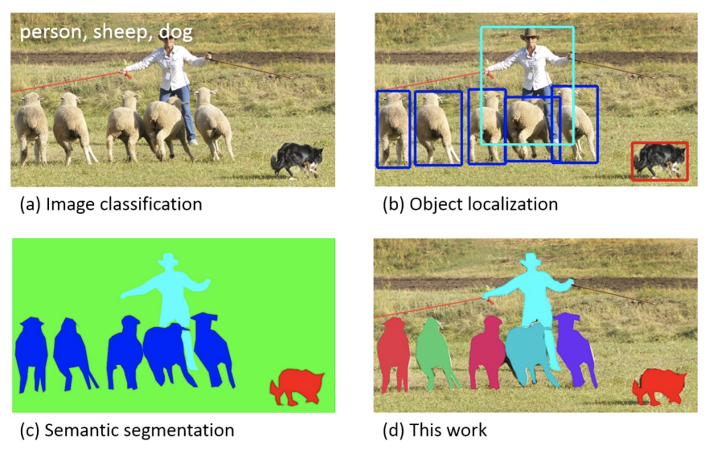
COCO
COCO (Common Objects in Context) is a large-scale object detection, segmentation, and captioning dataset:
330K images (>200K labeled)
1.5 million object instances
80 object categories

Slide 5
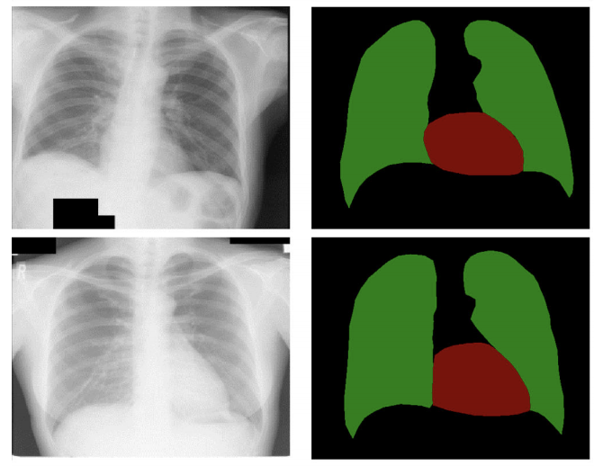
Semantic Segmentation Applications
https://www.researchgate.net/publication/318511415_Medical_image_semantic_segmentation_based_on_deep_learning
https://gluon-cv.mxnet.io/

