Slide 1
Fully Convolutional Neural Network (FCN)

Slide 2
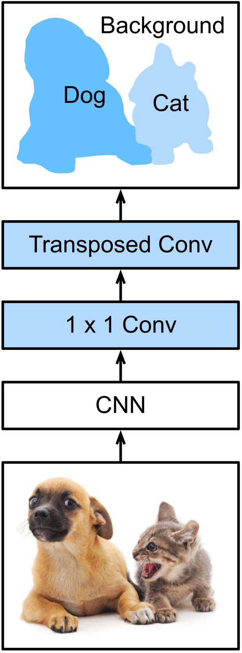
Fully Convolutional Neural Network (FCN)*
Two folds:
CNN shrinks features to shape of ”1x1xchannel“
Upsampling outputs the semantic segmentation mask
E.g., Transposed Convolution
Applying softmax at the end for pixel classification
Pixel classes (softmax)
Size: N x M
Upsampling by 32
Feature pooling
Size: (N/32 x M/32)
Feature map
Size: (N/32 x M/32 x C)
Input image
Size: NxMx3
* Long, J., Shelhamer, E., & Darrell, T. (2015).

Slide 3
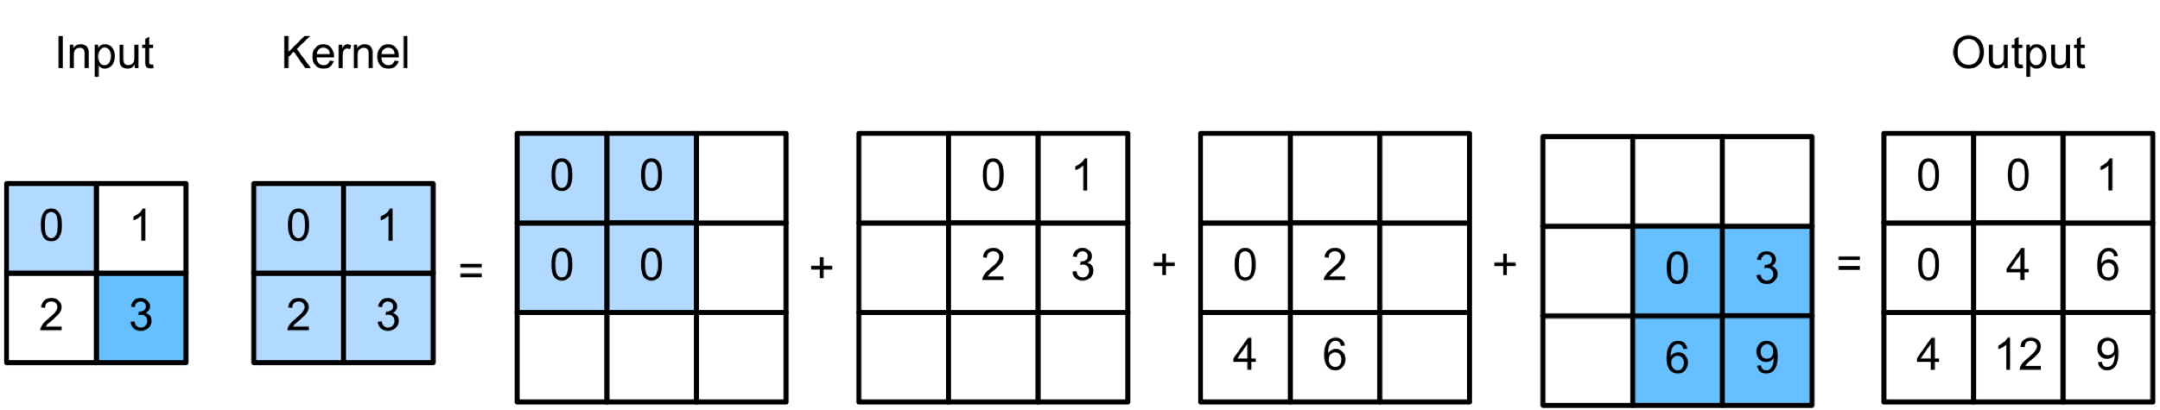
Transposed Convolution
Also called as Upconvolution or Deconvolution
Upsampling feature maps to match the original image size, e.g.,
Kernel weights are
trained through Gradient Descent
initialized with Bilinear Interpolation

Slide 4
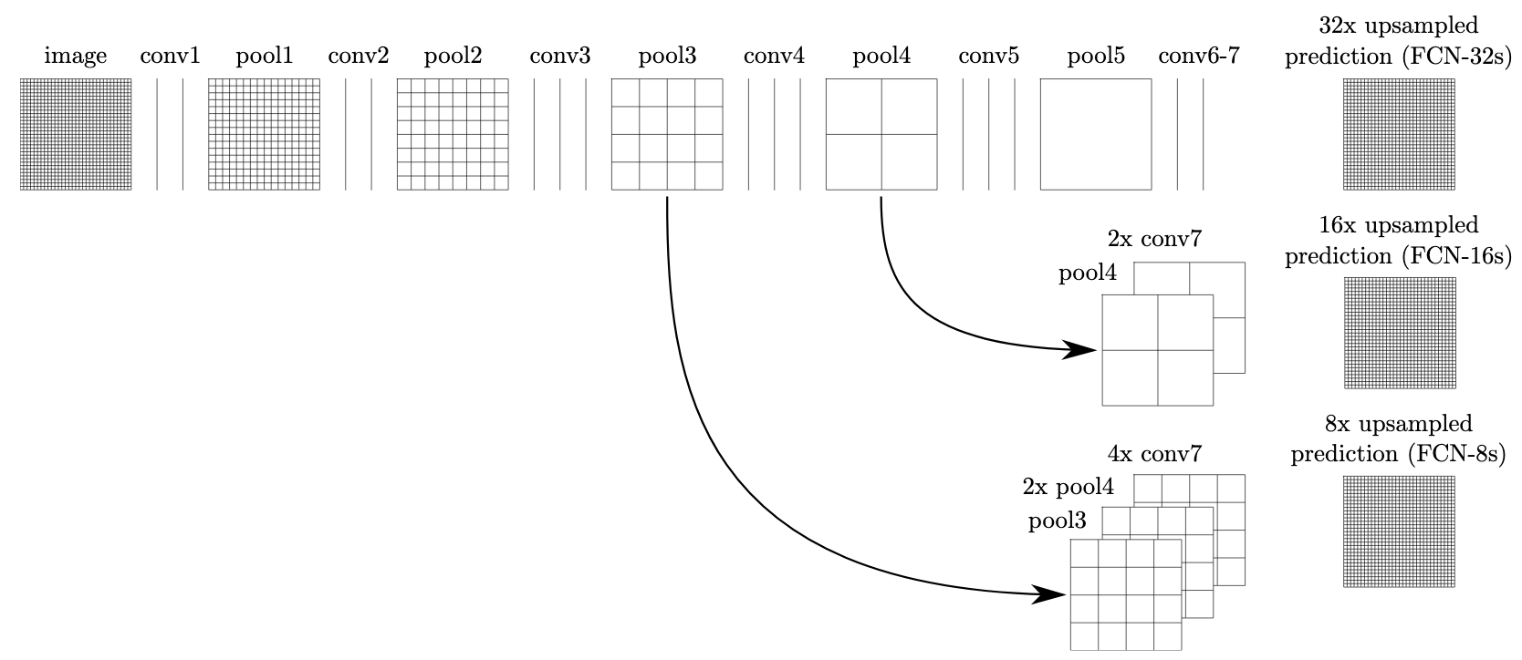
Skip Architecture
Refining the predictions by combining features from earlier layers
FCN-32, FCN-16 and FCN-8
224x224
112x112
56x56
28x28
14x14
7x7

Slide 5
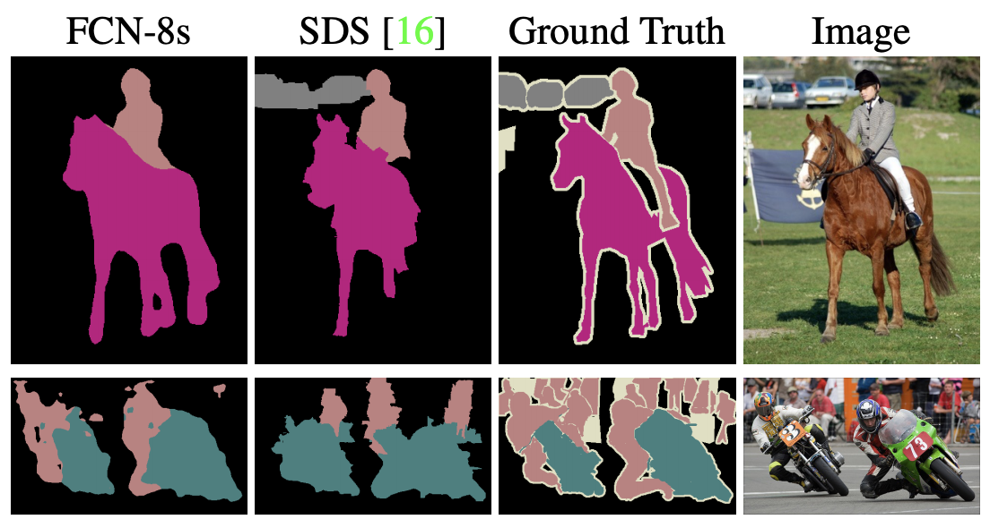
FCN Results on VOC
Common evaluation metrics: Pixel accuracy, mean IoU
Some results from VOC:
More Details.

