Slide 1
modulo1_Analisis
File created on: 02/11/2022 08:04:24 p. m.

Slide 2
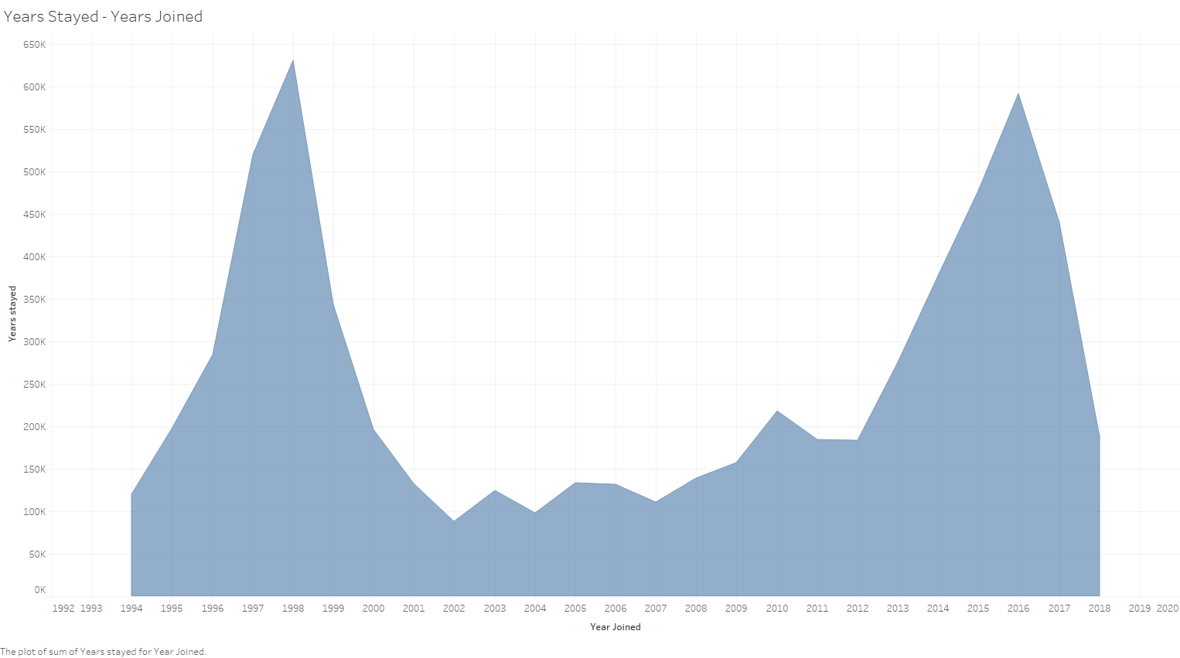

Slide 3


Slide 4


Slide 5


Slide 6
