Slide 1
Lab1 Intro Intro to Partial Reconfiguration Flow
Zynq
Vivado 2015.2 Version

Slide 2
Outline
Objectives
The Design
Methodology
Summary

Slide 3
Objectives
After going through this lab, you should be able to:
Use Tcl script to generate a Vivado IPI design, create a wrapper file from it, add the static logic files and generate the design checkpoint
Use Vivado’s bottom-up methodology to synthesize the necessary RMs
Floorplan the design
Add the desired RMs
Create multiple configurations
Implement the design and generate full and partial bitstreams for various configurations
Download bitstreams to demonstrate a working partial reconfigurable design

Slide 4
Outline
Objectives
The Design
Methodology
Summary

Slide 5
The Design
Source files consist of HDL (Verilog) files
Two RPs, each with two RMs
One RP performs addition and subtraction option
Other RP performs right- and left- shifting function as evident from LEDs display

Slide 6
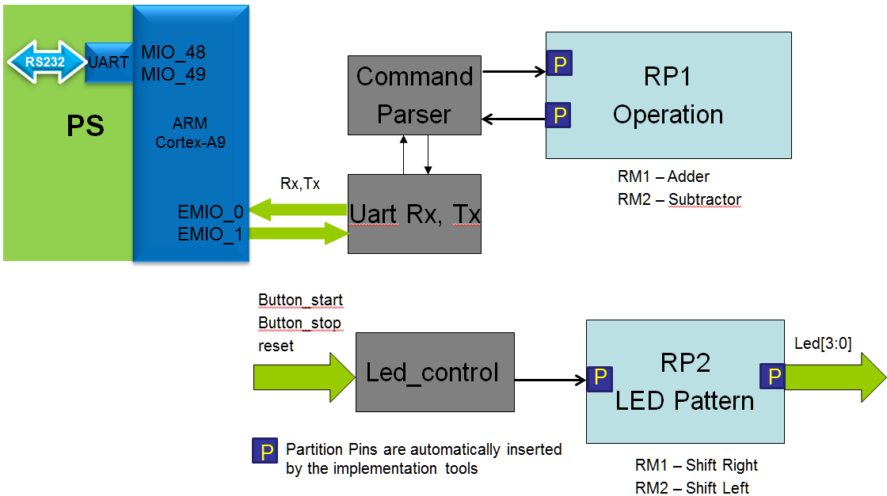
The Design
Static logic consists of UART receiver and transmitter, command parser, and LED control modules
Serial communication at 115200 Baud
Button_stop stops shifting, Buttons_start starts shifting pattern, and reset button resets the system
The PS system is used to move receive and transmit data between the external USB-UART bridge and the internal signals to PL

Slide 7
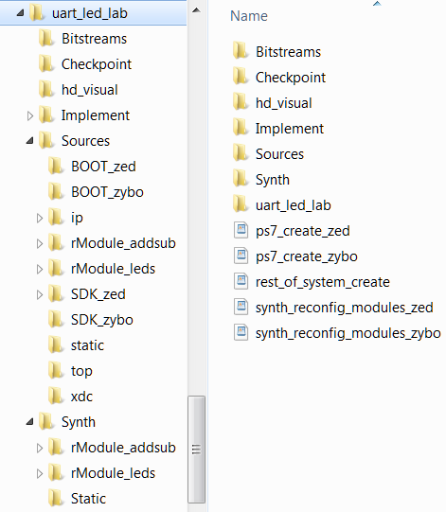
The Design – Directory Structure
The home directory of the lab contains Tcl scripts to generate the initial design and synthesize the RMs
Bitstreams will hold the generated full and partial bitstreams
Checkpoint will hold various design snapshots during the flow
Implement contains various configuration directories and associated results will be placed into those sub-directories
Synth is where RMs’ and the static design checkpoints (netlists) are stored
The BOOT directory under the Sources directory has the BOOT.bin file which is needed for the board to boot from. It brings the UART pins of the PS to the PL side. This is done through a software application provided in the uart_through_gpio.sdk folder
The hd_visual directory will have several script files which can be used to visualize the routing and placement

Slide 8
Outline
Objectives
The Design
Methodology
Summary

Slide 9
Methodology
Create a Vivado project
Generate design checkpoint for the static design in Vivado IDE
Synthesize each RM separately
Generate RM checkpoints for each RM through script using out of context synthesis
Each RM residing in a same RP must have same number, type, and size ports and the top-level module (entity) name
The out of context synthesis won’t insert I/O buffers
Define Reconfigurable Partitions pblocks
Bring reconfigurable partitions as black boxes
A design may have one or more reconfigurable partitions
Define the black boxes as reconfigurable partitions
Set HD.RECONFIGURABLE
PR feature should have been licensed

Slide 10
Methodology
Add Reconfigurable Modules
For each RP, add reconfigurable modules by providing unique name and unique netlist file
The netlist file will typically be a flat design (rather than hierarchical)
Define Reconfigurable Partition area
Use Draw Pblock
The drawn area should be large enough to provide the required types and amount of resources
This design uses slices resources

Slide 11
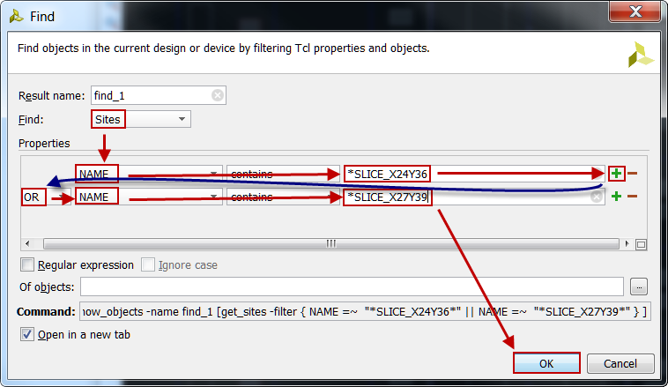
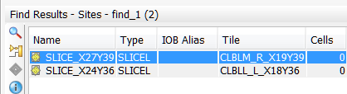
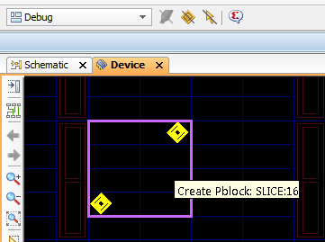
Set Pblock Size
Find sites using Edit -> Find command
Mark locations
Draw pblock

Slide 12
Methodology
Run Design Rule Checker (DRC)
The DRC checks for violations in floorplanning, clocking regions, IOs, partial reconfiguration specific
Create first configuration using one RM from each RP
Add top-level I/O if necessary
Run Implementation using default options
Implements static and the two RPs
Replace the used RMs with the blackboxes and save the design checkpoint
So the design checkpoint can be used in subsequent configurations
Create additional configurations
Since we have 2 RPs and 2 RMs in each RP, we can have up to eight possible configurations including blank RP
Minimum required will be three which provides all possible partial bitstreams, importing static region results from the first configuration

Slide 13
Methodology
Run PR_Verify
To ensure that the static implementation, including interfaces to reconfigurable regions, is consistent across all Configurations
Generate bitstreams
Minimum of one full bitstream is necessary
Must have partial bitstream for each RM
Optionally generate blanking bitstreams for each RP
Blanking bitstreams can be used to clear the region logic when the functionality in that region is not being used for a while, possibly reducing power consumption
Verify the design

Slide 14
Outline
Objectives
The Design
Methodology
Summary

Slide 15
Summary
This lab showed you steps involved in generating partial reconfiguration design using Vivado 2015.2 with partial reconfiguration feature enabled. You used the provided Tcl scripts to generate the static design that consists of the processing system to configure the UART port as a simple GPIO port and extend the signals to the programmable logic sub-system where they are connected to the actual design. You used another script to synthesize the RMs in a bottom-up approach which is required for the PR flow. You created the configurations and implemented the design. You generated the full and partial bitstreams, downloaded them and verified the functionality using the development board.

