Slide 1
Lab3 Intro Reconfigure Processor Peripheral
Zynq
Vivado 2015.2 Version

Slide 2
Outline
Objectives
The Design
Methodology
Summary

Slide 3
Objectives
After going through this lab, you should be able to:
Understand how to use Processor Configuration Access Port (PCAP) to partially reconfigure

Slide 4
Outline
Objectives
The Design
Methodology
Summary

Slide 5
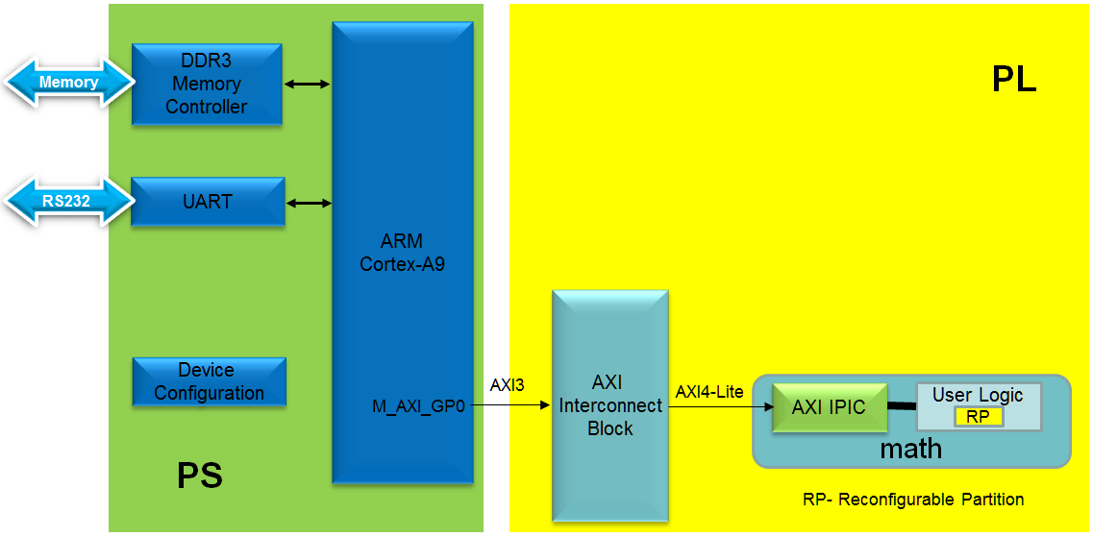
The Design
The processor subsystem provides access to the DDR memory where the partial bitstreams are loaded
The static logic consists of the processor subsystem, the AXI Interconnect, the AXI IPIC of the reconfigurable peripheral
The RP is user logic of an AXI-Lite peripheral
The RP has two RM performing
Add
Multiplication

Slide 6
Outline
Objectives
The Design
Methodology
Summary

Slide 7
Methodology
Steps and requirements are similar to the previous labs
The PS7 need to be configured to use M_GP0 interface so AXI-Lite peripheral can be connected
The reconfiguration is done using PCAP
The PCAP uses word input which is byte swap unlike ICAP which requires bit-swapped bytes
Use write_cfgmem program available in Vivado

Slide 8
Reconfiguration using PCAP - Hardware (1)
After the PL has been configured, it can be reconfigured using either the PCAP or ICAP. To use the ICAP, the PCAP_PR, bit 27 of the Control register, must be set Low. The initial configuration of the PL must also have connected the ICAP to an external interface or to some logic internal to the PL
To reconfigure the PL using PCAP, the PCAP_MODE and PCAP_PR bits must be set to 1 in the Control register. The internal loopback function must also be disabled. The reconfiguration bitstream is sent to the PL using the DevC DMA, the source and destination is the same as for the initial configuration

Slide 9
Reconfiguration using PCAP - Hardware (2)
PL reconfiguration flow using PCAP:
Set PCAP_MODE and PCAP_PR High
Clear the previous configuration from the PL (optional):
a. Set PCFG_PROG_B High
b. Set PCFG_PROG_B Low
c. Check for PCFG_INIT = 0 (STATUS-bit[4])
d. Clear PCFG_DONE_INT by writing a 1 to INT_STS[2]
Check for PCFG_INIT = 1 (STATUS-bit[4])
Set INT_PCAP_LPBK Low (MCTRL-bit[4])
Clear D_P_DONE_INT by writing a 1 to INT_STS[12]

Slide 10
Reconfiguration using PCAP - Hardware(3)
Initiate a DevC DMA transfer:
Source Address: Location of new PL bitstream
Destination Address: 0xFFFF_FFFF
Source Length: Total number of 32-bit words in the new PL bitstream
Destination Length: Total number of 32-bit words in the new PL bitstream
Poll or wait for devcfg.INT_STS[D_P_DONE_INT] to trigger an interrupt
(Optional) Check for PCFG_DONE_INT on INT_STS if the previous configuration was cleared

Slide 11
Reconfiguration using PCAP – API Used
Header file
xdevcfg.h
Configure and Initialize PCAP
XDcfg_LookupConfig (u16 DeviceId)
XDcfg_CfgInitialize (XDcfg *InstancePtr, XDcfg_Config *ConfigPtr, u32 EffectiveAddress)
Accessing control registers
XDcfg_EnablePCAP (XDcfg *InstancePtr)
XDcfg_SetControlRegister (XDcfg *InstancePtr, u32 Mask)
XDcfg_IntrGetStatus (XDcfg *InstancePtr)
XDcfg_IntrClear (XDcfg *InstancePtr, u32 Mask)
Transferring bitstream
XDcfg_Transfer (XDcfg *InstancePtr, void *SourcePtr, u32 SrcWordLength, void *DestPtr, u32 DestWordLength, u32 TransferType)

Slide 12
Outline
Objectives
The Design
Methodology
Summary

Slide 13
Summary
This lab showed you steps involved in creating a processor system using Vivado IPI. Full bitstream as well as partial reconfiguration bitstreams were generated by going through the PR flow. You also learned how to generate the boot image as well as how to convert the partial bit files to bin format.

