Slide 1
Introduction to Partial Reconfiguration Methodology
Zynq
Vivado 2015.2 Version

Slide 2
Objectives
After completing this module, you will be able to:
Define Partial Reconfiguration technology
List common applications for using Partial Reconfiguration
Define Partial Reconfiguration terminology
State the Partial Reconfiguration flow

Slide 3
Outline
What is Partial Reconfiguration(PR)?
PR Technology
PR Terminology
PR Design Flow
Summary

Slide 4
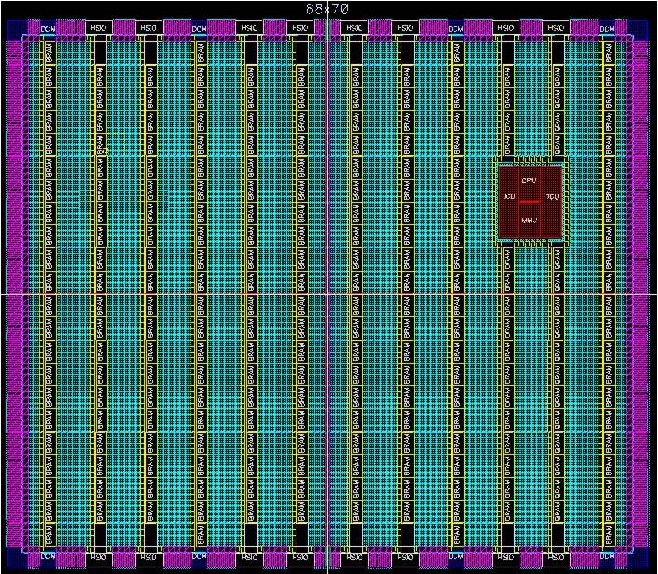
What is Partial Reconfiguration?
Partial Reconfiguration is the ability to dynamically modify blocks of logic by downloading partial bit files while the remaining logic continues to operate without interruption.
Full
Bit File
Function C2
Function B2
Function A2
Function C1
Function B1
Function A3
Function A1
Configuration Port
Configuration Port or ICAP
Partial Bit Files

Slide 5
PR Applications Analogy
Processor Context Switch
FPGA Configuration Switch
uP
FPGA
Stack
PR region 1
PR region 2
PR region N
MMU
Process 1
Partial Bitstream A
Process 2
Partial Bitstream B
Process N
Partial Bitstream N

Slide 6
PR Applications Analogy
Processor Context Switch
FPGA Configuration Switch
uP
FPGA
Stack
PR region 1
PR region 2
PR region N
MMU
Process 1
Partial Bitstream A
Process 2
Partial Bitstream B
Process N
Partial Bitstream N
Notes:
A FPGAs PR region is similar to the stack in a microprocessor. The FPGA can have many PR regions so it can be much more powerful than a microprocessor for applications switching.

Slide 7
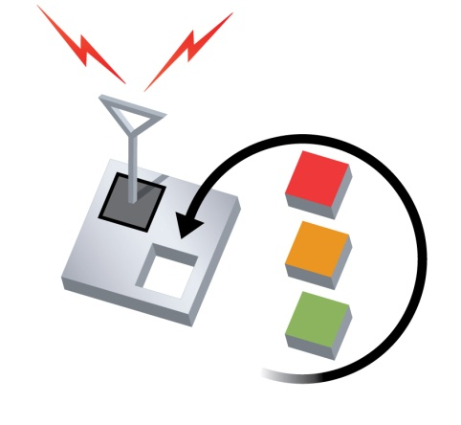
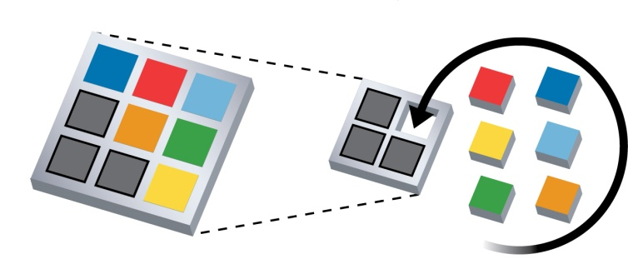

Partial Reconfiguration Technology and Benefits
Partial Reconfiguration enables:
System Flexibility
Swap functions and perform remote updates while system is operational
Size and Cost Reduction
Time-multiplexing hardware requires a smaller FPGA
Reduces board space
Minimizes bitstream storage
Power Reduction
Via smaller or/and fewer devices
Swap out power-hungry tasks

Slide 8
System Flexibility: Communication Hub
The FPGA can be a communications hub and must remain active
Cannot perform full reconfiguration due to established links
PR region 1
PR region 2
PR region 3
Radio Link
Monitor
Video
Link
Bus Link
FPGA

Slide 9
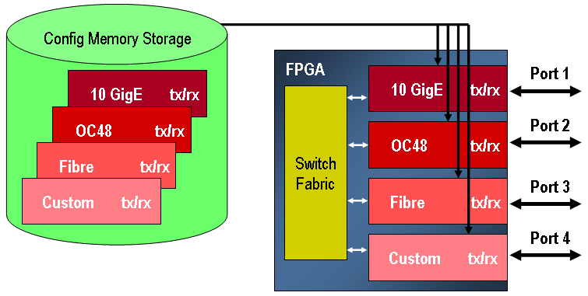
Size and Cost Reduction: Time Multiplexing
Applications need to be able handle a variety of functions
Supporting many at once can use a great deal of space
The library of functions use case covers a wide number of applications
Time-based multiplexing of functions reduces device size requirement
Notes:
A software-defined radio is an example.

Slide 10
Power Reduction Techniques with PR
Board space and resources are limited
Multi-chip solutions consume extra area, cost, and power
Many techniques can be employed to reduce power
Swap out high-power functions for low-power functions when maximum performance is not required
Swap out black boxes for inactive regions
Swap high-power I/O standards for lower-power I/O when specific characteristics are not needed
Time-multiplexing functions will reduce power by reducing amount of configured logic

Slide 11
Customer Example Flexible Video Processing
Swap decoders on the fly
One channel remains up while the other changes
Released “flat” version first
Two decoders per channel
Expanded functionality without changing hardware
Deployed new bitstreams for more decoders without changing hardware
DDR2 Memory
Controller
10 bits @ 150 MHz Display Data
128 bit @ 250 MHz
Display
Output
Partial Reconfiguration Region
128 bit @ 250 MHz
Decoder
[MPEG2, DV, VC3, ProRes 422]
64 bits @ 250 MHz DDR2
32 bits @ 125 MHz
128 bit @ 250 MHz
Data Decode Scheduler
8 bits @ 150 MHz Compressed Data
– External Source
128 bit @ 250 MHz
Data Input
Notes:
Customer can service two incoming video data formats in one FPGA, and swap decoding algorithms per port on the fly without disturbing the other port.
Hardware was initially released with service for two protocols, but is being updated for expanded service simply by uploading new bit files.

Slide 12

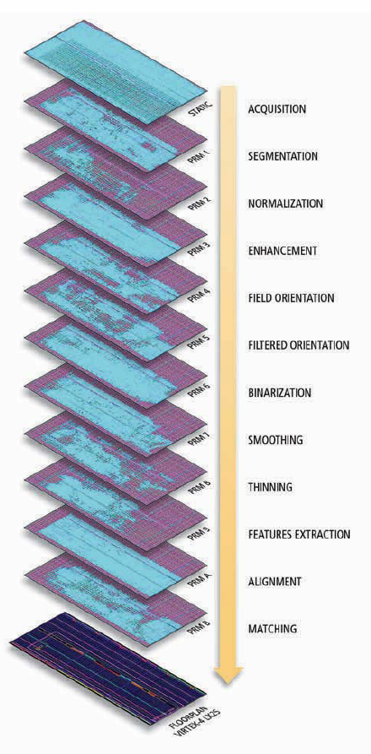
Customer Example Sequential Processing
Read the detailed article in Xcell Issue 72
Automatic Fingerprint Authentication System
Sequence of 12 different functions required
No two were needed at any one time
Load in functions on demand
Steps could be skipped or revisited
Processing time greatly improved
PC-based Software solution: 3.77 sec
Xilinx MicroBlaze solution: 143.19 sec
Xilinx Partial Reconfiguration: 0.7 sec
Includes 10ms total for all reconfiguration events
Efficient use of resources
“Flat” solution requires 39k flops, 52k LUTs
PR solution uses region with less than 10k of each

Slide 13
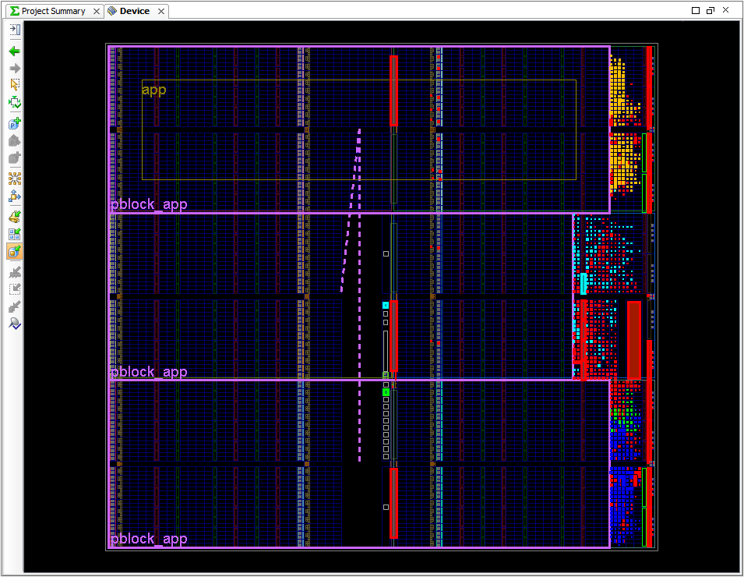
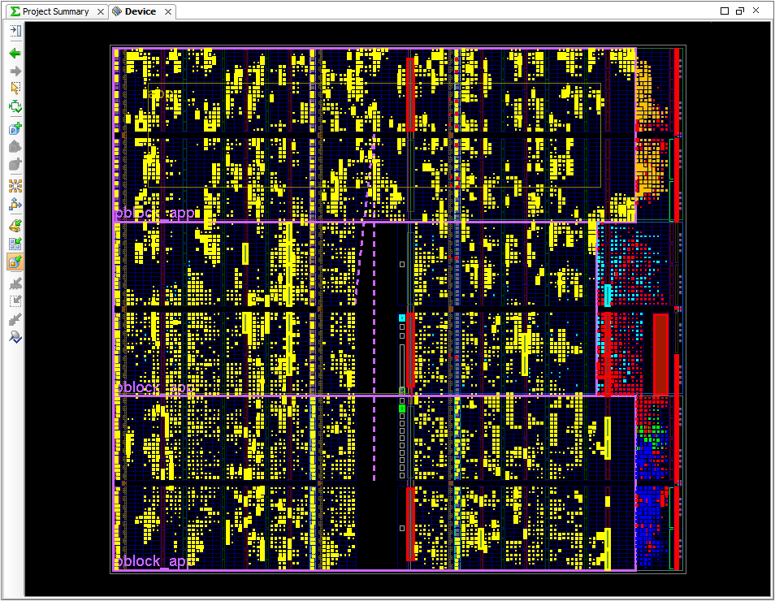
Customer Example Fast PCIe Configuration and Field Updates
Customer requirements:
Reduce PROM size
Improve PCIe configuration time
Enable live field updates
Solution details:
Config time reduced 73%
Static logic includes:
PCIe Gen2x1 core
Two 10G XAUI cores
AXI debug logic
ICAP loader

Slide 14

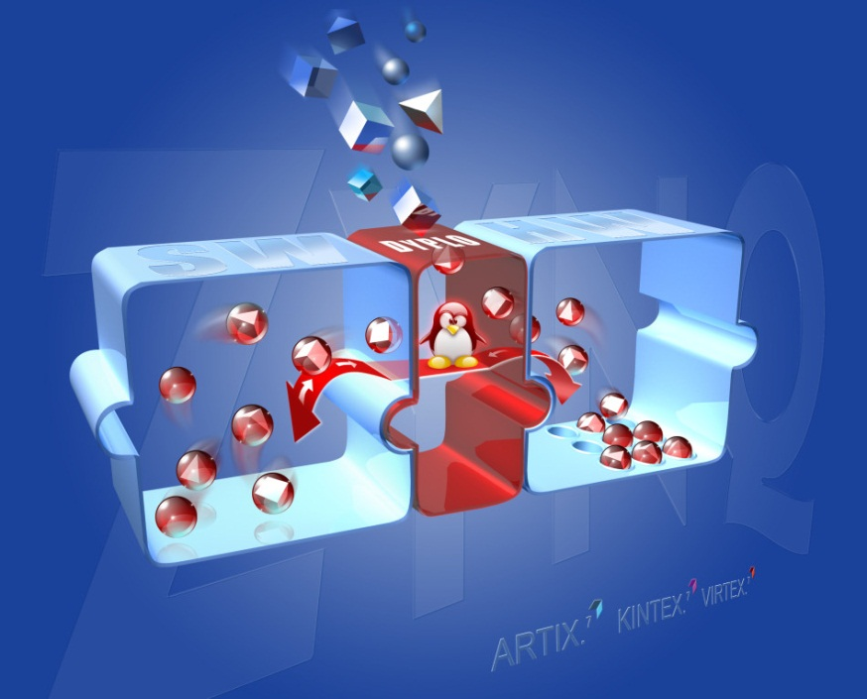
Customer Example Hardware Acceleration
Dyplo = DYnamic Process LOader
Solution distributes software functions between hardware and software spaces
Dyplo’s unique selling points
Optimized use of Zynq SoC device
Software driven Hardware development approach
Abstraction of implementation choices to system level
Simple use of partial reconfiguration blocks in hardware
Configuration Wizard tool to guarantee ease of use
Product launched in March 2015
Read more at http://topic.nl/en/dyplo or Xcell issue 85

Slide 15
Outline
What is Partial Reconfiguration(PR)?
PR Technology
PR Terminology
PR Design Flow
Summary

Slide 16
Programmability 101
Think of an FPGA as two layered device:
Configuration memory layer
Logic layer
Configuration memory controls function computed on logic layer
Logic Layer
Configuration Memory Layer

Slide 17
“Normal” Configuration
Configuration Bitstream
FPGA
Check Sum
Config. Data
Header
Start
Vcc Rise
Vcc
Stable
Power-on
Reset
Configure
FPGA
User
Mode

Slide 18
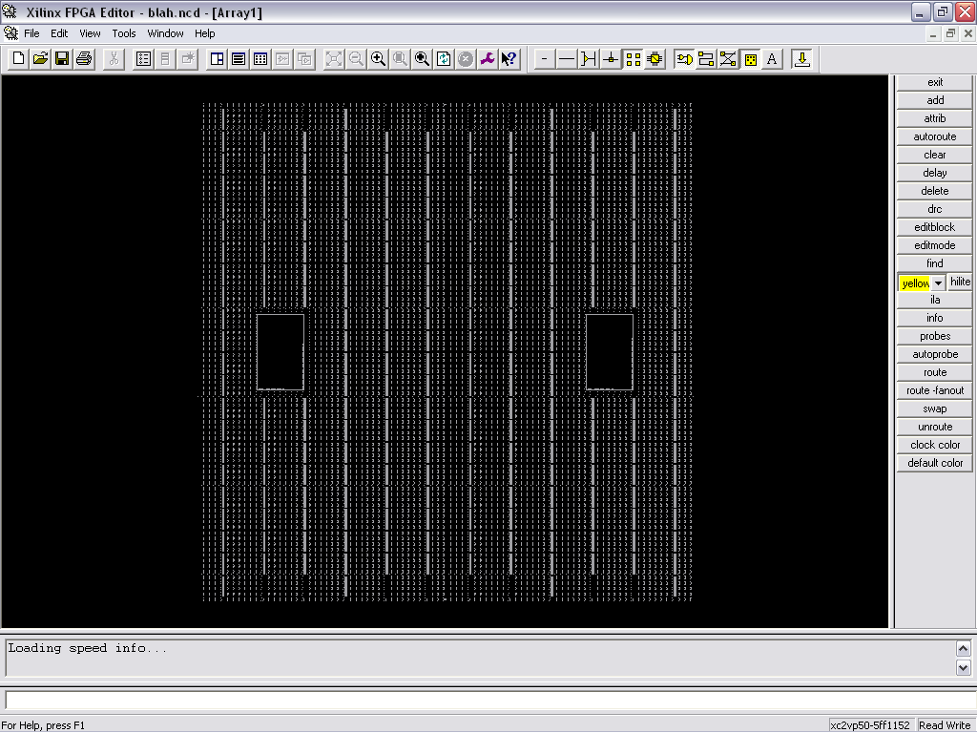
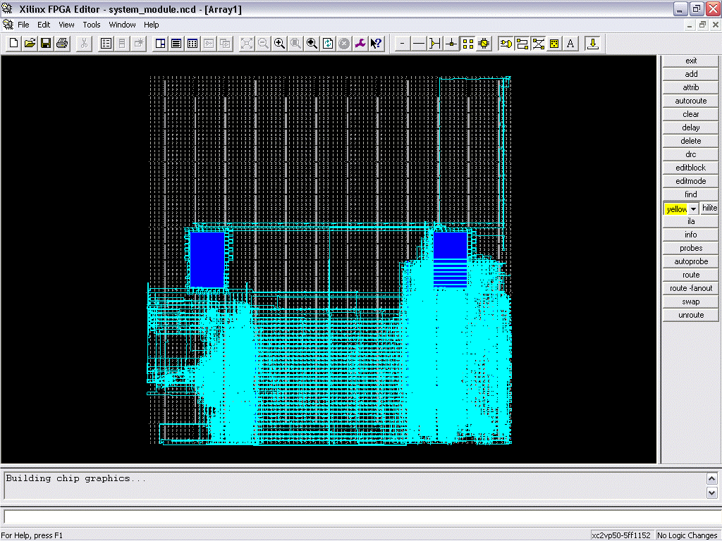
‘Typical’ Configuration Mode
Fixed configuration
Data loads from PROM or other source at power on
Configuration fixed until the end of the FPGA duty cycle
Used extensively during traditional design flow
Evaluate functionality of design as it is developed
Configuration
Overhead
Device
Duty-cycle
Function
Power On
Shut
Down
Time

Slide 19
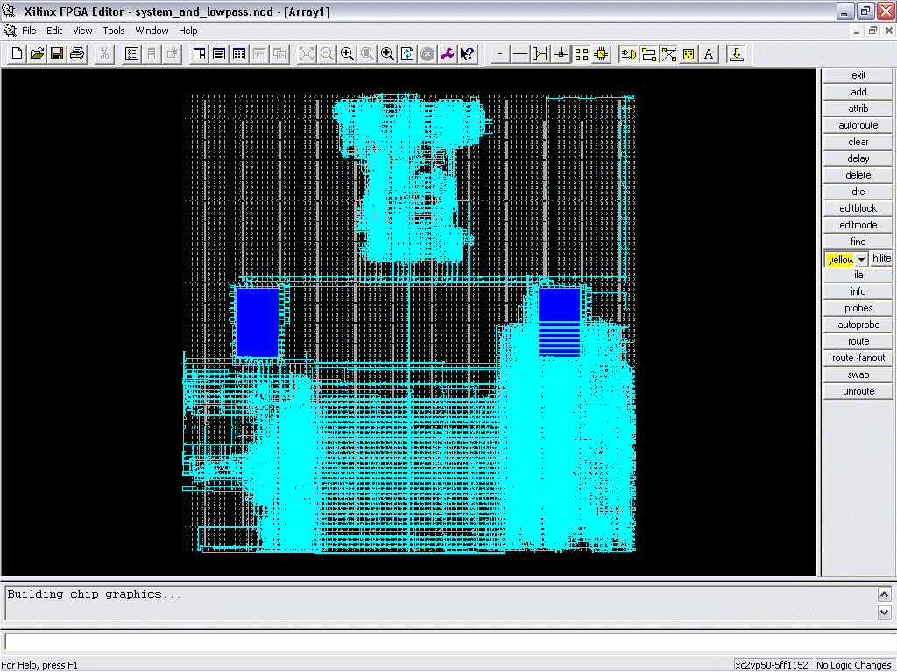
Reconfiguration
Configuration memory is no longer fixed during the system duty cycle
Initial bitstream loaded at power-on
Different, full device bitstreams loaded over time
Configuration
Overhead
Reconfiguration
Overhead
Function
Power On
Shut
Down
Time

Slide 20
Partial Configuration
Partial Configuration Bitstream
Config. Data
FPGA
Start
Vcc Rise
Initial Config.
Complete
User
Mode
Load Partial
Bitstream
User
Mode

Slide 21
Partial Reconfiguration
Only a subset of configuration data is altered
But all computation halts while modification is in progress…
Main benefit: reduced configuration overhead
Configuration
Overhead
Reconfiguration
Overhead
Function
Power On
Shut
Down
Time

Slide 22
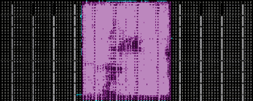
Dynamic Reconfiguration
A subset of the configuration data changes…
But logic layer continues operating while configuration layer is modified…
Configuration overhead limited to circuit that is changing…
Reconfiguration
Overhead
Configuration
Overhead
Function
Power On
Shut
Down
Time

Slide 23
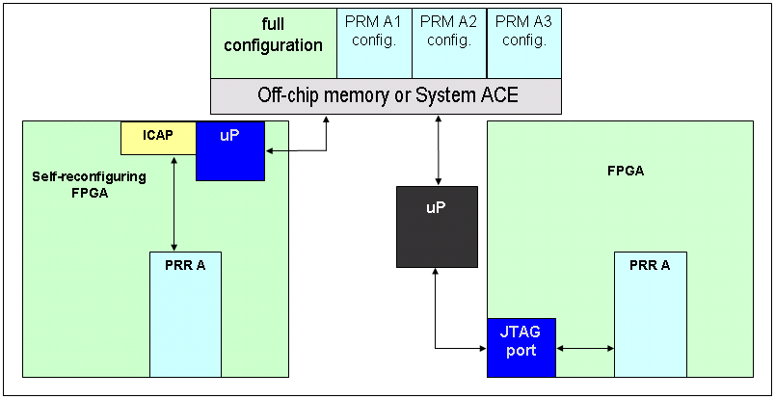
How Can We Reconfigure?
Initiation of reconfiguration is determined by the designer
On-chip state machine, processor or other logic
Off-chip microprocessor or other controller
Delivery of the partial bit file uses standard interfaces
FPGA can be partially reconfigured through the SelectMap, Serial or JTAG configuration ports, or the Internal Configuration Access Port
Logic decoupling should be synchronized with the initiation and completion of partial reconfiguration
Enable registers
Issue local reset

Slide 24
Outline
What is Partial Reconfiguration(PR)?
PR Technology
PR Terminology
PR Design Flow
Summary

Slide 25
Hierarchical Implementation Definitions
Partition
A logical block (entity or instance) to be used for design reuse
User determines implementation versus preservation for each block
Bottom-up synthesis
Separate synthesis projects resulting in multiple netlists or design checkpoints
No optimization across projects
Top-down synthesis; NOT used for Partial Reconfiguration (normal flow)
One synthesis project where synthesis flattens design for optimization
Often called flat synthesis
No support for hierarchical implementation

Slide 26
Terminology
Reconfigurable Partition (RP)
Design hierarchy instance marked by the user for reconfiguration
Reconfigurable Module (RM)
Portion of the logical design that occupies the Reconfigurable Partition
Each RP may have multiple Reconfigurable Modules
Static Logic
All logic in the design that is not reconfigurable
Configuration
A full design consisting of Static Logic and one Reconfigurable Module for each Reconfigurable Partition
Partition Pins
Ports on a Partition; Interface between Static and Reconfigurable Logic

Slide 27
Configurations
A Configuration is a complete FPGA design
Consists of Static Logic and one variant for each reconfigurable instance
Maximum number of RMs for any RP determines minimum number of Configurations required
Example: Possible Configurations for this design
Static + A1 + B1 + C1
Static + A2 + B2 + C2
Static + A3 + B2 + C3
Static + A3 + B2 + C4
Static Logic and repeated RMs are imported
Any combination of RMs can be selected to create unique full bit files
Reconfigurable Modules
A1
RP “A”
A2
A3
RP “B”
B1
B2
RP “C”
C1
Static
C2
C3
C4
Notes:
How many bit files will be created in this example? 16. Each configuration will generate 1 full and 3 partial bit files.
How many unique bit files will be created? 13. There will be 2 for A3 and 3 for B2, but they will have different names.

Slide 28
Reconfigurable Elements
What is reconfigurable?
Nearly everything in the FPGA
Slice logic (LUTs, flip-flops, and carry logic, for example)
Memories (block RAM, distributed RAM, shift register LUTs)
DSP blocks
Logic that must remain in static logic includes
Clock-modifying blocks (MMCM, DCM, PLL, PMCD)
Global clock buffers (BUFG)
Device feature blocks (BSCAN, ICAP, STARTUP, or PCIE, for example)
I/O components (IOLOGIC, IODELAY, IDELAYCTRL)

Slide 29
Reconfigurable Elements
Granularity of reconfigurable regions vary by device family
Boundaries recommended, but not required, to align to Clock Regions
7-Series (Vivado/ISE supported)
Slice region: 50 CLB high by 1 CLB wide
BRAM region: 10 RAMB36
DSP region: 20 DSP48
Virtex-6 (ISE supported)
Slice region: 40 CLB high by 1 CLB wide
BRAM region: 8 RAMB36
DSP region: 16 DSP48
Virtex-5 examples (ISE supported)
Slice region: 20 CLB high by 1 CLB wide
BRAM region: 4 RAMB36
DSP region: 8 DSP48
Virtex-4 examples (ISE supported)
Slice region: 16 CLB high by 1 CLB wide
BRAM region: 4 RAMB16 and 4 FIFO16
DSP region: 8 DSP48
Bit file sizes for each of these resource types will vary

Slide 30
Outline
What is Partial Reconfiguration(PR)?
PR Technology
PR Terminology
PR Design Flow
Summary

Slide 31
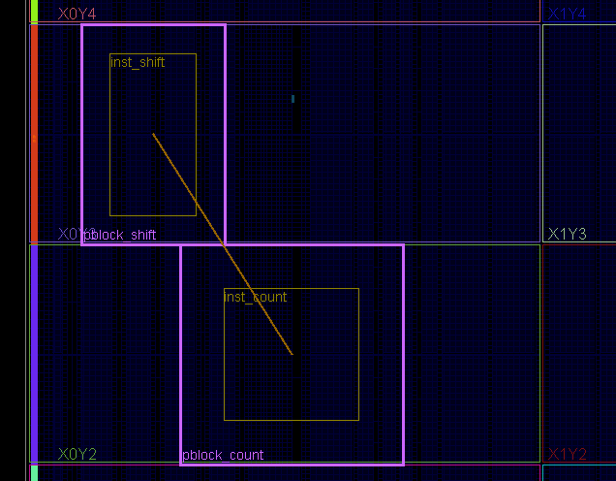
Intuitive Design Flow Project Creation and Floorplanning
Static Logic
Structure your design
Static Logic (unchanging design)
Reconfigurable Partitions (RP)
Instances to be reconfigured
Reconfigurable Modules (RM)
Functional variations for each RP
Synthesize bottom-up
synth_design –mode out_of_context
Define resources to be reconfigured
Pblocks map design modules to physical regions
Define XY ranges and resource types
Mark pblocks as reconfigurable
HD.RECONFIGURABLE initiates flow
RP_color
RP_pos
RM_allc
RM_orig
RM_gray
RM_rev
RM_sepia
i_PR_color
i_PR_pos

Slide 32
Leveraging Module Checkpoints for Partial Reconfiguration
Partition methodology enables Partial Reconfiguration
Allows clear separation of static logic and Reconfigurable Modules
Floorplan to identify silicon resources to be reconfigured
Design preservation accelerates design closure
Lock static design database while implementing new modules
To Implement Next Configuration
Implementing Configuration
Implementing Configuration
Storing Results
Storing New Results
Partitioning, Floorplanning
Static Logic
STATIC
RM_allc
RM_orig
STATIC
RM_gray
RM_rev
RP_color
RP_pos
Static Logic
RM_allc
RM_orig
RM_gray
RM_rev
RP_pos
RM_sepia
RP_color

Slide 33
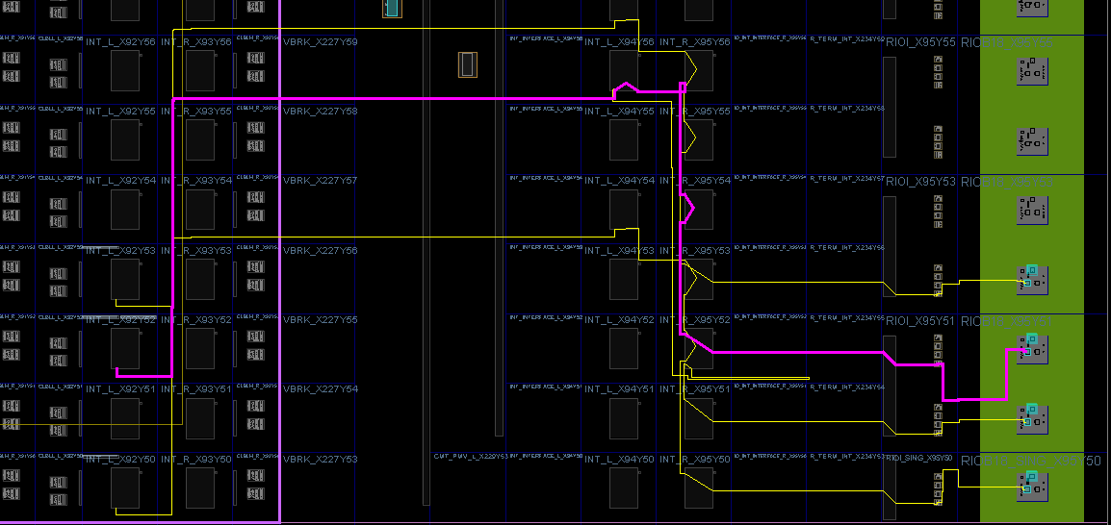
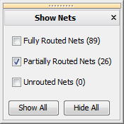
Vivado Software Features No Proxy Logic Required
Partition Pins are junction between static and reconfigured logic
Interface wires can be broken at interconnect tile site
“Anchor” between static and reconfigurable established mid-route
No overhead at reconfigurable partition interface
Decoupling logic still highly recommended
INT tile

Slide 34

Vivado Software Design Management Checkpoints for Each Partition
Vivado stores design data in checkpoints
Save full design as a configuration checkpoint for bitstream creation
Save static-only checkpoint to be reused across multiple configurations
Routed static checkpoint can remain open in memory
Results are locked at the routing level
Reconfigurable modules can also be stored as their own checkpoints
config_1.dcp
config_2.dcp
RP_1
RP_2
RP_1
RP_2
static.dcp
BB
BB
Load new synthesized modules to replace black boxes and create new configurations
RM_1a.dcp
RM_2a.dcp
Notes:
For this example design:
config_1.dcp can be used to create config_1.bit (which is the full design including RM_1a and RM2a), RP_1.bit and RP_2.bit
config_2.dcp can be used to create config_2.bit (with empty modules for the two RPs), and black box versions of RP_1.bit and RP_2.bit
New modules can be loaded in over the black boxes to create new configurations

Slide 35
Intuitive Design Flow Implementation
Place and Route all design configurations
Apply full design constraints in-context
Use normal timing closure, simulation and verification techniques
Currently non-project Tcl flow only – sample scripts provided
Final Verification
Validates consistency of place and routed results across the entire system
Generate Bitstreams
write_bitstream automatically creates all full and partial bit files

Slide 36
Configuration Details
Partial bit files are processed just like full bit files
Bit file sizes will vary depending on region size and resource type
Contain just address & data, sync & desync words, optionally final and frame-based CRC value
No startup sequences, DONE flag
Partial Reconfiguration time depends on two factors:
Configuration bandwidth
Partial bit file size
Estimate in Vivado, confirm in Rawbit file
Configuration Mode | Max Clock Rate | Data Width | Max Bandwidth
SelectMap / ICAP | 100 MHz | 32-bit | 3.2 Gbps
Serial Mode | 100 MHz | 1-bit | 100 Mbps
JTAG | 66 MHz | 1-bit | 66 Mbps

Slide 37
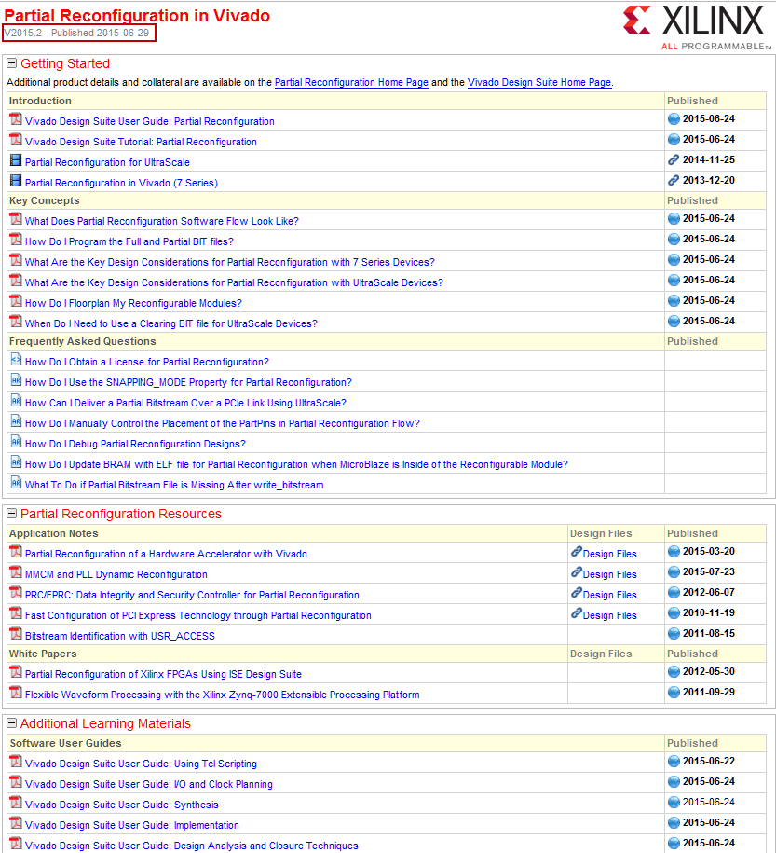
Partial Reconfiguration Collateral
Learn about Partial Reconfiguration
User Guide UG909
Tutorial UG947
PR Design Hub in DocNav
XAPP1159
More IP and references in the works
Read about Partial Reconfiguration
Xcell articles in Issues 72, 73, 75, 77, 78, 79, 80, 84, 85

Slide 38
Outline
What is Partial Reconfiguration(PR)?
PR Technology
PR Terminology
PR Design Flow
Summary

Slide 39
Summary
Partial Reconfiguration is an Expert Flow
Understanding PR terminology provides a commonality for PR design communication
PR enables
System flexibility
Size and cost reduction
Power reduction
The PR flow has four primary steps
Set up the design structure
Constrain RPs and run DRCs
Place & Route configurations
Create bit files

