Slide 1
Lab1 Intro Vivado Design Flow

Slide 2
Introduction
This lab guides you through the process of using Vivado IDE to create a simple HDL design targeting the Nexys4 DDR, Nexys Video, or the Basys3. You will simulate, synthesize, implement the design with default settings. Finally, you will generate the bitstream and download it in to the hardware to verify the design functionality.
Notes:
This will be your first exposure to Vivado.
In this lab you will be using the ZedBoard and run the Vivado design flow from start to finish.

Slide 3
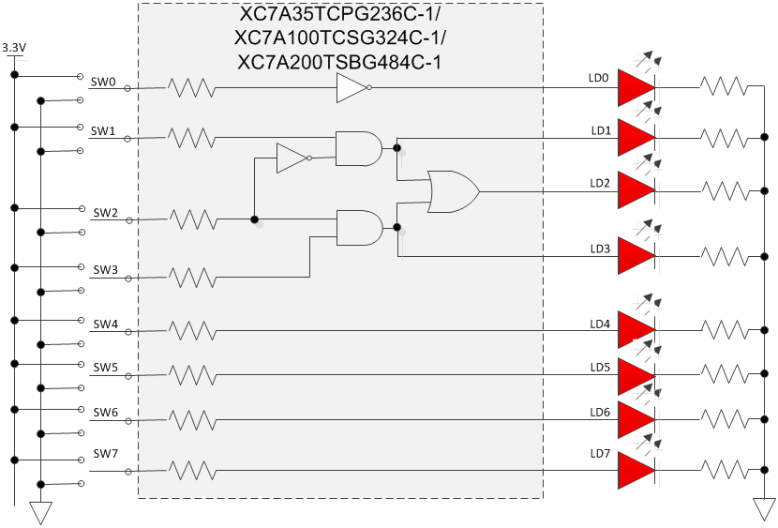
The Design
Notes:
This is the basic combinatorial design you will be implementing in the lab. Notice that different switch options will light up different LEDs.

Slide 4
Procedure
Create a project using Vivado IDE
Simulate the design using XSIM simulator
Synthesize the design
Implement the design
Perform the timing simulation
Generate the bitstream
Verify the design functionality in hardware using the Nexys4 DDR, Nexys Video, or the Basys3
Notes:
Here is a quick glance of the overview of the entire lab. It doesn’t look too difficult. ;)

Slide 5
Note on target board/device
The lab is written for the Nexys4 DDR, Nexys Video, and the Basys3 boards.
Nexys4 DDR targets the XC7A100TCSG324C-1
Nexys Video targets the XC7A200TSBG484C-1
Basys3 targets the XC7A35TCPG236C-1
The procedure in the lab differentiates between the three boards
Please pay attention to the instructions to ensure the right steps are followed
Also make sure the XDC file used is specific to the target device/board
Notes:
Here is a quick glance of the overview of the entire lab. It doesn’t look too difficult. ;)

Slide 6
Summary
The Vivado IDE tool can be used to perform a complete HDL design flow. The project was created using the supplied source files (HDL model and user constraint file). A behavioral simulation was done using the provided testbench to verify the model functionality. The model was then synthesized, implemented, and a bitstream was generated. The timing simulation was run on the implemented design using the same testbench. The functionality was verified in hardware using the generated bitstream.

