Slide 1
Lab2 Intro Synthesizing a RTL Design

Slide 2
Introduction
This lab uses a simple uart-led design. The design takes an input via a terminal operating at 115200 baud and displays the binary equivalent of the ASCII character the user has typed on the 8-LEDs. If the BTNU is pressed then the upper and lower nibbles of the binary number gets swapped.
You will synthesize the design with the default settings as well as with some settings changed and observe the effect
Notes:
This lab uses a USB UART Pmod.
I only have 8 Pmods but since everyone does the exercise at different rates, perhaps we can share them among people who completed the exercise and people who are still working on it.

Slide 3
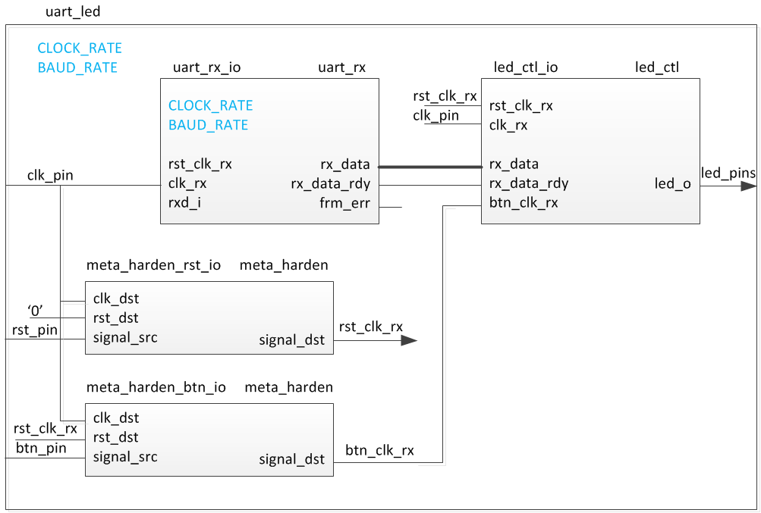
The Design
Notes:
This is a block diagram of the design.

Slide 4
Procedure
Create a project using Vivado IDE using the provided HDL files and timing constraints
Elaborate the design and view noise report and the schematic
Synthesize the design with the default settings
Open the synthesized design and view schematic
View various reports including the timing summary, resource utilization, and power
Write a checkpoint
Synthesize the design with one of the settings changed
Compare the generated schematic, timing summary, power and resource utilization
Write another checkpoint
Read previously written checkpoints and perform the same analysis
Notes:
The process will be a bit simpler but a bit more involved than the last lab. We do not need to do as many different activities as the last one but there are more back and forth on this one to get ideas across.

Slide 5
Note on target board/device
The lab is written for the Nexys4 DDR, Nexys Video, and the Basys3 boards.
Nexys4 DDR targets the XC7A100TCSG324-1
Nexys Video targets the XC7A200TSBG484C-1
Basys3 targets the XC7A35TCPG236-1
The procedure in the lab differentiates between the three boards
Please pay attention to the instructions to ensure the right steps are followed
Also make sure the XDC file used is specific to the target device/board
Notes:
Here is a quick glance of the overview of the entire lab. It doesn’t look too difficult. ;)

Slide 6
Summary
In this lab you applied the timing constraints and synthesized the design. You viewed various post-synthesis reports. You wrote checkpoints and read it back to perform the analysis you were doing during the design flow. You saw the effect of changing synthesis settings.

