Slide 1
Lab3 Intro Implementing the Design

Slide 2
Introduction
This lab continues with the previous lab. You will perform static timing analysis. Then you will open a hardware session and program the FPGA.

Slide 3
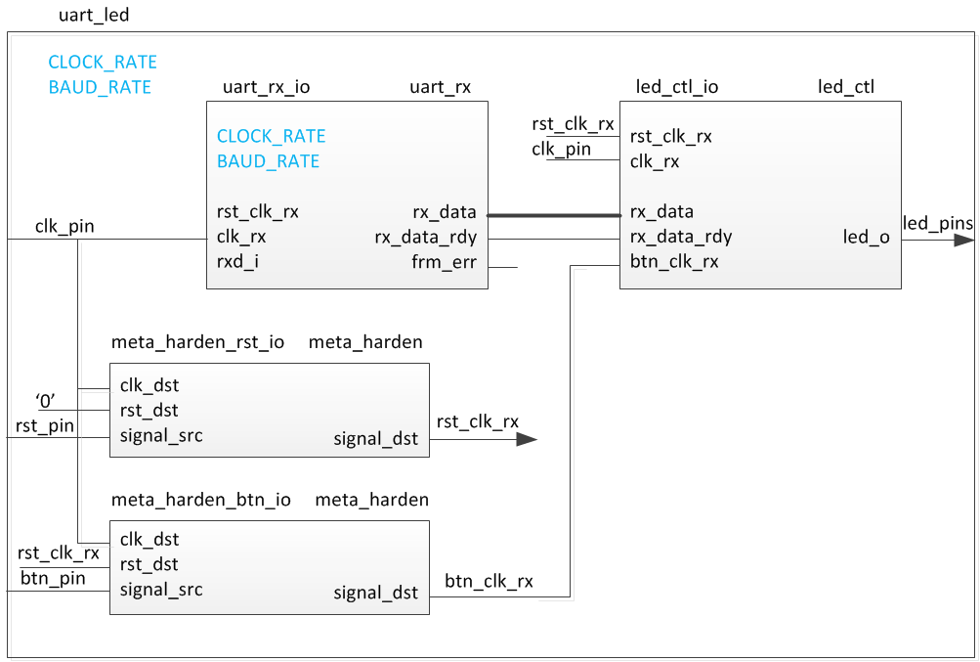
The Design

Slide 4
Procedure
Open the project you created in previous lab
Set the synthesis to its default values
Implement the design
Perform the static timing analysis
Generate the bitstream
Configure the board and verify the functionality

Slide 5
Note on target board/device
The lab is written for the Nexys4 DDR, Nexys Video, and the Basys3 boards.
Nexys4 DDR targets the XC7A100TCSG324C-1
Nexys Video targets the XC7A200TSBG484C-1
Basys3 targets the XC7A35TCPG236C-1
The procedure in the lab differentiates between the three boards
Please pay attention to the instructions to ensure the right steps are followed
Also make sure the XDC file used is specific to the target device/board
Notes:
Here is a quick glance of the overview of the entire lab. It doesn’t look too difficult. ;)

Slide 6
Summary
In this lab, you learned about many of the reports available to designers in the Vivado IDE. You also had the opportunity to learn basic design analysis using tools that are connected to the display of timing-critical paths, including the Schematic viewer, delay path properties and reports, Device view, and selecting primitive parents. You also learned about the basic timing report options that are at your disposal. You verified the functionality in hardware by typing characters on the host machine and seeing the LED pattern changes.

