Slide 1
Lab4 Intro Using IP Catalog

Slide 2
Introduction
In this lab you will use the IP Catalog to generate a clock resource. You will instantiate the generated core in the provided waveform generator design

Slide 3
The Design
The waveform generator in this design is intended to be a “standalone” device that is controlled via a PC (or other terminal device) using RS-232 serial communication. The design described here implements the RS-232 communication channel, the waveform generator and connection to the external DAC, and a simple parser to implement a small number of “commands” to control the waveform generation

Slide 4
The Design Functionality
This design "records" specific information via RS-232 serial communication and stores this data in an on-chip memory
After data has been stored, it can be retrieved via the RS-232 communications channel, or "played" out via a bank of LEDs or a DAC
Receives RS-232 serial data at 115200 baud (no parity, 8 data bits, no handshaking)
Handled in uart_rx, which is simple state machine and an over sampler
Small command set controls how information is stored and played back

Slide 5
The Design
The wave_gen design consists of several top level blocks:
Clock and reset management
UART receiver and transmitter
Command parsing
Response generation
Character FIFO
Sample RAM and generator
SPI generator
Various clock crossing modules

Slide 6
The Clock Domains
The wave_gen design uses three clock domains
Receive clock (clk_rx)
Transmit clock (clk_tx)
Sample clock (clk_samp)
All clocks are derived from a single clock input pin (clk_pin) using a single MMCM
The clock input depends on the board
The receive clock runs at the input clock frequency (100 MHz)
The receive clock is assumed to be asynchronous to the transmit and sample clocks
The transmit clock runs either at the same frequency or at 31/32 of that frequency
The sample clock is a decimated version of the transmit clock
Rate is determined by the prescale value

Slide 7
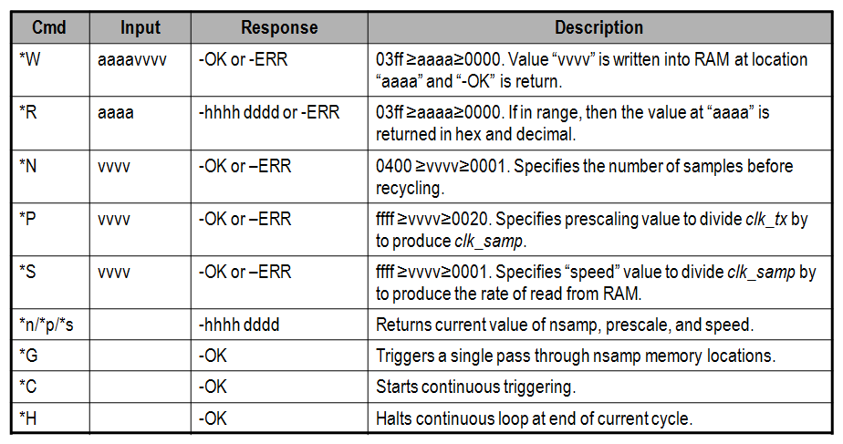
The wave_gen Commands

Slide 8
Procedure
Create the project
Generate and instantiate a clock generator module
Implement the design
Configure the target board and verify the functionality

Slide 9
Note on target board/device
The lab is written for the Nexys4 DDR, Nexys Video, and the Basys3 boards.
Nexys4 DDR targets the XC7A100TCSG324C-1
Nexys Video targets the XC7A200TSBG484C-1
Basys3 targets the XC7A35TCPG236C-1
The procedure in the lab differentiates between the three boards
Please pay attention to the instructions to ensure the right steps are followed
Also make sure the XDC file used is specific to the target device/board
Notes:
Here is a quick glance of the overview of the entire lab. It doesn’t look too difficult. ;)

Slide 10
Summary
In this lab, you learned how to add an existing IP during the project creation. You also learned how to use IP Catalog and generate a core. You then instantiated the core in the design, implemented the design, and verified the design in hardware. You also used the IP Integrator capability of the tool to generate a FIFO and then use it in the HDL design

