Slide 1
Lab5 Intro Xilinx Design Constraints

Slide 2
Introduction
In this lab you will use the uart_led design that was introduced in the previous labs. You will start the project with I/O Planning type, enter pin locations, and export it to the rtl. You will then create the timing constraints and perform the timing analysis

Slide 3
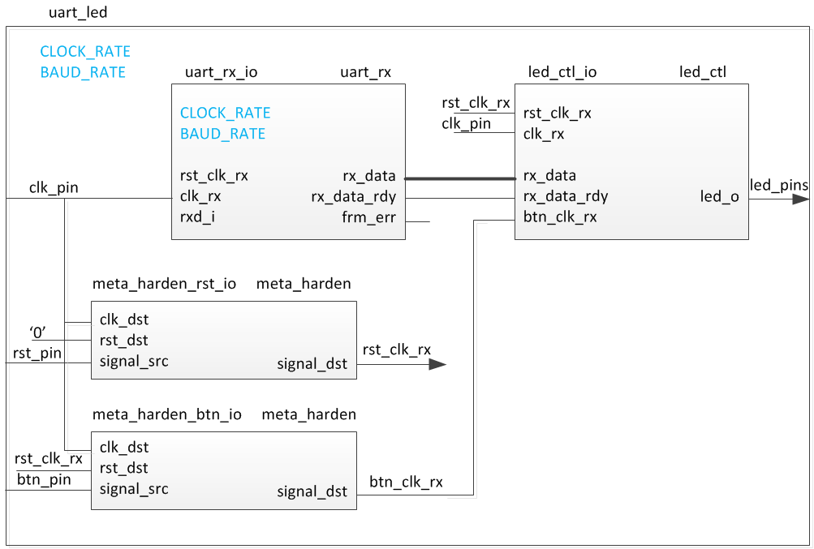
The Design

Slide 4
Procedure
Create a Vivado I/O Planning project
Assign various pins and source files
Synthesize and enter timing constraints
Implement and perform timing analysis
Generate the bitstream and verify (optional)

Slide 5
Note on target board/device
The lab is written for the Nexys4 DDR, Nexys Video, and the Basys3 boards.
Nexys4 DDR targets the XC7A100TCSG324C-1
Nexys Video targets the XC7A200TSBG484C-1
Basys3 targets the XC7A35TCPG236C-1
The procedure in the lab differentiates between the three boards
Please pay attention to the instructions to ensure the right steps are followed
Also make sure the XDC file used is specific to the target device/board
Notes:
Here is a quick glance of the overview of the entire lab. It doesn’t look too difficult. ;)

Slide 6
Summary
In this lab, you learned how to create an I/O Planning project and assign the pins via the Device view, Package Pins tab, and the Tcl commands. You then exported to the rtl project where you added the provided source files. Next you created timing constraints and performed post-synthesis and post-implementation timing analysis.

