Slide 1
Hardware Debugging

Slide 2
Objectives
After completing this module, you will be able to:
Understand the key benefits provided by the Vivado logic debug feature
List various debugging cores and their functionality
Describe the process of including debug tool sampling cores in the Vivado Design Suite

Slide 3
Outline
Introduction
Logic Debug Cores
Logic Debug Probing Flows
Summary

Slide 4
Debug and Verification is Critical
Debug and verification can account for over 40% of creating a FPGA design
Serial nature of debug and verification can make it difficult to optimize
Inefficient strategy may result in product launch delay
Final Device
Design Verification
and Debug
40%
of
Design
Time
Design
Implementation
Design
Specification

Slide 5
Recommended Debug Methodology
Engineers are trained to solve problems logically
Break a problem into smaller parts
Simplify by reducing variables & variation
Make a prediction, verify the results
Plan how and where to debug early in the design cycles
FPGA design is an iterative process
Debugging a FPGA design is an iterative process
1) Probe: Adding/modify debug probes
2) Implement: Compile design w/probes
3) Analyze: Look for bugs using probes
4) Fix: Fix any bugs, repeat as necessary
Create
design
Probe &
Implement
design
Fix
Bug
Find
Bug
Download &
Analyze
Design
in HW
The reconfigurable nature of FPGAs
facilitates the iterative debug process
Finish Design:
No bugs!
Notes:
Module: Debug
Time on foil: 1-2 mins.
Key Take-a-way: Our customers should really concentrate on their design instead of our debug IP or tools!
As previously mentioned, this the same debug methodology that we have recommended in the past and it has not really been changed.
We highly recommend planning out your hardware debug early in the design cycles – where and what to probe and let the tool to insert and connect debug cores for you for example.
The fact is that design iterations are just easier for FPGAs due the reconfigurable nature of FPGAs. We know that engineers are trained to solve problems logically but we just want to make sure that they breaking thing into a small and manageable parts.
Our main goal is to help our customers to debug their design using these recommended flow – Probe, Implement, Analyze, Fix, and Iterate as shown in the figure on this slide.

Slide 6
Xilinx Hardware Solutions for Debugging Designs
Hardware debugging tool
Vivado logic analyzer for hardware
Functionally replaces need for external logic analyzer
Now included in the Xilinx tool suite
A single JTAG connection to the PC can be used for
Programming the programmable logic
Hardware debugging

Slide 7
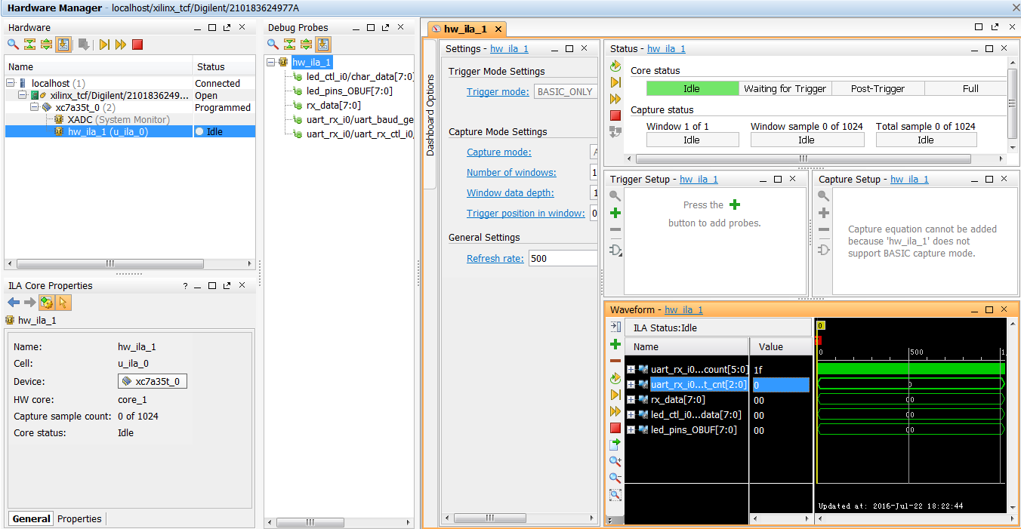
Vivado Logic Analyzer Feature Overview
Run-time software interface for interacting with ILA and VIO cores
Supports simultaneous ILA waveform viewers
Waveform formats can be saved and applied later for quick configurations

Slide 8
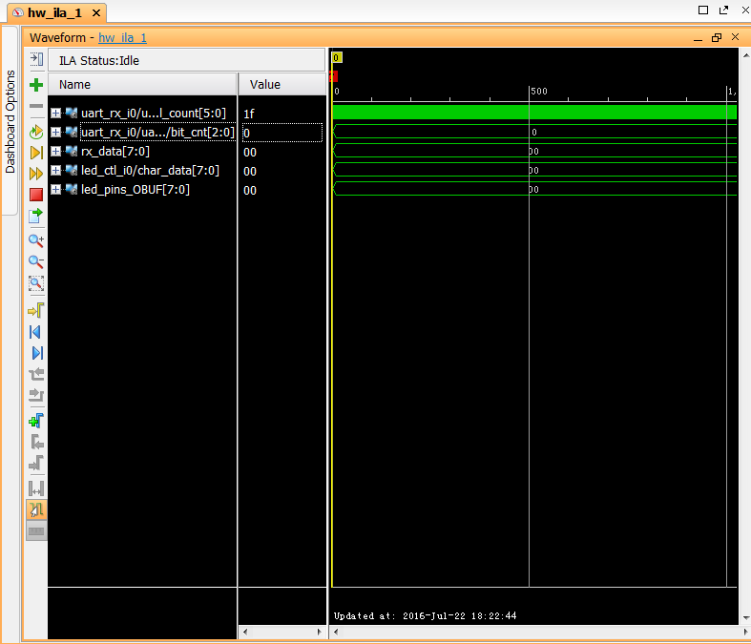
Vivado Logic Analyzer Feature Common Waveform Viewer
Shared across Vivado features
Simulator, Logic Analyzer, etc.
Reduces learning curve
Eases transition between features
New functionality
Cursors and markers w/measure
Zoom mouse gestures
Custom colors
Find next/previous transition
Find signal name
Multiple radix selections
Integrated analog plot w/row resize

Slide 9
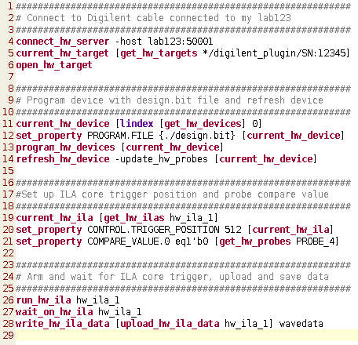
Vivado Logic Analyzer Feature Tcl Scripting
Enables automation of logic debug
Uses common Vivado Tcl engine and concepts
Run tests in interactive or batch mode
Save results for future viewing
Allows you to create custom functions and tests
Create repeatable tests
Link custom Tcl to toolbar buttons in Vivado IDE
More easily integrate into custom test environments

Slide 10
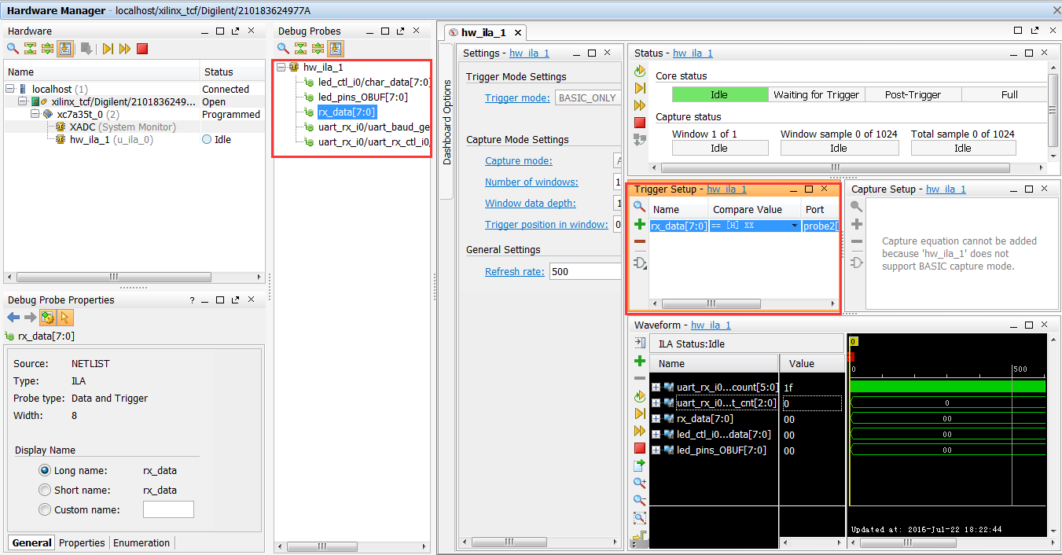
Benefits of Vivado Logic Debug Simplified Debugging
Single trigger comparator type (a.k.a. “match unit”) per PROBE
All comparison types, bit values
No ICON core instantiation required
Handled by auto detection and connections during implementation
Most debug parameters are set during runtime
Minimize unneccessary re-implementation
Focus on debugging the design,
not on the debug core!

Slide 11
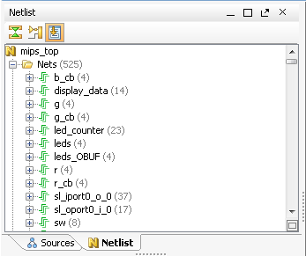

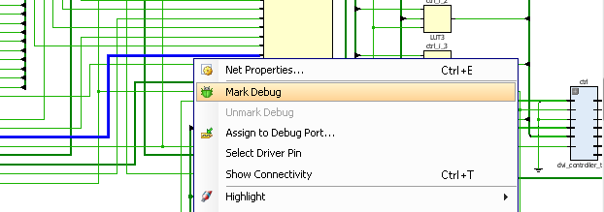
Benefits of Vivado Logic Debug High-level Debugging
Debug Probe
HDL
entity FIR is
port (clk : in
rst : in
din : in
Flexible, targeted probing of HDL design using MARK_DEBUG property
Synthesized design probing in multiple views
System-level probing inside of IP integrator view
Hierarchy
Schematic
Vivado IP Integrator
Debug the design at the appropriate level
Notes:
Users can probe and add debug nets to a design at different design phases including a System-level probing on AXI Interface like Vivado IP Integrator
Leverages the same probing method through out the design
Shorten learning curves
Supports probing in multiple views through GUI and Tcl commands
Allows users to choose a debug method that is suitable to their design flows
Shares the common usage models of adding probes

Slide 12
Outline
Introduction
Logic Debug Cores
Logic Debug Probing Flows
Summary

Slide 13
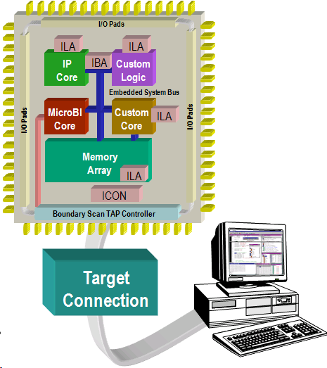
Vivado Integrated Logic Analyzer System
Vivado Design Suite debug cores provide internal visibility to all soft IP
Access to hard IP ports
Accesses all the internal signals, interfaces ports and nodes within the programmable logic (ILA v5.x)
Stimulus can be applied using the Virtual I/O core (VIO v3.x)
Debugging occurs at, or near, system speeds
Debug on-chip using the system clock
Minimize pins needed for debugging
Access via the JTAG interface (debug_core_hub)

Slide 14
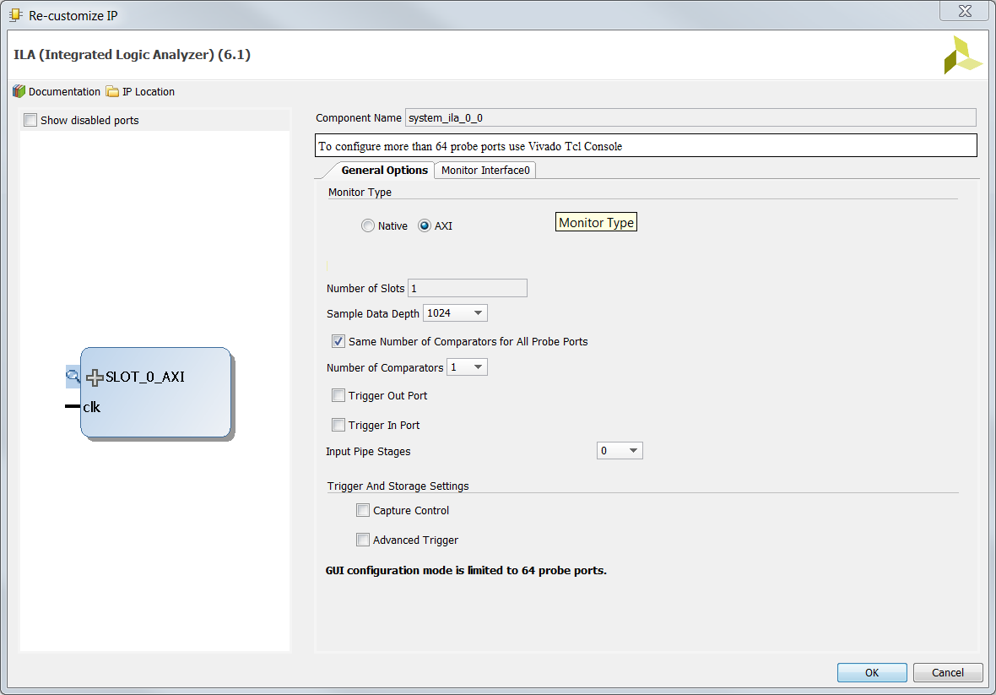
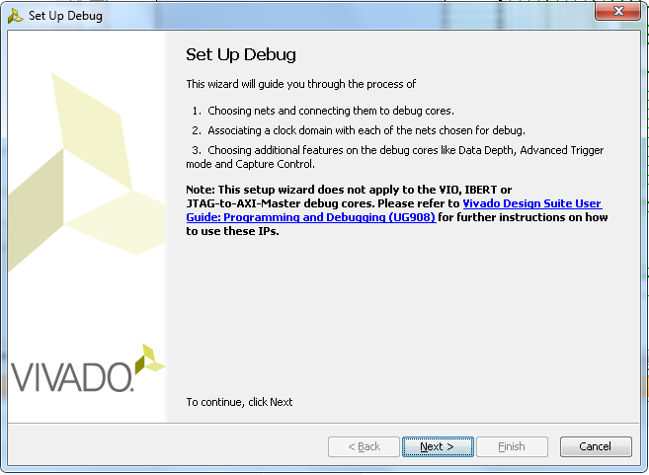
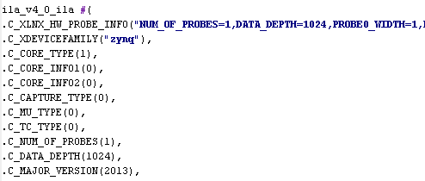
Vivado Logic Debug IP
ILA 6.1
Vivado native Integrated Logic Analyzer debug IP core
Netlist insertion support
HDL instantiation support
VIO 3.0
Vivado native Virtual Input / Output debug IP core
HDL instantiation
ILA 6.1 and VIO 3.0
HDL Instantiation
ILA 6.1
Netlist Insertion
Mark Debug Nets

Slide 15
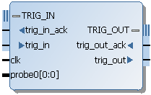
ILA Core
Used for monitoring internal programmable logic signals and ports for post-analysis
Multiple configurable ILA trigger units
Configurable trigger input widths and match types for use with different input signals types
Separate data and trigger inputs
Sequential triggering
Storage qualification
Trigger out signal for cross-probing
Pre- and post-trigger buffering (capture data before, during, and after trigger condition is met)
Notes:
The Integrated Logic Analyzer (ILA) core is a customizable core that can be used to monitor internal programmable logic signals in real time. The ILA core in the embedded system design is useful for monitoring individual signals. This core is based on a Tcl script that generates an HDL wrapper for the ILA core and generates the netlist based on user parameters.
Features include:
Multiple configurable ILA trigger units
Configurable trigger input widths
Configurable match types for use with different input signals types
Separate data and trigger inputs
Trigger-out signal for cross-probing between the analyzer and processor debug tools

Slide 16
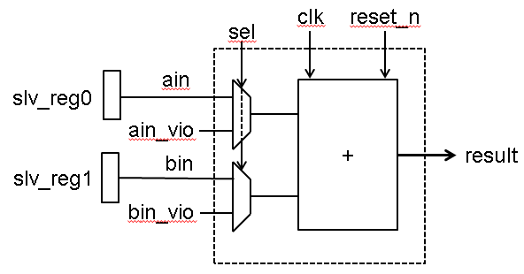
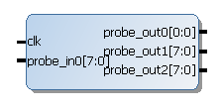
VIO Core
Support for monitoring and driving internal programmable logic signals in "real time"
Probe input unit
Probe output unit
Notes:
The Virtual I/O (VIO) core is a customizable core that can both monitor and drive internal programmable logic signals in real time. The number of ports and their widths depend on the configurable parameters as specified in the table.
Input Probes: These inputs to the VIO core are registered using the design clock that is attached to the CLK input port. The input values are read back periodically and displayed in the Vivado logic analyzer.
Output Probes: These outputs from the VIO core are driven to the surrounding user design. The output values are driven to combinations of 1s and 0s by the Vivado logic analyzer. Output probes can also be initialized to any desired value during generation time.
Activity Detectors: Every VIO core input has additional cells to capture the presence of transitions on the input. Because the design clock is most likely much faster than the sample period of the analyzer, it is possible for the signal being monitored to transition many times between successive samples. The activity detectors capture this behavior and the results are displayed along with the value in the Vivado logic analyzer.
Clock provided by the user is considered a "synchronous" VIO, if the user does not specify a clock (that is, runs the core "asynchronously") then the clock is derived from the JTAG clock. The user assumes all responsibility for managing meta-stable conditions.
"Real time" is a function of both the clock rate used in the sampling core as well as the latency of the PC software, drivers, transmission via UART, and on-chip processing.

Slide 17
Mark Debug
Besides the IP cores insertion, Vivado logic debugging can be done by making nets in the HDL code using Mark Debug property
VHDL syntax example
attribute mark_debug : string;
attribute mark_debug of char_fifo_dout: signal is "true";
Verilog Syntax example
(* mark_debug = "true" *) wire [7:0] char_fifo_dout;

Slide 18
Outline
Introduction
Logic Debug Cores
Logic Debug Probing Flows
Summary

Slide 19
Vivado Debug Probing Flows
Netlist insertion flow (Highly recommended)
Most flexible with high predictability
Probing at different design levels (HDL, synthesized design, system design)
Compatible with various tool modes (Project, Non-project)
HDL instantiation flow
Traditional flow for highest predictability, moderate flexibility
No longer requires ICON core instance
Probing at HDL design level only
Compatible with various tool modes (Project, Non-project)
Netlist insertion and HDL instantiation flows can be mixed
Notes:
Netlist insertion – With this flow, you don’t have to touch your HDL source files, which might be important for some of your customers. It’s our recommended flow because it’s:
Most flexible with high predictability
Probing at different design levels (HDL, synthesized design, system design)
Compatible with various tool modes (Project, Non-project)
HDL instantiation – this flows provides highest predictability as you would have expected because when you instantiate something in your HDL, you are likely to get those signals. The obvious disadvantages of this flow are:
You have to remove debug nets and IP from your design manually – meaning that you will have to touch your HDL source
It’s error prone
Both -- You can also use both flows in the same design. In addition, you can also mix and match new debug cores with legacy debug cores.

Slide 20
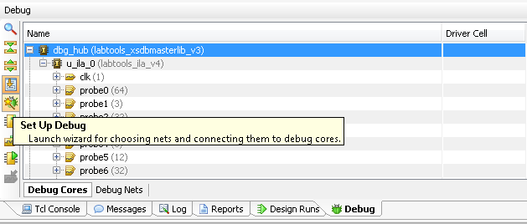
Vivado Debug Tool Access Points
Select Tools > Set up Debug to launch the Vivado Debug Wizard
Debug tab appears in the Synthesized Design view
Click on the Set Up Debug icon to re-launch the wizard
Add signals
Add new ILAs
Create debug core or port
Implement the cores

Slide 21
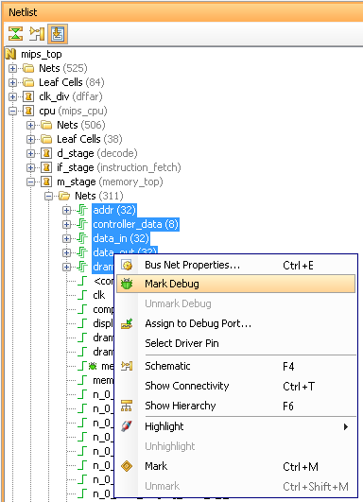
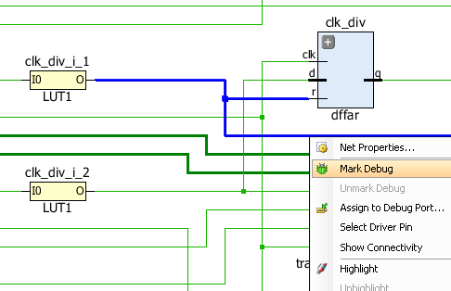
Selecting Signals to Debug
Multiple ways to select nets in Vivado
Netlist view (nets folders)
Each level of logic hierarchy
Schematic
Find results
Right-click the net and select Mark Debug
Nets added to Unassigned Nets folder in the Debug tab view
Placeholder for probable nets prior to configuring cores
Net name search also in the Set Up Debug Wizard
Notes:
The Vivado IDE offers cross-selection from any view and a GUI operation that allows you to select a net object. You can select a net and connect it to debug cores for probing with the debug tools. This includes the Netlist and Schematic views.
When a net is selected and Mark Debug is used, this will add the net name to a temporary folder which will be looked at later by the Set up Debug wizard. You can use this folder to select nets of interest on-the-fly as you are analyzing your design connectivity.
The Set Up Debug Wizard will give you the option of using the unassigned nets folder nets if there are any. There is also a find capability to let you search for nets of interest within the dialog box.

Slide 22
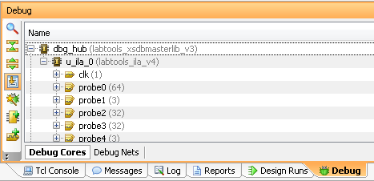
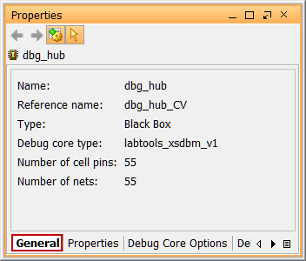
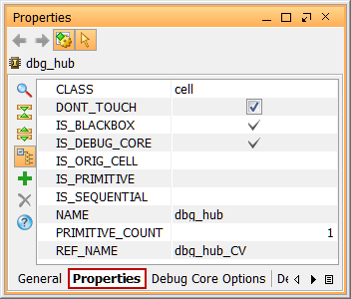
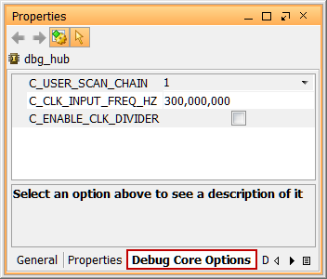
Debug Tool Configuration
The Vivado tool view displays core content and configuration
CLK, PROBE
Signal count
Set options for cores and signals in the Properties view

Slide 23
Outline
Introduction
Logic Debug Cores
Logic Debug Probing Flows
Summary

Slide 24
Summary
Vivado Logic debug features integration, common wave viewer, and Tcl command
Debugging is an integral and important component of embedded system development
The Vivado logic analyzer provides various cores to view the inside of a design—from individual signals to bus-level activities
ILA core
VIO core
The Debug Configuration Wizard simplifies hardware connections and logic analyzer peripheral inclusion
Three Vivado logic debug flows
HDL Instantiation
Netlist insertion
Mark Debug in netlist, schematic, and HDL
Notes:
Module: Debug
Time on foil: 2-3 mins
Key Take-a-way: Vivado logic debug flows prepare you for next Xilinx FPGA devices.
We make sure that the tool is reasonably easy to use and accommodated your needs/requirements.
You can take advantages of these new features today and we’re looking forward for your feedback/comments/suggestions…
Thank you for your time and attention!

