Slide 1
Lab6 Intro Hardware Debugging

Slide 2
Introduction
In this lab you will use the uart_led design that was introduced in the previous labs. You will use Mark Debug feature and also the available Integrated Logic Analyzer (ILA)core (in IP Catalog) to debug the hardware

Slide 3
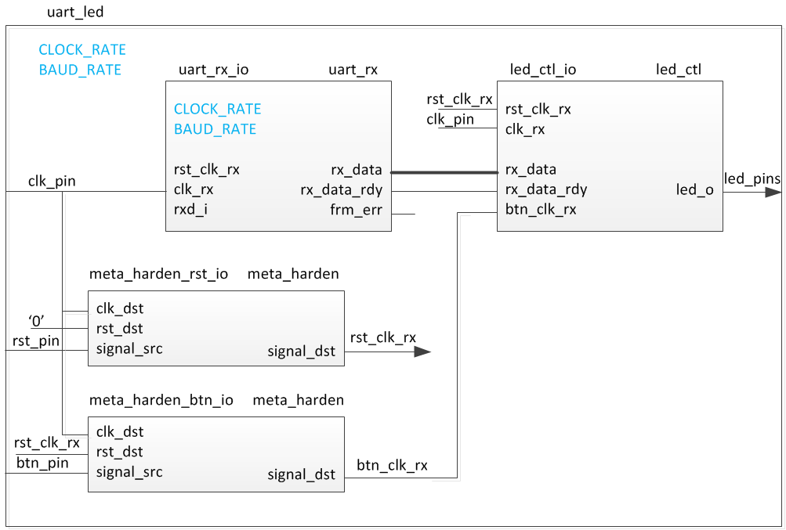
The Design

Slide 4
Procedure
Create the project
Add the ILA core
Synthesize the design and Mark Debug
Implement and generate bitstream
Debug in hardware

Slide 5
Note on target board/device
The lab is written for the Nexys4 DDR, Nexys Video, and the Basys3 boards.
Nexys4 DDR targets the XC7A100TCSG324C-1
Nexys Video targets the XC7A200TSBG484C-1
Basys3 targets the XC7A35TCPG236C-1
The procedure in the lab differentiates between the three boards
Please pay attention to the instructions to ensure the right steps are followed
Also make sure the XDC file used is specific to the target device/board
Notes:
Here is a quick glance of the overview of the entire lab. It doesn’t look too difficult. ;)

Slide 6
Summary
You used ILA core from the IP Catalog and Mark Debug feature of Vivado to debug the hardware design.

