Slide 1

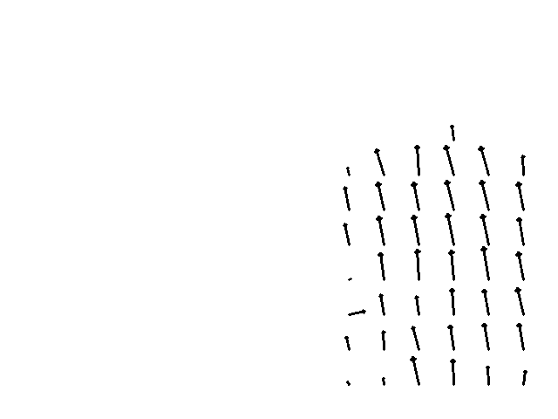
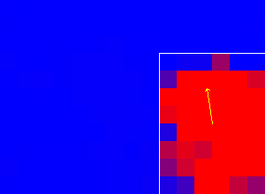



Video Stream
Vector Field
Heat Map
Old gray frame
Current gray frame
Symbol Canvas
OCR - processing
Optical Flow Calculation
Prediction

