Slide 1
Viso-Plasticity
Said Harb, Daniel Nickel, 26.07.2023, Nonlinear Solid Mechanics

Slide 2
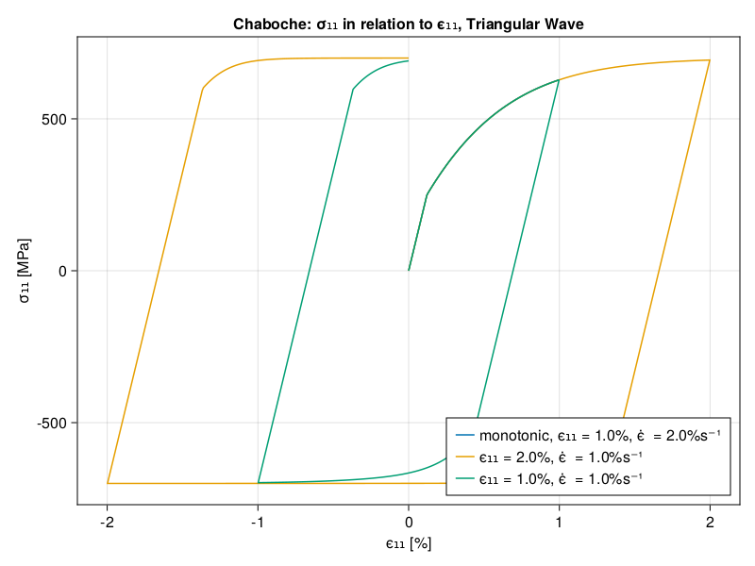
Chaboche Model

Slide 3
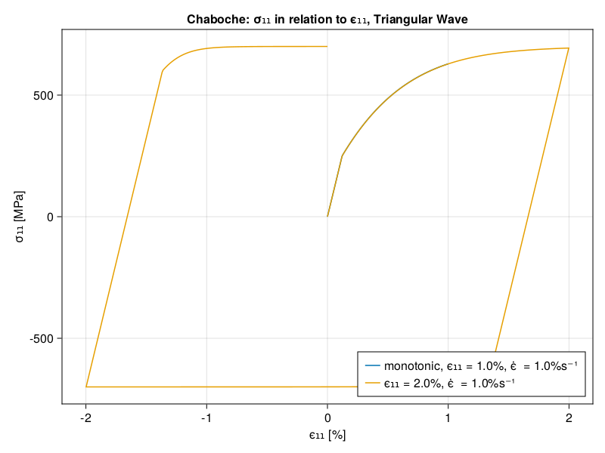
Chaboche Model

Slide 4
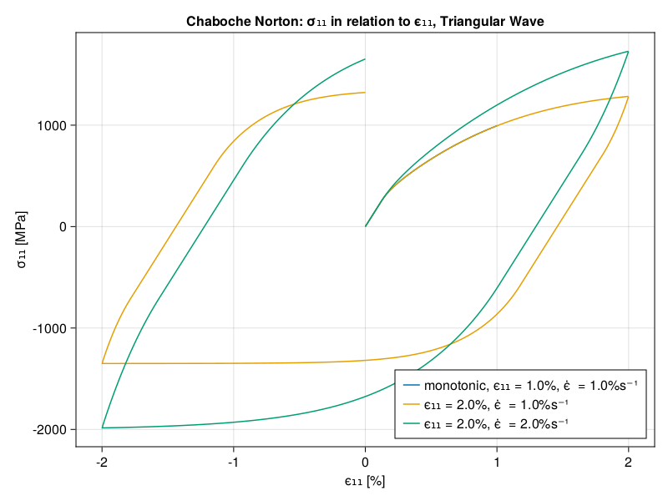
Chaboche Norton Model

Slide 5
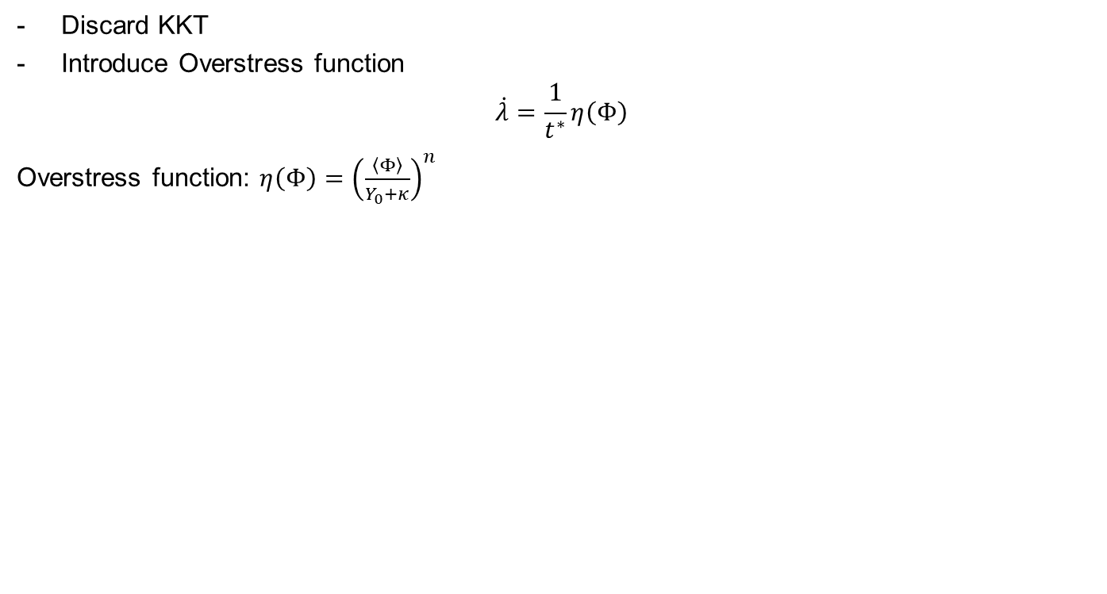
Chaboche Norton: Principle
Discard KKT
Introduce Overstress function
$$\dot{λ}=\frac{1}{t^{∗}}η\left(Φ\right)$$
Overstress function: $η\left(Φ\right)={\left(\frac{\left\langle Φ\right\rangle }{Y_{0}+κ}\right)}^{n}$

Slide 6
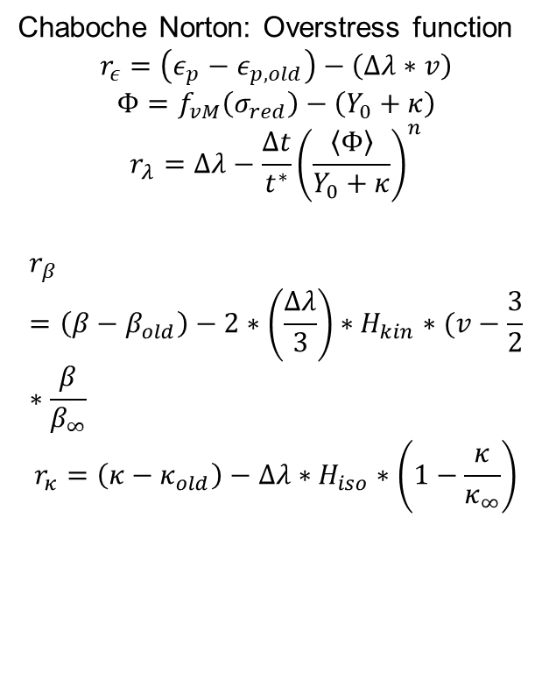
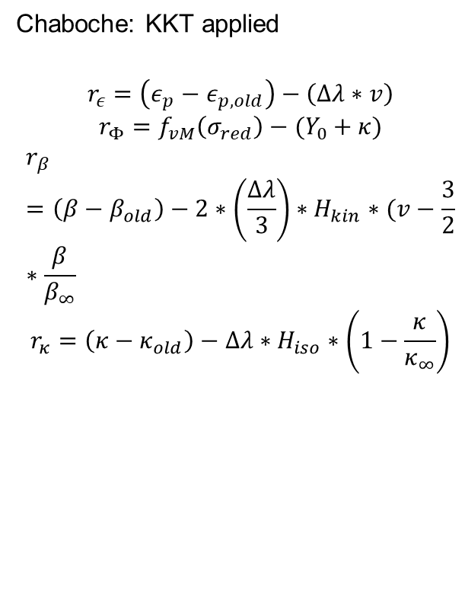
Residual Function
  Chaboche: KKT applied
$$r_{ε}=\left(ε_{p}−ε_{p,old}\right)−\left(Δλ∗v\right)$$
$$r_{Φ}=f_{vM}\left(σ_{red}\right)−(Y_{0}+κ)$$
$$r_{β}=\left(β−β_{old}\right)−2∗\left(\frac{Δλ}{3}\right)∗H_{kin}∗(v−\frac{3}{2}∗\frac{β}{β_{∞}}$$
$$r_{κ}=\left(κ−κ_{old}\right)−Δλ∗H_{iso}∗\left(1−\frac{κ}{κ_{∞}}\right)$$
  Chaboche Norton: Overstress function
  $$r_{ε}=\left(ε_{p}−ε_{p,old}\right)−\left(Δλ∗v\right)$$
  $$Φ=f_{vM}\left(σ_{red}\right)−\left(Y_{0}+κ\right)$$
  $$r_{λ}=Δλ−\frac{Δt}{t^{∗}}{\left(\frac{\left\langle Φ\right\rangle }{Y_{0}+κ}\right)}^{n}$$
$$r_{β}=\left(β−β_{old}\right)−2∗\left(\frac{Δλ}{3}\right)∗H_{kin}∗(v−\frac{3}{2}∗\frac{β}{β_{∞}}$$
$$r_{κ}=\left(κ−κ_{old}\right)−Δλ∗H_{iso}∗\left(1−\frac{κ}{κ_{∞}}\right)$$

Slide 7
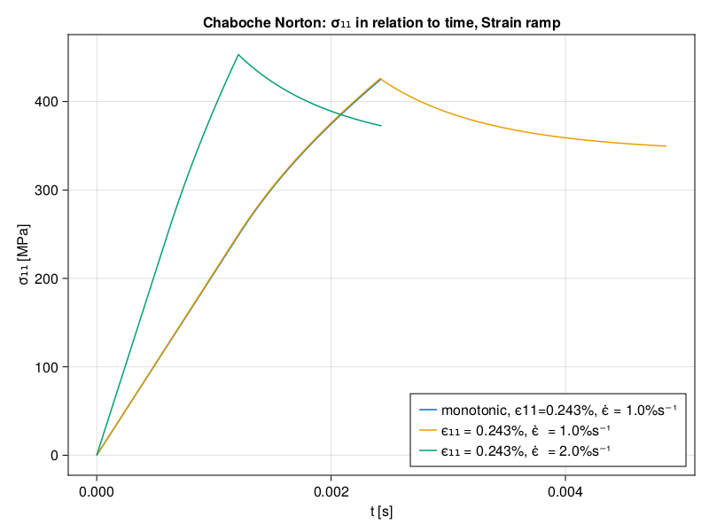
Chaboche Norton: Relaxation

Slide 8
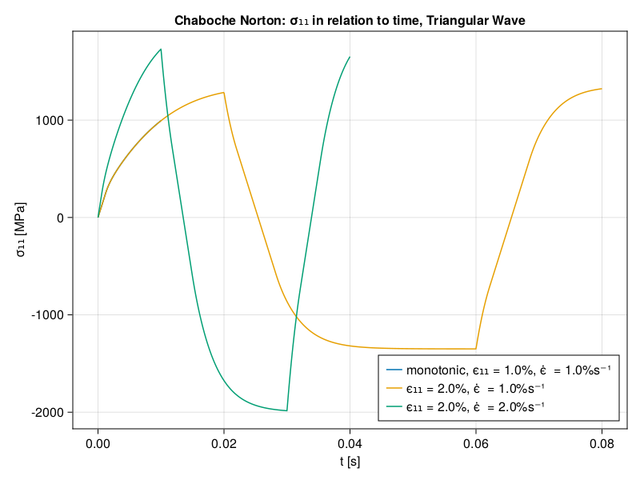
Chaboche Norton: Relaxation

