Slide 1

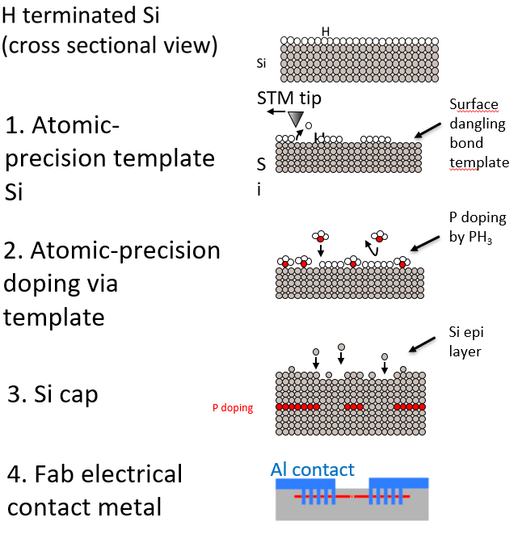
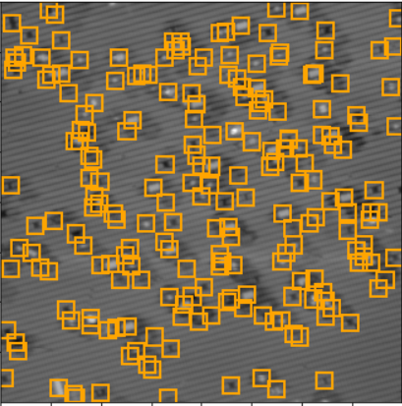
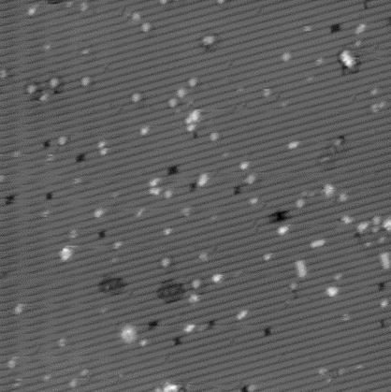
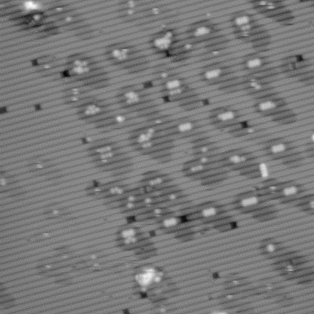
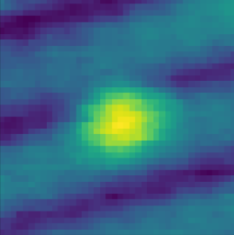
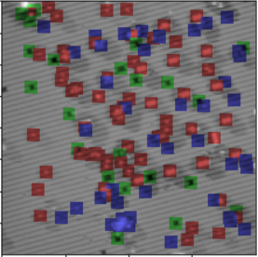
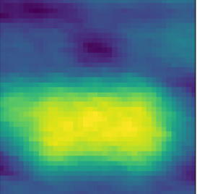
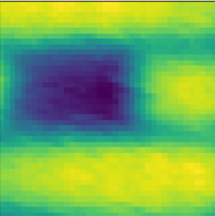
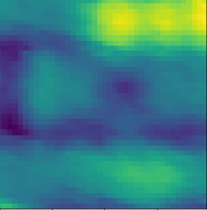
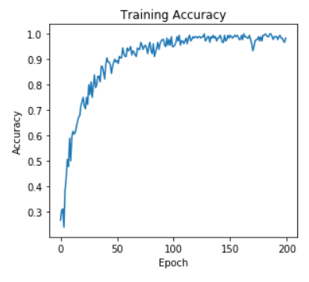
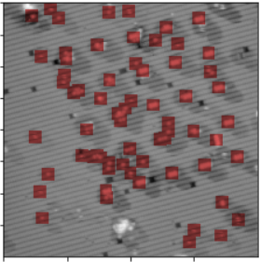
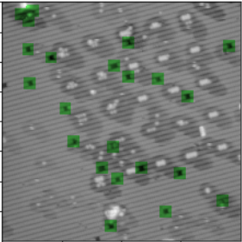
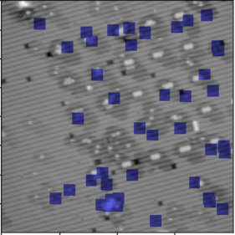


Machine learning detection and classification of defects in STM lithography data
Daniel A. Noble Hernandez[1, 2], Jeff A. Ivie[1], Sergei V. Kalinin[3], Maxim Ziatdinov[3], David Scrymgeour[1], Ezra Bussmann[1, 4], Andy M. Mounce[1, 4] [1] Sandia National Laboratories; [2] The University of Texas at Austin; [3] The Center for Nanophase Materials Science, Oak Ridge National Laboratory;
[4] Center for Integrated Nanotechnology, Sandia National Laboratories
cint.lanl.gov
Introduction
1. STM Lithography Data
2. Defect Detection Neural Network
Atom-by-atom fabrication using scanning tunneling microscopy (STM) has great potential to revolutionize materials synthesis for digital electronics. Key to the fabrication process is the automatic localization and classification of intended or unintended defects – seen in Figure 1(a) below – in STM data.
Auto defect detection and classification:
STM Lithography data
Defect detection neural network
Defect classification neural network
Scanning Tunneling Microscopy is used to generate images like those seen in Figure 2 (b and c)
Bright and dark spots are types of defects
Hydrogen depassivation as seen in Figure 2(a) leads to an array of stripped hydrogen as seen in Figure 2(c)
(a)
Broadly speaking, the first step of the machine learning workflow entails feeding an input image into a convolutional neural network that returns as its output the coordinates of any identified defects.
Autoencoder topology
Pre-trained on separate data
Binary classification of pixels as defect or lattice
Defect pixels’ location returned
(a)
(b)
Lithography Data
Localization CNN
Defect Detection
Classification CNN
Classified defects on original data
H Terminated
Templated
Figure 3: The image shows the output of the localization CNN, with the pixels marked as defects now bearing a bounding box over. These locations can also be used to obtain defect sub-images, to be used in the next part of the workflow.
(b)
(c)
(a)
(b)
(c)
Figure 1: Machine learning workflow showing the input and output data for each network
Figure 2: Hydrogen depassivation (c) is the process by which H atoms are removed. A hydrogen-passivated silicon surface (b) and another that has been depassivated (c), displaying an array of hydrogen-removed areas, both show varieties of defects.
3. Defect Classification Neural Network
Conclusions & Future Steps
Convolutional Neural Network takes defect sub-images as input
Classifies as lattice or 1 of 3 defect classes
Training accuracy of 0.98 is promising
Limited training set of 180 images
Tested on 20 labeled images with 0.91 accuracy
Figure 5:The three types of defect sub-images are shown in (a), (b), and (c), showing instances of classes 1, 2, and 3 respectively. Classification results overlaid on the original STM image are seen in (d), (e), and (f), showing defect classes 1, 2, and 3 respectively.
(a)
(b)
(c)
Immediate next steps will focus on the second part of the workflow. Although results from the classification network are promising, there are significant improvements yet to be made. During training, testing accuracy was shown as 0.91 on a very limited testing set, so expanding the data available for training will likely lead to significant improvement.
Three areas for future direction:
More training
Human verification
More labeled data
1. Ziatdinov, M., Fuchs, U., Owen, J.H.G., Randall, J.N., & Kalinin, S.V. Robust multi-scale multi-feature deep learning for atomic and defect identification in Scanning Tunneling Microscopy on H-Si(100) 2x1 surface (2020)
(d)
(b)
(c)
Figure 4: Current training accuracy of network is around 0.98
(e)
(f)
SAND2020-9961 J
Sandia National Laboratories is a multi-mission laboratory managed and operated by the National Technology and Engineering Solutions of Sandia, LLC, a wholly owned subsidiary of Honeywell International, Inc., for the DOE’s National Nuclear Security Administration under Contract No. DE-NA0003525. This work was funded by the Laboratory Directed Research and Development Program and performed, in part, at the Center for Integrated Nanotechnologies, an Office of Science User Facility operated for the U.S. Department of Energy (DOE) Office of Science.
Notes:
Atom-by-atom fabrication using scanning tunneling microscopy (STM) has great potential to revolutionize materials synthesis for digital electronics. Key to the fabrication process is the automatic localization and classification of intended or unintended defects – seen in Figure 1(a) below – in STM data.
This is a complex instance of an object detection problem that seeks to automate a human analysis task; we are addressing it by developing a two-step machine learning workflow involving two convolutional neural networks. The first, with an autoencoder topology, identifies defects on the surface that are not part of the standard silicon surface layer and creates an array of defect sub-images – as seen in Figure 1(b) as its output. This output feeds into the next CNN, which classifies each defect as a silicon vacancy, hydrogen depassivated site, or an unidentified feature. A visualization of these classifications for each sub-image are shown overlaid on the original image in Figure 1(c).
Scanning tunneling microscopy is used to generate atomic-scale images of surfaces, and for our purposes, provides images of hydrogen-passivated silicon surfaces. Sample images, illustrating surfaces before and after hydrogen depassivation – the removal of hydrogen atoms from the silicon surface – are shown in the figure below.
In both images, rows of H-passivated silicon dimers – paired silicon atoms with hydrogen attached – make up the background. The defects that we are interested in locating and classifying show up in both images as anything that stands out from this silicon background, with a clear distinction shown between bright spots and dark spots; in our classification, we denote three kinds of defects and predict accordingly.
Broadly speaking, the first step of the machine learning workflow entails feeding an input image into a convolutional neural network that returns as its output the coordinates of any identified defects.
The object localization network – using an autoencoder topology – was already pre-trained using separate data and when fed an input image, it categorizes each pixel in a binary fashion as either a defect or not. The pixel locations are then returned and can be used to draw bounding boxes around the defects as shown in Figure 3.
From this stage, it was fairly trivial to extract an array of sub-images of the defects given the coordinates, which forms the basis for the input into the classification network.
The second part of the machine learning workflow is the classification convolutional neural network. This network takes as its input the sub-images centered around defects and returns 4 possible labels, either background silicon or one of three possible defects. The network was trained on a set of 180 sub-images – evenly distributed over the four possible classes – taken from an STM image of a hydrogen-passivated silicon surface and human labels placed on each, identifying each one as either a silicon atom (label of 0) or a defect (possible labels of 1, 2, or 3). The network’s training accuracy and loss are shown in Figure 4. A limited testing set of 20 sub-images yielded a testing accuracy of 0.91, though significant improvement is expected using larger sets to train and test. The results of running the network on a new dataset are shown in Figure 5.

