Slide 1
CAMPUS CUISINE
Development Presentation
A .NET MAUI restaurant ordering app on a FastAPI backend
Module: Full-Stack Software Development
Submission: April 2026
SSIDs: 2308353 | 0804824

Slide 2
1
THE BRIEF
Requirements & rubric mapping
How the assignment brief was decomposed into MUST / SHOULD / MAY requirements, traced to design, and verified by the rubric.
01

Slide 3
BRIEF DECOMPOSITION
Requirements & rubric mapping
All
16 / 18
3 / 12
MUST requirements covered
SHOULD fully delivered (2 partial)
MAY fully delivered (3 partial)
Brief structure
How it traces
General application requirements (flyout nav, primary pages, persistent state)
Required pages (Welcome, Main, Dessert, Order Summary)
Order management (multi-quantity, totals, consistency)
Backend & APIs (REST, OpenAPI CRUD, status, validation)
Technology (.NET MAUI, MVVM, DI, reusable components)
Testing, documentation, project management, ethics
Each requirement assigned an ID (GEN-01, MAIN-04, TECH-06)
Mapped to a design response, owner, and concrete code evidence
Stored in docs/requirements/requirements-mapping.md
Reviewed against rubric before each milestone
Out-of-scope MAYs explicitly recorded with reason
SHOULD partials: Admin protection is x-admin-key not full RBAC, status display is confirmation only not live.
02

Slide 4
NUMBERS
Repository at a glance
136
11
261
5
commits across both members
pull requests merged
automated tests (51 + 210)
weeks of weekly board snapshots
Technology stack
Frontend: .NET MAUI 10 with XAML and C#; CampusCuisine.Core (platform-neutral) for view-models and services
Backend: FastAPI + SQLModel + SQLite + Pydantic settings; OpenAPI docs surface; static image serving
Tests: xUnit on the frontend (210), pytest on the backend (51); test doubles for dialogs, navigation, http, and cache
Where it lives
All source, tests, and supporting documentation in a single GitHub repository at github.com/DanielOlive-ARU/campus-cuisine
Repository structure: FrontEnd/ (MAUI app), CampusCuisine.Core/ (shared logic), CampusCuisine.Tests/ (xUnit), backend/ (FastAPI), docs/ (requirements, viva, ethics, project management)
10

Slide 5
2
BUILD
Architecture & implementation
System architecture, frontend MVVM layering, backend service shape, and the customer order journey end-to-end.
03

Slide 6
HOW THE PIECES FIT
System architecture
.NET MAUI app
REST contract
FastAPI service
REST + JSON over HTTP
MAUI Shell flyout
MVVM in CampusCuisine.Core
Constructor DI on every page
Offline cache decorator
GET /api/menu(?category=)
POST /api/orders
Admin CRUD (x-admin-key)
PATCH /api/admin/orders/{id}/status
FastAPI + SQLModel + SQLite
Pydantic validation
OpenAPI docs at /docs
Static images at /images/
Server-as-price-authority
Admin x-admin-key
Pydantic validation
Backend re-prices every order. Frontend submits item ids and quantities only; totals come from the server. Protects users from a tampered client.
Single header guards all mutating admin endpoints. Defendable for a student project; replaceable later by full RBAC. One dependency function would change.
extra=forbid; positive prices and quantities; non-blank names; known menu-item ids. Bad payloads rejected at the boundary, not deep in business logic.
04

Slide 7
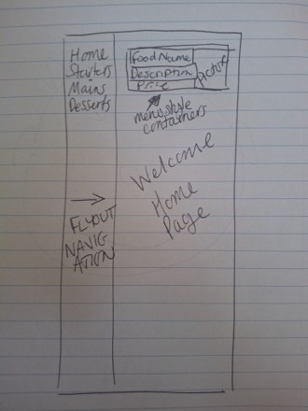
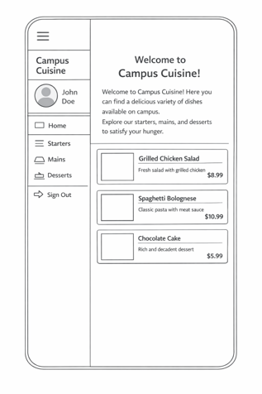
BEFORE THE PROJECT
Wireframe Concepts
Initial Wireframe
Refined Wireframe Concept
05

Slide 8
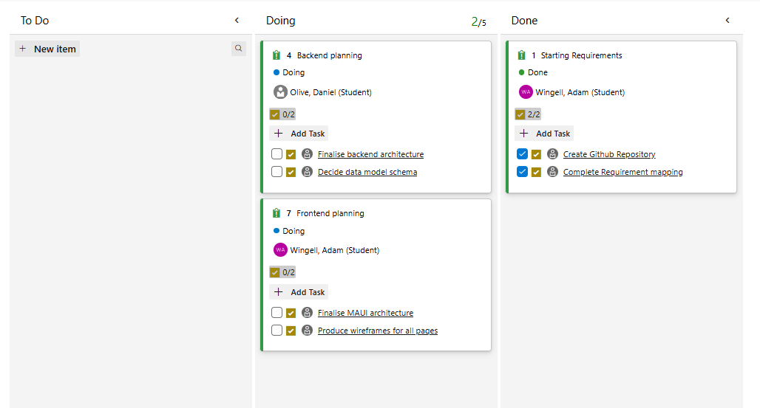
BEFORE THE PROJECT
Azure DevOps Development Timeline Week 1
08

Slide 9
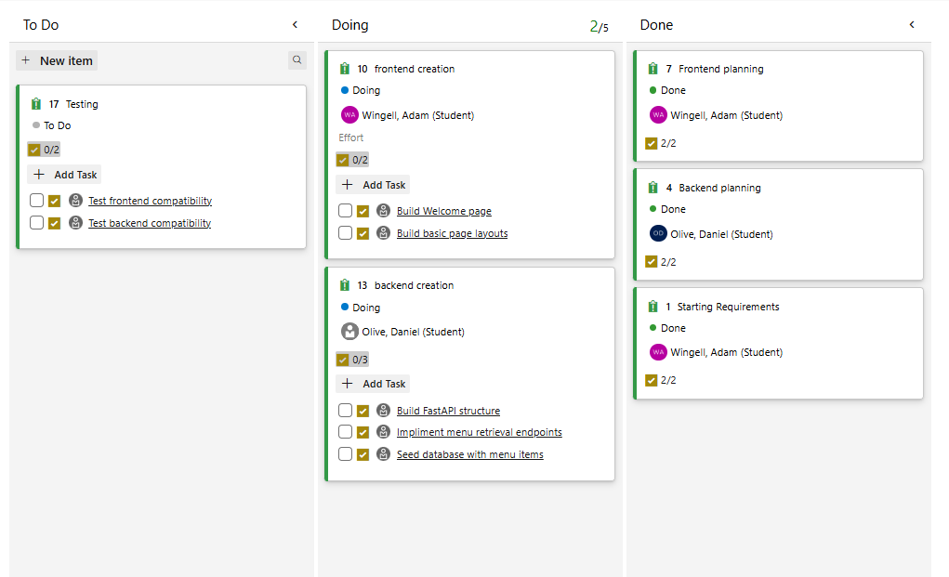
BEFORE THE PROJECT
Azure DevOps Development Timeline Week 2
08

Slide 10
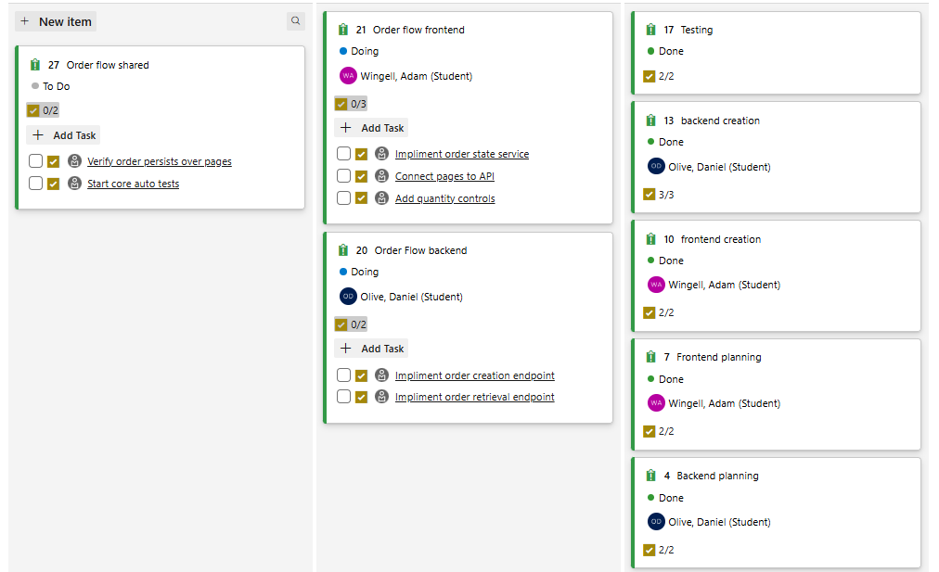
BEFORE THE PROJECT
Azure DevOps Development Timeline Week 3
08

Slide 11
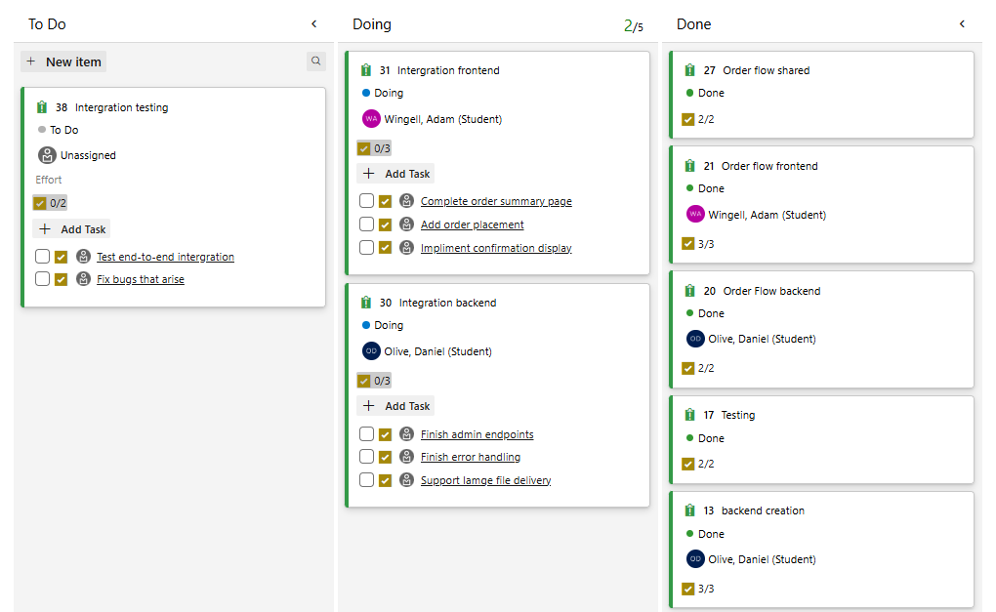
BEFORE THE PROJECT
Azure DevOps Development Timeline Week 4
08

Slide 12
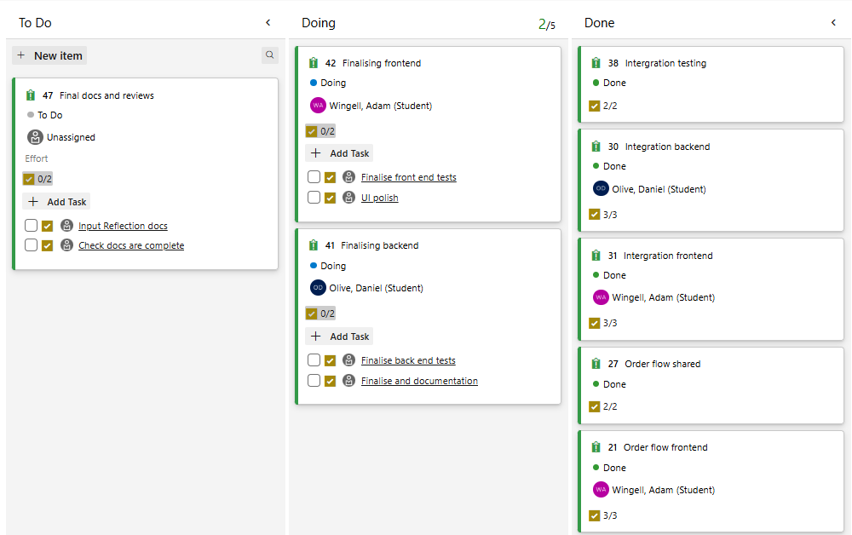
BEFORE THE PROJECT
Azure DevOps Development Timeline Week 5
08

Slide 13
LAYERED ARCHITECTURE
Frontend MVVM
210
tests across 24 commits / 5 phases
Views
HomePage, OrderSummaryPage, MenuItemView, OrderSummaryBar, HelpPage
MAUI seam
XAML pages, thin code-behind
Pages registered in DI, constructor injection
MauiDialogService wraps Shell.DisplayAlertAsync
ShellNavigationService wraps Shell.GoToAsync
PreferencesMenuCache wraps MAUI Preferences
Hand-rolled RelayCommand / AsyncRelayCommand (no NuGet)
Sync projections preserve VM identity (match-by-id)
Core has zero MAUI references
View-models
HomePageViewModel, OrderSummaryPageViewModel, OrderSummaryLineViewModel, MenuItemCardViewModel
Per-page + per-line
Services
IOrderStateService, IApiService, IDialogService, INavigationService, IMenuCache
Singleton state + abstractions
Models
OrderLineEntry, MenuItemSnapshot (record), OrderLineDto (wire only)
Records + serialisation DTOs
05

Slide 14
API SURFACE AND DESIGN CHOICES
Backend service
Method | Endpoint | Purpose | Auth
GET | /api/menu | List menu items (optional category filter) | public
GET | /api/menu/{id} | Single item lookup | public
POST | /api/orders | Create order; server prices and returns prep time | public
GET | /api/orders/{id} | Retrieve order with status and snapshot lines | public
CRUD | /api/admin/menu-items | Add / change / remove menu items via OpenAPI docs | x-admin-key
PATCH | /api/admin/orders/{id}/status | Order status transitions (confirmed -> cancelled) | x-admin-key
Why FastAPI + SQLModel
Why server-side totals
Status workflow scope
REST routing, dependency injection, automatic OpenAPI docs. SQLModel keeps types tidy. SQLite satisfies the brief's 'add food without code changes'.
Backend is the source of truth. Cannot trust client arithmetic. Easy to test. Protects users from a tampered or buggy client. Same principle for prep time.
confirmed -> cancelled only. Same-status updates idempotent; reverse transitions rejected. Minimal, defendable, aligned to the brief - not overbuilt as a full kitchen system.
06

Slide 15
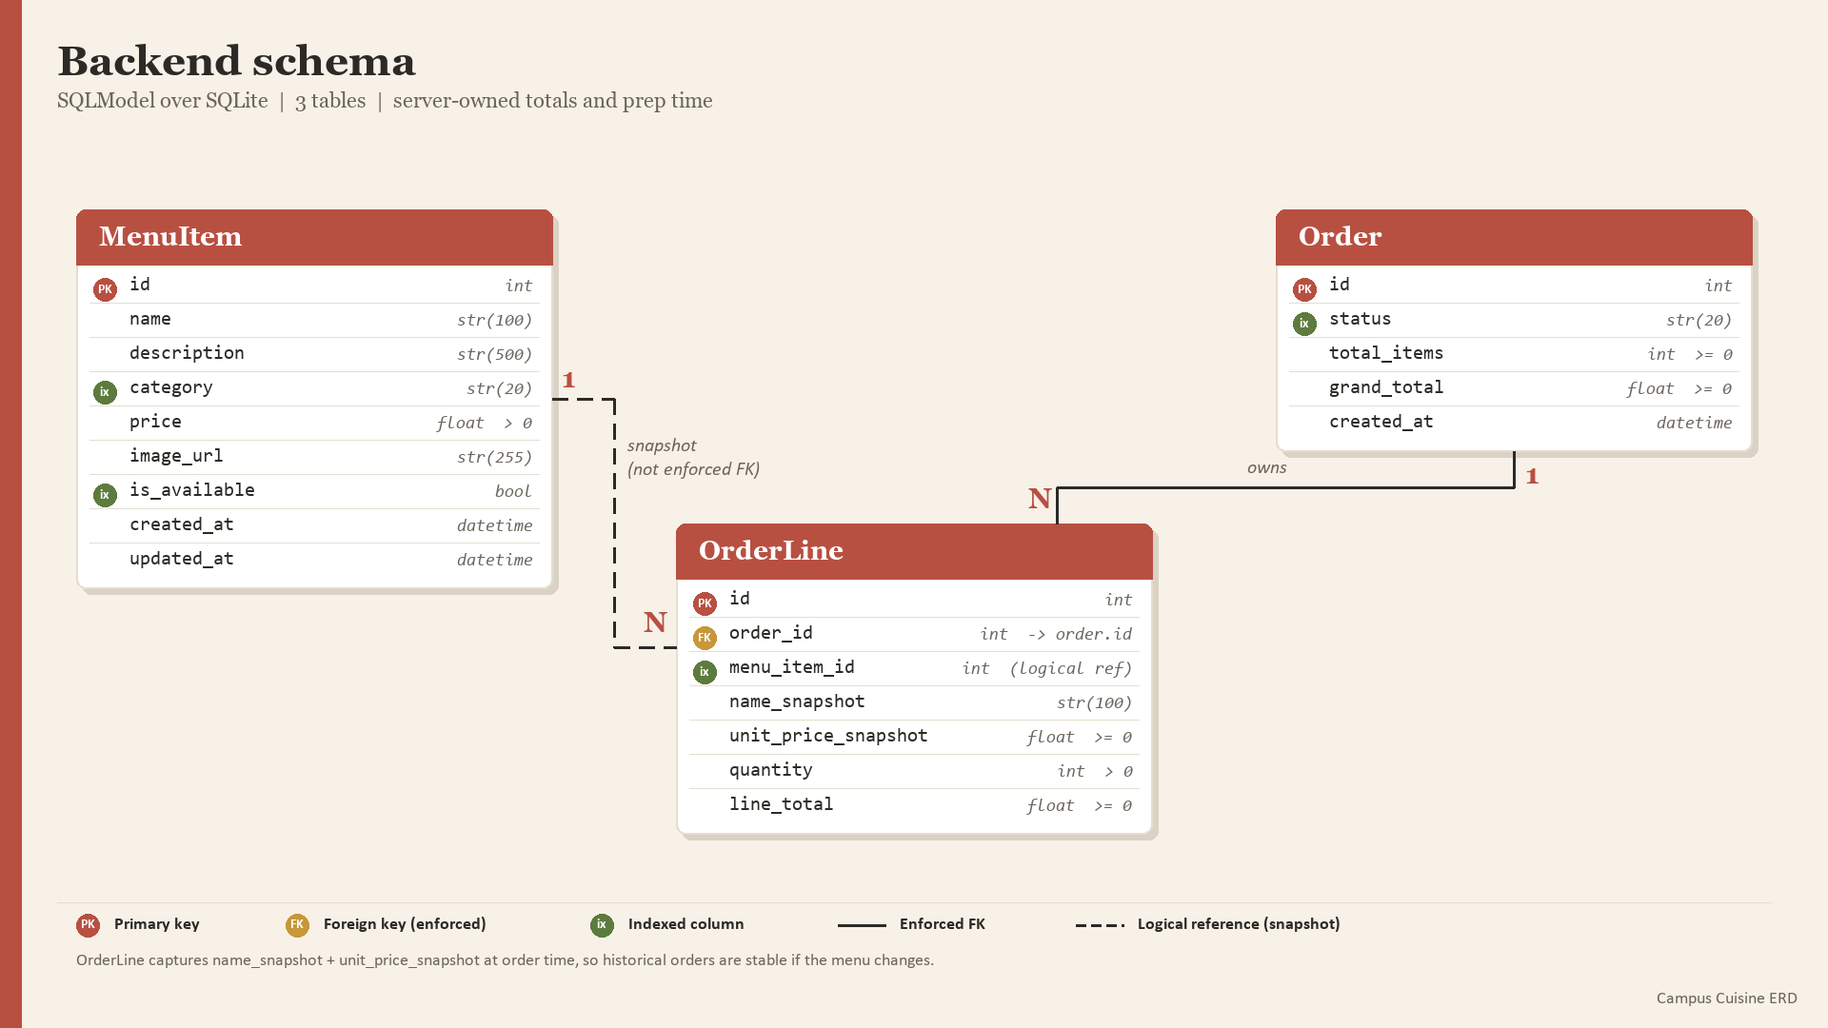
06

Slide 16
CUSTOMER EXPERIENCE
Order journey end-to-end
1
2
3
4
5
6
Browse
Add
Adjust
Review
Place
Confirm
Mains / Starters / Desserts via flyout
+ button captures snapshot to cart
Summary bar + per-card quantity
Edit, remove (with confirm), clear
Animation + busy-state guard
Order id, status, prep time
What guards the journey
Confirmation dialogs on every destructive action (remove line, clear order)
Place Order is busy-state guarded: button text and IsEnabled bound to IsPlacingOrder so a user cannot double-submit
Server re-prices the order on POST: client-side totals are display only; the confirmation message uses server numbers
Empty-cart state shown explicitly with disabled checkout; no silent path to a zero-line order
07

Slide 17
WHO BUILT WHAT
Team contribution split
Commits in main
Adam 41
Dan 95
Adam - foundation, PM
Dan - backend, tests, post-merge MVVM
Original MAUI scaffold and .NET 10 framework migration
Unified MenuItemView with menu-item injection model
Original shared OrderState service (snapshot ownership pattern)
Original Order Summary page and checkout flow
Menu quantity controls, platform-aware API base URL
API integration on category pages, backend-down error surfacing
Initial wireframe; weekly meetings documentation
Weekly project board (Azure DevOps)
Backend sole owner: FastAPI service, OpenAPI, validation
Admin x-admin-key router-level dependency
Server-side totals, estimated preparation time
Order status workflow
Entire automated test suite: 51 backend pytest + 210 frontend xUnit
Test infrastructure: Core/Tests project split
Reusable OrderSummaryBar, IOrderStateService
Brand vocabulary; offline cache; animation; prep time display
Post-merge MVVM refactor: 5 phases / 24 commits / PR #11
11

Slide 18
BEYOND THE MUST BASELINE
SHOULD / MAY: delivered
SHOULD - 16 of 18 delivered, plus 2 partial
MAY - 3 of 12 delivered, plus 3 partial
Consistent branding via shared Brand* tokens in Styles.xaml
Help page added to the flyout (additional primary page)
Distinct dessert palette via BasedOn overrides
Dynamic dish images served from the backend
Offline menu browsing (CachedApiService decorator)
Place Order press animation (ScaleToAsync 80ms in/out)
Order cancellation prior to checkout (Clear Order)
Partial: x-admin-key admin protection (NOT full role-based access control)
Partial: order status shown at confirmation (NOT live status updates)
Featured cards on Home: Today's pick + Today's indulgence
Estimated preparation / delivery time on order confirmation
Partial: CI workflow exists but is manual-trigger only (TEST-07)
Partial: in-app order confirmation alert (MAY - alert, not push notification)
Partial: guest-style ordering by default (MAY - no explicit guest flow)
08

Slide 19
HONEST SCOPE
Out of scope by design
These MAY items were deliberately deferred.
Order history + reorder
Authentication / accounts
Highest-priority next feature - pairs with existing GET /api/orders/{id}. Needs a list endpoint and a History page. Deferred because it would re-introduce a notion of user identity that the current data-minimisation posture deliberately avoids.
Foundational. Touches data handling (re-introduces personal data), security (password hashing, session management, RBAC), persistence (user table, order ownership), and every page that currently assumes guest flow. High-leverage but not a one-week item.
Payment sandbox
Analytics dashboard
Depends on real authentication and persisted orders with status transitions. PCI considerations apply even in sandbox mode. Deferred until the auth foundation lands.
Would be useful for the operator but introduces data-handling questions (aggregate vs personal, retention, opt-out). The current no-PII posture should be revisited consciously before adding this.
09

Slide 20
3
QUALITY & REFLECTION
Tests, decisions, AI usage, ethics, and what's next
How we verified the build, the four challenges that shaped the design, where AI helped and where judgement stayed human, and the future-development roadmap.
12

Slide 21
VERIFICATION
Automated test suite
261
automated tests passing
Backend - 51 pytest tests
Frontend - 210 xUnit tests
Health endpoint and startup behaviour
Seed-on-empty + seed idempotency + category coverage
Menu listing, filtering, and item lookup
Admin authentication and CRUD
Order creation, totals, and persistence
Estimated prep-time calculation
Order status transition rules + idempotency + reverse rejection
OrderState behaviour: add / decrease / set / clear / totals
View-models: HomePage, OrderSummary (page + line), MenuItemCard, MenuItemView
Sync projections: OrderSummaryLineSync, MenuItemCardSync (match-by-id, identity preservation)
Hand-rolled RelayCommand + AsyncRelayCommand contract
OrderConfirmationPresenter formatting (invariant culture)
ApiService + CachedApiService decorator (fallback paths)
Test doubles: FakeApiService, FakeDialogService, FakeNavigationService, FakeMenuCache, FakeHttpMessageHandler
13

Slide 22
REAL CHALLENGES FROM THE BUILD
Challenges & decisions
Order Summary navigation got stuck
Quantity Entry desync
Problem Opening Order Summary as a pushed Shell route left the previous flyout item selected; tapping it again did nothing.
Fix Treat Order Summary as a top-level Shell destination; navigate via absolute //OrderSummaryPage route.
Evidence commit f649e36, decision-log entry
Problem Editable Entry could drift from the committed quantity; binding directly to Quantity allowed transient invalid values.
Fix Lift QuantityText buffer onto OrderSummaryLineViewModel; pure TryValidateQuantity helper for the validation logic.
Evidence commits b0990c7 / 16b8c48 / 4c960cc
Wholesale collection rebuild lost focus
Pre-merge frontend was 'pragmatic MVVM'
Problem MenuItemView's Clear() + re-add pattern on every cart change destroyed scroll position and Entry focus.
Fix Match-by-MenuItemId incremental sync (OrderSummaryLineSync, MenuItemCardSync) preserves view-model identity.
Evidence commits fb910a4 / 8aa22d7
Problem Code-behind handlers, page-as-view-model, service-locator on pages all weakened the LO3 MVVM defence.
Fix 5-phase MVVM refactor: ICommand on every action, IDialog/INavigation abstractions, constructor DI on pages.
Evidence PR #11 (commit a6ccbf5) - 24 commits / 5 phases
14

Slide 23
HOW AI TOOLS WERE USED
AI usage during development
Required by the rubric across LO1+2, LO4+5, and LO6 of the viva. Below is what we used AI for, what stayed human, and how outputs were evaluated.
Where AI was used
Where AI was not used
How outputs were evaluated
Drafting documentation (viva notes, ethics, decision log)
Refactor planning: scoping the 5-phase MVVM with rollback anchors
Code generation for low-risk patterns: RelayCommand, OrderConfirmationPresenter
Bug-diagnosis dialogue (Order Summary navigation issue)
Cross-document consistency review (test counts, attribution, stale references)
API contract design
Scope decisions (what to ship vs defer)
GUI smoke testing
Architectural trade-offs (singleton OrderState, x-admin-key, prep-time confirmation-only)
Team coordination
Every AI-suggested code change committed as a separate green-building commit
dotnet build + dotnet test ran to green before the next commit
Rollback-anchor tags pre-homepage, pre-summary-vm, pre-commands marked known-good states
Documentation drafts checked against actual code
15

Slide 24
DESIGN PRINCIPLES
Ethics & accessibility
Ethics
Accessibility
Data minimisation: no accounts, no PII collected, no analytics by design
Server-as-price-authority: backend re-prices every order so a tampered client cannot manipulate totals
Confirmation dialogs on every destructive action remove line, clear order
Place Order is busy-state guarded against double submission
Admin x-admin-key protects mutating endpoints
Visible error messages on API failures rather than silent swallow
Honest counter-position on offline cache: user only sees degraded state if cache is empty
High-contrast brand palette: BrandInk text on light brand surfaces
Generous touch targets on menu-card +/- controls
Visible text labels (no icon-only controls)
All limitations documented in docs/ethics-and-future-development.md
16

Slide 25
WHAT'S NEXT, ORDERED BY LEVERAGE
Future development
PRIORITY 1
Order history, reorder from history, promo code / discount field.
High value, near-immediate
PRIORITY 2
Richer order-status workflow (received -> preparing -> ready -> collected); authentication and accounts (foundational; unlocks history, payments, admin RBAC).
High value but architecturally weighty
PRIORITY 3
Payment sandbox (Stripe or equivalent; depends on auth and persisted orders); real-time kitchen workflow (websockets / push); analytics dashboard (requires conscious data-handling revisit); multi-branch support.
Higher cost or compliance-heavy
PRIORITY 4
Staged GitHub Actions pipeline (tests then artifacts); Android image-loading fix (currently a documented limitation); accessibility hardening pass (screen-reader audit, font scaling).
Production polish
17

Slide 26
QUESTIONS?
Thank you
Reference docs in the repo:
docs/viva/backend-viva-notes.md - deep backend Q&A reference
docs/viva/frontend-mvvm-refactor-notes.md - deep MVVM Q&A reference
docs/requirements/requirements-mapping.md - every requirement traced to evidence
docs/ethics-and-future-development.md - ethics, AI usage, prioritised future work
docs/meetings/decision-log.md - architectural decisions with reason and alternatives

