Slide 1
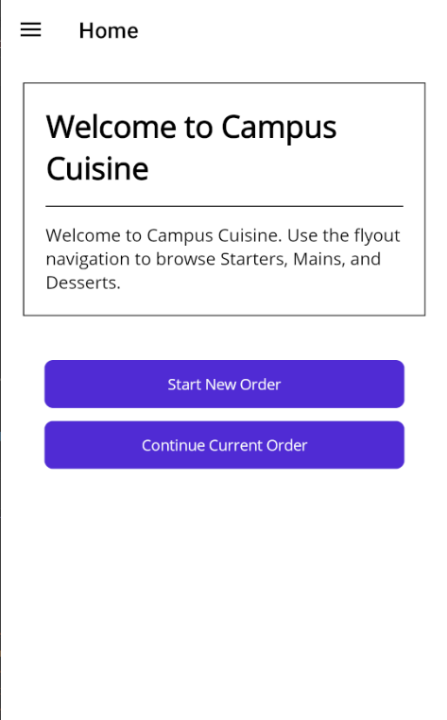
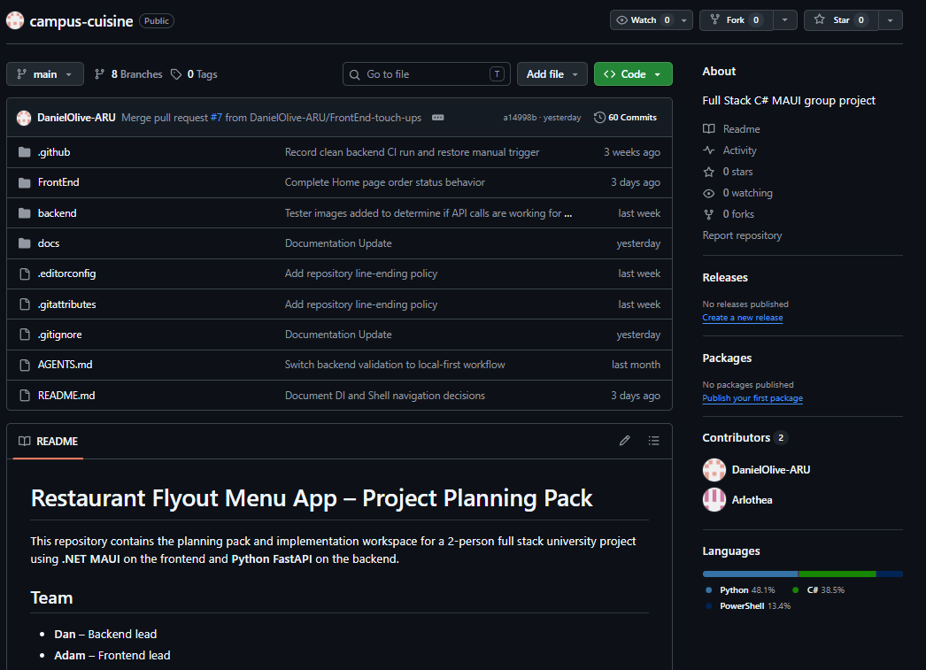
Campus Cuisine
Development Presentation
Prepared by: SSID: 2308353
SSID: 0804824
Module: Full stack software development

Slide 2
Git Commit and Folder structure
Git commit description and folder description
FOLDER STRUCTURE SCREENSHOT
COMMIT HISTORY SCREENSHOT
2

Slide 3
Project overview
APP overview description
Icons and labels (fonts etc)
Main features
APP OVERVIEW
HOMEPAGE SCREENSHOT
UI FEATURES
MAIN FEATURES
MENU CARD EXAMPLE SCREENSHOT
ORDER SUMMARY SCREENSHOT
3

Slide 4
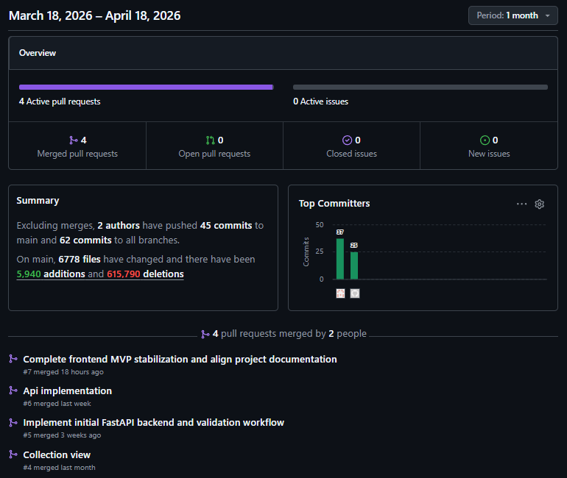
GitHub repository
Repository name:
Main branch used:
Development period:
Contributions and commits over the month
4

Slide 5
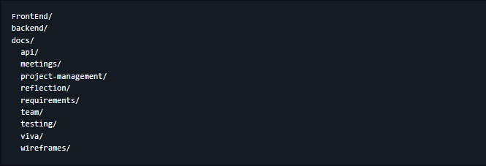
Initial planning and technical setup
Initial project idea.
Provisional file structure.
Chosen technologies:
TECH STACK
INITIAL FILE STRUCTURE
5

Slide 6
Requirements and project goals
Functional requirements
Non-functional requirements
Display food items or menu categories
Add and remove items from cart
Complete checkout
Store order details in the database
Generate receipt or confirmation output
Usable and easy to navigate
Reliable when handling order data
Maintainable code structure
Fast enough for normal campus usage
6

Slide 7
Development timeline
1. Setup
2. UI build
3. Database
4. Integration
5. Testing
1
2
3
4
5
Project created
Tech selected
Pages and components
added
Schema and SQL
work added
Frontend + backend
connected
Fixes and refinements
made
7

Slide 8
Phase 1 – Front-end development
Pages or views created: homepage, all menus
Components built: menu cards
Navigation and layout decisions
Style decisions: simple light layout description
UI STYLE
UI STYLE
DESSERTS SCREENSHOT
MAINS SCREENSHOT
8

Slide 9
Phase 2 – Database design
Database tables
Fields
How products, orders, and receipts relate to each other?
SCHEMA
SCREENSHOT OF BACKEND SCHEMA
9

Slide 10
Phase 3 – Backend integration
Frontend connected to backend endpoints
Menu data fetched from the database
User actions sent from the UI to the backend
API FLOW
BACKEND FILE
INTEGRATION EVIDENCE
10

Slide 11
Phase 4 – Cart, checkout, and order storage
Add-to-cart and quantity logic implemented
Checkout form or confirmation step built
Order data sent to backend and stored in database
Receipt or confirmation feature generated after submission
CART SCREEN
CHECKOUT SCREEN
ORDER STORAGE PROOF
11

Slide 12
Testing and debugging
What was tested
Methods
Evidence
Menu loading
Cart updates
Checkout submission
Database insertions
Receipt output
Manual testing
Step-by-step checks
Repeat bug fixes
12

Slide 13
Challenges and solutions
Challenge
How it was solved
Evidence
[Add challenge 1]
[Explain fix]
Add commit / screenshot
[Add challenge 2]
[Explain fix]
Add commit / screenshot
[Add challenge 3]
[Explain fix]
Add commit / screenshot
[Add challenge 4]
[Explain fix]
Add commit / screenshot
13

Slide 14
Final outcome and what the repository proves
The repository proves chronological development from setup to working solution.
This directly satisfies the requirement to explain the complete development process using GitHub as the primary reference.
FINAL SCREENSHOT
FINAL SCREENSHOT
“BEST EVIDENCE” COLLAGE
14

Slide 15
Conclusion and Q&A
Campus Cuisine was developed in clear stages from setup to final refinement.
GitHub provided evidence of implementation, testing, fixes, and progress over time.
The project achieved its core aim of building a working campus food-ordering application.
FINAL VISUAL
Suggested closing points

