Slide 1

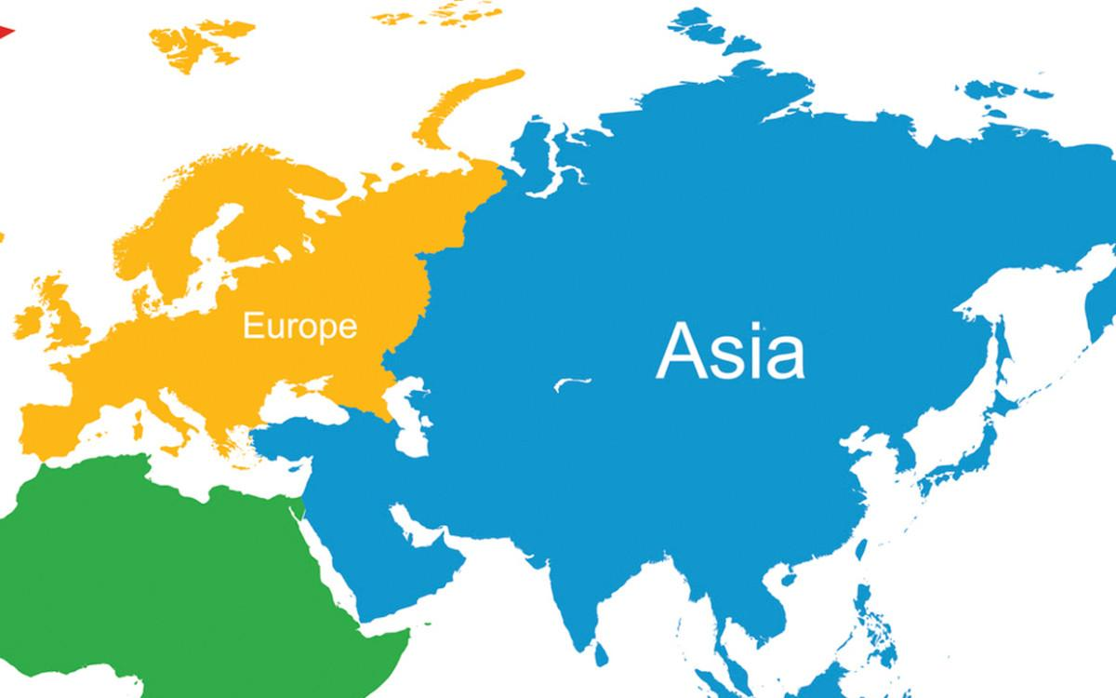
Digital Humanities Master's programme
Information Structures and Implications
Project
Asia and Europe
Geographical and socio-economic data
Team:
Jin Xu
r0917766
Daniel Oltean
r0940039

Slide 2
Argument:
Asia and Europe are two continents with very different pasts, geographical features, and cultures, but also with many common points
This project explores the two continents by comparing some of their traits
Dataset Mondial (University of Göttingen):
33 tables
http://www.dbis.informatik.uni-goettingen.de/Mondial/
Asia and Europe: Geographical and socio-economic data

Slide 3
Geographical data
1. How many countries are in each continent?
(COUNT, HAVING)
2. What are the highest mountains in Asia and Europe?
(JOIN with 3 tables)
3. What is the area of all the lakes in each continent?
(JOIN with 3 tables, SUM, HAVING IN)
4. How many islands has each of the Asian and European countries?
(JOIN with 3 tables, COUNT, DISTINCT, HAVING IN)
5. What are the Asian and European islands located closest to the North Pole?
(JOIN with 5 tables, HAVING IN)
Asia and Europe: Geographical and socio-economic data

Slide 4
Geographical data
6. What are the rivers with the most affluents in Asia and Europe?
(JOIN with 3 tables, recursive query, HAVING IN)
7. What are the Asian and European countries that have Mediterranean ports?
(nested query, HAVING IN)
8. What are the rivers passing through the most countries in Asia and Europe?
(nested query, UNION, COUNT, HAVING IN)
9. What is the river passing through the most countries in the world? Is it in Europe or Asia?
(nested queries, UNION, MAX, HAVING IN)
10. What is the country with the most cities in the world? Is it in Europe or Asia?
(nested queries, COUNT, HAVING)
Asia and Europe: Geographical and socio-economic data

Slide 5
Socio-economic data
1.What is the average GDP of Europe and Asia?
(AVG, GROUP BY)
2. Which european and asian countries whose tertiary industry is more developed than the primary industry?
(NESTED)
3. The latest independent European and Asian countries
(ORDER BY)
4.All ethnicgroups in Europe and Asia
(DISTINCT)
5. 20 asian AND european countries with lowest population growth and their GDP
(NESTED, ORDER BY, 4 TABLES, LIMIT)
Asia and Europe: Geographical and socio-economic data

Slide 6
Socio-economic data
6. All european and asian countries who speak only one language (LEFT JOIN)
7.All european and asian countries who are the member of more than 50 organizations (GROUP BY, HAVING,COUNT)
8.Religions only appear in one country in Europe and Asia(NESTED, EXISTS, RECURSIVE)
Asia and Europe: Geographical and socio-economic data

Slide 7
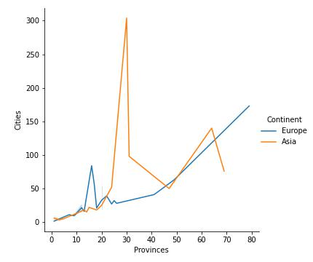
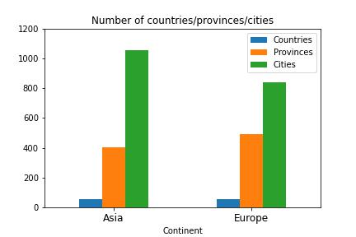
Q1. Number of countries/provinces/cities in each continent
Asia and Europe: Geographical and socio-economic data

Slide 8
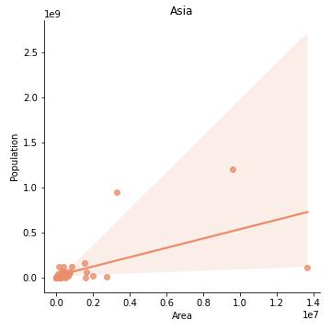
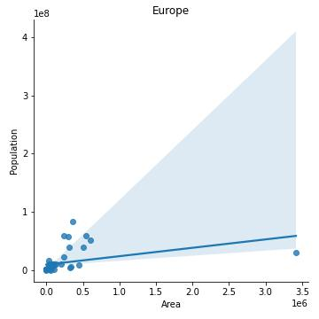
Q2. Relationship area/population for Asian and European countries
Asia and Europe: Geographical and socio-economic data

Slide 9
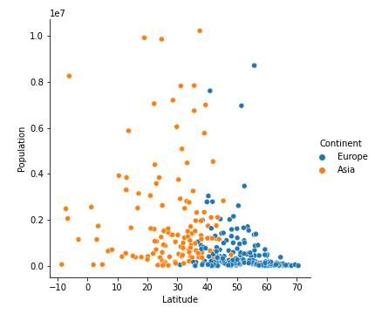
Q3. Relationship latitude/population for Asian and European cities
Asia and Europe: Geographical and socio-economic data

Slide 10
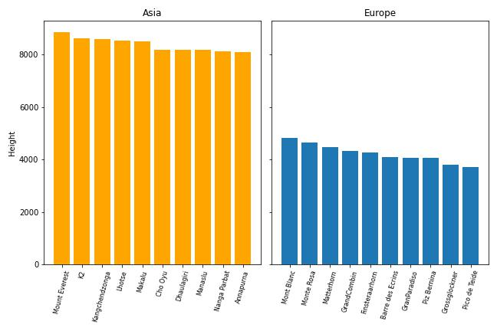
Q4. Highest mountains in Asia and Europe
Asia and Europe: Geographical and socio-economic data

Slide 11
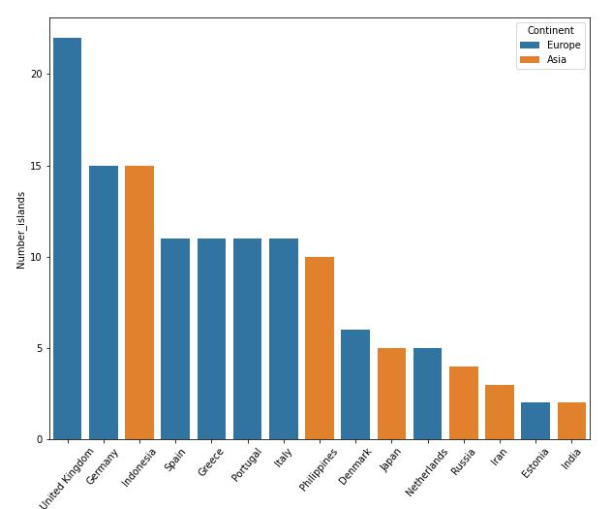
Q5. Number of islands of Asian and European countries
Asia and Europe: Geographical and socio-economic data

Slide 12
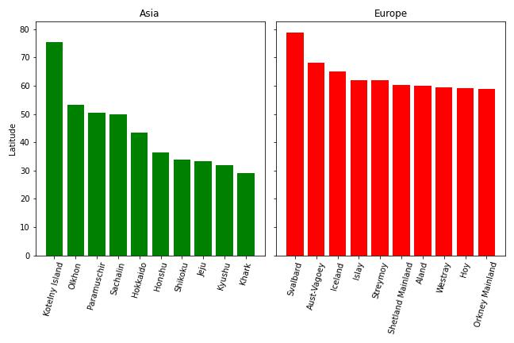
Q6: Asian and European islands located closest to the North Pole
Asia and Europe: Geographical and socio-economic data

Slide 13
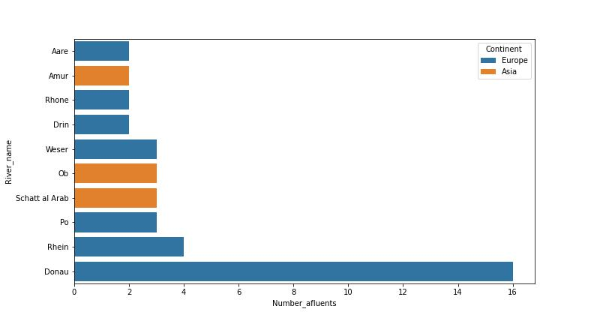
Q7: Rivers with the most affluents in Asia and Europe
Asia and Europe: Geographical and socio-economic data

Slide 14
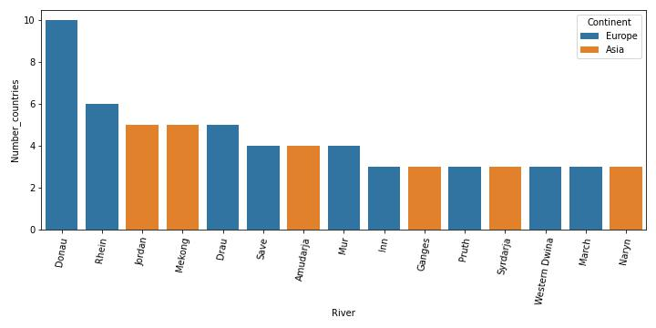
Q8: Rivers passing through the most countries in Asia and Europe
Asia and Europe: Geographical and socio-economic data

