Slide 1
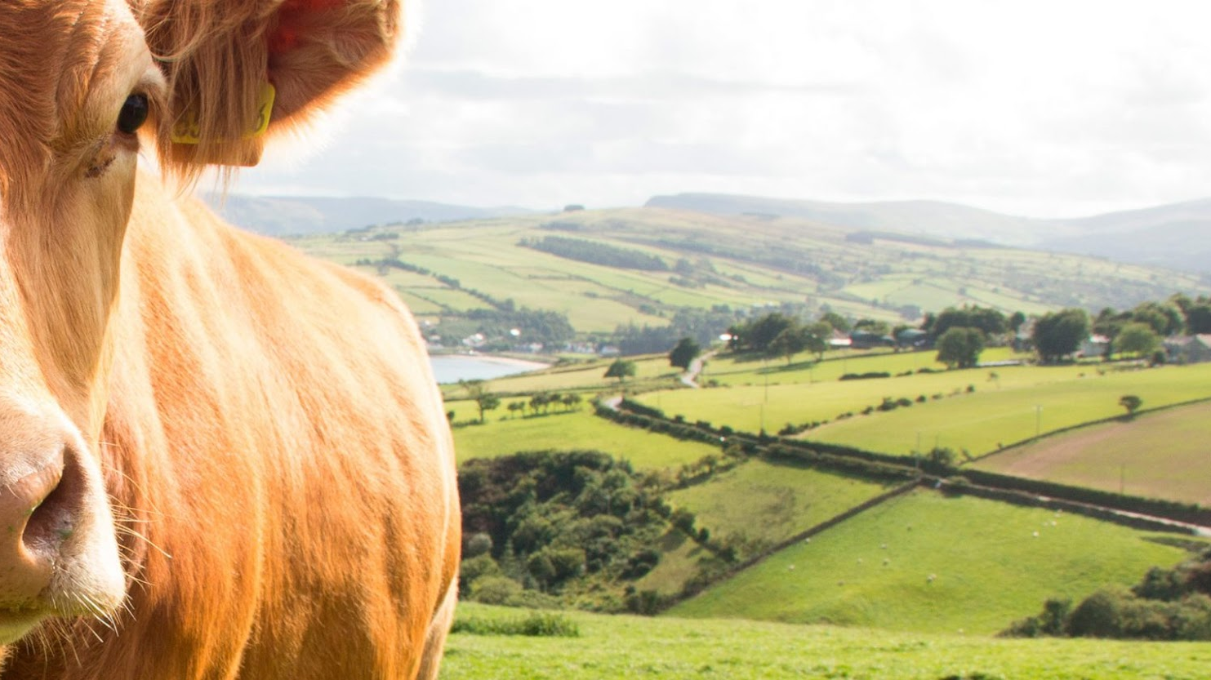

USE OF NEURAL NETWORKS AND COMPRESSION ALGORITHMS FOR COW’S -HEALTH CLASSIFICATION

Slide 2






Team Presentation
Victor Daniel Agudelo
Daniel Ricardo Palacios Diego
Simón Marín
Mauricio
Toro
https://github.com/DanielPalacios05/ST0245-001

Slide 3
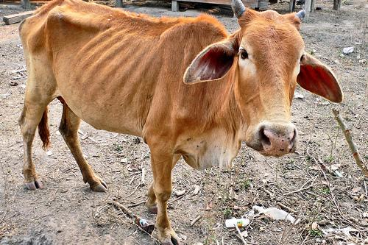
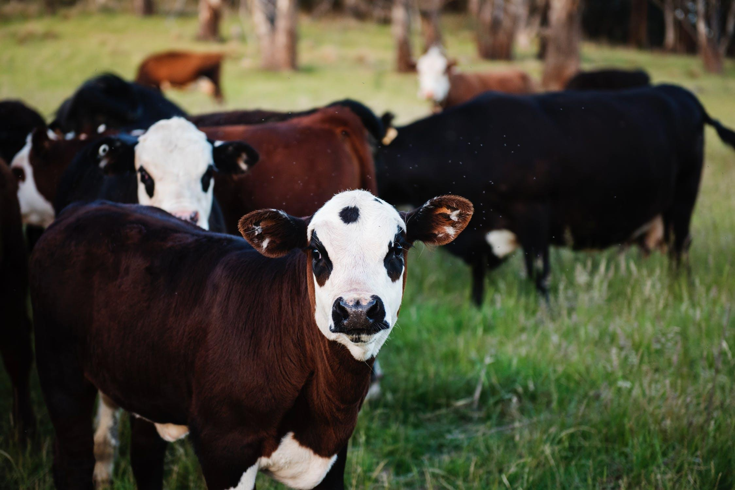
Training Process
Convolutional Neural Network
Sick-Cattle Images
Classification Algorithm
Classification Model
Healthy-Cattle Images

Slide 4
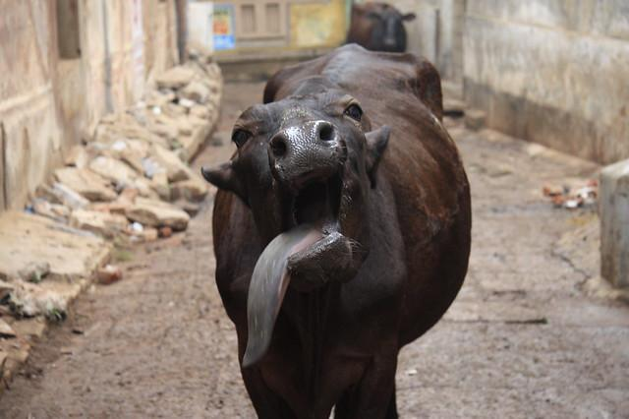
Testing Process
Seam Carving
Is sick
Cattle Image
Seam Carving
Classification Model
Output

Slide 5
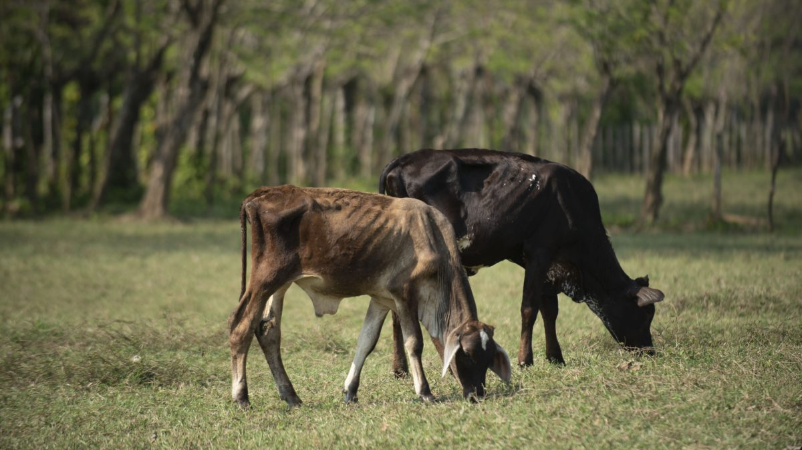
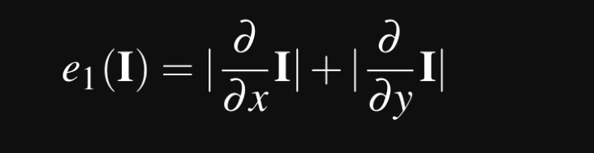
Compression Algorithm Design
Dual gradient function used for calculating the energy of each pixel
We calculated the energy of every single pixel using the dual gradient function, where we calculate the x and y gradient using the horizontal and vertical neighbor of the pixel respectively, the result will be a energy map

Slide 6
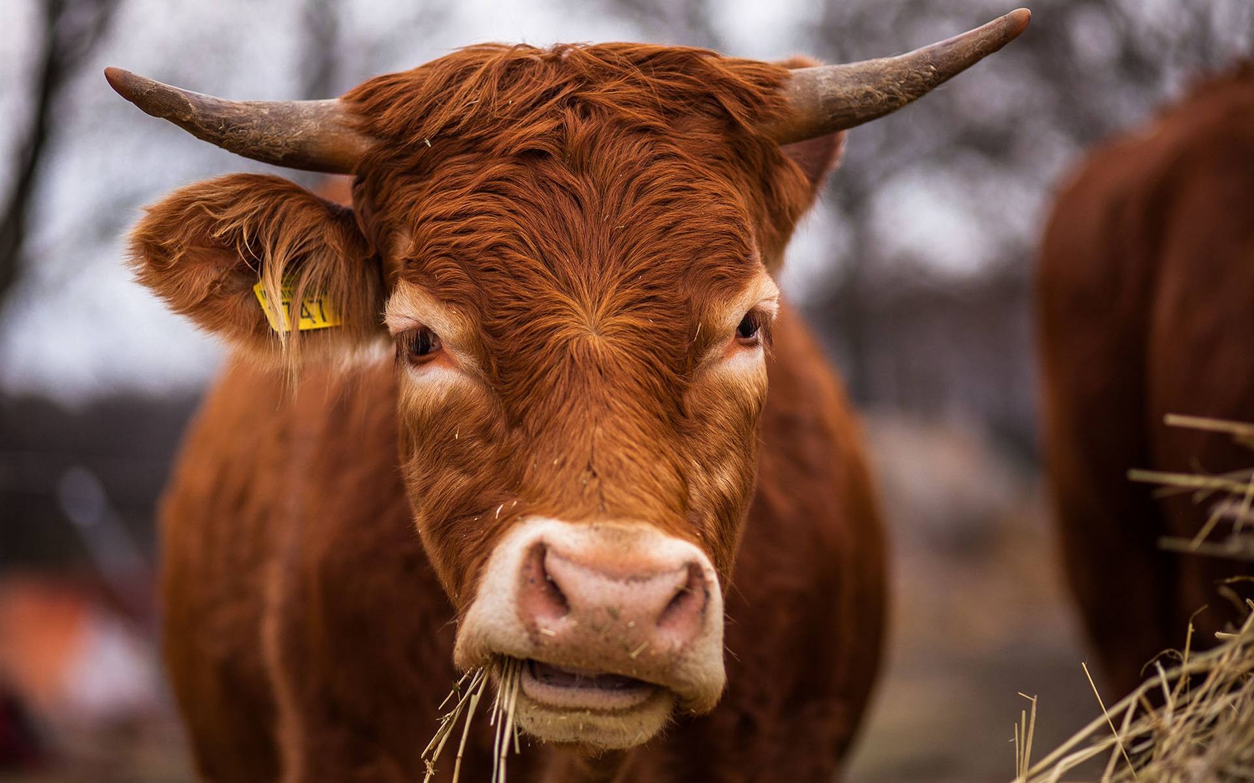
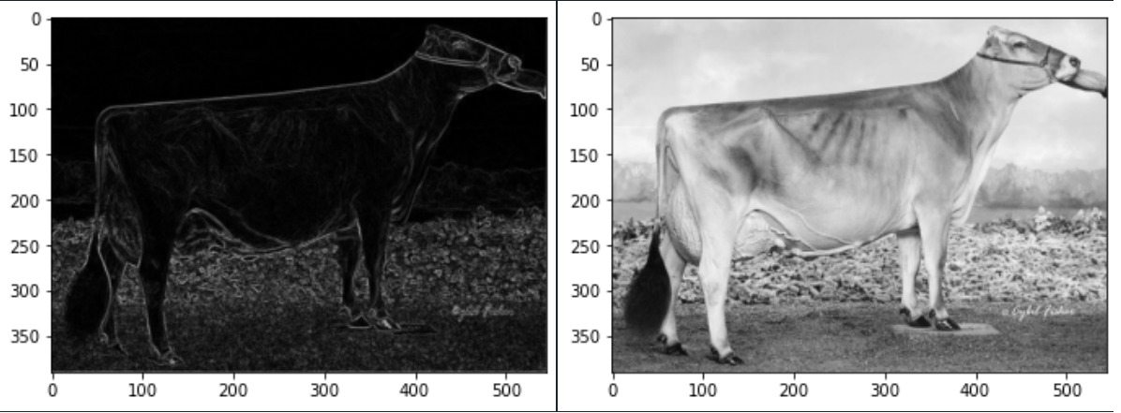
Compression Algorithm Design
In the photo we can see a comparation between the source image (on the right) and the energy map (on the left). The energy map represents how important each pixel is in the image. the seams can be extracted in different ways, among them dynamic programing that helps us a lot to reduce the complexity of our algorithm, we can also use a greedy algorithm approach but it is not very useful for large images.

