Slide 1
MACHINE LEARNING · 2026
Predicting Stock Price Gains
Can technical indicators predict a 10%+ gain within 30 days?
577,400
88
2015–2025
10.9%
Stock-day snapshots
Features
Date range
Positive rate

Slide 2
Can technical indicators predict whether a stock will gain 10% or more within the next 30 days?
RESEARCH QUESTION
The Question We're Answering
TARGET LABEL
CLASS BALANCE
TASK TYPE
Binary classification problem — yes or no — based on historical technical data.
gain_10pct_30d
10.9% positive
Binary Classification
1 if stock rose ≥10% within 30 days of observation, 0 otherwise
~1 winner per 9 non-winners — strongly imbalanced. Accuracy alone is meaningless here.
We need a model that ranks potential winners above non-winners.

Slide 3
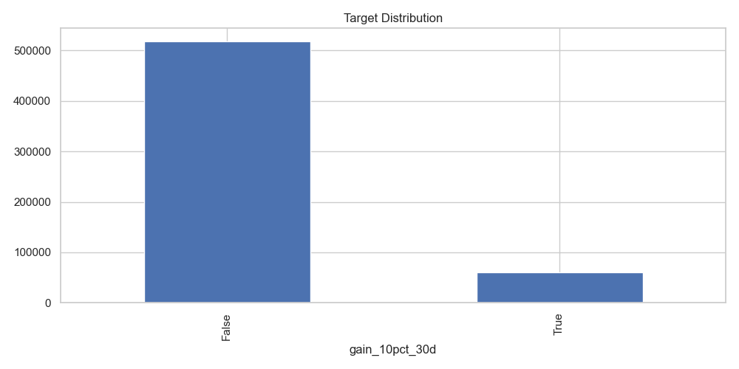
What We're Working With
DATA
577K
88
53
Snapshots
Raw features
After selection
TARGET DISTRIBUTION — CLASS IMBALANCE
TARGET VARIABLE
gain_10pct_30d = 1 if the stock's close price rose ≥10% from the signal day's close within the next 30 calendar days, else 0.
TIME RANGE
2015–2025 · snapshots only
Train: 2015→2022 · Val: 2023 · Test: 2024–2025
Each row = one stock on one day, filter if under $5K price, 500K+ daily volume. Note: stocks delisted or acquired during the 30-day window may understate the true win rate.
~515K non-winners vs ~63K winners = 10.9% positive rate. Heavily imbalanced — standard accuracy is meaningless here.

Slide 4
DATA PREPARATION
4-Stage Pipeline — From Raw to ML-Ready
1
2
3
4
Data Quality Filters
Feature Selection
Null Imputation
Outlier Treatment
Removed rows where ma_200 > 5× close (split-adjustment bug)
Removed spy_distance_from_200 > 50% (calculation error)
Dropped rows with missing target
Removed 11 engine-score features (total_score, signal_strength…)
Removed 13 low-info columns (>95% zeros/nulls)
Dropped 9 correlated pairs (Spearman >0.8)
One-hot encoded exchange
Median imputation for most numeric columns
MICE (iterative) for relative_strength
Null-indicator flags for above_long/fast_ma
log1p transform: volume, ADR, close, ATR
Signed log1p: MACD, OBV
Winsorize 1–99%: most indicators
Clip [0,100]: RSI
0 nulls remaining
Distributions normalized
415 bad rows removed
88 → 53 features

Slide 5
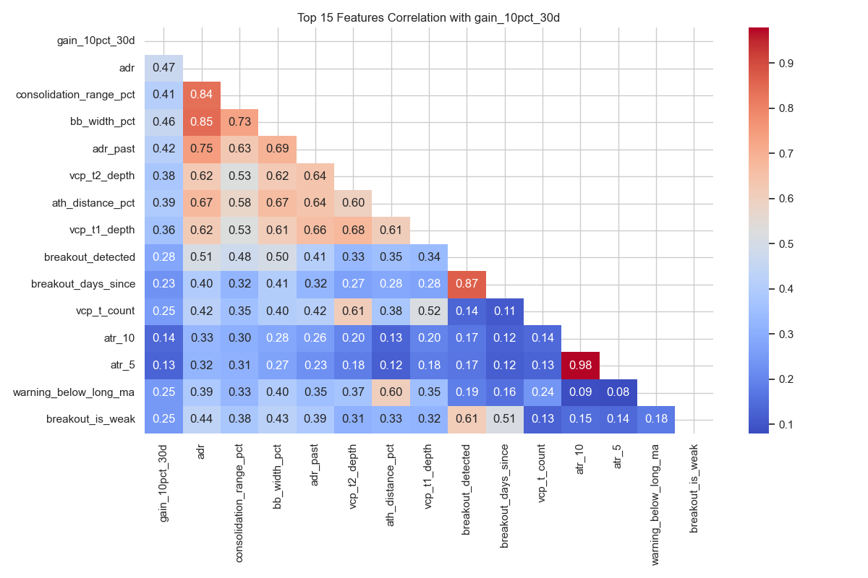
FEATURE SELECTION
Top 15 Features — Correlation with Target
HOW TO READ THIS
The first column shows each feature's Spearman correlation with gain_10pct_30d (our target). The rest of the matrix shows inter-feature correlations.
High inter-feature correlation (orange/red) = redundancy. We keep only the most predictive of a correlated pair.
KEY OBSERVATIONS
adr (0.47) — strongest single predictor of a 10%+ gain.
atr_5 / atr_10 (0.98) — nearly identical, one was dropped.
breakout_detected / breakout_days_since (0.87) — redundant pair, one removed.

Slide 6
DATA SPLITTING
Time-Based Split — No Future Leakage
TRAIN
WHY TIME-BASED?
353,691 rows
Jan 2015 → Dec 2022 · 10.4% positive
Each row's target is computed from a 30-day forward window. A random split would place the same stock's future in the training set — leaking tomorrow's prices into today's features.
30-day embargo gap
VALIDATION
54,787 rows
Jan 2023 → Dec 2023 · 10.6% positive
The embargo gap prevents the 30-day forward window from crossing the split boundary and creating data leakage.
30-day embargo gap
TEST (held out)
141,575 rows
Jan 2024 → Dec 2025 · 11.0% positive

Slide 7
MODEL COMPARISON — VALIDATION SET
Five Model Families Benchmarked
ROC-AUC
Measures ranking quality: given a random winner and a random loser, how often does the model rank the winner higher? 0.89 = 89% of the time. Threshold-independent.
PR-AUC (Average Precision)
Precision-Recall area under curve. More sensitive to imbalanced classes than ROC-AUC. Our baseline rate is 10.9% — so 0.47 is meaningful lift.
Key finding: LR, RF, and SVM all land within 0.01 of each other on ROC-AUC (~0.89). More model complexity doesn't help — the signal ceiling is the limiting factor.

Slide 8
KEY INSIGHT
The Linear Ceiling
FINDING 1
FINDING 2
FINDING 3
All models converge
Features already capture non-linearity
The ceiling is a feature problem
LR, RF, GBM, and SVM all land at ROC-AUC ~0.89. Adding complexity gives nothing — the signal in the data is largely linear.
The Kairognos upstream pipeline already engineered most interactions. The model is learning to re-combine them — not discover new ones.
To break through 0.89 ROC-AUC, we need richer data (earnings, fundamentals, options flow) — not more sophisticated algorithms.
The bottleneck is information, not model architecture.

Slide 9
FEATURE ENGINEERING
14 New Features Added — Did They Help?
INTERACTIONS (5 new)
0.891
adr × volume_ratio — volatility × surge
adr × ath_distance — volatility × distance from peak
consolidation × adr — tightness × range
atr / close — normalized daily range
volume / avg_volume — relative volume
ROC-AUC — baseline (val)
ROC-AUC — engineered (test)
0.901
+0.010
PR-AUC — baseline (val)
0.473
PR-AUC — engineered (test)
0.474
+0.001
F1 — baseline (val)
0.520
SYMBOL HISTORY (3 new)
symbol_hist_pos_rate — stock's historical win rate (shifted 31d to prevent leakage)
symbol_adr_60d_mean — 60-day rolling ADR
symbol_rsi_60d_mean — 60-day rolling RSI
F1 — engineered (test)
0.536
+0.016
Feature engineering gave a small but real improvement (+0.01 ROC-AUC). The ceiling is real — more features help marginally, but the fundamental signal limit stays around 0.90.
LAG + TIME (6 new)
5-day change in RSI, ADR, BB-width, consolidation range
Month, quarter, day-of-week

Slide 10
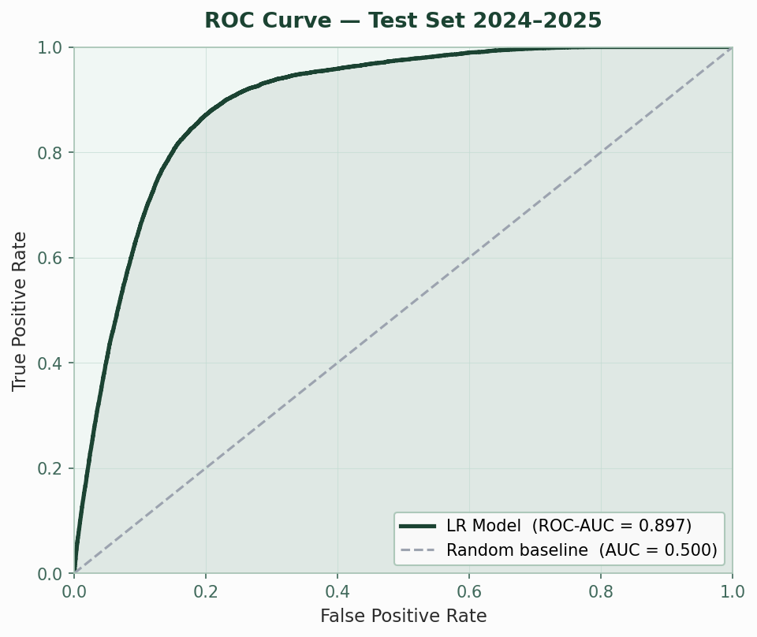
FINAL TEST RESULTS — 2024–2025
Best Model: Logistic Regression + Feature Engineering
141,575 test rows
0.901
0.474
ROC-AUC
PR-AUC
Ranks winners above losers 90.1% of the time
4.3× above the 10.9% baseline (random = 0.109)
ROC CURVE — TEST SET 2024–2025
0.467
0.628
0.536
Precision
Recall
F1 Score
47% of flagged stocks actually hit +10%
Catches 63% of all actual winners
Harmonic mean of precision and recall
Despite testing RF, GBM, KNN, and SVM — Logistic Regression with engineered features won. Simple, interpretable, and generalizes best to the 2024–2025 test period.

Slide 11
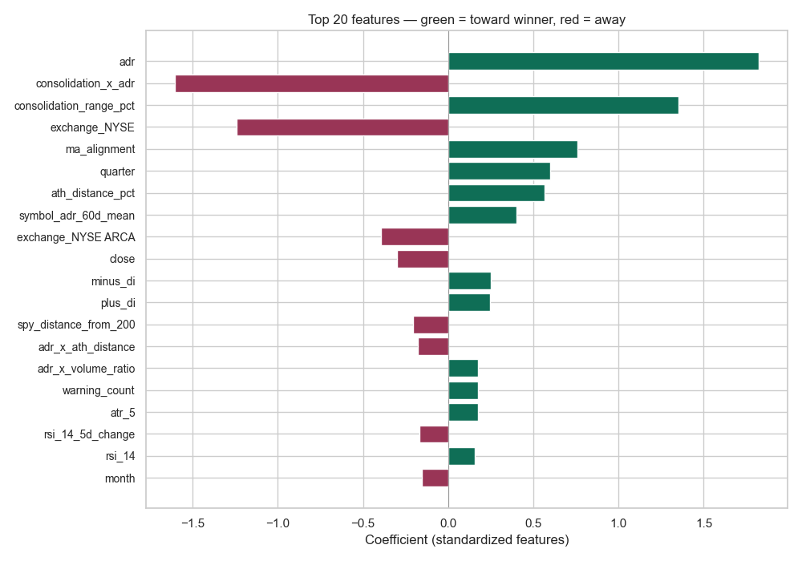
FEATURE IMPORTANCE
What the Model Learned — Top 10 Coefficients
HOW TO READ THIS
These are standardized LR coefficients. Positive = pushes toward a win signal. Negative = pushes against. Larger absolute value = stronger influence.
KEY TAKEAWAYS
ADR dominates (+1.85) — stocks with large average daily ranges are most predictive of breakouts.
Consolidation × ADR (−1.65) — this interaction pushes against a win when both are high simultaneously.
Consolidation tightness (+1.35) — narrow range before the move is strongly predictive on its own.
NYSE listing (−1.05) — NYSE-listed stocks are less likely to hit the target than OTC/ARCA.

Slide 12
UNDERSTANDING THE SCORE
ROC-AUC 0.90 — What It Really Means
Given any random winner and any random non-winner from the test set, the model correctly ranks the winner higher 90% of the time.
WHAT 0.90 MEANS IN CONTEXT
0.90
A random guesser scores 0.50. A perfect model scores 1.00. At 0.90, we're capturing strong, real signal — well above chance, well below perfect.
THRESHOLD-INDEPENDENT METRIC
The gap between 0.90 and 1.00 reflects the inherent unpredictability of markets. Some outcomes are simply unknowable from technical data alone.
Analogy: Imagine drawing one stock that actually gained 10%+ and one that didn't. ROC-AUC = 0.90 means our model assigns the winner a higher probability score 9 out of 10 times. It doesn't depend on which threshold you use to decide "buy or skip."
0.50
0.90
1.00
Random baseline
Our model
Perfect (impossible)
WHY THIS METRIC FIRST
ROC-AUC is reported first because it evaluates the model's ranking ability across all thresholds. It tells us the signal is real before we decide how aggressively to act on it.

Slide 13
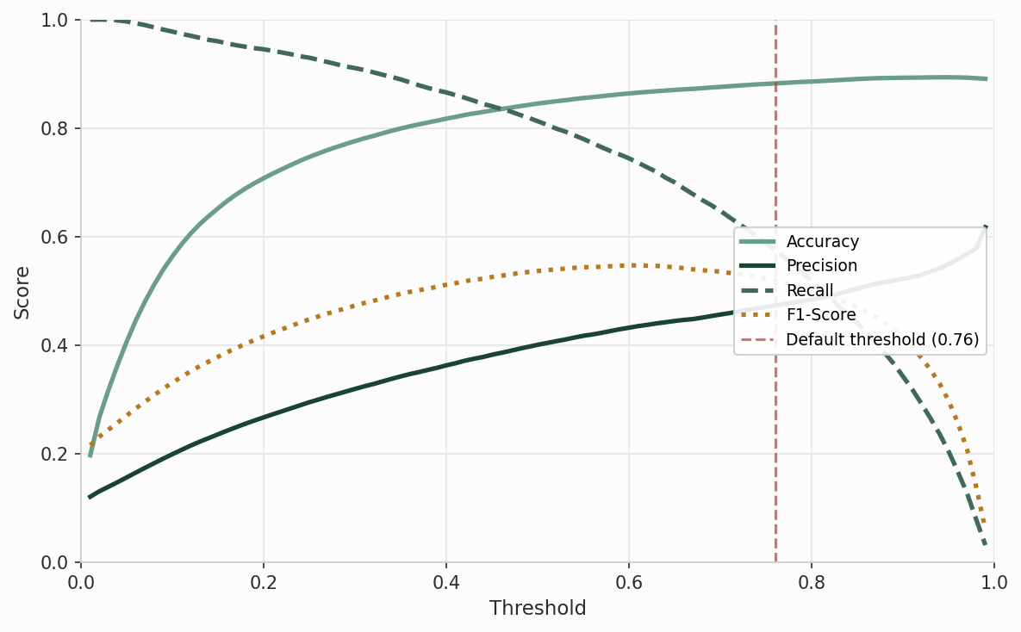
THRESHOLD ANALYSIS
Choosing an Operating Point — Precision vs. Recall Trade-Off
HOW TO READ THIS
As the classification threshold rises, the model becomes more selective — Precision climbs but Recall falls. F1-Score peaks where the two are best balanced.
OPERATING CHOICE
Default threshold 0.76 — Precision 0.467, Recall 0.628, F1 0.536.
Higher threshold — fewer but higher-quality signals. Right choice when false positives are costly.
Lower threshold — more coverage, but more noise in the flagged list.

Slide 14
SUMMARY
What We Built — and Where We Go Next
0.901
4.3×
47%
LR
ROC-AUC
LIFT OVER RANDOM
PRECISION
WINNING MODEL
Ranks winners above non-winners 90% of the time on unseen 2024–2025 data.
PR-AUC of 0.474 vs. 0.109 baseline — the model is 4× better than a random scan.
At the default threshold, nearly 1 in 2 flagged stocks actually reaches +10% in 30 days.
Logistic Regression beat RF, GBM, SVM, Cascade, and Stacking. Simple wins.
NEXT STEPS TO BREAK THE 0.90 CEILING
Earnings & fundamentals — add EPS surprises, revenue growth, P/E ratios
Options flow — unusual call volume is a leading indicator of breakouts
Sector & macro context — market regime features (VIX, sector rotation)
Live signal pipeline — move from batch to daily automated scoring
The bottleneck is data richness, not model complexity. The foundation is solid.

