Slide 1
Range-based for loops
C++ 11 standard

Slide 2
Range-Based For Loops
A feature introduced in 2011 (C++11 standard)
Used as a more readable equivalent to the traditional For Loop.
Less keyboard strokes required.
Saves programmer’s time.
No new functionality.
Can be thought of as an extra layer of abstraction on top of traditional For Loops.
Example that shows the differences and similarities between Traditional and Range-based For Loops:

Slide 3
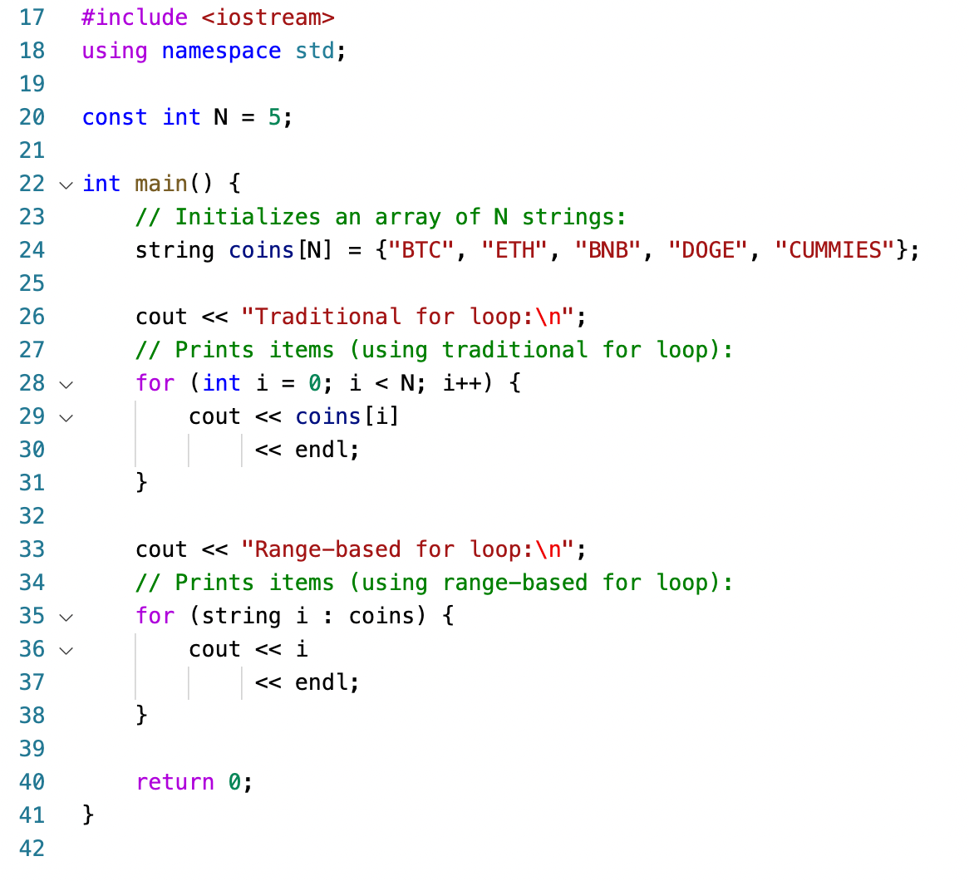
Example
Notice the main difference:
Traditional For Loop “loops” over the items of the array using the indices of individual item.
Range-based For Loop ”loops” directly over the items.

