Slide 1
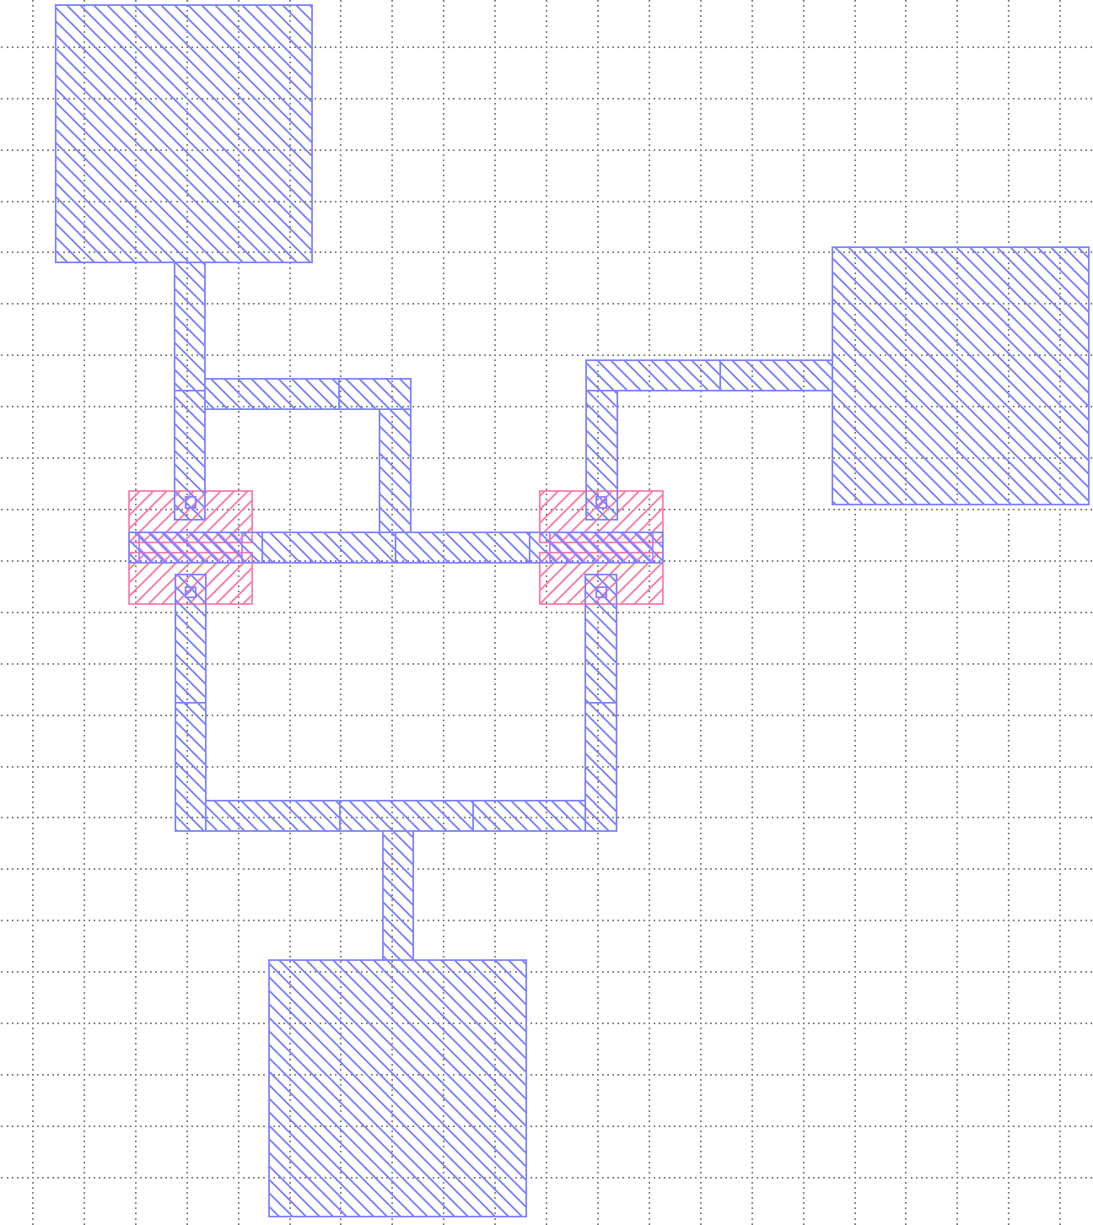
Current Source
Rset
VCS
-V

Slide 2
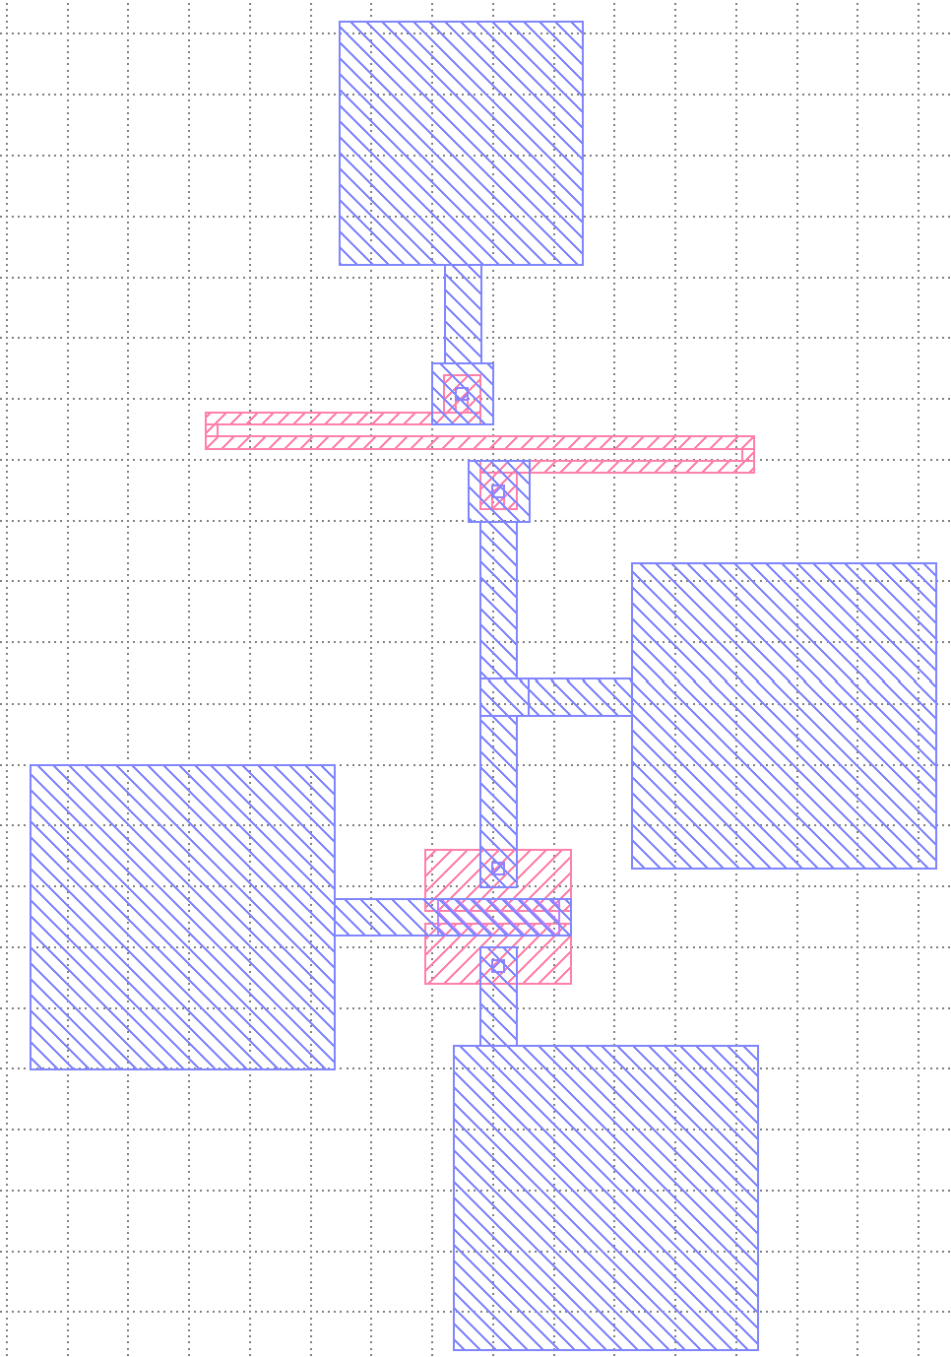
Common Source Amp
VDD
Vout
Vin
GND

Slide 3
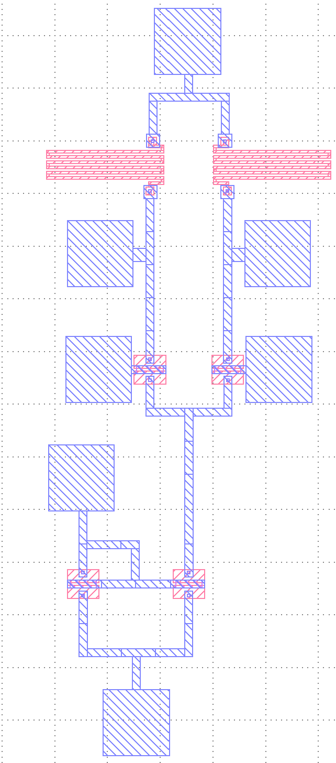
Differential Amp w/ Current
+V
Out1
Out2
Vin
GND
Rset
-V

Slide 4
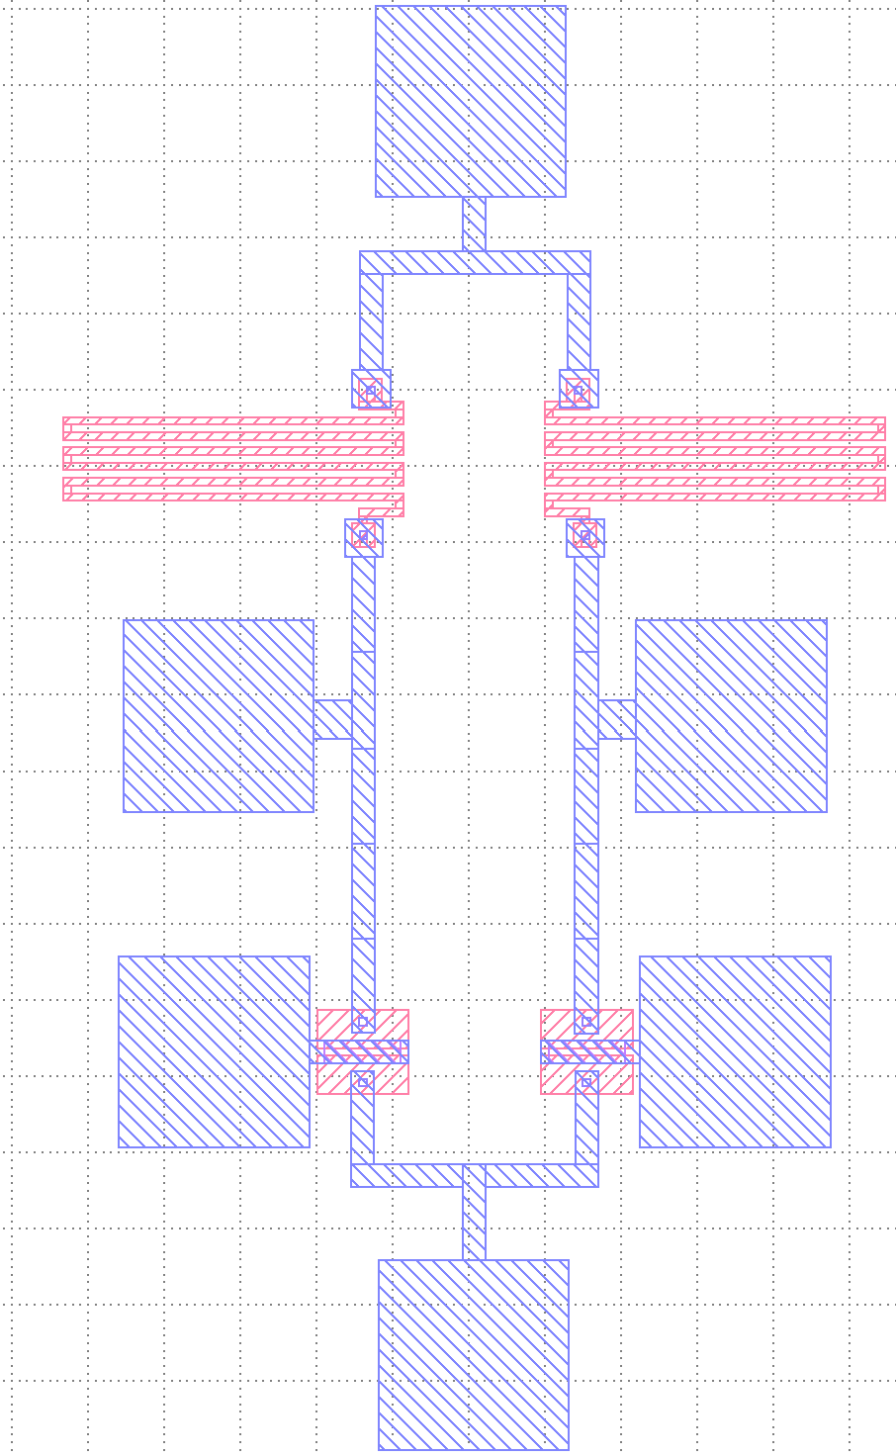
Differential Amp w/ Current
+V
Out1
Out2
Vin
GND
Current

