Slide 1
Scores and substitution matrices in inexact matching (sequence alignment)
CMSC423
Slides courtesy of Sushmita Roy
U. Wisconsin

Slide 2
Key concepts in this unit
Probabilistic interpretation of scores in alignment algorithms
Different substitution matrices
Assessing significance of scores
Bayesian approach
Extreme Value Theory
Heuristic algorithms to speed up search (BLAST)

Slide 3
Readings
Sections 2.1, 2.2
Sections 2.3 till end of Smith-Waterman
Section 2.7
Section 2.8

Slide 4
Guiding principles of scores in alignments
Sequence is said to have diverged from a common ancestor through mutations
Substitutions
Insertions and deletions (gaps)
Score evolutionarily close alignments higher than those that are not
That is we compute the likelihood ratio of an alignment given the two sequences are related versus not related

Slide 5
PROBABILITY PRIMER

Slide 6
Sample spaces
Sample space: a set of possible outcomes for some event
examples
flight to Chicago: {on time, late}
lottery: {ticket 1 wins, ticket 2 wins,…,ticket n wins}
weather tomorrow:
{rain, not rain} or
{sun, rain, snow} or
{sun, clouds, rain, snow, sleet} or…

Slide 7
Random variables
Random variable: represents the outcome of an experiment
Example
X represents the outcome of my flight to Chicago
we write the probability of my flight being on time as P(X = on-time)
or when it’s clear which variable we’re referring to, we may use the shorthand P(on-time)

Slide 8
Probability distributions
If X is a random variable, the function given by P(X = x) for each x is the probability distribution of X
Requirements:
0.3
0.2
0.1
sun
clouds
rain
snow
sleet

Slide 9
Joint distributions
Joint probability distribution: the function given by P(X = x, Y = y)
Read “X equals x and Y equals y”
Example
x, y | P(X = x, Y = y)
sun, on-time | 0.20
rain, on-time | 0.20
snow, on-time | 0.05
sun, late | 0.10
rain, late | 0.30
snow, late | 0.15
probability that it’s sunny
and my flight is on time

Slide 10
Marginal distributions
The marginal distribution of X is defined by
“the distribution of X ignoring other variables”
This definition generalizes to more than two variables, e.g.

Slide 11
Marginal distribution example
joint distribution
marginal distribution for X
x, y | P(X = x, Y = y)
sun, on-time | 0.20
rain, on-time | 0.20
snow, on-time | 0.05
sun, late | 0.10
rain, late | 0.30
snow, late | 0.15
x | P(X = x)
sun | 0.3
rain | 0.5
snow | 0.2

Slide 12
Conditional distributions
The conditional distribution of X given Y is defined as:
“the distribution of X given that we know the value of Y ”

Slide 13
Conditional distribution example
conditional distribution for X
given Y=on-time
joint distribution
x, y | P(X = x, Y = y)
sun, on-time | 0.20
rain, on-time | 0.20
snow, on-time | 0.05
sun, late | 0.10
rain, late | 0.30
snow, late | 0.15
x | P(X = x|Y=on-time)
sun | 0.20/0.45 = 0.444
rain | 0.20/0.45 = 0.444
snow | 0.05/0.45 = 0.111

Slide 14
Independence
Two random variables, X and Y, are independent if

Slide 15
Independence example #1
joint distribution
marginal distributions
x, y | P(X = x, Y = y)
sun, on-time | 0.20
rain, on-time | 0.20
snow, on-time | 0.05
sun, late | 0.10
rain, late | 0.30
snow, late | 0.15
x | P(X = x)
sun | 0.3
rain | 0.5
snow | 0.2
y | P(Y = y)
on-time | 0.45
late | 0.55
Are X and Y independent here?
NO.

Slide 16
Independence example #2
joint distribution
marginal distributions
x, y | P(X = x, Y = y)
sun, fly-United | 0.27
rain, fly-United | 0.45
snow, fly-United | 0.18
sun, fly-Northwest | 0.03
rain, fly-Northwest | 0.05
snow, fly-Northwest | 0.02
x | P(X = x)
sun | 0.3
rain | 0.5
snow | 0.2
y | P(Y = y)
fly-United | 0.9
fly-Northwest | 0.1
Are X and Y independent here?
YES.

Slide 17
Log odds score
Let X be a random variable representing an alignment
Let M₁ and M₂ be two probabilistic models for X
Log odds score S(X)
If S(X)>0, X is more likely to come from model M₁
If S(X)<0, X is more likely to come from model M₂

Slide 18
What are M₁ and M₂ in our sequence alignment problem
M₁: foreground model, that is the sequences are “related by evolution”.
M₂: background model, that is the sequences are unrelated
Need to compute the probability of an alignment X, under the two models M₁ and M₂
Assume alignments on protein sequences with no gaps.

Slide 19
M₁: foreground model
Assume each pair of aligned positions evolved from a common ancestor
Let p_{ab} be the probability of observing a pair {a,b}
Probability of an alignment between x and y is

Slide 20
M₂: background model
Assume the individual amino acids at a position are independent of the amino acid in another position.
Let q_{a} be the probability of amino acid a
The probability of an n-character alignment of x and y is

Slide 21
Computing the log odds ratio to score an alignment
The score of an alignment is the log odds ratio of the two sequences from M₁ and M₂

Slide 22
Computing the log odds ratio to score an alignment
Score of an alignment
Substitution matrix entry

Slide 23
Some common substitution matrices
BLOSUM matrices [Henikoff and Henikoff, 1992]
BLOSUM45
BLOSUM50
BLOSUM62
Number represents percent identity of sequences used to construct substitution matrices
PAM [Dayhoff et al, 1978]
Empirically, BLOSUM62 works the best

Slide 24
How to estimate the probabilities?
Need a good set of confirmed alignments
Depends upon what we know about when the two sequences might have diverged
p_{ab} for closely related species is likely to be low if a !=b
p_{ab} for species that have diverged a long time ago is likely close to the background.

Slide 25
Dayhoff Point accepted mutation (PAM ) matrix
Substitution data from very similar/evolutionary close proteins
71 protein sequences
Estimate ancestral sequence based on parsimony
We will look at this in detail in Phylogenetic trees
Estimate A_{ab} the frequency of observing a,b pair in ancestor child pairs.
Derive a conditional probability of P(a|b) for unit time.
Derive a condition probability for longer time by taking powers of the conditional probability matrix.

Slide 26
Calculating Dayhoff PAM matrices
Ancestral points
A
Count number of amino acid pairs for each ancestor – child pair
D
A
D
D
Total number of observed a,b pairs
Conditional probability in unit time

Slide 27
BLOSUM matrices
BLOck Substitution Matrix
Derived from a set of aligned ungapped regions from protein families called BLOCKS
Cluster proteins such that they have no less than L% of similarity

Slide 28
Different BLOSUM matrices
BLOSUM50
Proteins >50% similarity are in the same group
BLOSUM62
Proteins >62% similarity are in the same group

Slide 29
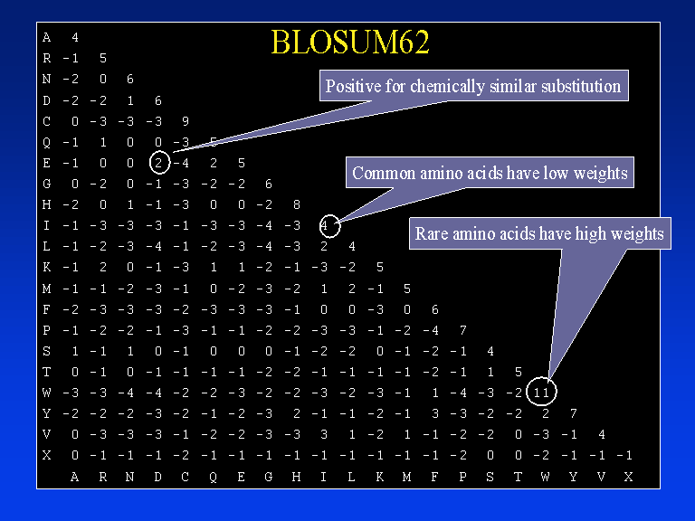
Example substitution scoring matrix (BLOSUM62)
Notes:
BLOSUM: BLOck Substitution Matrix. E: Glutamic acid, D: Aspartic acid. Both are acidic, negative charged.

Slide 30
Conserved blocks
AABCDA...BBCDA
DABCDA.A.BBCBB
BBBCDABA.BCCAA
AAACDAC.DCBCDB
CCBADAB.DBBDCC
AAACAA...BBCCC
Block1
Block2
From Ron Shamir’s lecture http://www.cs.tau.ac.il/~rshamir/algmb/98/scribe/html/lec03/node10.html

Slide 31
Estimating the probabilities in BLOSUM

Slide 32
Calculating the probabilities
: Number of ab pairs in the k^{th} column of a block
AABCDA...BBCDA
DABCDA.A.BBCBB
BBBCDABA.BCCAA
AAACDAC.DCBCDB
CCBADAB.DBBDCC
AAACAA...BBCCC

Slide 33
Estimating significance of scores
How do we know whether a given alignment score is random or significant?
Two approaches
Bayesian Approach
A classical approach: the extreme value distribution

Slide 34
Bayesian approach
Recall in our log odds ratio we estimated
We could instead ask what is the probability of the two sequences being related as opposed to unrelated
Related
Unrelated

Slide 35
Bayes theorem
An extremely useful theorem
There are many cases when it is hard to estimate P(x | y) directly, but it’s not too hard to estimate P(y | x) and P(x)

Slide 36
Bayes theorem example
MDs usually aren’t good at estimating P(Disorder| Symptom)
They’re usually better at estimating P(Symptom | Disorder)
If we can estimate P(Fever | Flu) and P(Flu) we can use Bayes’ Theorem to do diagnosis

Slide 37
Using Bayes Rule to estimate P(M₁|x,y)
Bayes rule
Marginalization
Chain Rule

Slide 38
Using Bayes Rule to estimate P(M₁|x,y)
Bayes rule
Marginalization
Chain Rule
Model priors

Slide 39
Points about P(M₁|x,y)
Has the form of a logistic function
where
Alignment score
Prior log odds score

Slide 40
Points about P(M₁|x,y)
The prior log odds score is added to the sequence score
This can be used to encode our prior belief of expected number of matches
In fact the prior log odds score should be inversely related to the number of sequences we have in a database

Slide 41
The classical approach to assessing sequence :Extreme Value Distribution
Suppose we have a particular substitution matrix and amino-acid frequencies
We need to consider random sequences of lengths m and n and finding the best alignment of these sequences
This will give us a distribution over alignment scores for random pairs of sequences
If the probability of a random score being greater than our alignment score is small, we can consider our score to be significant

Slide 42
Scores from random alignments
Suppose we assume
Sequence lengths m and n
A particular substitution matrix and amino-acid frequencies
And we consider generating random sequences of lengths m and n and finding the best alignment of these sequences
This will give us a distribution over alignment scores for random pairs of sequences

Slide 43
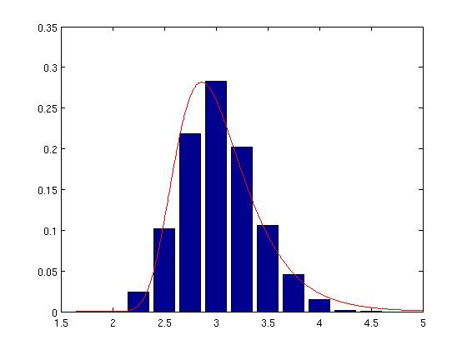
The extreme value distribution
Because we’re picking the best alignments, we want to know the distribution of max scores for alignments against a random set of sequences looks like
this is given by an extreme value distribution
P(x)
x

Slide 44
Assessing significance of sequence score alignments
It can be shown that the mode of the distribution for optimal scores is
K, λ estimated from the substitution matrix
Probability of observing a score greater than S
Notes:
This is actually called a Gumbel distribution which has a mean and a variance. The variance is assumed to be 1 in this case

Slide 45
Need to speed up sequence alignment
consider the task of searching the RefSeq collection of sequences against a query sequence:
most recent release of DB contains 32,504,738 proteins
Entails 33,000,000*(300*300) matrix operations (assuming query sequence is of length 300 and avg. sequence length is 300)
O(mn) too slow for large databases with high query traffic

Slide 46
Speeding up sequence alignment
Indexing techniques to locate possible small high scoring segments
Throw away segments that are not significant (based on theory of score significance)
Extending only high scoring segments
Two heuristic algorithms
BLAST
FASTA

Slide 47
BLAST: Basic Local Alignment Search Tool
Altshul et al 1990
Cited >48,000 times!
Optimizes Maximal Segment Pair (MSP) score
A local measure of similarity
Used EVD like theory for random sequence score
Works for both protein sequence and DNA sequence
Only scores differ

Slide 48
Maximal Segment Pair (MSP)
Sequence segment: A contiguous stretch of residues of any length
Relies on key assumption of additivity:
Similarity score for two aligned segments of the same length is the sum of similarity values for each pair of aligned residues.
MSP: highest scoring pair of identical length segments from two sequences
Theoretical analysis gives the statistical significance of an MSP score
Allows BLAST to efficiently prune out low scoring pairs

Slide 49
BLAST continued
BLAST finds locally maximal segment pairs that exceeds a particular cutoff
Let a word pair be a segment pair of length w
BLAST only seeks those word pairs that have a score at least T
Extend only word pairs with a score of at least T to determine if it has a segment pair of score at least S.

Slide 50
Key steps of the BLAST algorithm
For each query sequence
Compile a list of high-scoring words of score at least T
First generate words in the query sequence
Then find words that match query sequence words with score at least T
Thus allows for inexact matches
Scan the database for hits of these words
Extend hits

Slide 51
Determining query words
Given:
query sequence: QLNFSAGW
word length w = 2 (default for protein usually w = 3)
word score threshold T = 9
Step 1: determine all words of length w in query sequence
QL LN NF FS SA AG GW

Slide 52
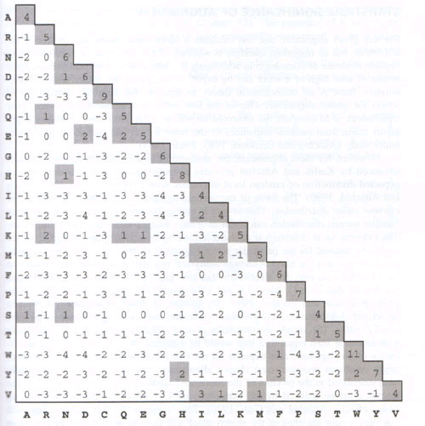
Determining query words
Determine all words that score at least T when compared to a word in the query sequence
QL QL=9
LN LN=10
NF NF=12, NY=9
…
SA none
...
words from
query sequence
words with T≥9
Additional words in
the database
Notes:
Generates all words of length 2 from the amino acid alphabet and checks if they have a value greater than T.

Slide 53
Scanning the database
How to efficiently search a long sequence for multiple occurrences of short sequences
BLAST has two approaches
Indexing approach
Finite state machine

Slide 54
Indexing approach
Let w=3. For amino acids, the number of words is 20³.
Map a word to an integer between 1 and 20³.
Thus a word has an index into an array
Each index points to a list of matches of the word in the query sequence
As we scan the database, each database word immediately leads to the hits in the query sequence

Slide 55
Deterministic finite state machine (FSM)
Deterministic behavior as input is read
State transitions/outputs
An example FSM to match CHY, CHH and CYH
ε1
2
H
0
C
1
C
Transition from 2 or 3 to 0,
happens when C is not observed.
Can result in “restarting” or
“acceptance”
~C
~CHY
C
Y
3
ε2
Notes:
What is the state sequence of CHCYHC? An FSM is determistic and has well-defined state transitions for different inputs. Might sometimes produce outputs as well. More efficient, but more complicated

Slide 56
Extending a hit
Extending a word hit to a segment pair is straightforward
Terminate extension when the score of the pair falls a certain distance below the best score found for shorter extensions

Slide 57
How to choose w and T?
Tradeoff between running time and sensitivity
Sensitivity
T
small T: greater sensitivity, more hits to expand
large T: lower sensitivity, fewer hits to expand
W
Larger w: fewer query word seeds, lower time for extending, but more possible words (20^{w} for AAs)
In practice w=4, T=17 is good for proteins

Slide 58
Summary of BLAST
T: Don’t consider seeds with score < T
Don’t extend hits when score falls below a specified threshold
Pre-processing of database or query helps to improve the running time

Slide 59
FASTA
Starts with exact seed matches instead of inexact matches that satisfy a threshold
Extends seeds (similar to BLAST)
Join high scoring seeds allowing for gaps
Re-align high scoring matches

Slide 60

Different versions of BLAST programs
Program | Query | Database
BLASTP | Protein | Protein
BLASTN | DNA | DNA
BLASTX | Translated DNA | Protein
TBLASTN | Protein | Translated DNA
TBLASTX | Translated DNA | Translated DNA
Notes:
How many ways to translate a DNA sequence? – 6-ways

Slide 61
Sequence databases
Large database centers
NCBI: http://www.ncbi.nih.gov
EBI: http://www.ebi.ac.uk
Sanger: http://www.sanger.ac.uk
Each of these centers link to hundreds of databases
Nucleotide sequences
Genbank
EMBL-EBI Nucleotide Sequence Database
Comprise ~8% of the total database (Nucleic Acid Research 2006 Database edition)
Protein sequences
UniProtKB

Slide 62
Using BLAST
http://blast.ncbi.nlm.nih.gov/Blast.cgi

