Slide 1


Predicting Housing Prices with Course Methods
By Daniel Phelps

Slide 2


Motivation
Problem: Home prices depend on many factors (size, quality, age, neighborhood). It is hard to understand which characteristics matter most and whether natural market segments exist.
Why this matters:
Better understanding helps buyers, sellers, and analysts see what features truly drive value and simplifies complex housing data.

Slide 3
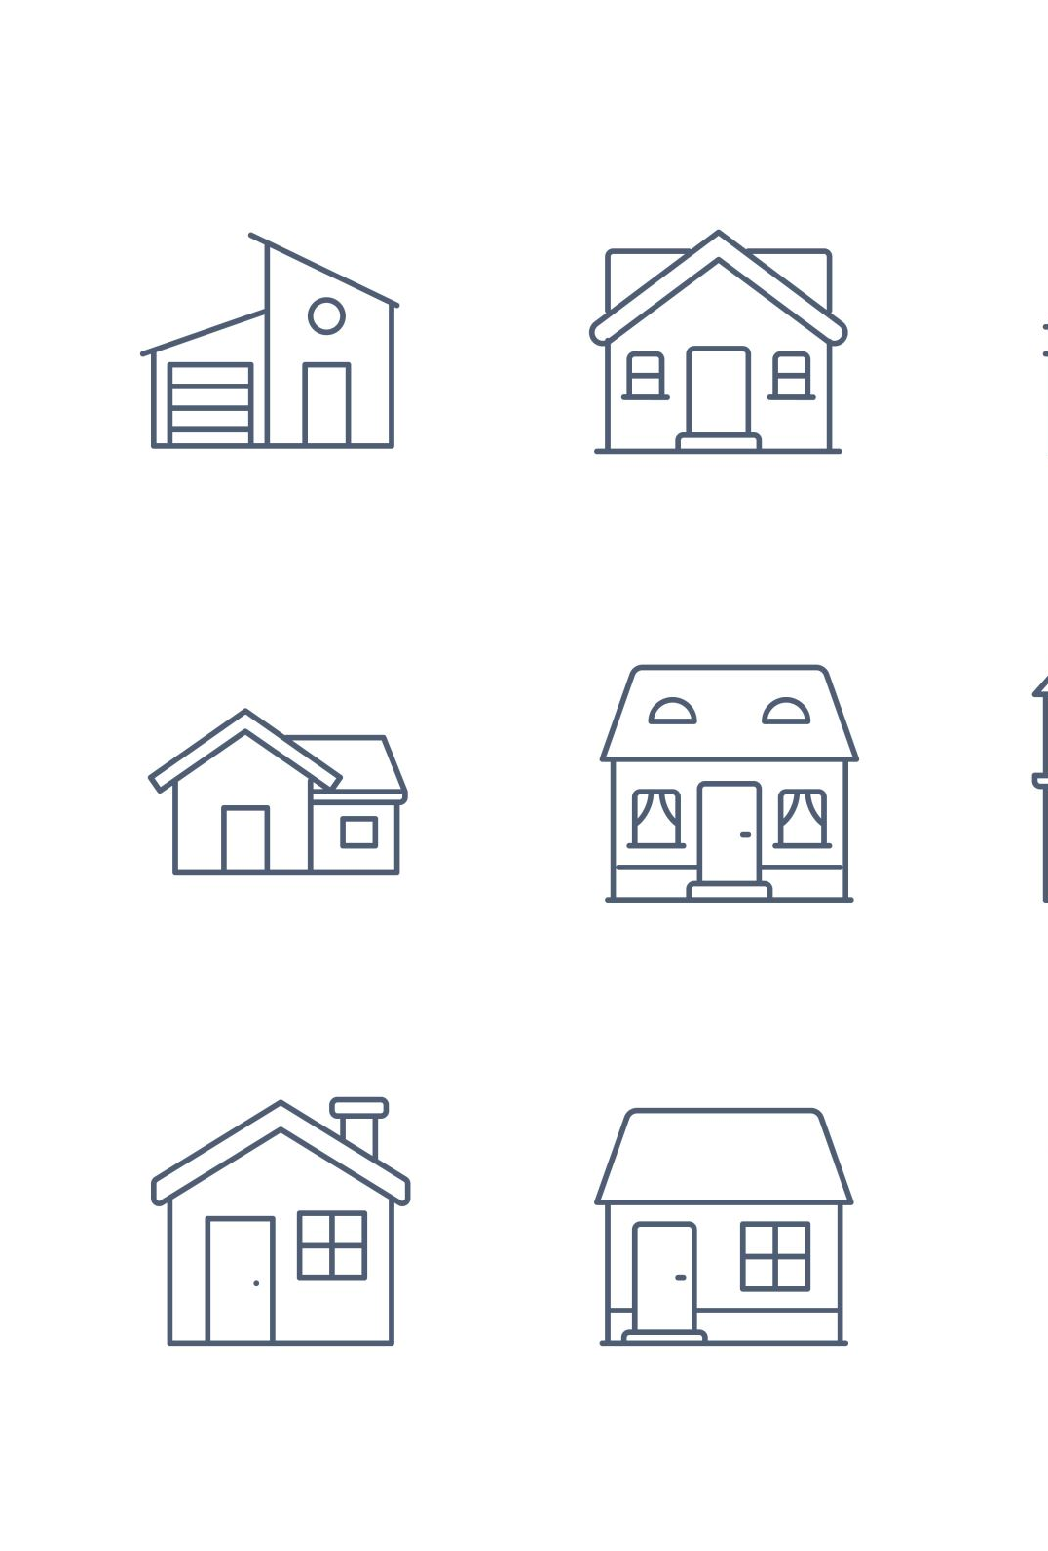
Dataset & Key Features
Dataset: Ames, Iowa Housing (Kaggle)
﻿﻿1,460 homes
Target: SalePrice
﻿﻿Features: living area, basement size, garage capacity, rooms, baths, quality scores, and neighborhood indicators
Preprocessing:
﻿﻿Log-transform SalePrice
﻿﻿Standardized numeric features (z-scores)
﻿﻿Focused on 35 numeric variables for PCA + K-Means

Slide 4
Methods: EDA + PCA + K-Means
Techniques Used:
﻿﻿EDA & Visualization: Histograms, scatterplots, boxplots
﻿﻿PCA: Reduced 35 correlated numeric features into important components
﻿﻿K-Means Clustering: Used PCA space to identify natural home segments
Why PCA:
Housing features (sqft, rooms, baths, basement, garage) are highly correlated. PCA reduces redundancy and uncovers main dimensions of variation.

Slide 5
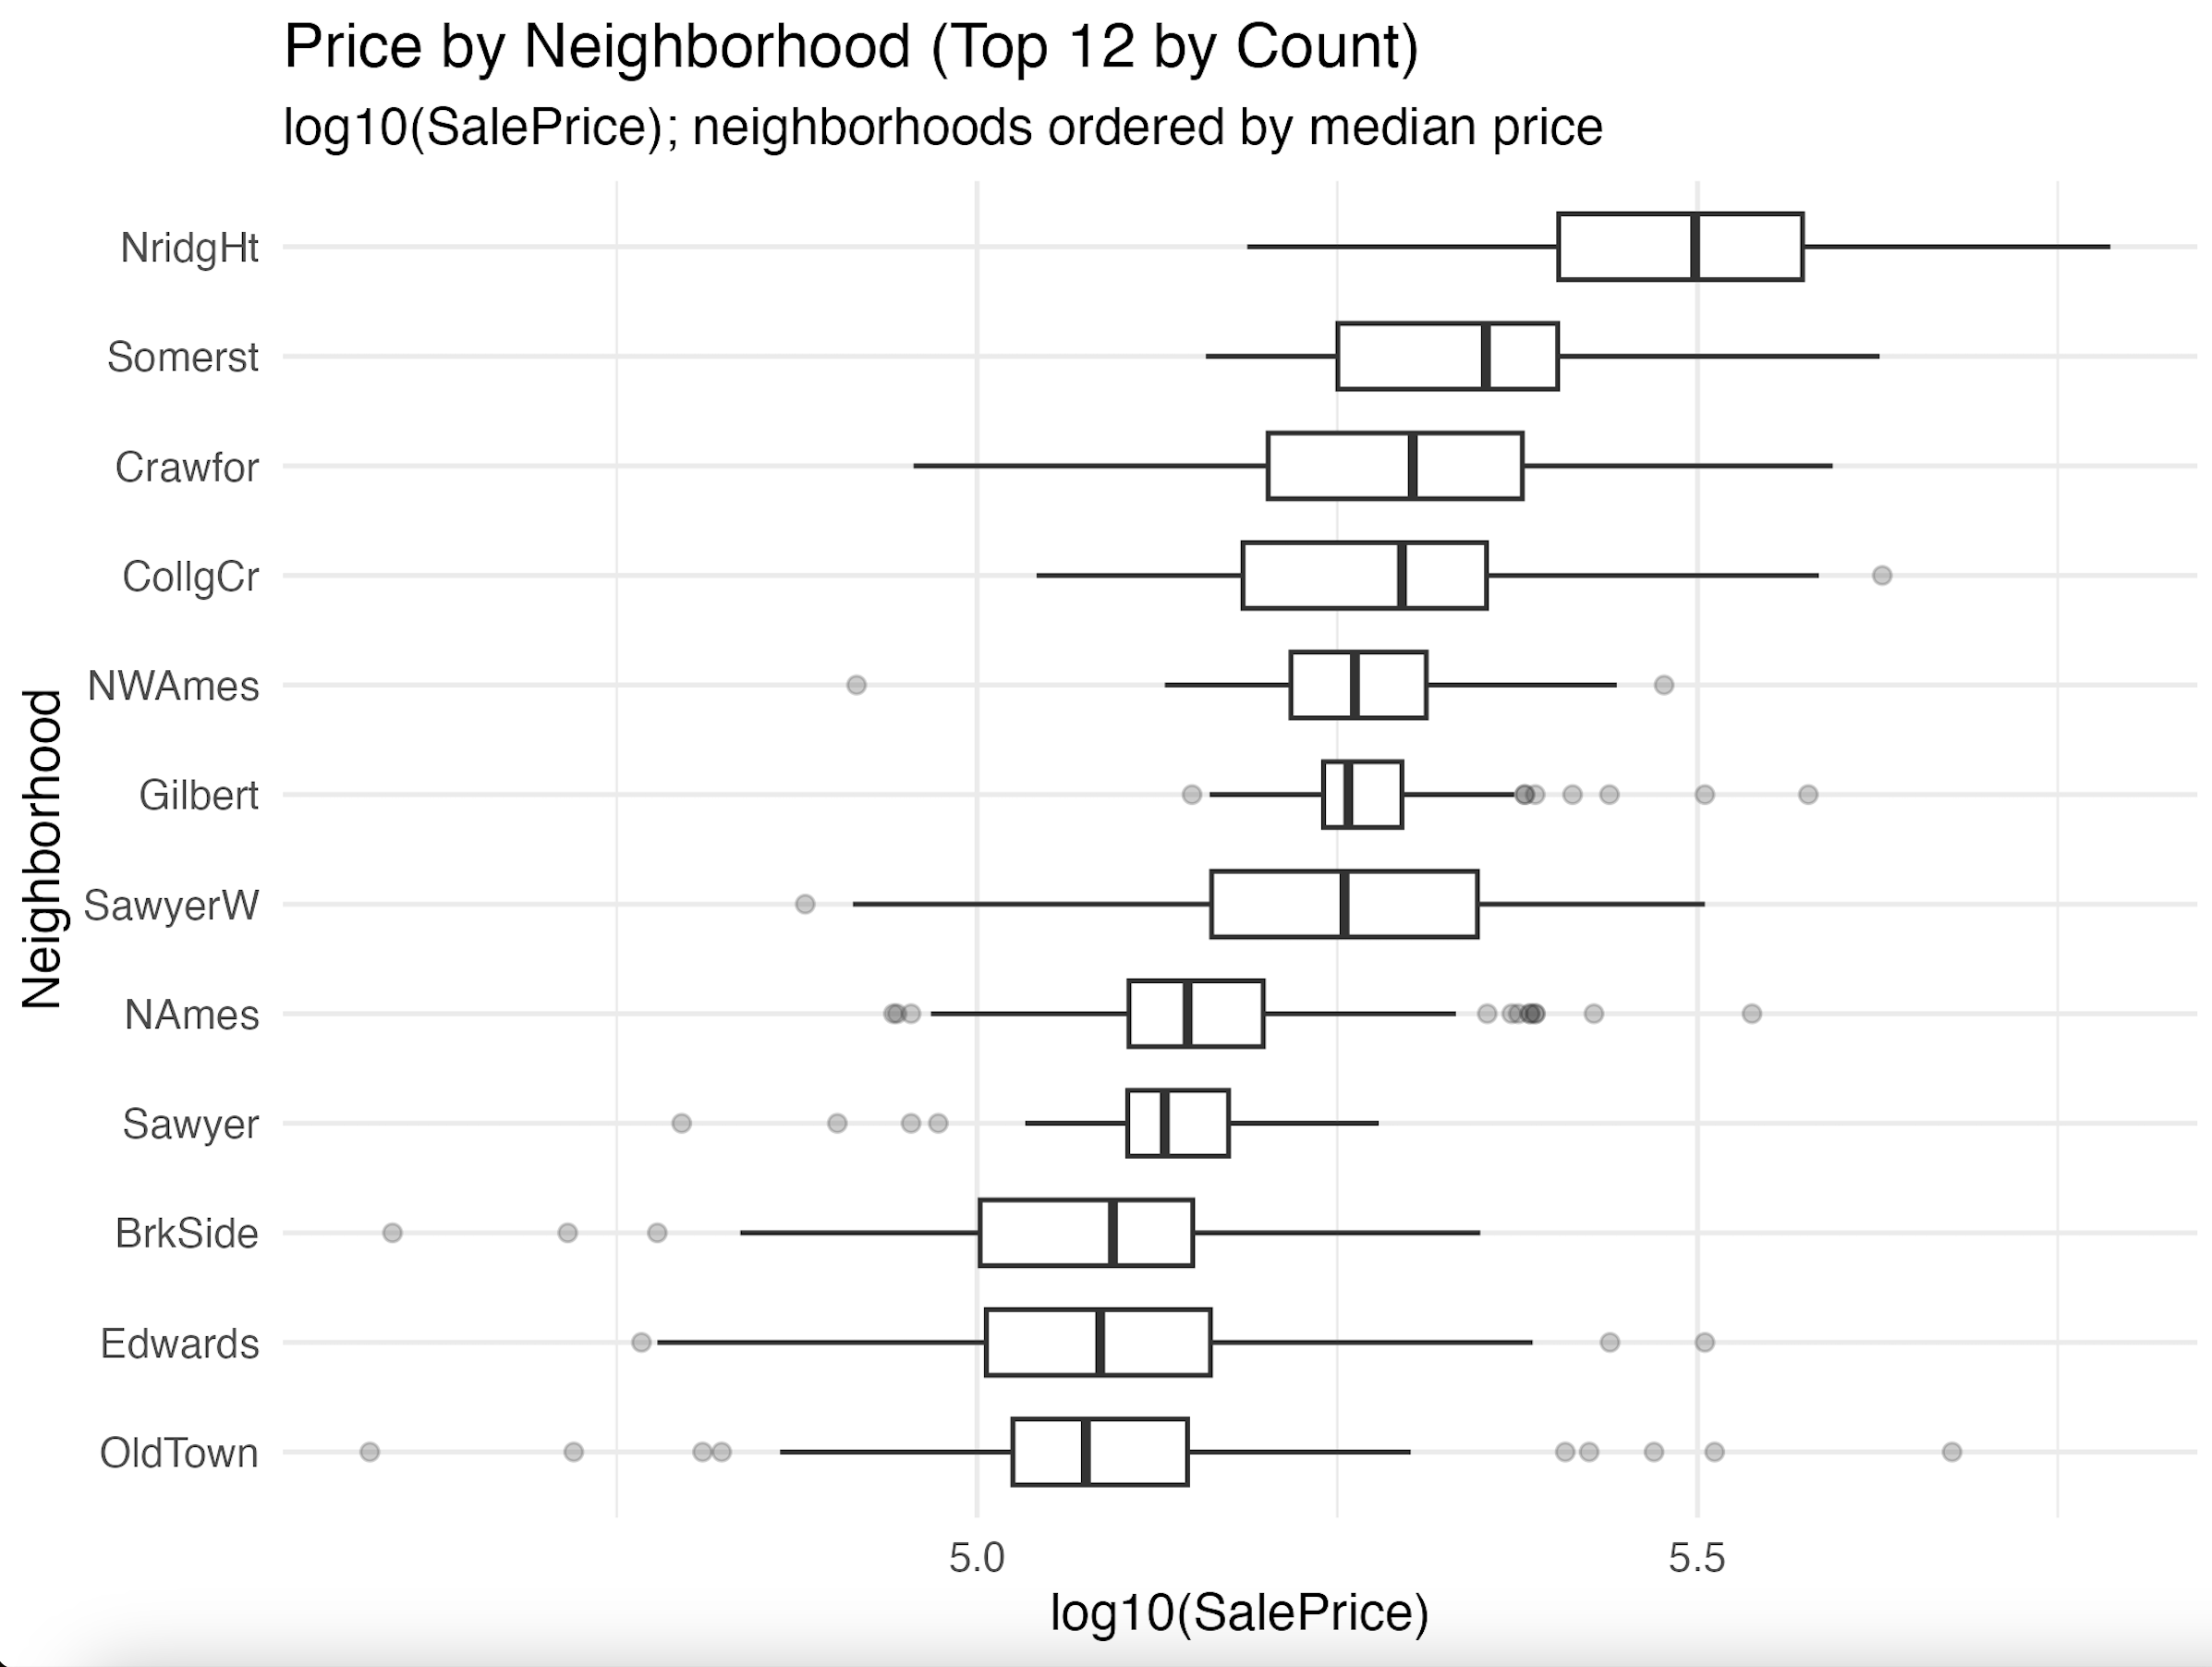
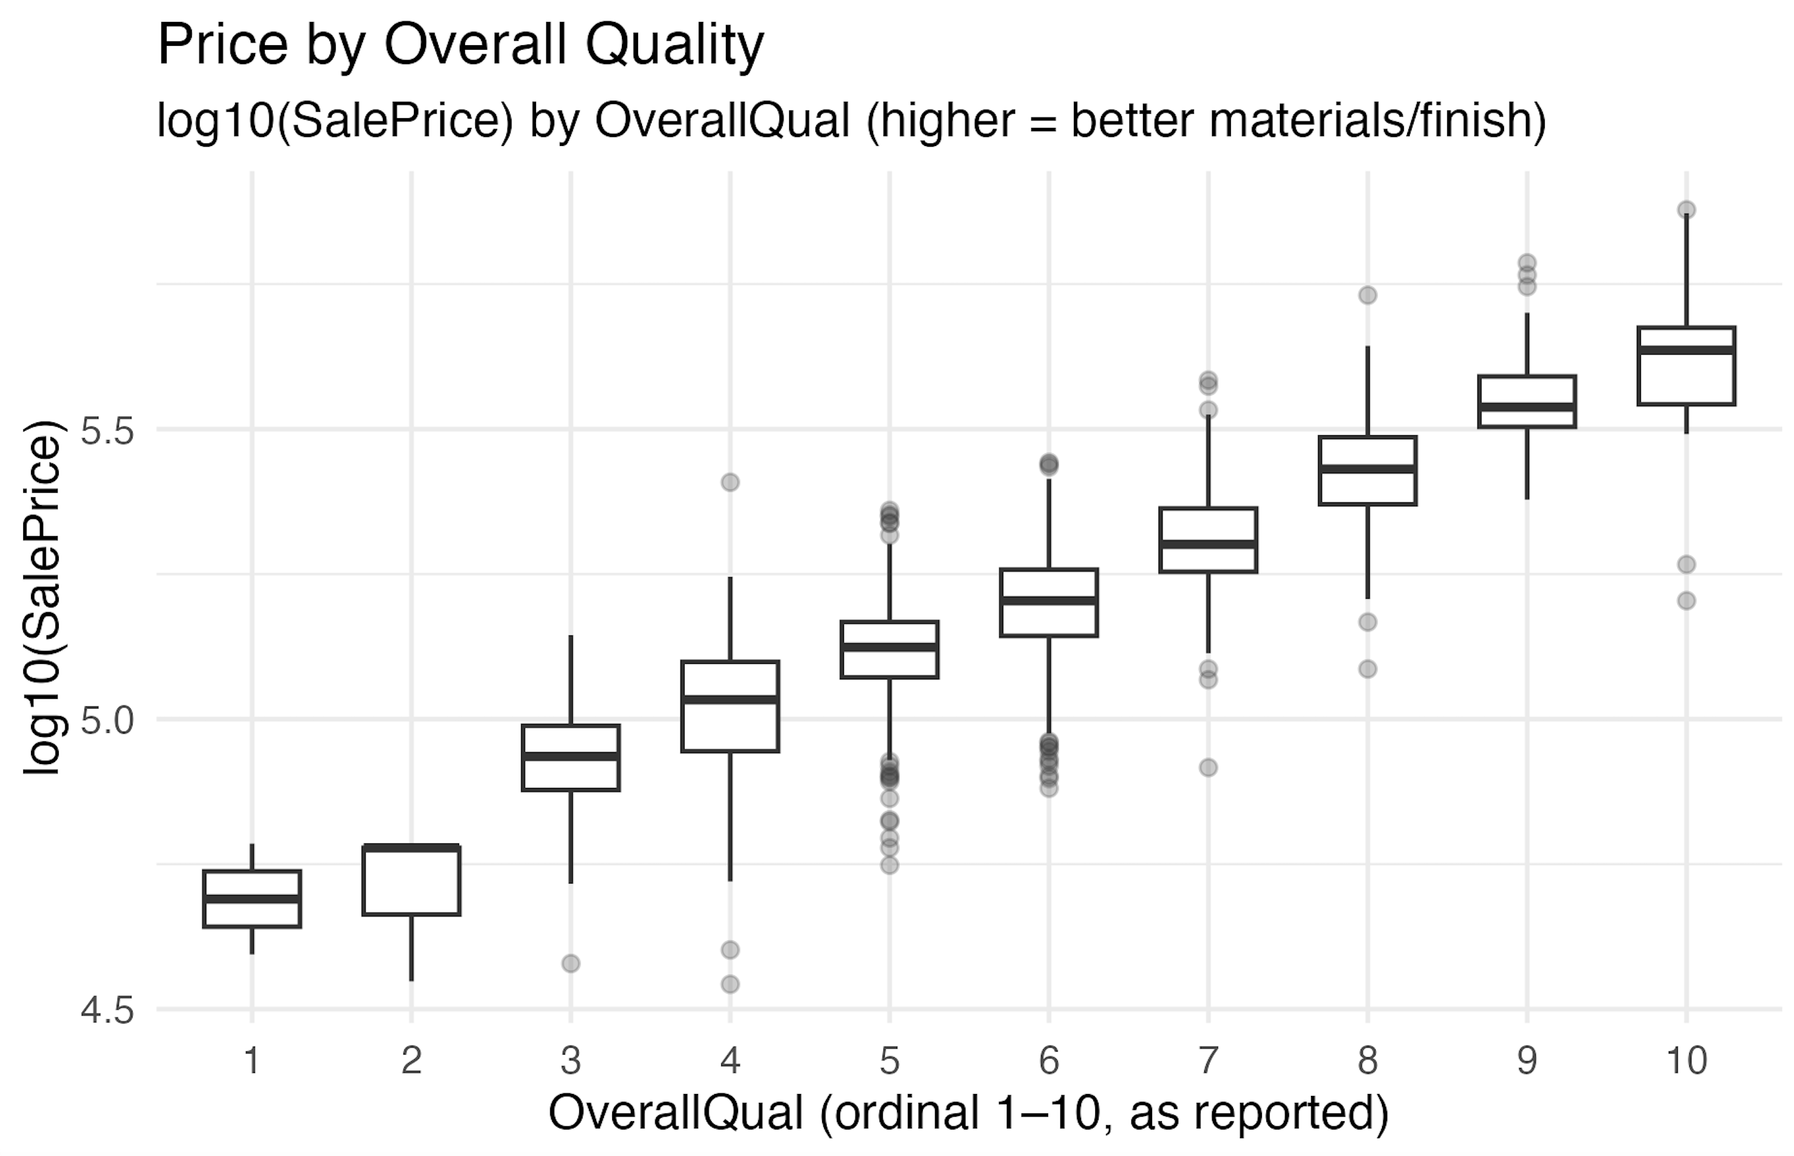
Key Result #1: Price Patterns
Finding:
﻿﻿Log(SalePrice) is approximately normal -> better modeling
﻿﻿Quality strongly drives price: homes rated 7-9 show big jumps in value
﻿﻿Neighborhoods show clear layers: some are consistently higher priced

Slide 6
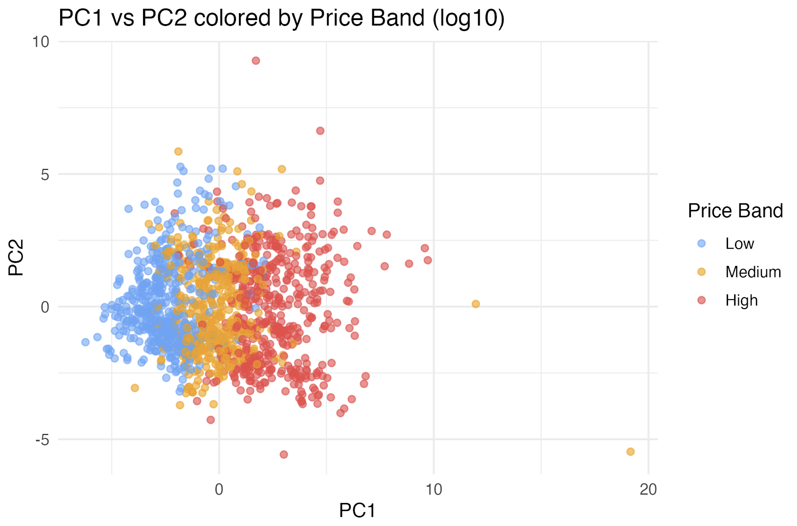
Key Result #2: PCA Patterns
PC1 = Home Size + Capacity
Largest loadings: living area, garage area, basement, rooms
PC2 = Layout / Room configuration
Loadings: bedrooms, finished basement, bathrooms
Insight:
High-priced and high-quality homes shift toward the right side of PC1 (bigger + better).

Slide 7
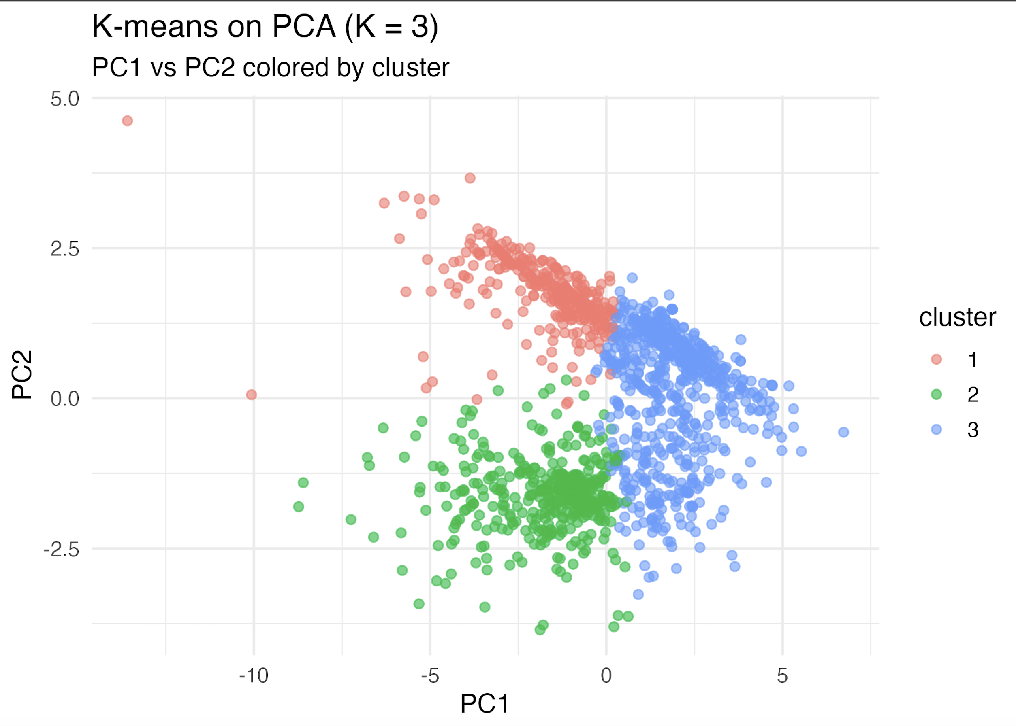
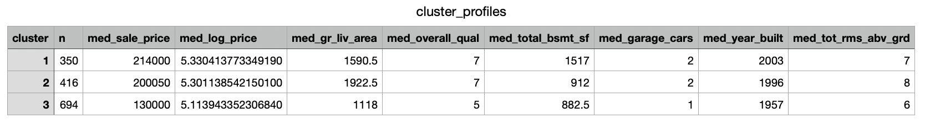
Slide 6 - Key Result #3: Clustering
K-Means selected K = 3
Cluster 1 - Higher-end homes
﻿﻿High quality (7)
﻿﻿Newer (2003)
﻿﻿﻿﻿Highest prices ($214k)
Cluster 2 - Large but older homes
﻿﻿Larger Area(1,922 sqft)
﻿﻿Mid-price ($200k)
Cluster 3 - Starter homes
﻿﻿Smaller (1,118 sqft)
﻿﻿Lower quality (5)
﻿﻿Lowest prices ($130k)
﻿﻿Older (1957)

Slide 8
Challenge & Solution
Main Challenge:
The dataset contains many correlated numeric variables that alter clustering and raise dimensionality.
Solution:
Apply PCA first to compress size-related variables into components, then run K-Means on PC space, which produced much clearer, more interpretable clusters.

Slide 9
Conclusion
Summary:
﻿﻿Size and quality are the strongest overall drivers of home value.
﻿﻿PCA reveals two dominant dimensions: size/capacity and layout/configuration.
﻿﻿K-Means identifies three meaningful market segments in the Ames dataset.
Future Extensions:
﻿﻿Add predictive models (Lasso, RF)
﻿﻿Include categorical encodings for better clusters
﻿﻿Explore spatial modeling and time-based pricing

Slide 10

Thank You

