Slide 1



Predicting December U.S. Flight Delays with Classical and Modern Methods
By Austin Phelps

Slide 2

Motivation:
I set out to predict whether a U.S. flight will depart 15+ minutes late during December.
December matters because holiday peaks strain staffing, gates, and passenger communications.
To keep the problem realistic, we only used information available before the aircraft pushes back (no weather after departure, no actual delay fields).
I trained on December 2010 and tested on December 2011 to check if the model generalizes to a different year with similar seasonal pressure.

Slide 3
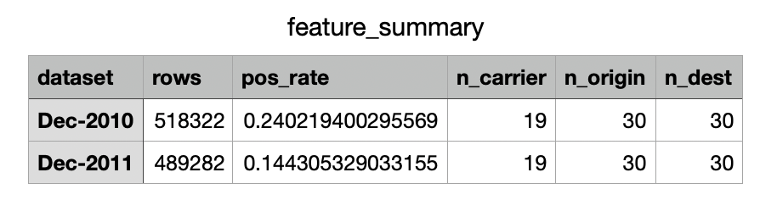
Dataset & Features
The data come from the U.S. Bureau of Transportation Statistics On-Time Performance files. After removing cancelled and diverted flights, we had 518k flights in Dec-2010 and 489k in Dec-2011.
The target label is DepDelay15 (yes/no).
Predictors are simple, pre-departure items: hour of day, weekday, carrier, origin, destination, etc.
I also "capped" very rare categories using 2010 frequencies so that the number of dummy variables stays manageable and consistent across years.

Slide 4

Methods (Models & Validation)
We used two standard classifiers: ridge logistic regression (a linear model with L2 regularization to prevent overfitting) and a small Random Forest as a quick non-linear check.
For model selection we used 5-fold week-wise cross-validation on Dec-2010: each fold is a full calendar week, which avoids information leakage across days.
After tuning, I locked the parameters and evaluated once on Dec-2011.
This design answers, "Will this approach still work next December, not just on last week's data?”

Slide 5
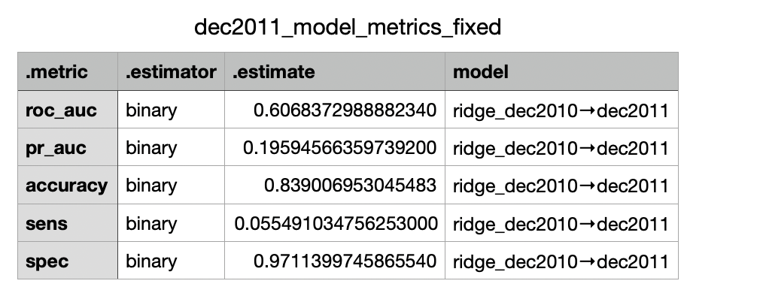
Results (A): Ridge on Dec-2011
On the held-out Dec-2011 set, ridge achieved ROC-AUC = 0.61 and PR-AUC = 0.20.
ROC-AUC shows how well the model ranks flights from least to most risky; 0.5 is guessing, 1.0 is perfect, so higher is better. PR-AUC focuses on the rare "delay" class and asks, across many cutoffs, "when the model says a flight looks risky, how often is it actually delayed?" Accuracy is the overall percent correct at the chosen cutoff (we used 0.50). Sensitivity/Recall: How many real delays did we catch? Specificity: “how well did we avoid false alarms?"
In short, the model carries useful signal, but the operating threshold must be chosen carefully.

Slide 6
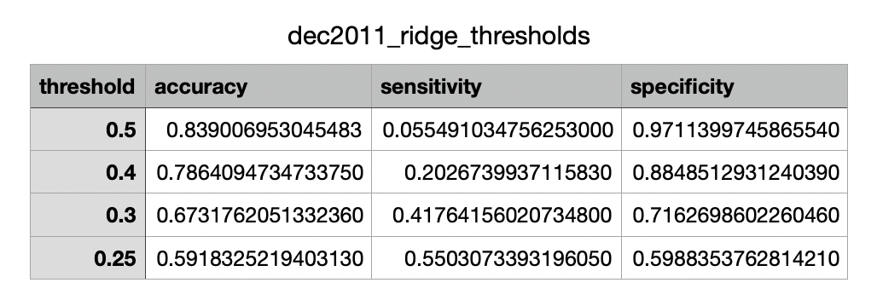
Results (B): Threshold trade-offs
When we lower the decision threshold (e.g., 0.50 - 0.40 -> 0.30 - 0.25), sensitivity rises (we catch more true delays) while specificity/accuracy fall (we flag more on-time flights).
These are the classic precision-recall trade-offs in an imbalanced setting.
The right threshold depends on operations: if the goal is to manage a limited number of high-risk departures, pick a lower threshold that increases recall and review capacity; if false alarms are costly, use a higher threshold and accept lower recall.

Slide 7
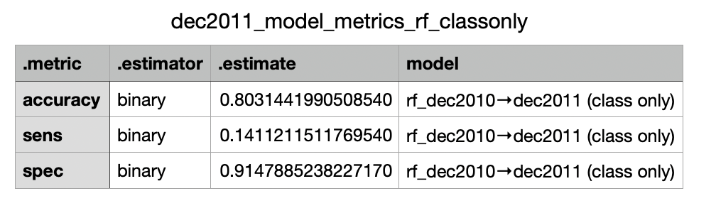
Results (C): Random Forest Check
A small Random Forest trained on Dec-2010 and scored on Dec-2011 shows a similar pattern: accuracy = 0.80, sensitivity >= 0.14, specificity >= 0.91 at a standard cutoff.
This confirms the class imbalance challenge rather than a weakness of a single algorithm.
The takeaway is consistent: the models can rank flights by risk, but performance in catching true delays depends on using probability scores with an appropriate threshold (or cost-sensitive rules), not relying on a default 0.50.

Slide 8

Challenge/Solution: Making the model useful when delays are rare
The main problem was class imbalance: Most of the flights are on time, so true delays are rare.
With the default 0.50 cutoff, the model looked accurate, but it caught only 6% of real delays (recall = percent of actual delays we find).
My fix was to lower the decision threshold and test a few settings (0.50 -> 0.40 -> 0.30 -> 0.25). At 0.30, recall rose to 42%; at 0.25, recall was 55%, but this also created more false alarms (specificity and accuracy dropped).
This same pattern showed up with a small Random Forest, so the issue is from the data being imbalanced, not from one specific model.

Slide 9
Conclusion
Training on one December and testing on the next shows year-over-year generalization with meaningful ranking power.
These models are practical for top-risk flights for gate coordination or passenger messaging.
Future steps that should lift recall without overwhelming false alarms include adding weather and congestion features and setting thresholds by cost.

Slide 10
Thank You

