Slide 1
Fundamental Techniques and Measurements
Mass Measurements
Volume Measurements
Preparation of a solution of known concentration
UV-Visible Spectrophotometer

Slide 2
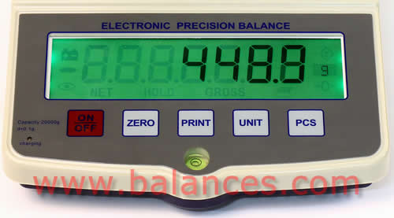
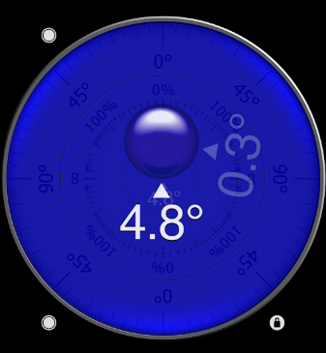
Electronic Balance
What does an electronic balance measure? _____
If you took an electronic balance with a capacity of 100 g to the moon what would its range be? _____
force
600 g
Why do good electronic balances have bubble level indicators?

Slide 3
Mass: Electronic Balance
Accuracy
4 to 6 significant digits
Calibration
Use known mass
Check weekly or when balance is moved
Sources of error
Balance must be calibrated and maintained in same orientation in _________ field
hydroscopic chemicals: dry to constant mass first (will increase in mass rapidly as they reabsorb water on the balance!)
When preparing a solution of a given concentration it may be difficult to get the exact mass desired____________
evaporation of wet samples
gravity
report actual!

Slide 4
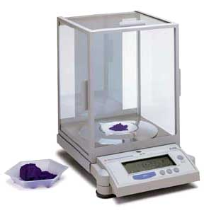
Electronic Balance
M
o
d
e
l
C
a
p
a
c
i
t
y
R
e
s
o
l
u
t
i
o
n
D
I
-
1
0
0
1
0
0
g
0
.
0
0
0
1
g
D
I
-
8
0
0
8
0
0
g
0
.
0
1
g
D
I
-
5
0
0
0
5
0
0
0
g
0
.
1
g
For maximum accuracy use balance with _______ resolution possible!
Don’t forget to clean the balance if you spill any chemicals!!!!!!
smallest

Slide 5
Volume
Volumetric flask
accuracy of ______/100 mL
Graduated cylinder
accuracy of ______/100 mL
Beaker
accuracy of _____/100 mL
Pipette
accuracy of ± _____ for 100-1000 µL
accuracy of ± _____ for 10-100 µl
What will accuracy of solution be if you use pipette, volumetric flask, and electronic balance? ________
0.16 mL
1 mL
1 %
What controls the accuracy? _______
5 mL
Pipette
0.6%
0.8%

Slide 6
Digital Pipettes
Air displacement
Do not directly contact fluid volume
avoids contamination of pipette
avoids sample carryover
Require air tight connection between tip and body

Slide 7
Pipette Workings
piston
cylinder
Pipette tip

Slide 8

Preparation of Solutions
Example: Prepare 100 mL of a 30 mM solution of methylene blue.
The molecular weight of methylene blue (C₁₆H₁₈N₃SCl) is 319.87 g.
$$CV=M$$
=
concentration
conversion
volume
mass

Slide 9

Preparation of Dilutions
Prepare 100 mL of a 300 µM solution from the 30 mM solution
Conservation of _____
mass
$$V_{concentrate}=$$
= 1 mL

Slide 10

Preparation of Solutions
Fill volumetric flask half way with distilled water
Add reagent (could be solid or liquid)
Mix
Fill volumetric flask to the line
Mix
Verify that volume didn’t change (if necessary refill to line)

Slide 11
UV-Visible Spectrophotometer
Theory
Instrument
Sample requirements
Software

Slide 12
Light Attenuation by an Aqueous Solution
P₀
P
P₀
P
P is light intensity (photons/s)

Slide 13
Theory: Light Attenuation = f(?)
For a given excitation process, a molecule absorbs only one discrete amount of energy: expect very narrow absorption lines.
Different vibrational and rotational states yield _______ absorption lines.
First order decay with distance
broad

Slide 14
A=εbc
Po - _________ light intensity
P light intensity after passing through sample
b - ______________
c - ______________
ε - ___________ coefficient (function of wavelength and molecule)
incident
path length (1 cm)
concentration
extinction
ε is not a function of concentration!

Slide 15
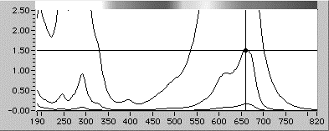
Absorption Spectra
Absorption Spectra for Methylene Blue
Broad peaks
Absorbs ________, looks ______
orange
blue

Slide 16
Instrument Light Path

Slide 17
Sample Requirements
Sipper cell
peristaltic pump draws sample into sipper cell
requires a few mL to displace previous cell contents
sample
pump
Light source
detector

Slide 18

Software
Reference (single sample)
measures absorbance of sample cell and reference solution
usually distilled water or reagent blank
Standards (multiple samples)
used to create a __________ curve
Samples (multiple samples)
after sampling, standards can be used to estimate the concentration of samples
calibration

Slide 19
Absorbance Measurement Limitations
P_{o} is a function of the _____.
If absorbance is high what is P? ______
Suppose A = 3, what is P_{o}/P? _____
Suppose I create samples of higher and higher concentration. What will happen to the absorbance measurements?
lamp
small
1000
minimum
There is a _________ (non zero) P that can be measured by an instrument.
A _______ keep increasing!
A_{max} ≈3
doesn’t

Slide 20
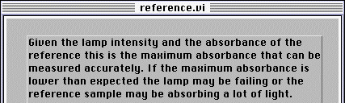
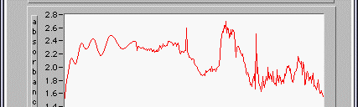

Maximum Absorbance: P₀ is measured as reference!
Max absorbance f()
________________
________________
________________
________________
________________
absorbance readings that exceed this value will not be used in analysis
lamp intensity
detector sensitivity
cell absorbance
reference absorbance
acceptable error

Slide 21

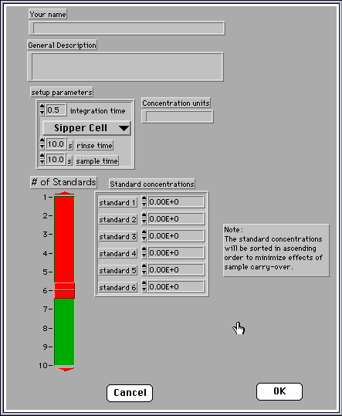
Standards
your name
general description
rinse time
sample time
sample concentrations
Include zero
select number of samples by moving this control

Slide 22
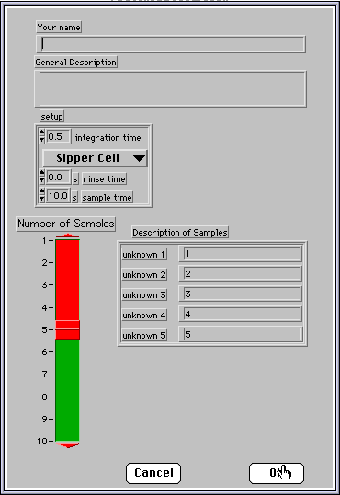
Samples
enter sample descriptions here
select number of samples
by moving this control

Slide 23
